Slide 1
Idna6ma

Slide 2
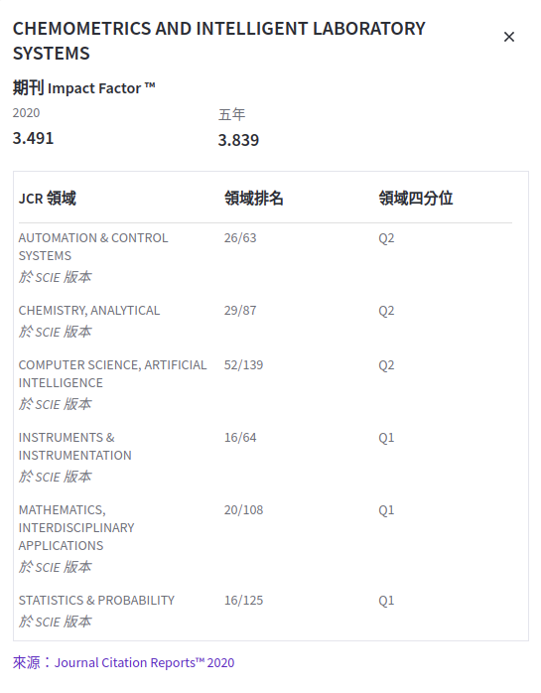

Slide 3
outline
Introduction
Datasets
Model
Evaluate
Result

Slide 4
outline
Introduction
Datasets
Model
Evaluate
Result

Slide 5
Introduction
DNA methylation is an elementary epigenetic process. In eukaryotes, the high recognized DNA modification is 5-methylcytosine (5 mC) sites while in prokaryotes; the most pervasive DNA modification is N6 -methyladenine (6 mA) sites.
Specific unicellular eukaryotes, green algae, and ciliates consist of both 5 mC and 6 mA in their genomes, however the biological importance of these modifications, for living beings had remained mostly uncharacterized.
Most recently, DNA N6 -methyladenine (6 mA) as a non-canonical DNA modification has been reported in three kingdoms of life. The modification of N6 -methyladenine is nearly concerned along with a numbers of biological processes i.e., transcription, DNA replication and repair.
To decipher the complete biological functions of 6 mA, it is imperative to identify its location throughout the whole genome.

Slide 6
INTRODUCTION
A number of experimental procedures like
single-molecule real-time sequencing (SMRT-seq)
methylated DNA Immunoprecipitation sequencing (MeDIP-seq)
capillary electrophoresis and laser-induced fluorescence (CE-LIF)
A group of Chinese scientists has recently explored the 6 mA profile of rice genome by mass spectrometry analysis and immunoprecipitation followed by sequencing (IP-seq).However, along with productive data information, the experimental procedure also impedes the genome-wide prediction of N6 -methyladenine.
Although the biochemical exploratory techniques can give some information related to the 6 mA sites, it is high pricy and labor-intensive. Thus, it is a huge challenge to establish fast and precise computational model to identifying the 6 mA sites.

Slide 7
introduction
The ubiquitous and complex post-translational modifications (PTMs) play a key roles in different biological processes,
protein localization and trafficking
protein folding
cell signaling
transcriptional regulation
cell-cell interactions
Apoptosis
regulating cellular dynamic and plasticity.
The irregularity of the PTMs are nearly related or connected with harmful diseases i.e., Alzheimer's, Parkinson's and cancers.

Slide 8
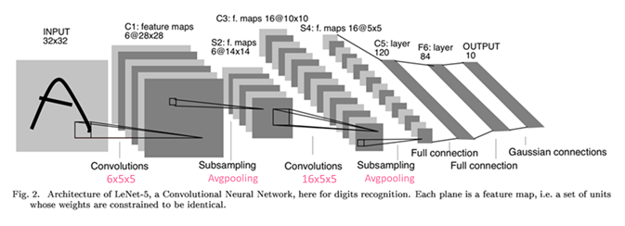
introduction
Accordingly, researchers introduced a variety of predictors and techniques for discrimination of PTM sites using protein and RNA/DNA samples.
Chen et al. introduced a predictor using machine learning to predict the N6 -methyladenine sites in the rice genome based on support vector machine (SVM) and nucleotide frequency and nucleotide chemical properties as features extraction techniques. The existing computational models need domain knowledge to hand design the input feature spaces.
The second step of the guideline of Chou's 5-step rules for developing a useful prediction model is to extract feature space from the RNA/DNA sequences.
The computational model may automatically capture the important features of 6 mA sites from input samples. This concept achieved by deep learning to extract the features from multiple levels of abstraction.

Slide 9

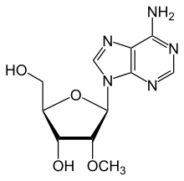

introduction
Deep learning has generated very successful results in natural language processing, speech recognition, and image recognition. Currently, various predictors have been proposed based on deep learning such as iDeepS , branch point selection, alternative splicing sites prediction, and iRNA-PseKNC(2methyl) prediction model.
In this connection, we propose iDNA6mA (5-step rule) model for the identiﬁcation of DNA N 6 -methyladenine sites that is based on the deep learning approach.

Slide 10
outline
Introduction
Datasets
Model
Evaluate
Result

Slide 11
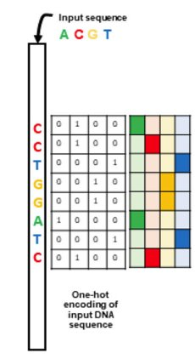
datasets
We have selected and downloaded a valid benchmark dataset (http://lin-group.cn/server/i6mAPred/data), which was constructed by Chen et al. , to show the efficiency of the proposed prediction model. The length of all samples is 41bp long with the 6 mA site in the center.
The dataset is divided as 70% training, 10% validation and 20% testing.
Species​ | Positive​ | Negative​
Rice​ | 880​ | 880​

Slide 12
outline
Introduction
Datasets
Model
Evaluate
Result

Slide 13
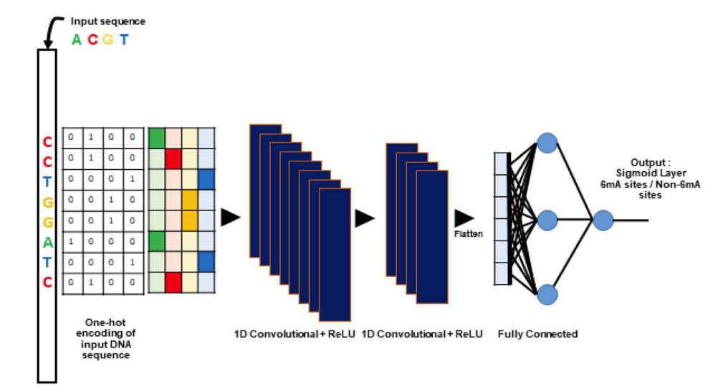
model

Slide 14
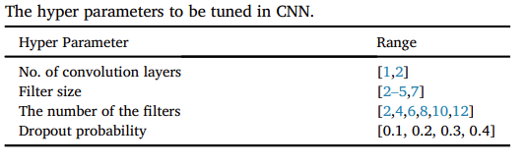
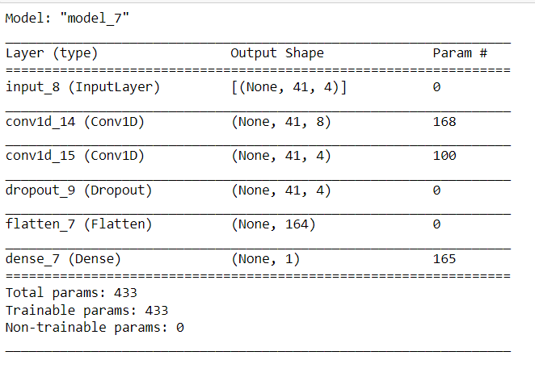
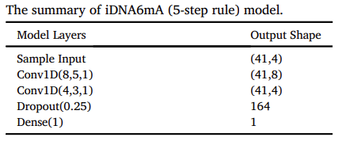
model
The number of batches is set to 32 and the number of epochs is set to 50. Learning rate is set to 0.001 and optimizer is Adam.

Slide 15
outline
Introduction
Datasets
Model
Evaluate
Result

Slide 16
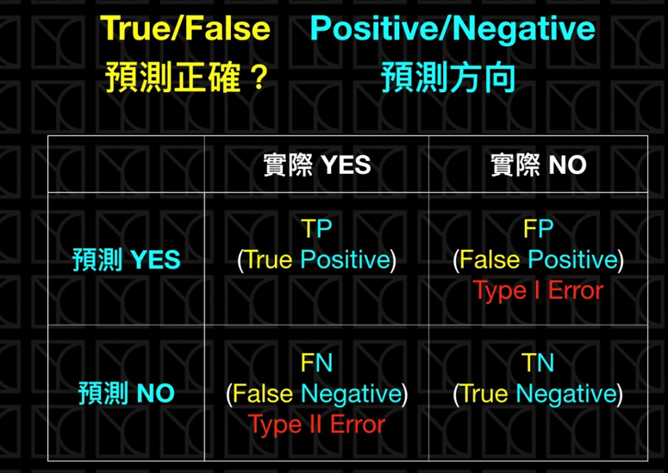

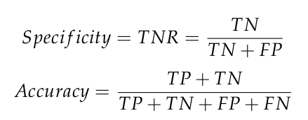

Evaluate

Slide 17
outline
Introduction
Datasets
Model
Evaluate
Result

Slide 18
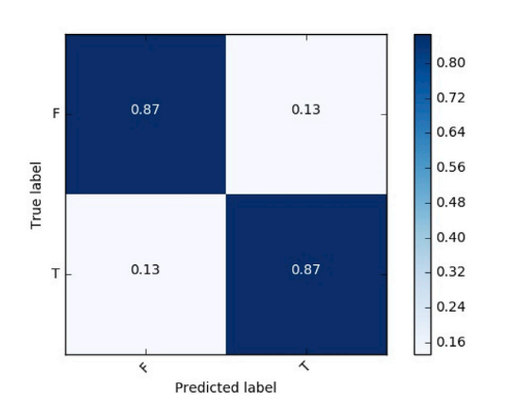
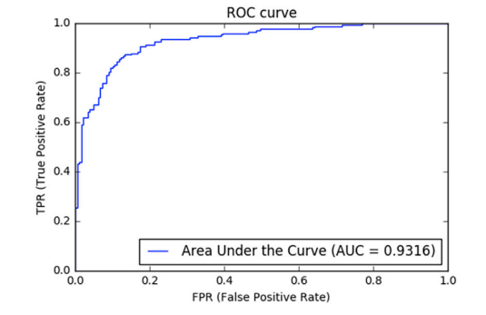
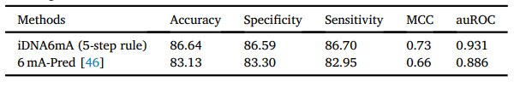
result
It is evident that iDNA6mA (5-step rule) model outperforms the 6 mA-Pred model by 3.51% of accuracy, 3.29% of specificity, 3.75% of sensitivity, 7.00% of MCC, and 4.50% of auROC.

Slide 19
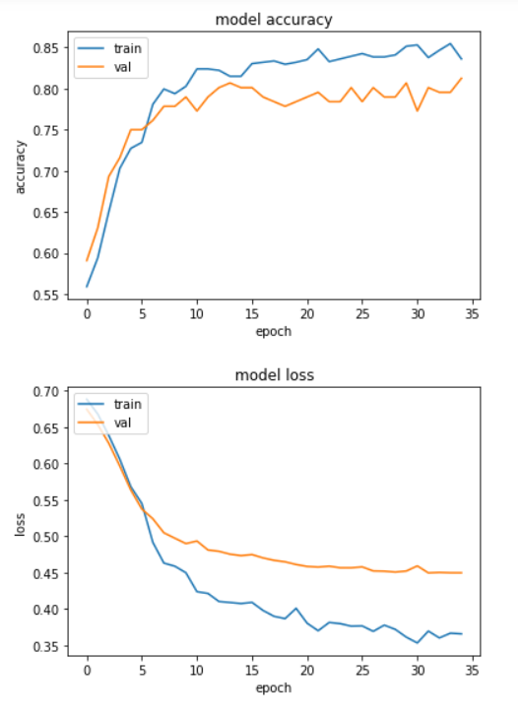
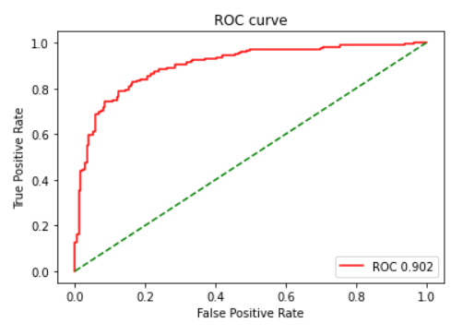
result

