Slide 1
DeepM6A
Elucidation of DNA methylation on N6-adenine with deep learning

Slide 2
DNA methylation is extensively involved in epigenetic settings and exerts different regulatory roles in multiple species. It is traditionally acknowledged that 5-methylcytosine (5mC) presents a dominant modification in eukaryotes, while N6 -methyladenine (6mA) is mostly prevalent in prokaryotes.
Recently, thanks to the development of high-throughput sequencing (6mA-IP-seq) and single-molecule real-time (SMRT) sequencing technology, the prevalence and significance of DNA 6mA in eukaryotes (for example, Arabidopsis thaliana and Drosophila melanogaster) has been revealed.
However, DNA 6mA is a dynamic process, which can be developmental and tissue-specific. In addition, many 6mA sites may be methylated at very low levels, making them very hard to capture. Consequently, current experimental approaches, although precise, are unable to provide a complete catalogue of all 6mA sites.

Slide 3
It has been long recognized that 6mA plays a vital role in the discrimination of host genomic DNA (gDNA) from foreign pathogenic DNA in bacteria.
Recently, it has been demonstrated that 6mA may be involved in gene activation or repression in eukaryotes. The underlying mechanism, however, remains elusive. Methylation-associated gene regulatory motifs may shed light on understanding the mechanism.
Although conventional motif analysis of 6mA has revealed some interesting cis-regulatory patterns, they account for only a small proportion of all methylated sites. Therefore, we hypothesize that more sophisticated regulatory mechanisms yet to be explored may exist for 6mA formulation.
Finally, the whole in vivo cataloguing procedure of 6mA is costly and laborious. Thus, in silico prediction may be an attractive alternative if we can precisely predict 6mA sites at single-nucleotide resolution based on just genomic sequence information

Slide 4
It is worth noting that our proposed prediction is purely based on sequence information where only the cis effect will be captured. Whether a candidate is a 6mA site or not will also depend on many other exogenous trans effects.
Therefore, what our method predicts is the candidacy or potential for being a 6mA site. Most of the methylation data we used in our model were collected without any information about developmental stages and tissue cells.
We thus cannot make any developmental and tissue-specific 6mA prediction for them. When developmental stages are provided, our models are readily adapted to make the corresponding prediction. Our interest is to predict the candidacy or potential for being a 6mA site, which implies a necessary condition but not a sufficient condition.
This 6mA prediction is quite similar to gene prediction or gene finding in the early bioinformatics era, which refers to the process of identifying the regions of gDNA that encode genes.

Slide 5
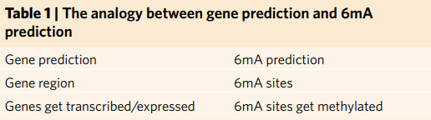
Most gene prediction methods utilize DNA sequence information only, as does our method. The analogy is illustrated in Table 1. To predict 6mA candidate sites, we first developed a deep convolutional neural networks-based end-to-end algorithmic framework (Supplementary Fig. 1 and Methods) to capture sophisticated regulatory patterns for predicting 6mA sites de novo from genomic sequences (DeepM6A).
Machine learning methods have been used for genomic sequence-based prediction. Most reply on human handcrafted features, such as k-mer for predicting mutation effects and polyadenylation sites, among others.
Compared with k-mer-based methods, our proposed DeepM6A has four major advantages:
automation of the sequence feature representation of different granularities, hierarchically;
integration of a broad spectrum of flanking context sequences, effectively;
enabling of the potential visualization of inherent sequence motifs for interpretation, naturally;
facilitation of model development and prediction in large-scale genomic data, seamlessly.

Slide 6
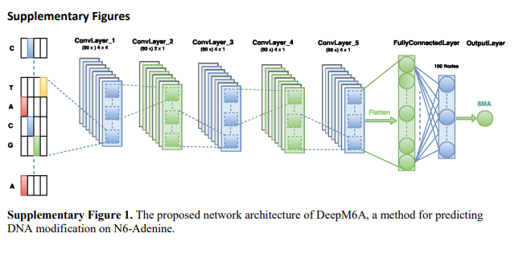

Slide 7
The multilayer perceptron (MLP) is a classical feedforward neural network with an input layer, hidden layers and an output layer. The hidden layers are composed of fully connected nodes. DeepM6A leverages the local spatial dependency of inputs by introducing convolutional layers into MLP to capture underlying coherence patterns.
The first two desirable properties jointly contribute to the appealing predictive capacity of DeepM6A. Based on the third property, we then introduced a novel learning protocol to decode the underlying methylation patterns. Both cis-regulatory elements and regions are identified, which will offer useful insights into the in-depth exploration of the underlying formulating and regulatory mechanisms of 6mA. Exploiting its accurate prediction, we performed a whole-genome scan using DeepM6A to catalogue all potential 6mA sites

Slide 8
DeepM6A accurately predicts 6mA candidate sites
We tested DeepM6A in three representative model organisms: A. thaliana (eukaryote, plant), D. melanogaster (eukaryote) and Escherichia coli (prokaryote). As a benchmark, classical k-mer based logistic regression (LR) was also evaluated.
The raw SMRT-seq data of A. thaliana, D. melanogaster and E. coli were collected from the PacBio public database. Base modification detection was performed to generate an initial set of 6mA sites following the automated data analysis workflows recommended by PacBio (see Methods for details).
To reduce false positives, we further filtered out the following candidates:
candidates with any sequence variance located between 10bp upstream and 5bp downstream of the identified modification site;
candidates where the variation of estimated methylation level is greater than 30%. As a result, we ended up with 19,632, 10,653 and 33,700 6mA sites for A. thaliana, D. melanogaster and E. coli, respectively. These sites account for 0.025696% (total of 76,401,454), 0.013418% (79,393,495) and 1.475402% (2,284,124) of whole-genome adenine sites.

Slide 9
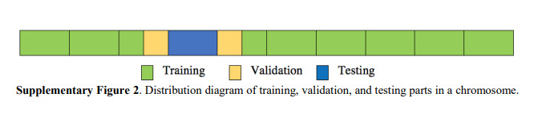
The above 6mA sites were used as positive samples in prediction models. To generate negative samples, we randomly sampled the same numbers of non-methylated adenine sites from the whole-genome sequences. At the same time, for the sampled negative non-methylated sites, we required that their distance to any positive methylated site be at least 200bp away. Then, for both positive and negative samples, contextual sequences around the adenine site at each side were extracted as the input for predictive models. We considered lengths of flanking sequences from 3bp to 200bp.
We divided all positive and negative samples into three sets for training, validation and testing, respectively, based on their genomic locations. Specifically, for each chromosome of a species, we split it into 10 equal segments(Supplementary Fig. 2 and Methods) .We then randomly picked one segment and used the samples within that segment for testing. The samples on the nearest half upstream and half downstream segments were used for validation . The rest of all sites were used for training purpose. In this manner, we achieved a ratio of 8:1:1 among training, validation and testing datasets, with the training and testing parts strictly non-overlapping.

Slide 10
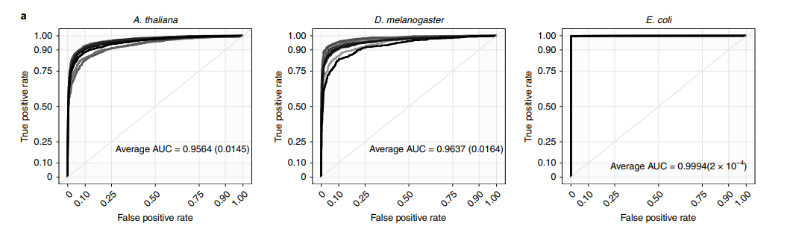
Taking the +/− 30-bp flanking sequences as input, DeepM6A is capable of accurately predicting 6mA sites with average areas under the receiver operating characteristic curve (AUC) of 0.9564, 0.9637 and 0.9994 for A. thaliana, D. melanogaster and E. coli, respectively (Fig. 1a), as evaluated by the holdout testing genomic sequences(see Methods). The salient performance differences among the three model organisms indicate the more challenging task of identifying 6mA sites and associated sophisticated patterns in advanced eukaryotes than in primitive prokaryotes.

Slide 11
DeepM6A effectively exploits signal information from context
We varied the contextual lengths of the input sequence from 3bp to 200bp to demonstrate the capability of DeepM6A in exploiting signal information from contextual sequences. With varied input sequence lengths, DeepM6A consistently outperformed LR (Fig. 1b). Specifically, the performance of DeepM6A improves with increasing length and reaches a plateau after ~10bp for both A. thaliana and D. melanogaster. By contrast, with LR, although increasing length is initially beneficial, it has the opposite effect after 7bp.
This finding confirms that the immediate up/downstream 7–10bp region of the 6mA site is critical. However, there may be additional subtle and/ or sophisticated signals beyond the 10-bp position. This distant signal can be captured by DeepM6A, as indicated by its increased performance, whereas the extended region proves deleterious for the k-mer-based approach. We attribute the superiority and robustness of DeepM6A to its hierarchical representation of regulatory patterns and suggest that the k-mer based methods are suffering from their inherent drawbacks of handcrafted feature extraction.

Slide 12
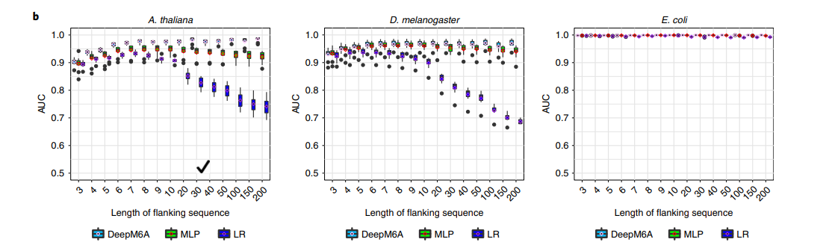

Slide 13
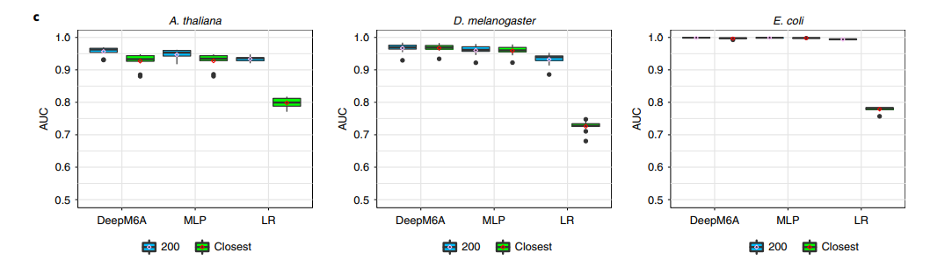
DeepM6A is sensitive at single-nucleotide resolution
The non-N6 -methylated adenines in the control cohort are at least 200bp away from any 6mA. To show the robustness of DeepM6A with single-nucleotide sensitivity, for each 6mA site, we selected its closest non-N6 -methylated adenine and built a new control cohort (>75% fall within 5bp of 6mA sites; Supplementary Fig. 3) At the contextual length of 30bp, there is a substantial overlap between cases and the new controls, making separation of 6mA from the control more challenging. We also re-evaluated previously trained models. The performance of DeepM6A drops a little, but remains consistently high, while the performance of LR deteriorates substantially (Fig. 1c). This robustness of DeepM6A advocates its application to 6mA prediction at single-nucleotide resolution.

Slide 14
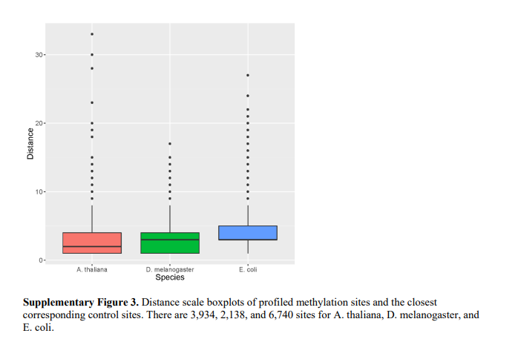

Slide 15
DepM6A outperforms standard deep-learning approaches
In addition to the classical k-mer-based LR, we also compared DeepM6A with a standard MLP network (see Methods) that uses the same input as our method for predicting N6 -methyladenine sites. The input of MLP is also the one-hot encoding of nucleotides centred on the target adenine with different lengths of flanking sequences. The training, validation and testing procedures exactly followed the way DeepM6A was optimized. The predictive capacity under different contextual sequences and the robustness of single-nucleotide sensitivity are reported in Fig. 1b,c. DeepM6A outperforms MLP, in particular for longer flanking sequences. As with LR, initially, the performance of MLP improves with length, but it degrades slightly after 10bp (Fig. 1b).
Regarding single-nucleotide sensitivity, both DeepM6A and MLP share similar robustness. Overall, the one-hot encoding is a better feature representation, preserving the primitive sequences in comparison with the k-mer format. The hierarchical feature extraction of DeepM6A is more powerful than that of MLP.

Slide 17
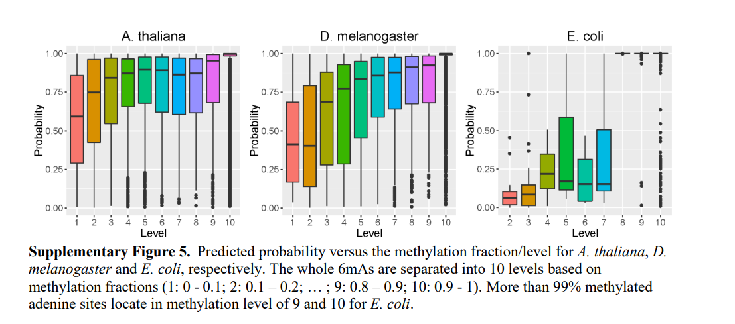
We therefore conclude that DeepM6A is both precise and robust in predicting 6mA. Its superiority is—at least in part—attributed to its deep network structure, which uses several hidden layers to learn a high-level representation of the DNA sequence hierarchically. To elucidate the power of this hierarchical representation and learning, we visualized the positive and negative samples using t-SNE18 based on the features learned at different network layers.
As shown in Supplementary Fig. 4, the features become more and more discriminative along the layer hierarchy, with methylated and non-methylated sites mixed at the input layer, culminating with a clear separation in the output layer. Interestingly, the higher the methylation level, the better the separation, as observed in the last layer (Fig. 2a–c). This is also consistent with the observed high correlation between predicted probability and methylation level (Supplementary Fig. 5).

Slide 18
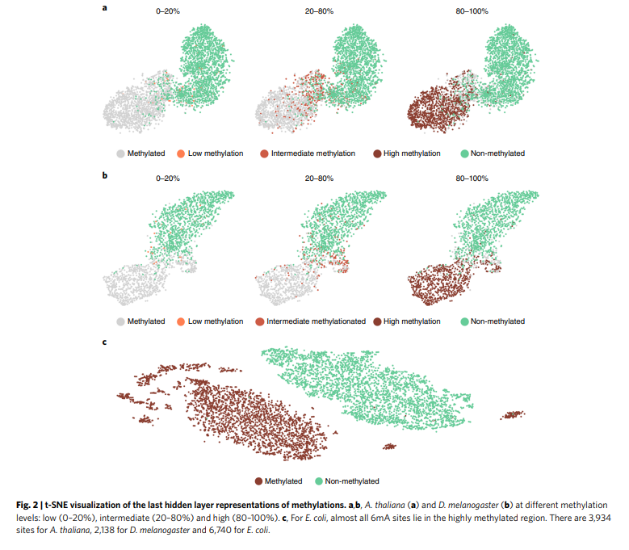

Slide 19
With appropriate design DeepM6A can predict 6mA dynamics
The aforementioned experiments were performed on the SMRT-seq data generated under general conditions. We note that DeepM6A is not limited to SMRT-seq and is also applicable in various experimental conditions. In fact, N6 -methylation is a dynamic epigenetic modification. When coupled with additional experimental design and data, DeepM6A may make more informative and valuable predictions.
To illustrate this point, we applied DeepM6A to a 6mA dataset with developmental stage information available. This study captures 24,338 6mA loci in different developmental stages of D. melanogaster embryos19 (see Methods). Specifically, it profiles 6mA peaks at three stages—0.75, 3 and 6h—which account for 17,528, 4,363 and 2,447 peaks, respectively (Supplementary Fig. 6).

Slide 20
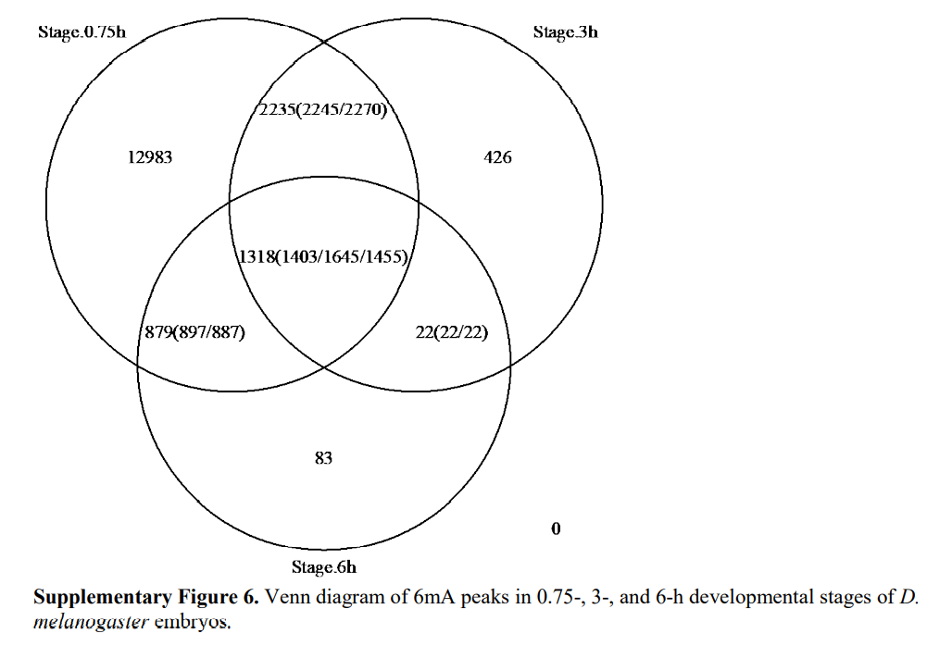

Slide 21
It is noted that some loci may be observed with peaks at multiple stages. To accommodate and exploit stage information, we can simply modify DeepM6A to make multi-label (stage) predictions by introducing vectorized outputs,which denote the probabilities of a locus being methylated at 0.75, 3 or 6h, or not at all. Thus, DeepM6A not only predicts being methylated or not, but can also reveal at which stage(s) m6A would happen.
To make a comparison, we also extended the baseline MLP and k-mer LR methods to the multi-label prediction task. As reported in Fig. 3, DeepM6A significantly outperforms MLP and LR, with average AUCs of 0.882, 0.939 and 0.973 for 0.75, 3 and 6h, respectively. These superior prediction accuracies indicate that DeepM6A is able to predict methylation dynamics accurately when given relevant information for training. These findings jointly demonstrate that DeepM6A can achieve an appealing performance, regardless of whether dynamic conditions are considered.

Slide 22
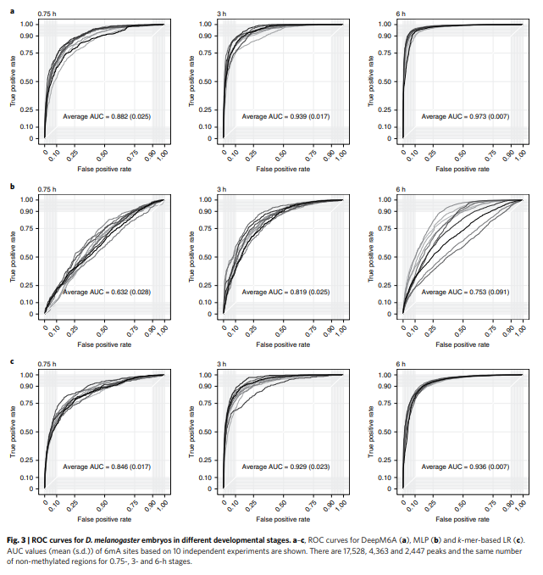

Slide 23
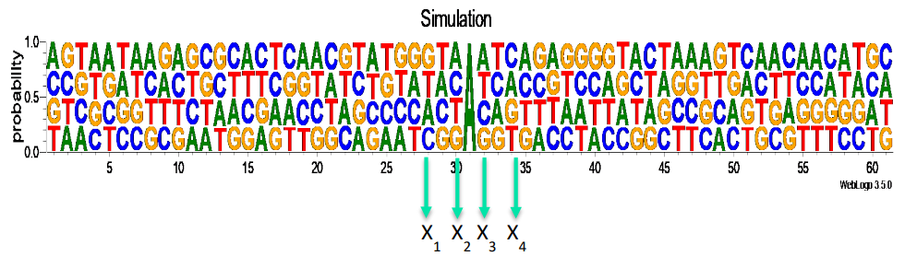
SM-CAP can reveal advanced cis-regulatory patterns
After identifying 6mA, the next step, typically, is to search for regulatory sequences in the surrounding regions. Unlike conventional motif analysis, we developed a saliency maps-based context analysis protocol (SM-CAP). SM-CAP works by quantifying the contribution of a single base in the modelling context of all other participating bases, such as the nonlinear models DeepM6A employs. In contrast, conventional motif analysis assumes simple independence and additive effects among regulatory bases.
Our current knowledge suggested that genomic 6mA may not be conserved. Such conservancy status is defined conventionally as traditional motif definition. Advanced nonlinear motif patterns can exist and exhibit unconventional conservancy status. If we consider simulated data, for example, as shown in Supplementary Fig. 7, there is supposed to be a 61-bp DNA segment with adenine in the centre, and A, C, G and T distributed evenly at the remaining loci.

Slide 24
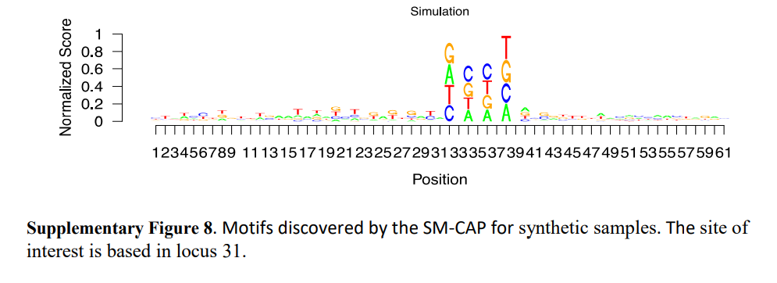
The central adenine will become methylated if and only if a combination of {A, C, G, T} shows at four specific loci X1, X2, X3 and X4. The order A, C, G and T does not matter, for example, ACGT, TCGA or GATC can all lead to the methylation of the central adenine. We can see that the motif pattern at the four loci {X1, X2, X3, X4} is not conserved according to the conventional conservancy status definition. Conventional motif search algorithms would fail to recognize this motif. As shown in Supplementary Fig. 8, our proposed SM-CAP can successfully identify the four loci and assign appropriate importance scores for the four bases, in comparison with other irrelevant loci. Our SM-CAP can thus capture advanced patterns that are missed by traditional analysis, as verified by simulation studies (see Supplementary Information).

Slide 25
cis-regulatory patterns of 6mA revealed by SM-CAP
We used SM-CAP to analyze and visualize the contextual region of 6mA for the three species (Fig. 4a–c). We can see that the central region is the most critical and that the eukaryotes exhibit more sophisticated patterns than the prokaryote. Interestingly, we observe asymmetrical contributions of the flanking contextual sequences, with the downstream more predominant than the upstream sequences in terms of both strength and length.
To further quantify and confirm their contributions, we perturbed nearby regions alternately and evaluate their impact on the prediction performance (Fig. 4d–f and Supplementary Fig. 9). We observed that the central M0 [±2bp] and downstream D1 [+3bp, +7bp] regions play the most important role in predicting 6mA across different species, which is in line with the cis-regulatory patterns elucidated by SM-CAP. We noticed that some patterns are shared by the two eukaryotes, for example, GAGG [−1bp, +2bp], as shown in Fig. 4a,b. The normalized scoring maps thus present a good summary of the underlying conventional conserved motifs, which might co-regulate 6mA.

Slide 26
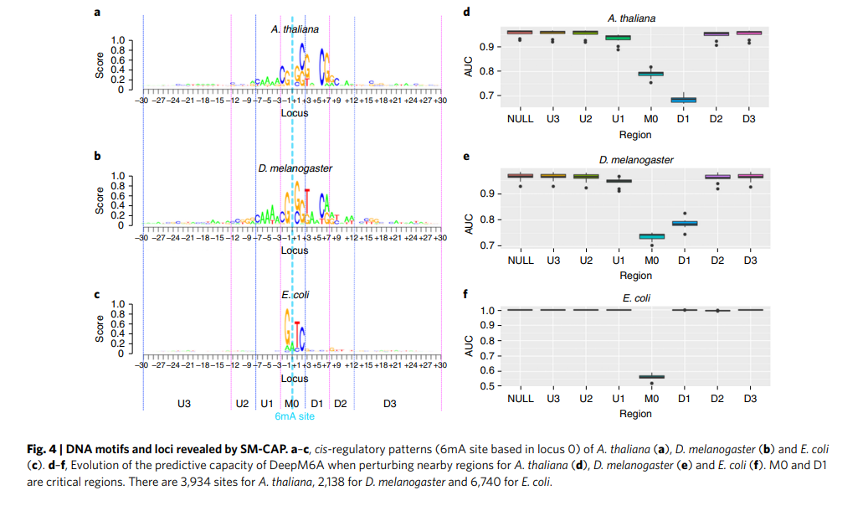

Slide 27
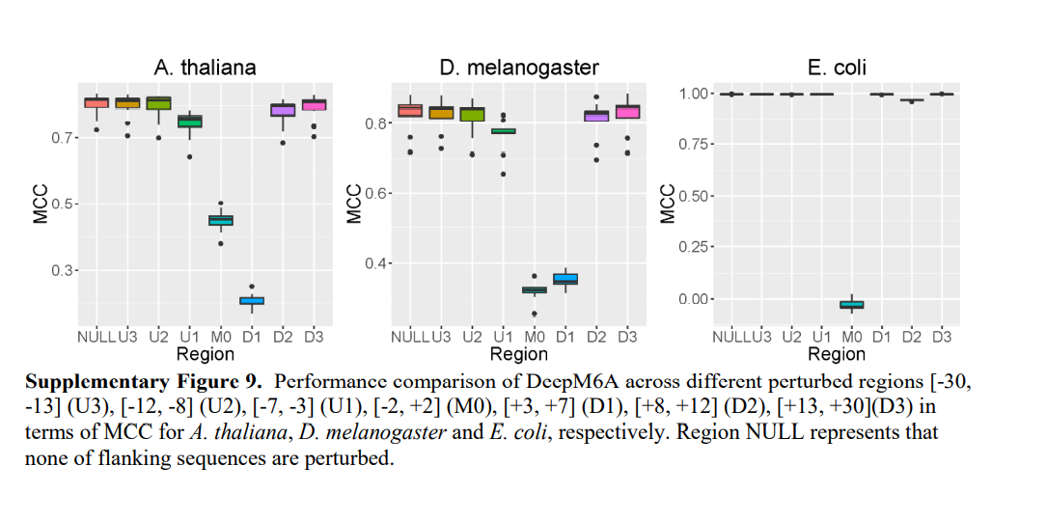

Slide 28
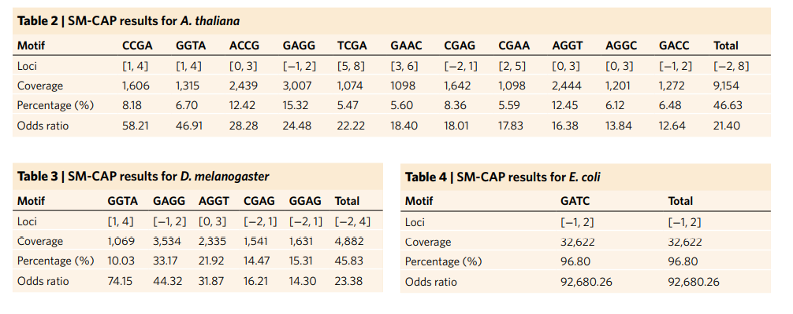
Further examination of the salient patterns revealed by SM-CAP shows that these patterns are more discriminative and account for more than 45% of the 6mA sites with an odds ratio of more than 20 for A. thaliana (Table 2) and D. melanogaster (Table 3), respectively (see Methods). As a comparison, we also tried to elucidate conventional motif patterns using HOMER(Supplementary Figs. 10–12) (all with odds ratios of less than 2 for the two eukaryotes). It is noted that conventional conserved motifs could be a special case of the patterns SM-CAP can capture. An example in point is the well-known motif GATC (−1bp, +2bp) in E. coli, as also identified successfully by SM-CAP (Table 4)

