Slide 1
iN6-Methyl

Slide 2
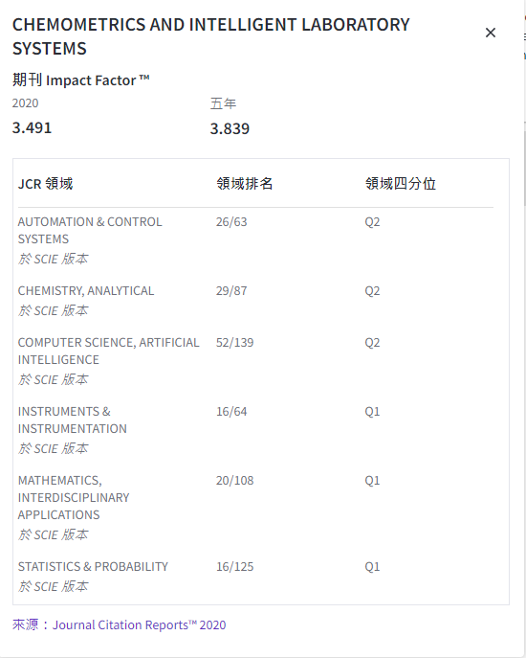

Slide 3
Introduction:
N6-methyladenosine (m6A) is the most frequent RNA modification that exists in various species. It plays important roles in various biological processes such as alternative splicing, regulation of circadian clock , cell differentiation and reprogramming , primary microRNA processing , and RNA structural dynamics.
The m6A is found at mRNA , tRNA, rRNA, small nuclear RNA, and long non-coding RNA . It also exists in archaea, viruses, bacteria, and most eukaryotes such as yeast, plants, and mammals, Therefore, identifying m6A is important to understand their functional mechanisms. Recently, high-throughput experiments such as m6A-seq and MeRIP-Seq provided a genomewide m6A profiles for various species such as Homo sapiens, Mus musculus , and Saccharomyces cerevisiae.
Based on these experimental findings, it was revealed that m6A sites are more likely to occur within long internal exons, in 3’ UTR, and near the stop codon. In addition, the nonrandom existence of m6A sites across the genome is conserved from yeast to human. Therefore, it is an essential and important for species. On the other hand, m6A-seq and MeRIP-Seq experiments are expensive and not accurate enough. Therefore, it is important to develop reliable computational tools for identifying m6A sites.

Slide 4
Introduction :
Recently, machine learning based approaches have been used for developing computational tools for m6A site identification. “iRNA-Methyl” was developed for m6A site identification. In this method, sequence-order information using PseDNC (pseudo dinucleotide composition) and physicochemical properties are used for feature extraction then followed by support vector machine .
Jia et al. Improved the performance by incorporating three types of feature descriptors such as dinucleotide composition, bi-profile Bayes, and KNN scores. On the other hand, Xiang et al. merged k-mer frequency and binary encoding scheme to improve the performance. Recently, a powerful tool, “SRAMP”, was proposed . In this work various feature extraction techniques have been utilized such as k-nearest neighbor encoding, secondary structure pattern, positional binary encoding of nucleotide sequence, and binary representation of nucleotide sequence. Then random forest model was trained based on the extracted features and the performance outperformed the other methods.
Xiang et al. Proposed “RNAMethyPre” predictor that was based on position-specific and compositional information for m6A sites on both mouse and human. Most of the previously mentioned predictors are species-specific.
However, Qiang et al.Proposed a multiple species predictor for m6A sites. They used Local position-specific dinucleotide frequency and dinucleotide binary encoding as features extraction and enhanced them using sequential forward search and F-score algorithm. Then, XGBoost algorithm was used to construct the predictive model.

Slide 5
Introduction :
In general, all of the proposed predictors require domain knowledge to manually design the features. These features should be designed in a way that the sequence-pattern information is preserved. For instance, pseudo amino acid composition or PseAAC is a good example for feature extraction technique.
The popularity of this concept has led to developing open source softwares such as ‘PseAAC-Builder’, ‘propy’, and ‘PseAAC-General’ . Later, PseAAC was extended to PseKNC (Pseudo K-tuple Nucleotide Composition) to obtain numerical features from DNA/RNA sequences.

Slide 6
Introduction :
On the other hand, deep-learning based predictors enable designing powerful tools from raw RNA/DNA sequences without handcrafting the features such as DeepCpG, iDeepS, branch point selection, alternative splicing sites prediction , 2′-Omethylation sites prediction , and other biological processes.
Deep-learning based predictors for m6A such as DeepM6ASeq and BERMP have extracted the features from the raw m6A sites using CNN and RNN. However, we learn the new representation for the m6A sites using word2vec algorithm and then utilize the new representation for m6A identification.
The learnt features from word2vec are more comprehensive as they are based on the whole mRNA rather than small set of RNA/DNA samples. In this paper, we propose a novel multiple-species sequence-based predictor, namely “iN6-Methyl (5-step)”, for identifying m6A sites in RNA sequences.
It consists of two steps. The first step is the feature representation stage in which each sequence is divided into words (3-mer) then a natural language processing models called word2vec is applied in order to map each word to its corresponding feature representation. The second step is a deep learning computational model that predicts the m6A sites based on the generated features of the first step word2vec. The achieved results outperform the state-of-the-art methods in all evaluation metrics.

Slide 7
Introduction :
In this work, we follow the Chou's 5-step rules.
According to the Chou’s 5-step rule, to develop a really useful sequence-based predictor for a biological system as done in a series of recent publications, one should make the following five procedures very clear:
(i)bench mark dataset,
(ii) sequence sample formulation,
(iii) operation engine or algorithm,
(iv) cross-validation, and
(v) web server.
Below, we are to address these procedures one by one.

Slide 8
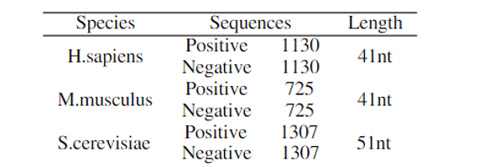
Benchmark datasets :
In order to predict m6A sites in multiple species, we use three benchmark datasets for three different species namely Saccharomyces cerevisiae (S51) , Homo sapiens (H41), and Mus musculus (M41) . The datasets S51, H41, and M41 contain 2614, 2260, and 1450 samples, respectively, and the length of each sample in S51 dataset is 51 nt and it is 41 nt for H41 and M41 datasets. Each sample of these datasets is centered on the m6A site for the positive sequences, whilst the negative sequences prepared by adenines at the center without having biologically m6A peak.
As a quality control, we utilize 10-fold cross-validation in the training process. In this case, we randomly split the dataset into 10 folds. Nine folds are used for training and early stopping and the remaining fold is used for testing.

Slide 9
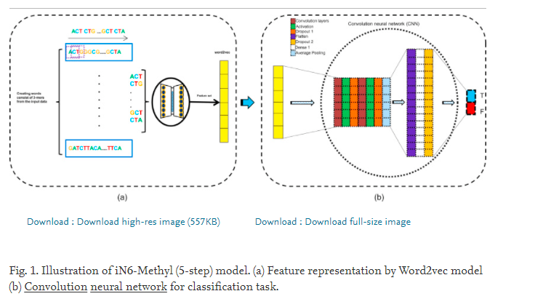
Methodology:
We present a novel method in order to finding and predicting m6A sites in different species called iN6-Methyl (5-step) model.
Our proposed method consists of two major steps. The first step is the feature representation stage in which each sequence is divided into words (3-mer) then a natural language processing models called word2vec is applied in order to map each word to its corresponding feature representation.
The second step is a deep learning computational model that predicts the m6A sites based on the generated features of the first step. This process is illustrated in Fig. 1 and is described in detail in the following sections.

Slide 10
Distributed feature representation:
The existing approaches for m6A sites identification require domain-knowledge to hand-craft the input features of the classification models. In this work, we aim to build a computational model that can learn features representation automatically based on the genomic data. This technique helps in obtaining more optimal features by reducing the noise in the data, consequently, improving the performance of the final computational model.
Genetic data is considered as a language, that is represented in DNA and RNA sequences, by which the information passes within and between the cells. It is based on a continues chain of nucleotides (A, C, G, and T). In addition, NLP techniques have been used successfully in various biological problems such as alternative splicing site prediction.
Thus, we utilize NLP model “word2vec” to get interpretable representations for m6A sites . The first step in word2vec is corpus construction. In this step we split the continuous genomic sequences into words represented by overlapped k-mer to break its continuity. In our model we empirically set k=3. This selection performs better than using other values of k such as 4-mer,5-mer, 6-mer, etc. This selection confirms the previous findings in which setting k=3 was the best choice. In addition, 3-mer has been widely used in DNA/RNA sequence formulation. Thus, The constructed corpus has four different nucleotides (A, C, G, and T) and consequently forms 64 unique words. For instance, the biological sequence {ACAGAATG} results in the following words {ACA, CAG, AGA, GAA, AAT, and ATG}. The generated corpus for each sequence is used for training the word2vec model.

Slide 11
Distributed feature representation:
Generally, we use human mRNA from GenBank which is available at: hgdownload.soe.ucsc.edu.
The genome assembly is divided into 21 chromosomes (Chr1, Chr2, …, X, and Y) and each chromosome is then divided into sentences with length of 100 nt. Finally, each sentence is cut into overlapping 3-mer to create the words.
Continuous bag-of-words (CBOW) method is used for training word2vec model. CBOW method predicts the current word w(t) based on the surrounding context words in a predefined window. The detailed parameters that are used for training word2vec model are given in Table 1. These parameters are widely used in genomic data . As a result of using word2vec, each word (3-mer) is represented by a 100-dimensional vector and each sequence with length L is represented by an array of shape ( L-2 ) * 100.
Dominissini et al. Showed that mammalian m6A have a DRACH consensus motif (D = U, G or A; R = G or A; H = U, C or A) which can be denoted in an overlap 3-mer as {AAA, AGA, GGA, UGA,UAA, AAC, GAC, ACA, ACC, ACU, GAA}. These 3-mers are shown in the 2d-space in Fig. 2 from the learnt representation using word2vec. Fig. 2 is obtained by using t-distributed stochastic neighbor embedding (t-SNE) .

Slide 12
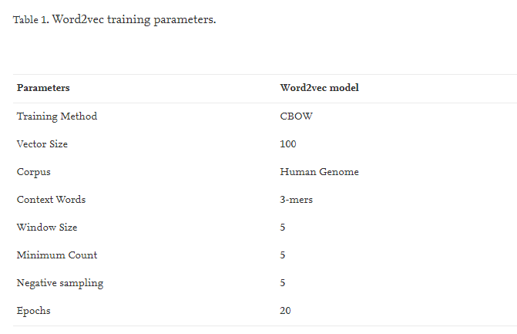
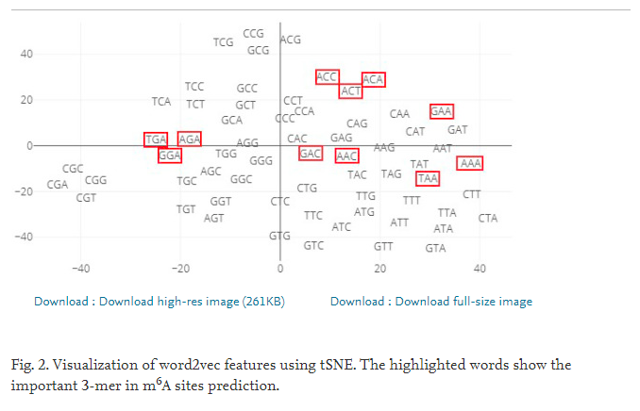
Distributed feature representation:

Slide 13
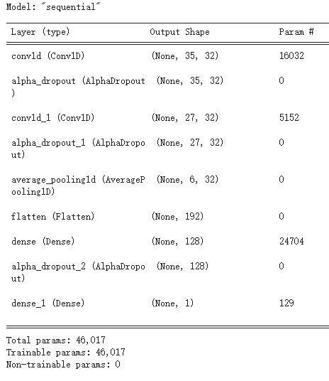
Deep learning model:
The extracted feature representation for each sequence from the first step is used for training the proposed deep learning model which is a simple and efficient convolution neural network as shown in Fig. 1(b). The grid search algorithm is utilized for searching the best hyper-parameters. The input shape of the proposed model is ( L-2 ) * 100 where L is the length of the input sequence.
It consists of two dilated convolution layers where the number of the filters is 32 and the size of the filter is 5 for both of them. The dilation rate is set to d=1 and d=2 for the first and the second convolution layers, respectively.
Dilated convolution produces exponentially larger receptive field with less number of layers with comparison to conventional convolution layers. Each layer is followed by rectified linear unit (ReLU) activation function. Alpha dropout is used in order to retain the variance and the mean of the inputs to their original values after applying dropout . The dropout probability is set to 0.2. The generated features of the dilated convolution layers are averaged using average pooling operator with window size equals to 4 and then passed to two fully connected layers. The first layer has 128 nodes and followed by ReLU activation function and alpha dropout with probability of 0.2. On the other hand, the second fully connected layer has only one node with sigmoid activation function for prediction.

Slide 14
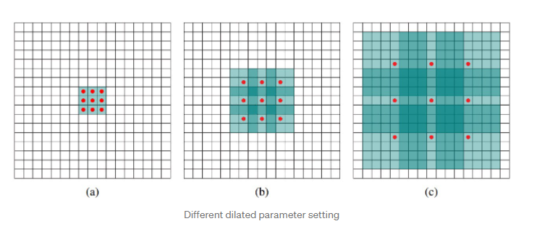
Deep learning model:
(a)圖對應3x3的1-dilated conv2d(Dilation_rate=1)，和普通的捲積操作一樣，
(b)圖對應3x3的2-dilated conv2d (Dilation_rate=2) ，實際的捲積kernel size還是3x3，但是空洞為1，也就是對於一個7x7的圖像patch，只有9個紅色的點和3x3的kernel發生卷積操作，其餘的點略過。也可以理解為kernel的size為7x7，但是只有圖中的9個點的權重不為0，其餘都為0。可以看到雖然kernel size只有3x3，但是這個卷積的感受野已經增大到了7x7
(c)圖對應3x3的4-dilated conv2d (Dilation_rate=4)

Slide 15
Deep learning model:
Layer | Parameter
Conv1d | Filter_num=32 | Kernel_size=5 | Activation=relu | Dilation_rate=1
AlphaDropout | dropout_rate=0.2
Conv1d | Filter_num=32 | Kernel_size=5 | Activation=relu | Dilation_rate=2
AlphaDropout | dropout_rate=0.2
AveragePooling1D | Pool_size=4
Flatten
Dense | neurons = 128 |  | Activation=relu
AlphaDropout | dropout_rate=0.2
Dense | neurons = 1 |  | Activation=Sigmoid

Slide 16
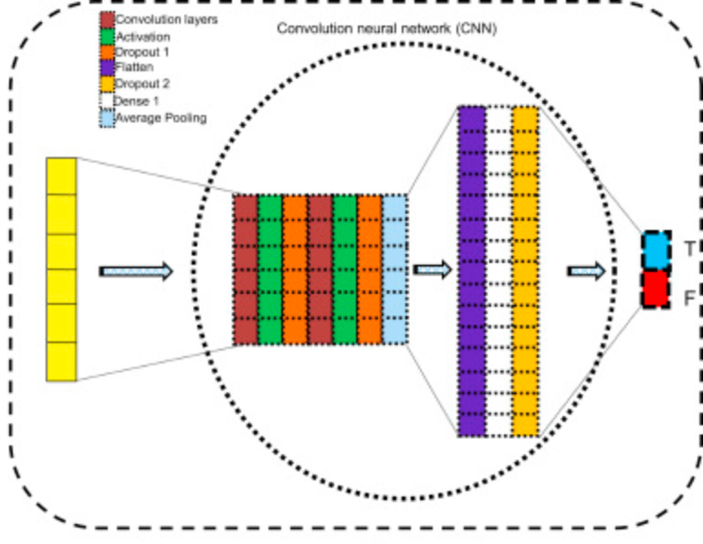
Deep learning model:

Slide 17
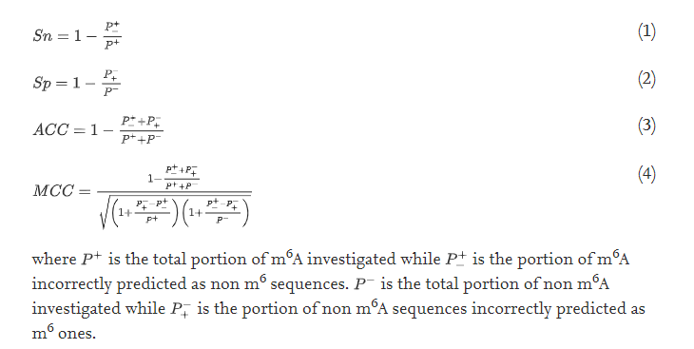
Results and discussion:
In this work, we use accuracy (ACC), sensitivity (Sn), specificity (Sp), and Matthew correlation coefficient (MCC) . These metrics were widely used in the recent publications

Slide 18
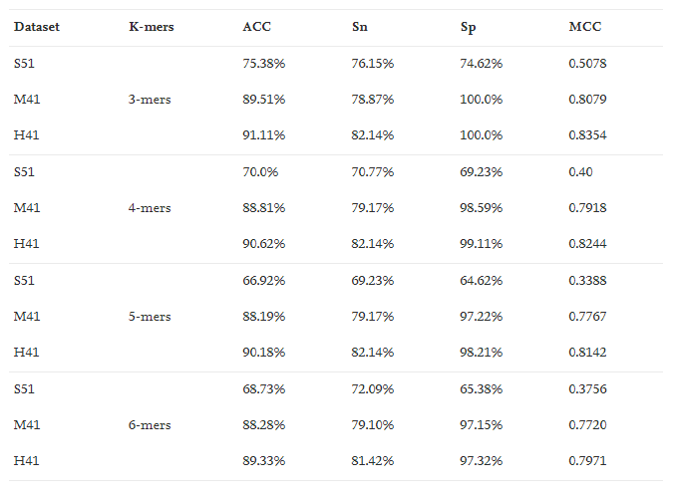
Results and discussion:
The proposed model is evaluated on three datasets S51, H41, and M41. In order to study the effect of using different values of k-mer we test 3-mer, 4-mer, 5-mer, and 6-mer as shown in Table 2.
The results show that using 3-mer produces the best performance on the three datasets compared with the other values of k-mer. These results confirm the finding of the previous studies in which 3-mer was the best performing selection .

Slide 19
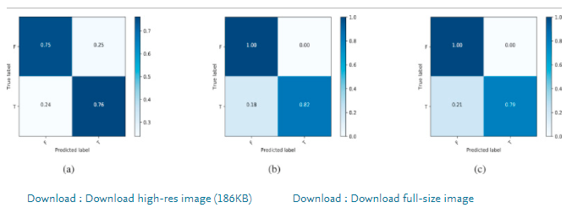
Results and discussion:
Fig. 3 shows the confusion matrix results of S51, H41, and M41. It can be seen that iN6-Methyl (5-step) model performs better in the case of H41 and M41 datasets than S51 dataset.
S51
H41
M41

Slide 20
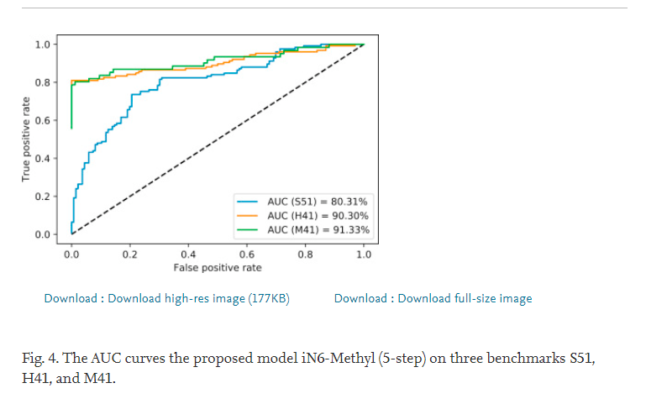
Results and discussion:
Fig. 4 shows the achieved AUC for S51, H41, and M41. It can be observed that H41 and M41 have AUC of 90.30% and 91.33%, receptively. while the AUC of S51 is 80.31%.

Slide 21
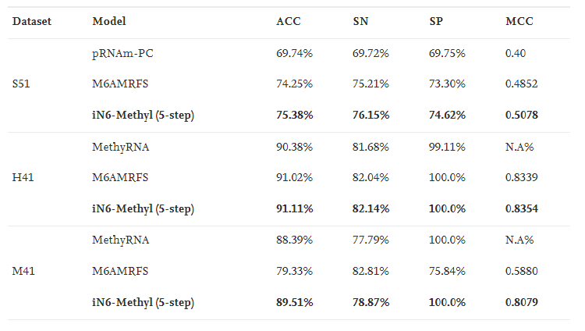
Results and discussion:
In addition we compare the results of the proposed model with the state-of-the-art-models pRNAm-PC and M6AMRFS using the same 10-fold cross-validation tests. Table 3 show the performance of the proposed model with comparison with other classifiers in terms of ACC, SP, SN, and MCC. It can be seen that iN6-Methyl (5-step) outperforms the other methods as shown in Table 3.

Slide 22
Conclusion:
In this study, we have proposed a novel deep-learning based model, called iN6-Methyl (5-step), for the identification of m6A sites in multiple species.
It consists of two steps namely features extraction and classification. We have adopted wrod2vec in order to automatically extract the features form raw genomics sequences then a simple and efficient deep learning model based on dilated convolution neural network has been used for classifying the m6A sites.
The obtained results outperformed the state-of-the-art models in all evaluation metrics i.e. , accuracy, sensitivity, specificity, and Matthew correlation coefficient.

