Slide 1
Leveraging the attention mechanism to improve the identification of DNA N6-methyladenine sites

Slide 2
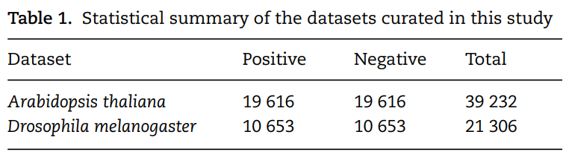
Benchmark datasets
In this study, the DNA 6mA data of the two model organisms Arabidopsis thaliana and Drosophila melanogaster were taken from [28] (DeepM6A). The raw data came from the PacBio public database [38]. Candidates were further filtered out by excluding those with the sequence variance located between 10 bp upstream and 5 bp downstream of the identified modification site and the variation ratio of the estimated methylation level of greater than 30%.
After this filtering procedure, 19 632 and 10 653 6mA sites for A. thaliana and D. melanogaster were obtained, respectively.

Slide 3
Benchmark datasets
Non6mA sites of the same number were used as negative samples. Each non-6mA site was at least 200 bp away from any neighboring 6mA site. For more detailed information on the data set construction, please refer to [28]. We further screened the sequences to weed out those sequences that contained sites with uncertain DNA bases. Finally, 19 616 positive samples and 10 653 positive samples were retained for A. thaliana and D. melanogaster, respectively. A statistical summary of the two datasets is provided in Table 1. For each organism, the samples were randomly divided with a ratio of 9:1 as the training and independent test datasets.

Slide 4
Feature representation
The proposed models take as the input a DNA sequence centered on 6mA site or non-6mA site. The binary one-hot encoding scheme is adopted to represent the input DNA sequences with the following rules: A = [1, 0, 0, 0], C = [0, 1, 0, 0], G = [0, 0, 1, 0] and T = [0, 0, 0, 1]. Such encoding scheme makes the elements in the encoding matrix correspond to the bases in the input sequence, which is convenient for the analysis of the attention matrix/vector. Accordingly, each DNA sequence of length L is converted to a 2D matrix of the size L × 4 after the encoding. The length of each sequence is 41 bp, which is composed of 20 flanking nucleotides at each side and the centered adenine site.

Slide 5
Network architecture
The input sequences are encoded and fed into the end-to-end networks directly. DNA data analysis is analogous to natural language processing [39], in which recurrent neural networks (RNNs) can be used to process the sequential data. As a popular and powerful RNN architecture, long short-term memory (LSTM) [40] has been widely used to address sequence analysis problems [41] and has achieved excellent performance. Here we employ BiLSTM to capture the short-range and long-range information of DNA sequences. The use of LSTM makes up the shortcoming for the lack of time information in the one-hot encoding.

Slide 6
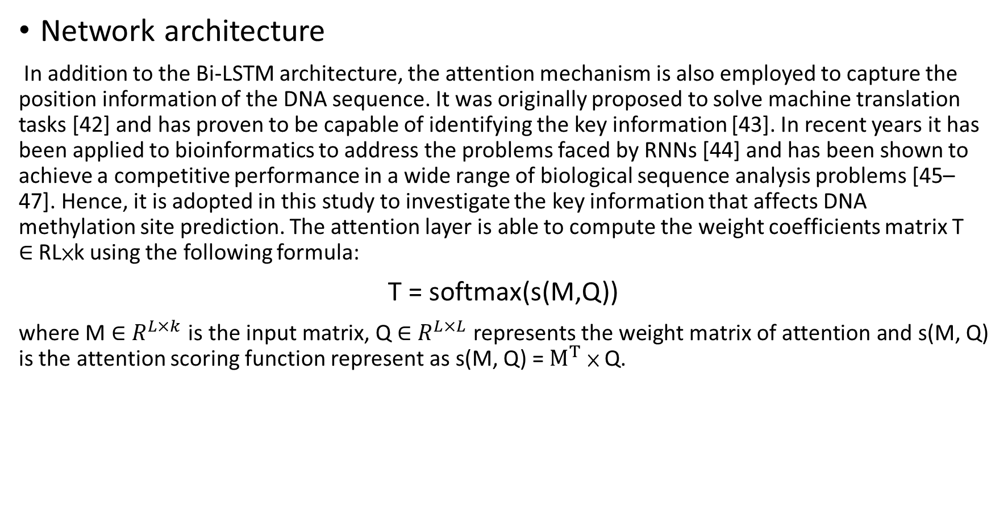
Network architecture
In addition to the Bi-LSTM architecture, the attention mechanism is also employed to capture the position information of the DNA sequence. It was originally proposed to solve machine translation tasks [42] and has proven to be capable of identifying the key information [43]. In recent years it has been applied to bioinformatics to address the problems faced by RNNs [44] and has been shown to achieve a competitive performance in a wide range of biological sequence analysis problems [45–47]. Hence, it is adopted in this study to investigate the key information that affects DNA methylation site prediction. The attention layer is able to compute the weight coefficients matrix T ∈ RL×k using the following formula:
T = softmax(s(M,Q))
where M ∈ $R^{L×k}$is the input matrix, Q ∈ $R^{L×L}$ represents the weight matrix of attention and s(M, Q) is the attention scoring function represent as s(M, Q) = $M^{T}$ × Q.

Slide 7
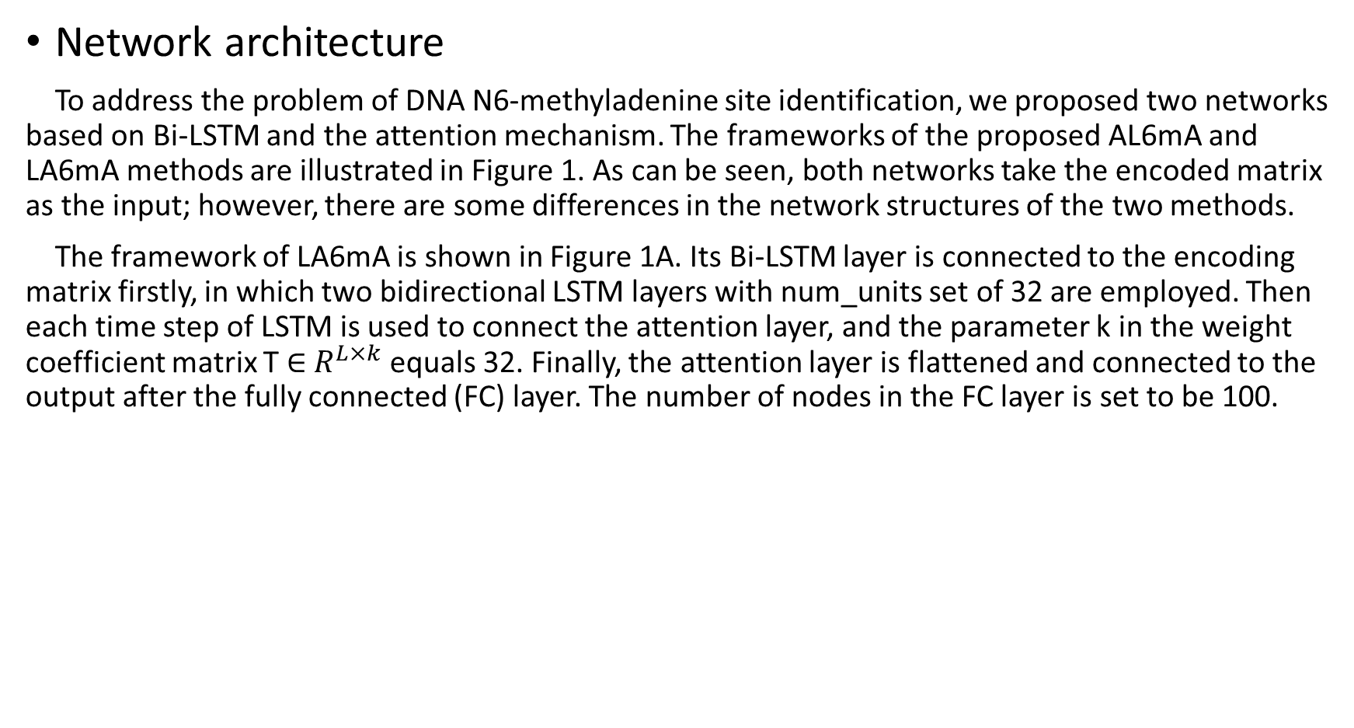
Network architecture
To address the problem of DNA N6-methyladenine site identification, we proposed two networks based on Bi-LSTM and the attention mechanism. The frameworks of the proposed AL6mA and LA6mA methods are illustrated in Figure 1. As can be seen, both networks take the encoded matrix as the input; however, there are some differences in the network structures of the two methods.
The framework of LA6mA is shown in Figure 1A. Its Bi-LSTM layer is connected to the encoding matrix firstly, in which two bidirectional LSTM layers with num_units set of 32 are employed. Then each time step of LSTM is used to connect the attention layer, and the parameter k in the weight coefficient matrix T ∈ $R^{L×k}$ equals 32. Finally, the attention layer is flattened and connected to the output after the fully connected (FC) layer. The number of nodes in the FC layer is set to be 100.

Slide 8
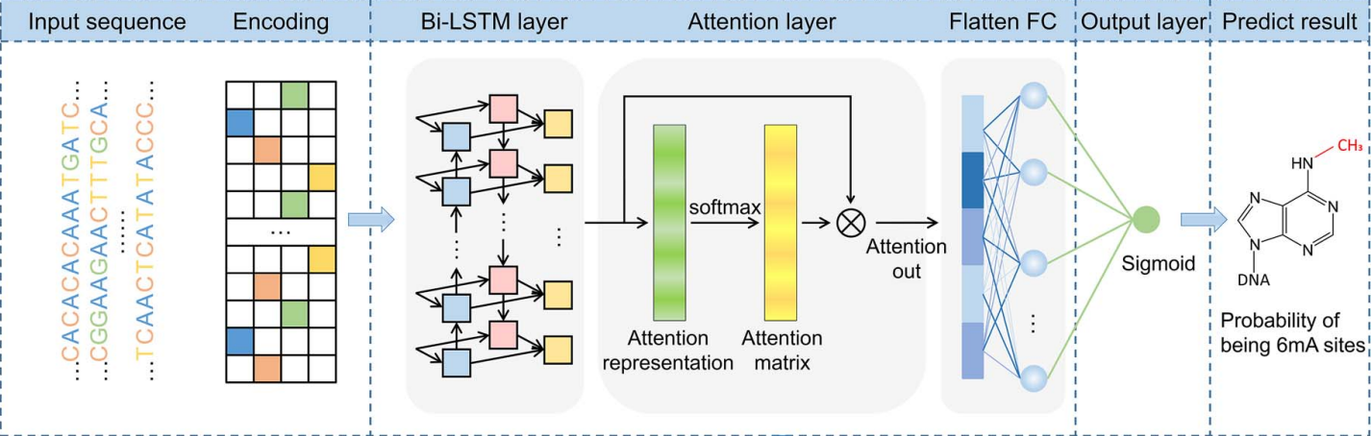
Network architecture

Slide 9
Network architecture
The structure of AL6mA is a little different from that of LA6mA, as shown in Figure 1D. The input sequence of length L is encoded and then directly connected with the attention layer. After the attention layer is one bidirectional LSTM layer, the parameters of which are as follows: num_units set is at 128, whereas the time_steps is set at 41. Finally, the output of the last time step of Bi-LSTM is used as the final predict result.

Slide 10
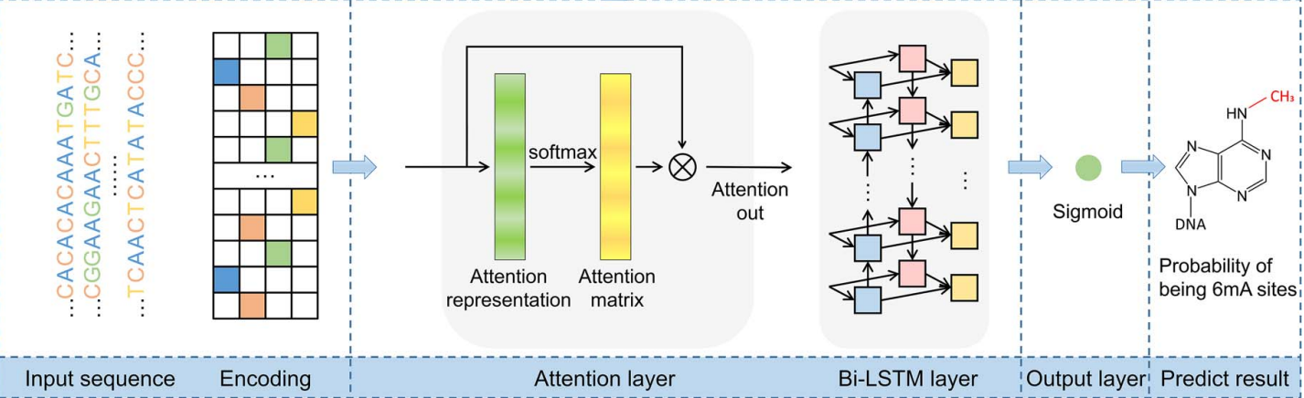
Network architecture

Slide 11
Network architecture
It is noteworthy that the two proposed methods are not merely used to predict potential methylation sites. They also enable us to perform an in-depth analysis of the hidden information that the model pays attention to and utilizes to make the prediction. Figure 1B and C depict how the attention matrices are analyzed and interpreted for this purpose.

Slide 12
Implementation
The models are implemented in Keras (version 2.3.1) and trained on one NVIDIA TITAN X GPU. The batch size is set to be 128. The Adam optimizer is employed with the default learning rate of 0.001, beta_1 = 0.9, beta_2 = 0.999, and a learning rate decay of 0.5 with patience of 7. 5-fold cross-validation is performed to determine the model structure and hyperparameters on the training data. After the model structure is determined, we take 8/9 (about 8/10 of the whole dataset) and 1/9 (about 1/10 of the whole dataset) of the training data to train and verify the trained model, respectively. Early stopping with patience of 7 is adopted on the validation set to avoid overfitting, which means the training process will terminate when the prediction performance does not improve on the validation set.

Slide 13
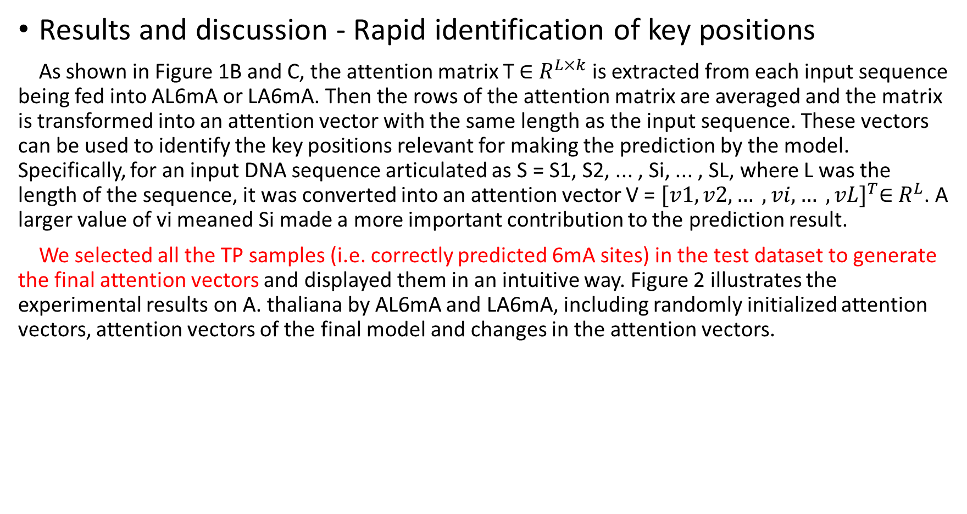
Results and discussion - Rapid identification of key positions
As shown in Figure 1B and C, the attention matrix T ∈ $R^{L×k}$ is extracted from each input sequence being fed into AL6mA or LA6mA. Then the rows of the attention matrix are averaged and the matrix is transformed into an attention vector with the same length as the input sequence. These vectors can be used to identify the key positions relevant for making the prediction by the model. Specifically, for an input DNA sequence articulated as S = S1, S2, ... , Si, ... , SL, where L was the length of the sequence, it was converted into an attention vector V = ${[v1, v2, … , vi, … , vL]}^{T}$∈ $R^{L}$. A larger value of vi meaned Si made a more important contribution to the prediction result.
We selected all the TP samples (i.e. correctly predicted 6mA sites) in the test dataset to generate the final attention vectors and displayed them in an intuitive way. Figure 2 illustrates the experimental results on A. thaliana by AL6mA and LA6mA, including randomly initialized attention vectors, attention vectors of the final model and changes in the attention vectors.

Slide 14
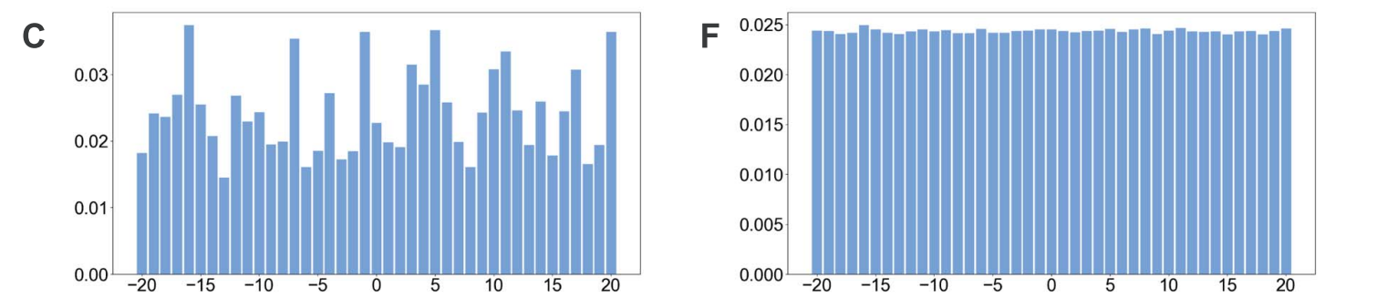
Results and discussion - Rapid identification of key positions
Figure 2C and F display the randomly initialized attention vectors of the AL6mA and LA6mA methods, respectively. As can be seen, the initial attention weights of AL6mA appeared to be distributed randomly throughout the sequence (Figure 2C), which obviously differed from each other. In the case of LA6mA, its initialized attention weights were almost evenly distributed (Figure 2F). When an input sequence was fed into an initialized LA6mA model, the LSTM layer extracted the features of the sequence, which were then passed into the attention layer. That is the main reason why the values in the extracted initial attention vector of LA6mA were distributed evenly.

Slide 15
Results and discussion - Rapid identification of key positions
Figure 2A and D show the final attention vectors of AL6mA and LA6mA, respectively. Regardless of the distribution of the initial attention, it is apparent that the weights of the central region in the attention of the final model are larger than those of the marginal region. This suggests that the central region made more contributions to the prediction of the final result. Furthermore, we conjecture that the right flanking region contributed more to the prediction than the left f lanking region. Specifically, the region of [−2, 9] made the most significant contributions to the prediction in terms of the values of the attention weights. From a biological perspective, mutations in this region might affect the methylation possibility of the centered adenine site, which has been confirmed in [48]. In addition, the changes in methylation caused by such mutation may lead to abnormal biological processes.

Slide 16
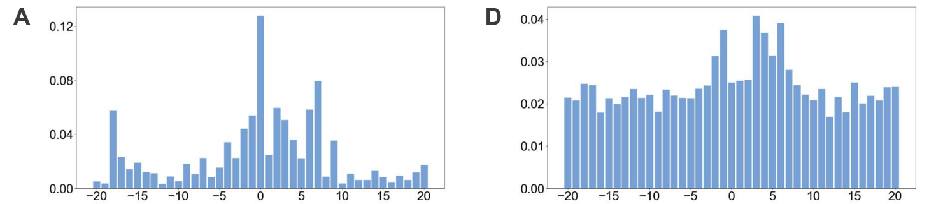
Results and discussion - Rapid identification of key positions

Slide 17
Results and discussion - Rapid identification of key positions
To observe the changes of the attention vectors, the attention weights were extracted during model optimization. The changes are then displayed as 3D graphics, shown in Figure 2B and E. It can be seen that, in accordance with the increase of the epochs, the values of the central regions increased, whereas the values of the marginal regions decreased, highlighting that the models could automatically focus on the key areas during the optimization. Surprisingly, the changes of the attention vectors that attended to the key positions appeared to occur after only a few epochs, and as the iteration progressed, the values of the attention vectors were being constantly fine-tuned and eventually reached the plateau. Figure 2B and E verified rapid identification of the key positions that are relevant for making the prediction by the model.

Slide 18
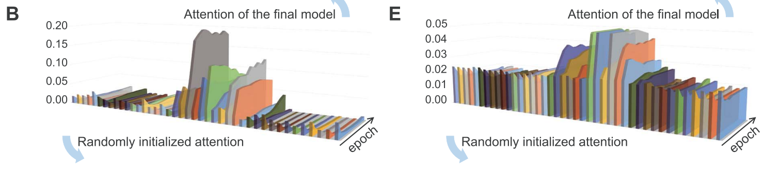
Results and discussion - Rapid identification of key positions

