Slide 1
MGF6mARice
prediction of DNA N6-methyladenine sites in rice by exploiting molecular graph feature and residual bloc

Slide 2
Datasets
The performance of MGF6mARice is evaluated on three kinds of datasets, i.e. benchmark datasets Rice:Chen and Rice:Lv, imbalanced datasets constructed via Rice:Chen or Rice:Lv, two types of independent datasets.

Slide 3
Benchmark datasets
The dataset Rice:Chen is the first high-quality DNA 6mA benchmark dataset in the rice genome [19]. After obtaining SMRT-seq data from NCBI GEO (Gene Expression Omnibus) via the accession number GSE103145 [15], the positive samples of Rice:Chen were produced according to Methylome Analysis Technical Note. And the negative samples of Rice:Chen were fetched from the sequence that was not methylated proved by experimental results, or from motifs where 6mA was less enriched. Compared with Rice:Chen, Rice:Lv is a larger dataset constructed from iDNA6mA-Rice [22]. The acquisition rules about positive and negative samples of Rice:Lv are similar to those of Rice:Chen.
In both datasets, the CDHIT tool [49] was adopted to reduce homology bias and de-redundancy. Considering the huge time and space cost, the construction and optimization of the model use the small dataset Rice:Chen, and the Rice:Lv is used to evaluate the performance of the model on a large amount of data.

Slide 4
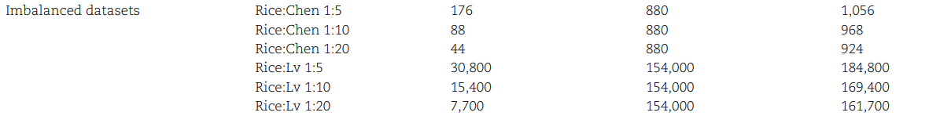
Imbalanced datasets
In nature, the number of negative samples is generally far larger than that of positive samples. Sometimes, sample imbalance may significantly decrease the classification performance. In order to investigate the robustness of various methods to sample imbalance, six imbalanced datasets are constructed. Based on Rice:Chen and Rice:Lv, positive and negative samples of these imbalanced datasets are randomly selected via 1:5, 1:10 and 1:20 of positive to negative samples selection ratio, respectively [38].

Slide 5
Independent datasets
After training and tuning of a model, independent dataset is often used to check the generalization ability of the model. Two types of independent datasets are prepared in this work:
Same species independent dataset. Wang et al. [39] collected, processed and obtained a 6mA dataset in rice from eRice database [50], with positive and negative samples approaching 600 000, respectively. Considering the huge amount of samples, only 10 000 positive and negative samples are randomly selected, respectively, to form independent dataset of the same species. The samples of independent dataset have no intersection with the samples of the benchmark datasets Rice:Chen and Rice:Lv.
Cross species independent datasets. Three cross species from 6mAPred-MSFF [40], including A.thaliana, D.melanogaster and R.chinensis, are directly adopted as independent datasets.

Slide 6
Architecture of MGF6mARice
Section 1 shows the flow diagram of MGF6mARice’s architecture. It mainly contains four modules: SMILES representation of DNA, MGF encoding, extracting features by residual blocks and MGF6mARice prediction.

Slide 7
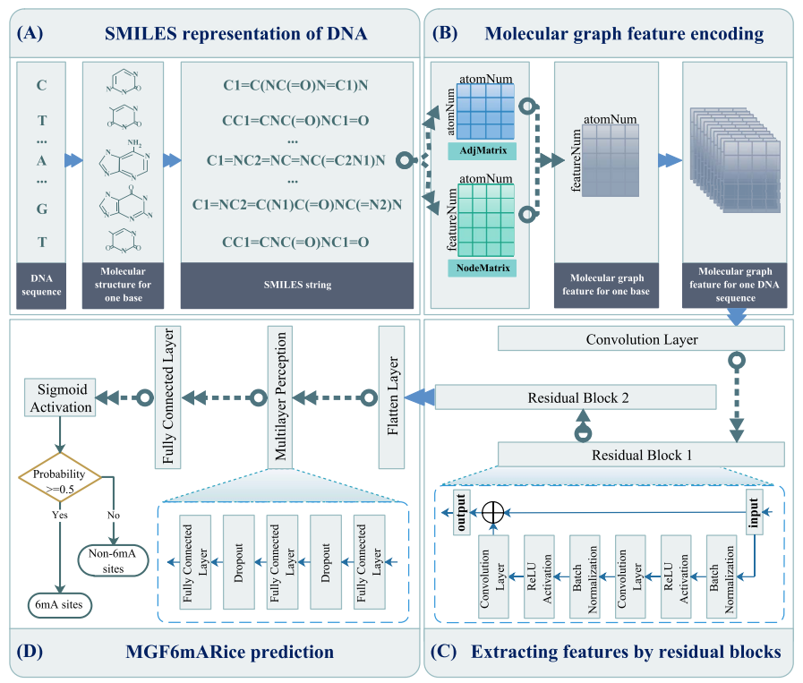

Slide 8
SMILES representation of DNA
In our work, how to effectively represent the molecular structure is the key step to realizing the feature encoding. Built by using molecular graph, SMILES is a concise chemical molecular language to describe molecular structure via ASCII string [46]. SMILES string has been widely used in bioinformatics and chemoinformatics, such as interaction and binding affinity prediction of drug–target [51–53], peptide toxicity prediction [43] and so on. For a DNA sequence, there are four kinds of bases, i.e. adenine (A), thymine (T), guanine (G) and cytosine (C).
Each base corresponds to a chemical molecular structure. The chemical molecular structure needs to be converted into a form that can be processed by computer. Nevertheless, the SMILES string has not been applied on DNA bases to further extract features so far. Therefore, we utilize the SMILES string in this section to represent DNA, as shown in Figure 1A. The specific process of converting the chemical molecular structure of bases to the corresponding SMILES string is shown in Figure 2. Note that the canonical SMILES [54] is used in this study to avoid ambiguity.

Slide 9
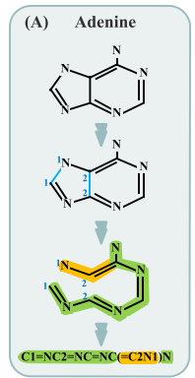
SMILES representation of DNA
Take base A as an example (Figure 2A):
The first row shows the chemical molecular structure of base A, including carbon atom (C, expressed by inflection point or endpoint), nitrogen atom (N), single bond and double bond (=).
In the molecular structure on the second row, two blue bonds are assumed to be broken and denoted by 1, 2 respectively. Thus, a closed molecular structure is transformed into a linear open form for an easier description.
In the third row, there are the main chain (marked in green) and the branch chain (marked in yellow).
Finally, all atoms, bonds and breakpoints are recorded in the prescribed order, where these at the branch chain are enclosed in parentheses. So the SMILES representation of base A is obtained as: C1=NC2=NC=NC(=C2N1)N. SMILES strings of other bases are obtained in the same way (Figure 2B–D).
Therefore, we obtain the related data from PubChem database [55] to construct the set of SMILES strings to characterize the DNA sequence.

Slide 10
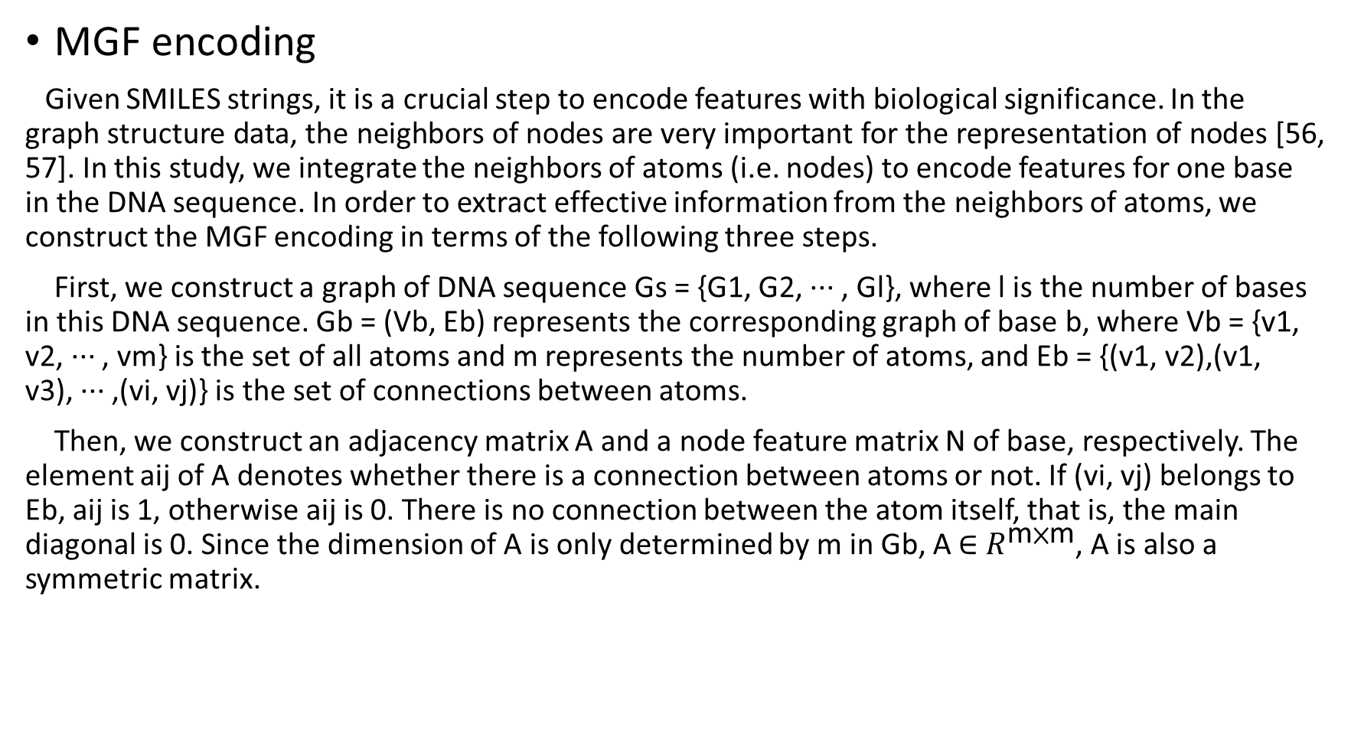
MGF encoding
Given SMILES strings, it is a crucial step to encode features with biological significance. In the graph structure data, the neighbors of nodes are very important for the representation of nodes [56, 57]. In this study, we integrate the neighbors of atoms (i.e. nodes) to encode features for one base in the DNA sequence. In order to extract effective information from the neighbors of atoms, we construct the MGF encoding in terms of the following three steps.
First, we construct a graph of DNA sequence Gs = {G1, G2, ··· , Gl}, where l is the number of bases in this DNA sequence. Gb = (Vb, Eb) represents the corresponding graph of base b, where Vb = {v1, v2, ··· , vm} is the set of all atoms and m represents the number of atoms, and Eb = {(v1, v2),(v1, v3), ··· ,(vi, vj)} is the set of connections between atoms.
Then, we construct an adjacency matrix A and a node feature matrix N of base, respectively. The element aij of A denotes whether there is a connection between atoms or not. If (vi, vj) belongs to Eb, aij is 1, otherwise aij is 0. There is no connection between the atom itself, that is, the main diagonal is 0. Since the dimension of A is only determined by m in Gb, A ∈ $R^{\text{m}\text{×}\text{m}}$, A is also a symmetric matrix.

Slide 11
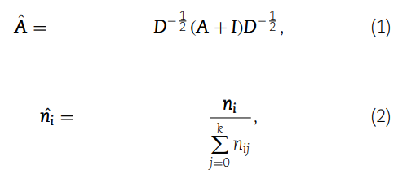
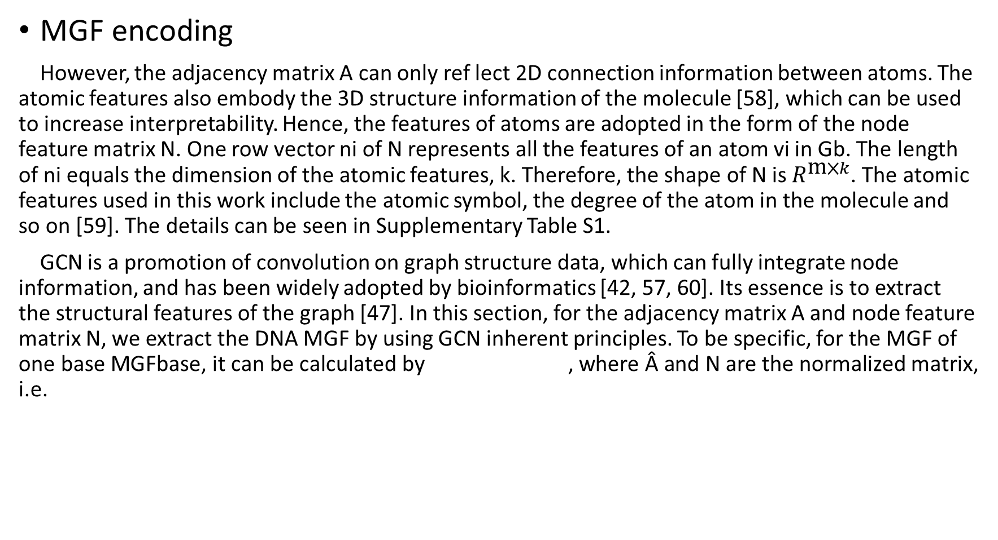
MGF encoding
However, the adjacency matrix A can only ref lect 2D connection information between atoms. The atomic features also embody the 3D structure information of the molecule [58], which can be used to increase interpretability. Hence, the features of atoms are adopted in the form of the node feature matrix N. One row vector ni of N represents all the features of an atom vi in Gb. The length of ni equals the dimension of the atomic features, k. Therefore, the shape of N is $R^{\text{m}\text{×}k}$. The atomic features used in this work include the atomic symbol, the degree of the atom in the molecule and so on [59]. The details can be seen in Supplementary Table S1.
GCN is a promotion of convolution on graph structure data, which can fully integrate node information, and has been widely adopted by bioinformatics [42, 57, 60]. Its essence is to extract the structural features of the graph [47]. In this section, for the adjacency matrix A and node feature matrix N, we extract the DNA MGF by using GCN inherent principles. To be specific, for the MGF of one base MGFbase, it can be calculated by , where Â and N are the normalized matrix, i.e.

Slide 12

MGF encoding
where I is the identity matrix with the same size of A, which is used to add self-loop to include the feature of the node itself (i.e. atom in molecule). D is the degree matrix of A + I. nij is an element in the node feature matrix N. represents one row vector of the normalized node feature matrix . Finally, the MGF of one DNA sequence MGFseq is obtained by appending together the MGFs of bases in order (Figure 1B). The details are provided in Supplementary Materials

Slide 13
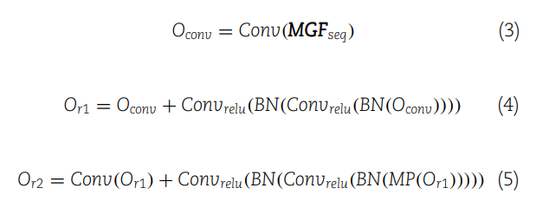
Extracting features by residual blocks
Many researches have shown that, compared with the direct connection between layers in the traditional neural network, the residual block by shortcut connection in ResNet can effectively prevent the gradient from exploding or disappearing in deep network [61, 62]. Inspired by He et al., we use the combination of residual blocks to mine the useful information for 6mA prediction in MGF (Figure 1C). First, we input the MGFseq into a convolutional layer (Conv) for preliminary feature extraction, and then feed the output into two residual blocks to extract more effective and distinguishable features:
where Oconv, Or1 and Or2 are the output of the convolutional layer, the first and the second residual block, respectively. Convrelu is a convolution layer with relu activation function. BN denotes batch normalization. MP denotes a max-pooling layer.

Slide 14


MGF6mARice prediction
For the deeper features extracted using residual blocks, we use multilayer perception (MLP) to build a prediction module to determine whether the DNA sequence contains 6mA site (Figure 1D). The output of residual blocks (Or2) is fed into three-layer MLP with relu activation function (FCrelu), i.e.
Finally, the probability of a sample being a 6mA site (pred) is calculated as follows:
where FCsigmoid denotes a fully connected layer with a sigmoid activation function. If pred is less than 0.5, the DNA sequence is a negative sample, which means that there is no 6mA site. Otherwise, it is a positive sample that contains a 6mA site.

Slide 15
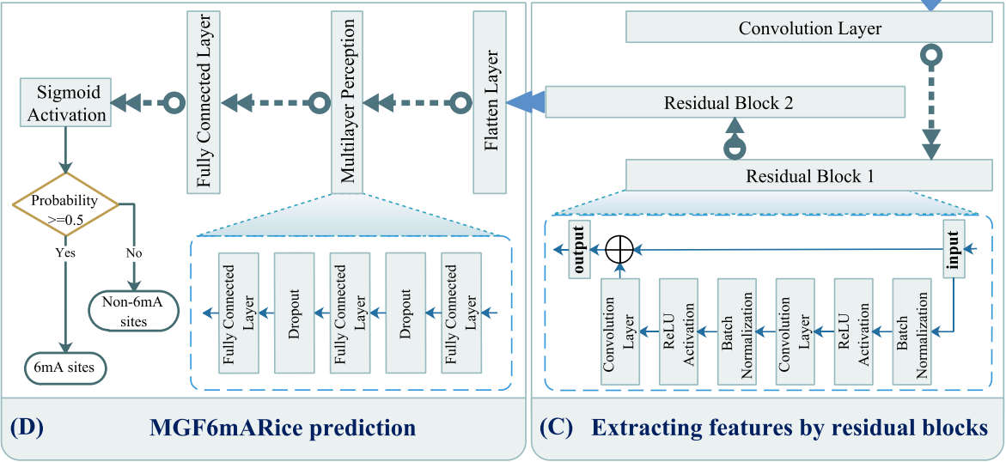

Slide 16
Optimization of MGF6mARice
The optimization of hyperparameters plays a vital role in the prediction model of neural networks [42, 63]. In our predictive model, the hyperparameters to be optimized are the number of residual blocks, number of fully connected layers in MLP, number of units in each fully connected layer, dropout rate, optimizer and batch size (see Supplementary Table S2 for value range). To reduce optimization time and improve optimization efficiency, we use the Bayesian optimization algorithm to obtain optimized hyperparameters, provided by the Python package hyperopt [64]. The details of the relevant results are given in Supplementary Table S3.
In addition, we utilize the binary cross-entropy as the loss function and use the stochastic gradient descent optimizer to optimize it. To prevent overfitting, the batch normalization and dropout layer are adopted in MGF6mARice. At the same time, MGF6mARice also uses a learning rate decay strategy to facilitate the optimization and generalization of the model [65].

