Slide 1
i6mA-DNC

Slide 2
Outline
Introduction
Materials and methods
Results and discussion
Conclusion

Slide 3
Introduction
DNA methylation refers to an important epigenetic process by which a methyl groups are added to the DNA bases. It often modifies the activity of the genes without changing the sequences. Among DNA’s four bases, the cytosine and adenine bases can be methylated.
In eukaryotes, 5-methylcytosine (5 ​mC) is the most common type of DNA modification. In prokaryotes, however, 6-methyadenine (6 ​mA) is the most dominant DNA modification. As a non-canonical DNA modification, DNA N6-methyladenine (6 ​mA) has been detected in three kingdoms of life: bacteria, archaea, and eukaryotes.
The 6​mA modification is highly correlated with a wide-ranging biological processes, such as DNA replication , transcription, repair, and cellular defense. In genome, the 6 ​mA sites distribution is not uniform. Therefore, in order to fully understand the biological functions of 6 ​mA, it is essential to precisely identify its genomic location.

Slide 4
Introduction
To this end, a variety of experimental methods have been introduced to identify 6 ​mA sites, such as ultra-high performance liquid chromatography coupled with mass spectrometry (UHPLC-Ms/Ms), single-molecule real-time sequencing (SMRT-seq), methylated DNA Immunoprecipitation sequencing (MeDIP-seq), and capillary electrophoresis and laser-induced fluorescence (CE-LIF).
Although the biochemical experimental methods provide positive data information related to the 6​mA sites, it is costly and time-consuming to use these wet lab techniques. To deal with this issue, it is required to design a powerful, precise, and fast computational model using the pre-existing experimental data to detect the N6-methyladenine sites.

Slide 5
Introduction
Machine learning methods were designed to identify N6-methyladenine sites in the rice genome. A group of biologists obtained the 6mA profile of rice genome by using mass spectrometry analysis and Immunoprecipitation followed by sequencing (IP-seq).
The information acquired in that research made it possible to develop computational models based on machine learning approaches. Chen et al.Proposed the first computational model based on support vector machine (SVM) to identify the N6-methyladenine sites in the rice genome using nucleotide frequency and nucleotide chemical properties as features extraction techniques. Their model achieved an accuracy of 83.13% and 0.66 of Matthews’s correlation coefficient (MCC). A few months later, Le, N. Q. K. designed another SVM-based model using a continuous bag of nucleobases via Chou’s 5- step rule. With cross-validation, this model obtained accuracy of 87.78% and 0.756 of MCC.

Slide 6
Introduction
Another group of researchers proposed a computational model based on a convolution neural network (CNN) to identify the N6-methyladenine sites in the rice genome. They used the one-hot encoding algorithm for the sequences and fed them into the CNN model. Unlike Chen’s SVM model, their model extracts features from DNA sequences automatically.
The model, iDNA6mA, gained accuracy of 86.64% and 0.732 of MCC. iDNA6mA used one-hot encoding for representing the input sequences. However, one-hot encoding is a low dimensional feature representation that cannot capture the hidden information in the input sequence. Therefore, in order to find the significant information between successive nucleotides we used a higher-order coding in order to extract sequence features and significantly improving the final prediction performance.
In order to determine DNA N6-methyladenine sites, we proposed the i6mA-DNC model for identification of 6 ​mA using dinucleotide composition that is based on the convolution neural network (CNN). We divided the raw DNA sequences into dinucleotide components and fed them to the CNN model. The novel deep learning model that we proposed has superior prediction outcomes compared to the existing models. In addition, a user-friendly webserver has been established and made freely accessible at https://home.jbnu.ac.kr/NSCL/i6mA-DNC.htm.

Slide 7

Materials and methods
Benchmark dataset
First of all, we selected a valid benchmark dataset to predict and test our proposed model effectively. The dataset for rice genome was constructed by Chen et al. All samples have 41 nucleotides with the 6​mA site in the center. Therefore, the dataset is represented as:
Where R represents the whole dataset comprising of 1760 samples. The subset R+ have 880 sequences with 6 ​mA sites while the subset R− consists of 880 sequences with non-6mA sites. The ∪ denotes the union of the two subsets.
Species | Sequence |  | Length
Rice | Positive | 880 | 41
 | Negative | 880

Slide 8
Materials and methods
Proposed model
Fig. 1 shows the framework of i6mA-DNC model. It is a model to predict the 6 ​mA sites using convolutional neural network (CNN).
First of all, the proposed model takes a single input of a DNA sample. A given sequence S is represented as S={N1,N2,…Ni} where N1 denotes the first nucleotide of the sequence, N2 denotes the second nucleotide and so forth. Every nucleotide belongs to one of these four A,C,G,T. i=41 and represents the length of the sample.
It is important to convert the raw genomic sequence into a vector form that deep learning can recognize. It is also needed to consider the loss of pattern sequence information while converting sequence data into vector forms, as it mostly happens in the discrete models. To avoid the pattern loss, many techniques have been introduced including pseudo amino acid composition (PseAAC) which was widely used in proteomics. Some vigorous software regarding PseAAC has been developed as an open source, such as PseAAC-Builder, protein in python (Propy). Another approach, known as Pseudo K-tuple nucleotide composition (PseKNC), was introduced to extract different feature vectors from RNA and DNA sequences. This method has been widely used in many research works.

Slide 9
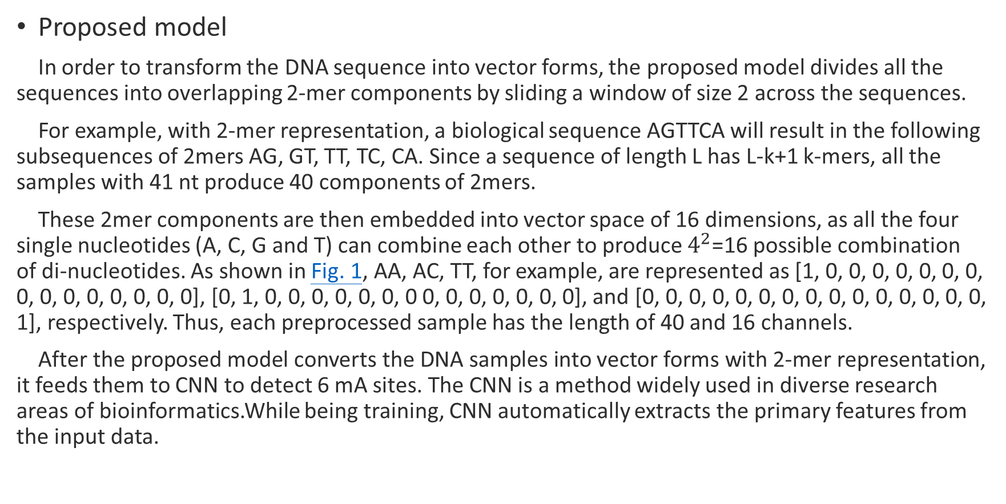
Materials and methods
Proposed model
In order to transform the DNA sequence into vector forms, the proposed model divides all the sequences into overlapping 2-mer components by sliding a window of size 2 across the sequences.
For example, with 2-mer representation, a biological sequence AGTTCA will result in the following subsequences of 2mers AG, GT, TT, TC, CA. Since a sequence of length L has L-k+1 k-mers, all the samples with 41 ​nt produce 40 components of 2mers.
These 2mer components are then embedded into vector space of 16 dimensions, as all the four single nucleotides (A, C, G and T) can combine each other to produce $4^{2}$=16 possible combination of di-nucleotides. As shown in Fig. 1, AA, AC, TT, for example, are represented as [1, 0, 0, 0, 0, 0, 0, 0, 0, 0, 0, 0, 0, 0, 0, 0], [0, 1, 0, 0, 0, 0, 0, 0, 0 0, 0, 0, 0, 0, 0, 0], and [0, 0, 0, 0, 0, 0, 0, 0, 0, 0, 0, 0, 0, 0, 0, 1], respectively. Thus, each preprocessed sample has the length of 40 and 16 channels.
After the proposed model converts the DNA samples into vector forms with 2-mer representation, it feeds them to CNN to detect 6 ​mA sites. The CNN is a method widely used in diverse research areas of bioinformatics.While being training, CNN automatically extracts the primary features from the input data.

Slide 10
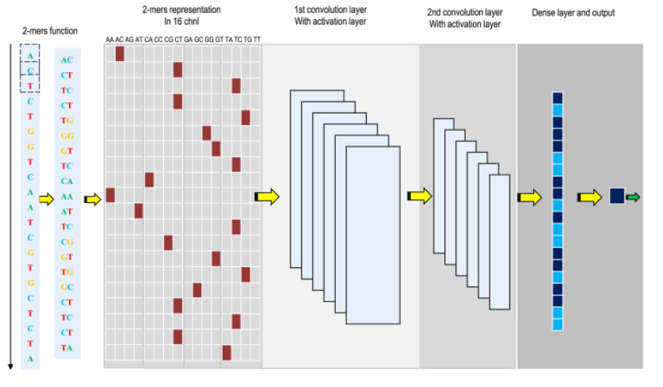
Materials and methods
Proposed model

Slide 11
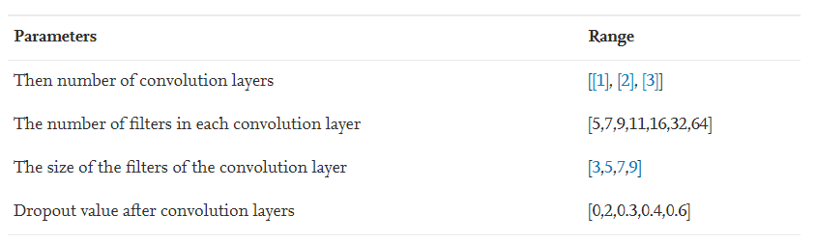
Materials and methods
Proposed model
Convolution neural network is composed of various layers such as convolution layer, pooling layer, ReLU layer, dropout layer, and fully connected layer. Each layer contains different hyper-parameters to be tuned while learning.
The best combination of the hyper-parameters of each layer was chosen based on a grid search approach. The tuned hyperparameters are the number of convolution layer, the number of filters in the convolution layers, the size of filters in the convolution layer, and the dropout rate after convolution layers. Table 1 represents the hyperparameter selection of the model.

Slide 12
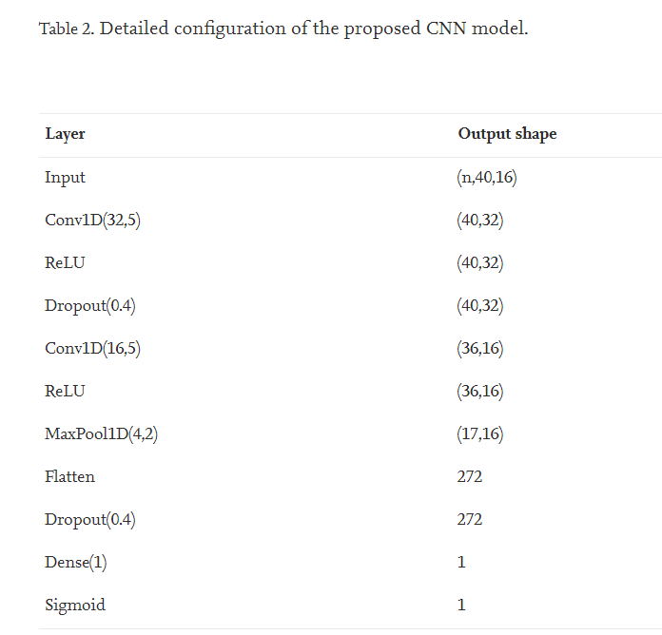
Materials and methods
Proposed model
Table 1 shows the architecture of the proposed model. The Conv1D (f,s) is a one-dimensional convolution layer where f is the number of filters and s is the size of the filter. Every convolution layer is followed by a nonlinear activation function known as rectified linear unit (ReLU).
The Dropout (p) is used as an operator with a probability of p to prevent a model from overfitting. Maxpool1D (m,d) reduces the dimensionality by selecting the maximum value within the window m where m is the pool-size and d is stride. Dense (n) is a fully connected layer with n number of nodes. The last layer is Sigmoid () function which is a nonlinear activation function that squeezes the output values between 0 and 1. We used this layer to predict if the input sequence has an m6A site or non-m6A site.
Our proposed model used Keras framework. The number of epoch, the learning rate, and the batch size were set to 50, 0.005, and 32, respectively. The Adam optimizer was used.

Slide 13
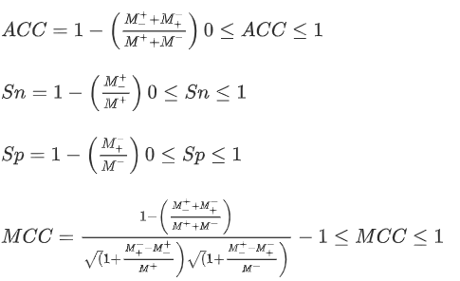
Materials and methods
Performance evaluation
In order to evaluate the success rate of the trained model, we selected and performed proper cross-validation. Four metrics are usually used to calculate the performance of prediction system. They are accuracy (ACC), Mathew’s correlation coefficient (MCC), specificity (Sp), and sensitivity (Sn).

Slide 14
Materials and methods
Cross-validation
Choosing a precise cross-validation method is also a foremost part for evaluating the performance of the proposed model. There are three basic cross validation methods: independent dataset test, k-fold cross-validation, and jackknife test.
Among these, the k-fold cross-validation is the most robust method used for performance evaluation of predictors. In this work, we used 10-fold cross-validation by dividing the whole dataset randomly into 10 partitions of approximately equal sizes of 10 subsets. A single subset was used as a test dataset to evaluate the proposed model while the remaining 9 subsets were retained as training datasets. The cross-validation process was repeated 10 times, with every subset used once as the test data. Then we calculated the average from the 10 results of all folds.

Slide 15
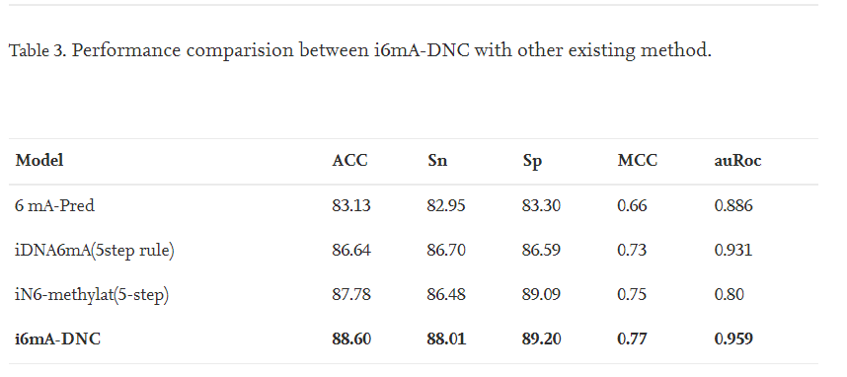
Results and discussion
In this part, we discuss the achievement of the proposed model using benchmark dataset via the k-fold cross-validation test. Table 3 shows the comparison of success rate between the proposed model i6mA-DNC and the existing state-of-the-art models 6 ​mA-Pred, iDNA6mA(5step rule), and iN6-methylat(5-step) for identifying N6-methyladenosine sites in the rice genome.

Slide 16
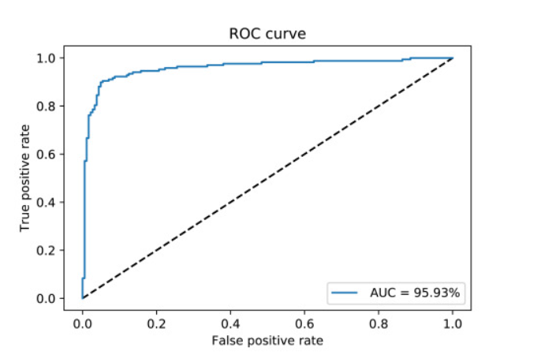
Results and discussion
The area under the receiver operating characteristics curve (auROC) is used to evaluate the performance quality of a classifier. Fig. 2 represents the auROC of i6mA-DNC, which is 95.93.

Slide 17
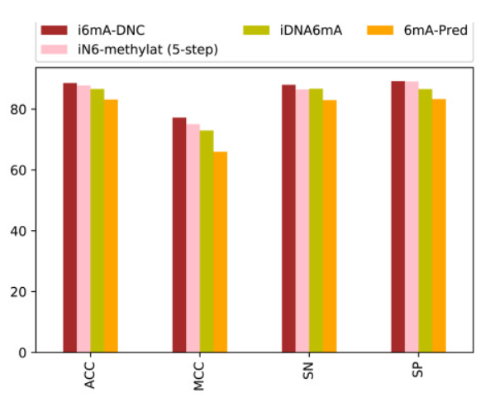
Results and discussion
Fig. 3 is a graphical illustration that compares the performance between the four prediction systems: i6mA-DNC, iN6-methylat (5-step), iDNA6mA, and i6mA-Pred. This figure shows that our proposed model produced the best result.

Slide 18
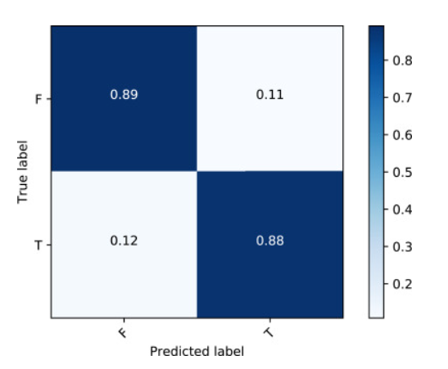
Results and discussion
Fig. 4 shows the visualization of the confusion matrix performance of i6mA-DNC.

Slide 19
Results and discussion
For the comprehensive evaluation, we tried to test the model on an independent dataset which is available at (https://www.ncbi.nlm.nih.gov/geo/query/acc.cgi?acc=GSE103145). In this dataset, we selected the sequences with association modification score (ModQV) with more than 30 as well as they share less than 60% of similarity of the sequences in the benchmark dataset. As a result, we obtained 221 6​mA positive sequences. On the other hand, the 221 negative sequences were chosen with A at the center but not detected by SMRT-seq. The achieved results are 88.64%, 89.09%, 88.18%, 77.28% for Acc, Sn, Sp, and MCC, respectively.
Finally, we study the ability of the proposed model to figure out in-silico mutagenesis. For this, we computationally mutate the nucleotides in the benchmark dataset and we study the effect of the mutation on the final prediction outcomes. For example; for each sequence with length L, we have L x 3 possible mutations. For each mutation, we save the absolute difference. Then, we take an average of the prediction score modifications due to the mutations over the whole sequences in the benchmark dataset. The heat map in Fig. 5 illustrates that the mutations in the center of the sequence affect the final prediction results more than the mutations in both sides of the sequence.

Slide 20
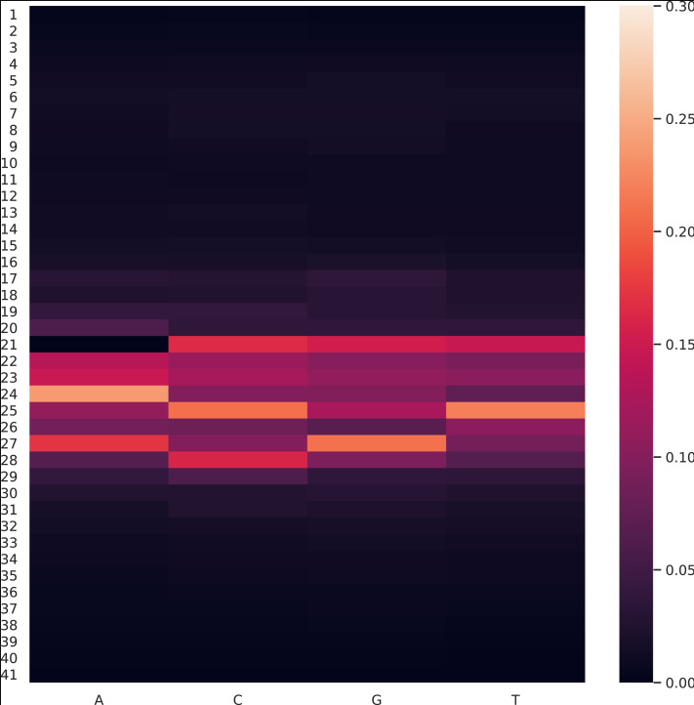
Results and discussion

Slide 21
Conclusion
Identification of DNA methylation sites is crucial for understanding various biological processes for both drug development and academia. In this study, we designed a novel computational model based on CNN to identify 6 ​mA sites from DNA samples.
We frist converted the raw genomic sequences into groups of dinucleotide components and then fed the pre-processed samples to CNN to identify 6 ​mA sites. Our proposed model was tested on a benchmark dataset and surpassed the existing state-of-the-art models with regard to every evaluation parameters(sensitivity, specificity, accuracy, Mathew’s correlation coefficient, and area under the receiver operating characteristics curve).
We also tried the comprehensive evaluation of the proposed model based on independent dataset and achieved better results. To observe the ability of the proposed model, in-silico mutagenesis was tried by computationally mutate the nucleotides in the benchmark dataset. Finally, a user-friendly web server for the proposed model has been constructed and made available at https://home.jbnu.ac.kr/NSCL/i6mA-DNC.htm.

