Slide 1
Service automation portal
Demo

Slide 2



Technologies

Slide 3
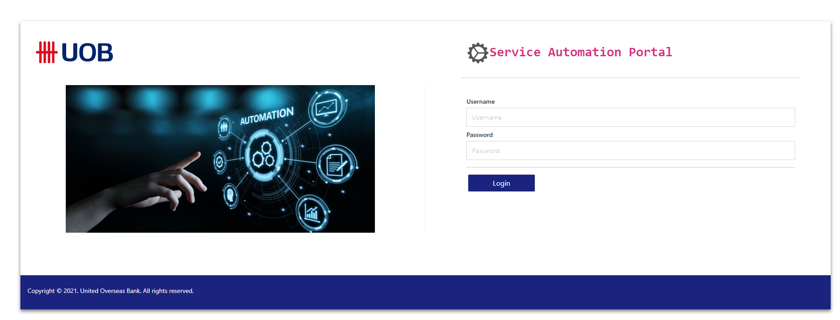
Login
Authenticate with Django using Django Rest Framework Simple JWT

Slide 4
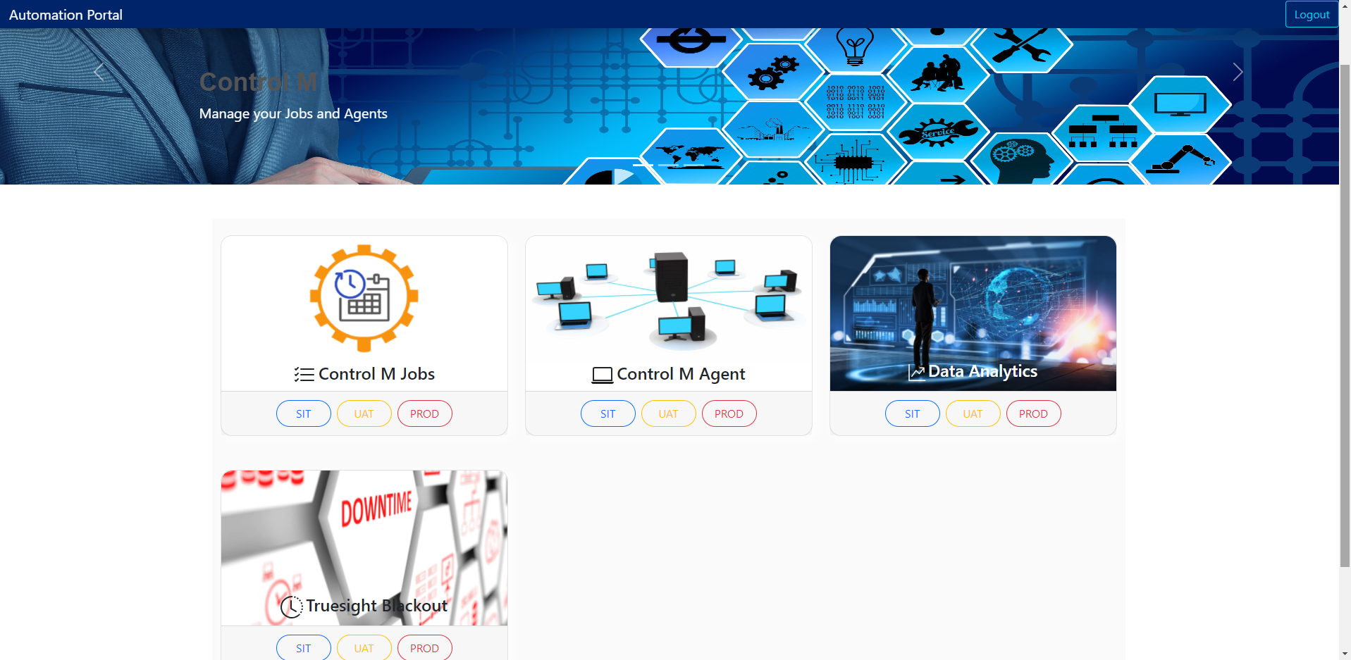
Landing Page

Slide 5
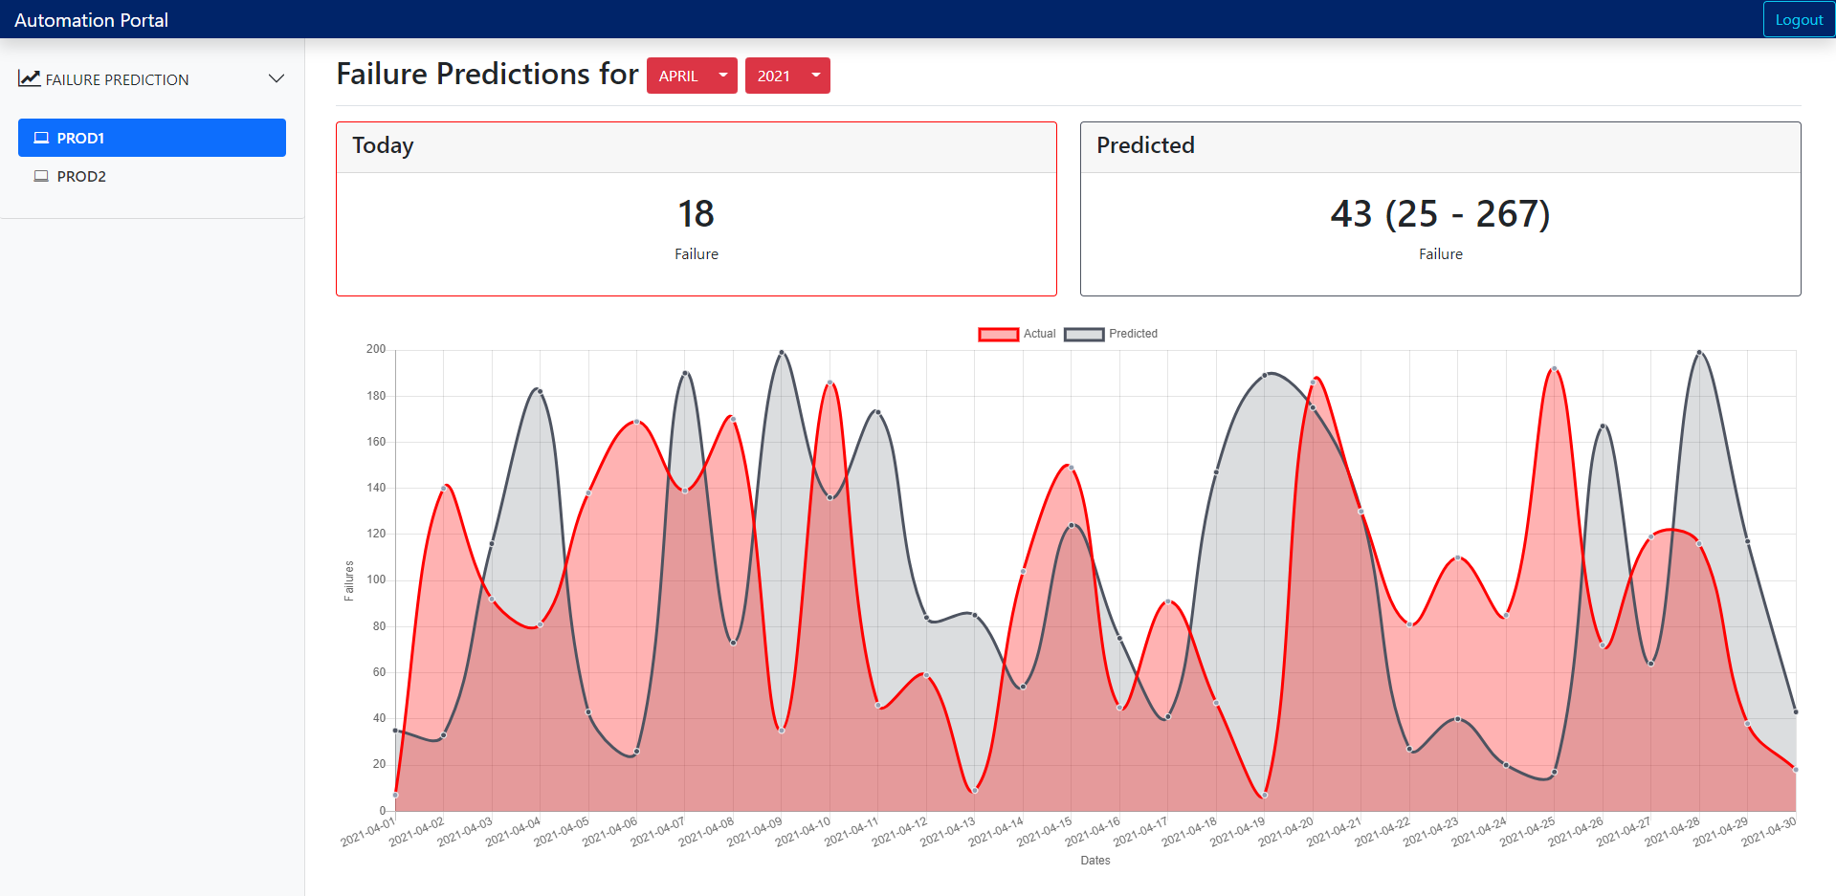
DATA Anayltics Failure Prediction

