Slide 1

Akari puzzle solver
YanLam Ng
Xiaojian Xie

Slide 2
Convert Akari Puzzle into CSP
Puzzle is set as a 2D array
’b’ represents the light bulb and ‘#’ represents the light-up cell
<diagram here>

Slide 3
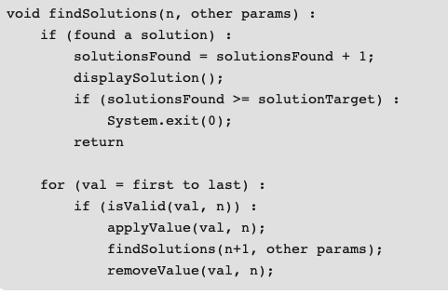
Backtrack
Parameter: puzzle, list of not assigned cells
Domain: insert light bulb or leave blank
Notes:
At the end of recursion, if there is no solution, insert back the cells and do backtrack

Slide 4
Forward checking
0
 |  |  |  |  | 1
 |  |  | 0
 | 4
 |  |  |  | 2
We create is array to show that how likely the cell would be a light bulb.
-1 : not possible to be light bulb
1 : confirm to be light bulb
0 : unknown
Between 0-1 : the probability of the light bulb that is even distributed by
the wall constraint and the
-1 | -1 | -1 | 0 | 0 | 0.5
-1 | -1 | -1 | -1 | 0.5 | -1
-1 | 1 | -1 | -1 | -1 | -1
1 | -1 | 1 | -1 | -1 | -1
-1 | 1 | -1 | -1 | -1 | 1
-1 | -1 | -1 | -1 | 1 | -1

Slide 5
Heuristics
H1-search the cell that is highest probability of a light bulb
H2-search the light bulb that can light the most empty cell
H3- base on H1. If the probability is same, we use H2 to determine which cell is going to be bulb.

Slide 6
Investigation
 | F0 | f1 | f2 | f3 | b0 | b2
6*6 | 9 | 9 | 12 | 9 | 6697 | 1660
8*8 | 19 | 19 | 34 | 19 | timeout | timeout
10*10 | 21 | 21 | 59 | 21 | timeout | timeout
 | F0 | f1 | F2 | f3 | b0 | b2
12 walls | timeout | timeout | timeout | 17 | timeout | Timeout
24 walls | 74 | Timeout | timeout | timeout | timeout | timeout
48 walls | 39 | 39 | timeout | 39 | timeout | timeout

Slide 7
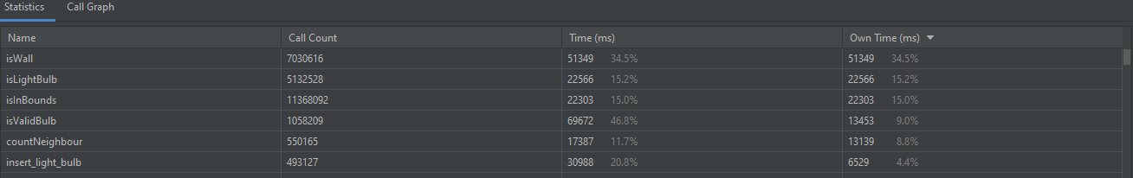
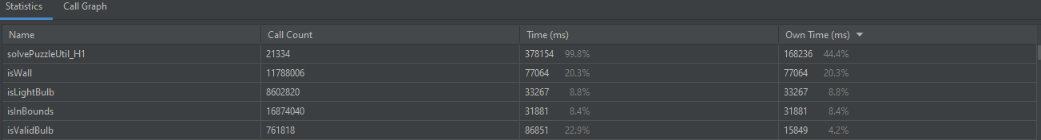
Improvement
backtrack
Forward checking H1

