Slide 1

Machine Learning Using TensorFlow
YanLam Ng
Xiaojian Xie

Slide 3
Part2: Classification: Myo Armband Keyboard
Filtering Data
Normalize data
Split data
Cross Validation

Slide 4
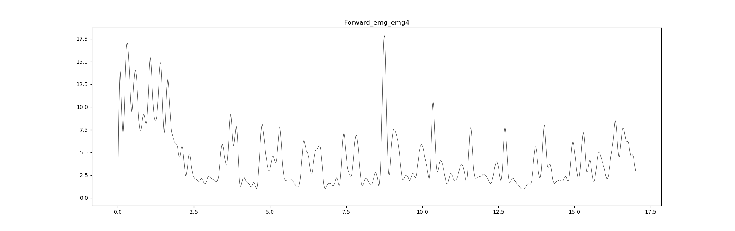
Filtering Data:

Slide 5
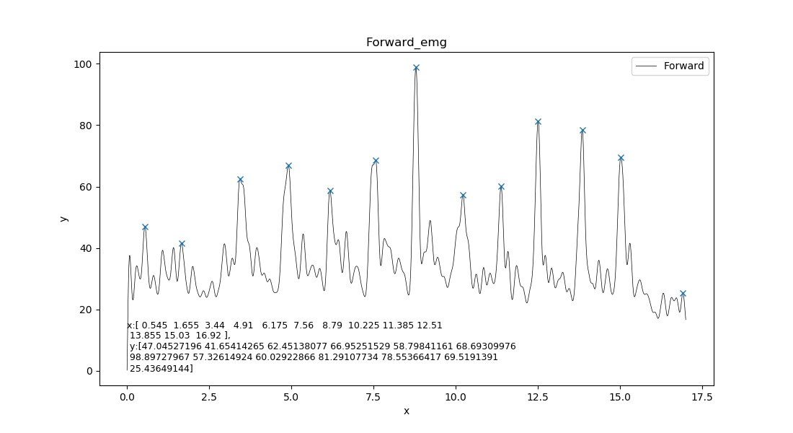
Find the 10 smaples
Normalize Data
Sum all EMG and find the local max
Local max

Slide 6
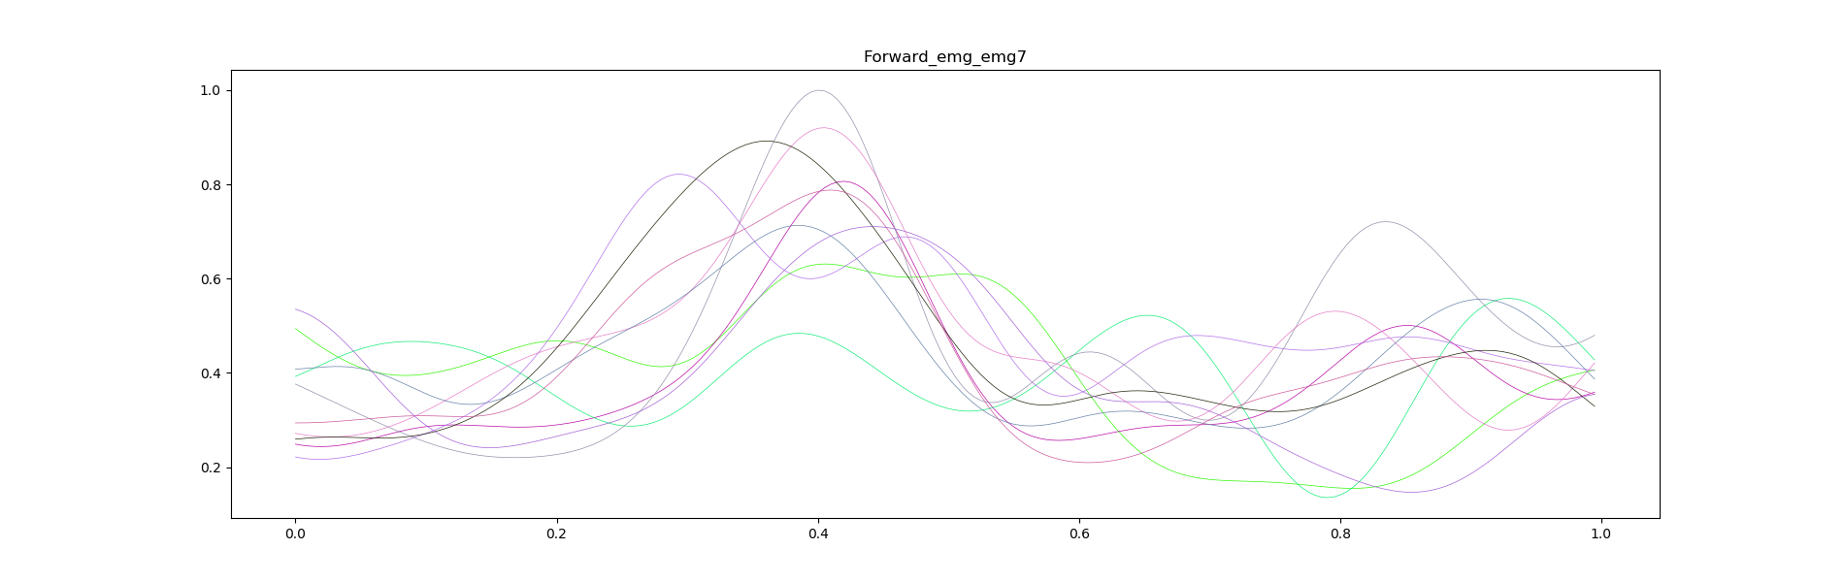
Split data

Slide 7
Build multilayer perceptron
3 hidden lay: 512, 256, 256
Cross Validation with 90% training and 10% testing
Learning rate: 0.002
Training step : 2000

Slide 8
Result
average accuracy:
multi-axis composition:
All Data: 0.96
All accelerometer 0.60
All EMG 0.92
All gyroscope: 0.64
All orientation: 0.54
All orientation Rule: 0.74
single dimension:
emg1: 0.56
emg2: 0.22
emg3: 0.44
emg4: 0.54
emg5: 0.64
emg6: 0.44
emg7: 0.56
emg8: 0.76

