Slide 1
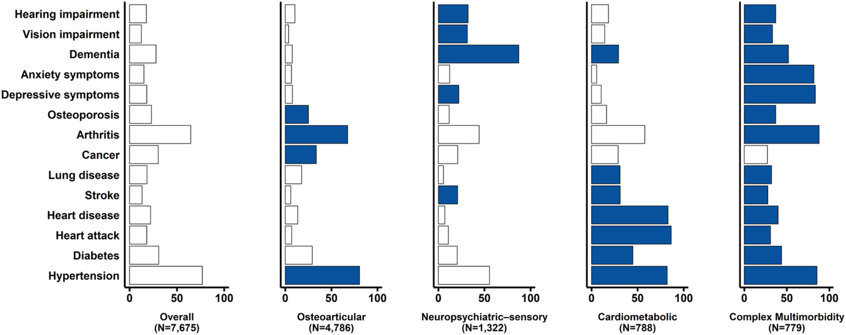
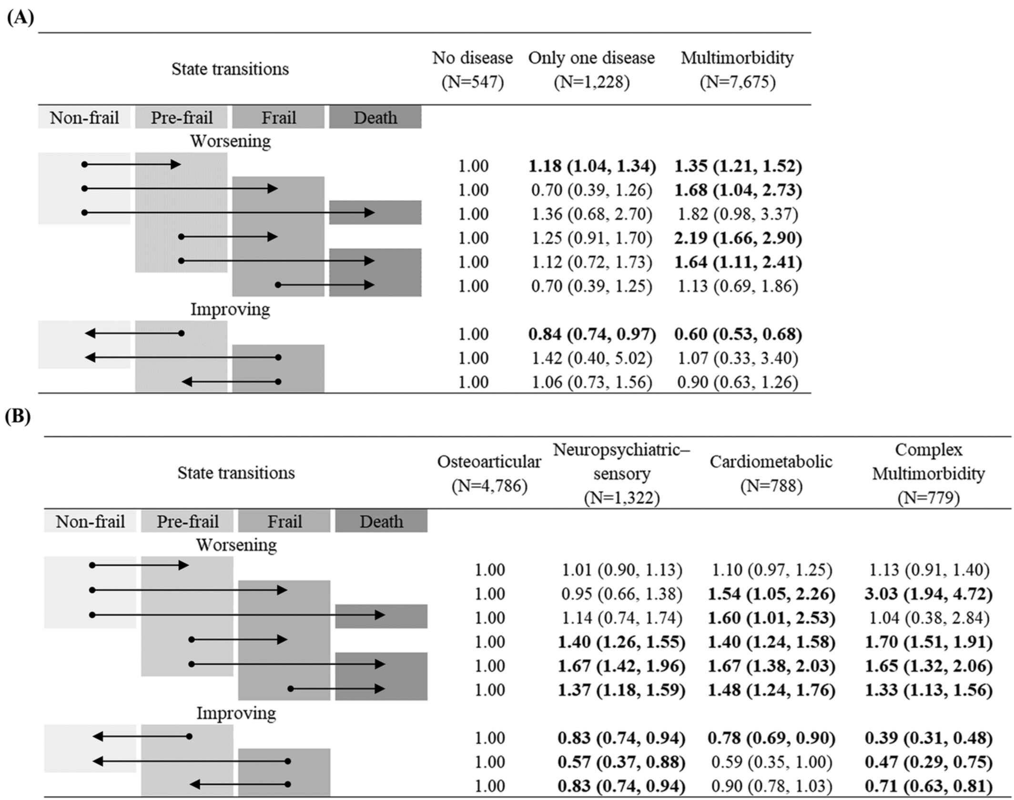
Multimorbidity patterns
Association of condition counts and multimorbidity patterns with frailty transitions

Slide 2
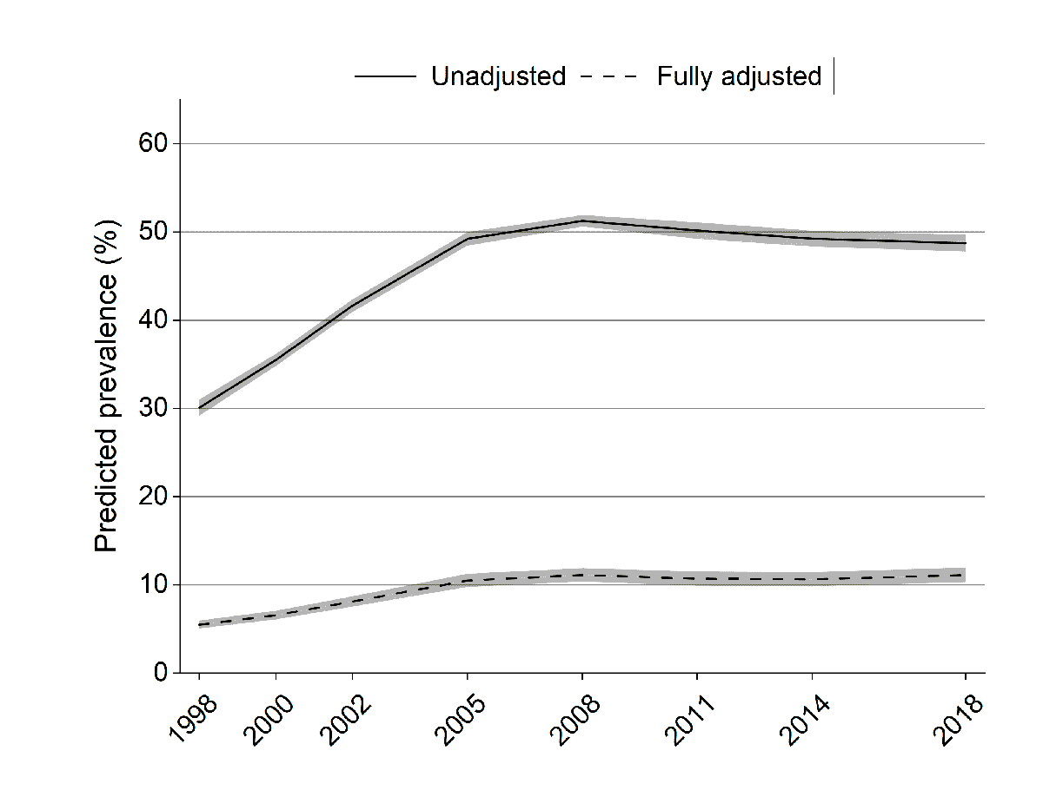
Predicted prevalence of vision impairment

Slide 3
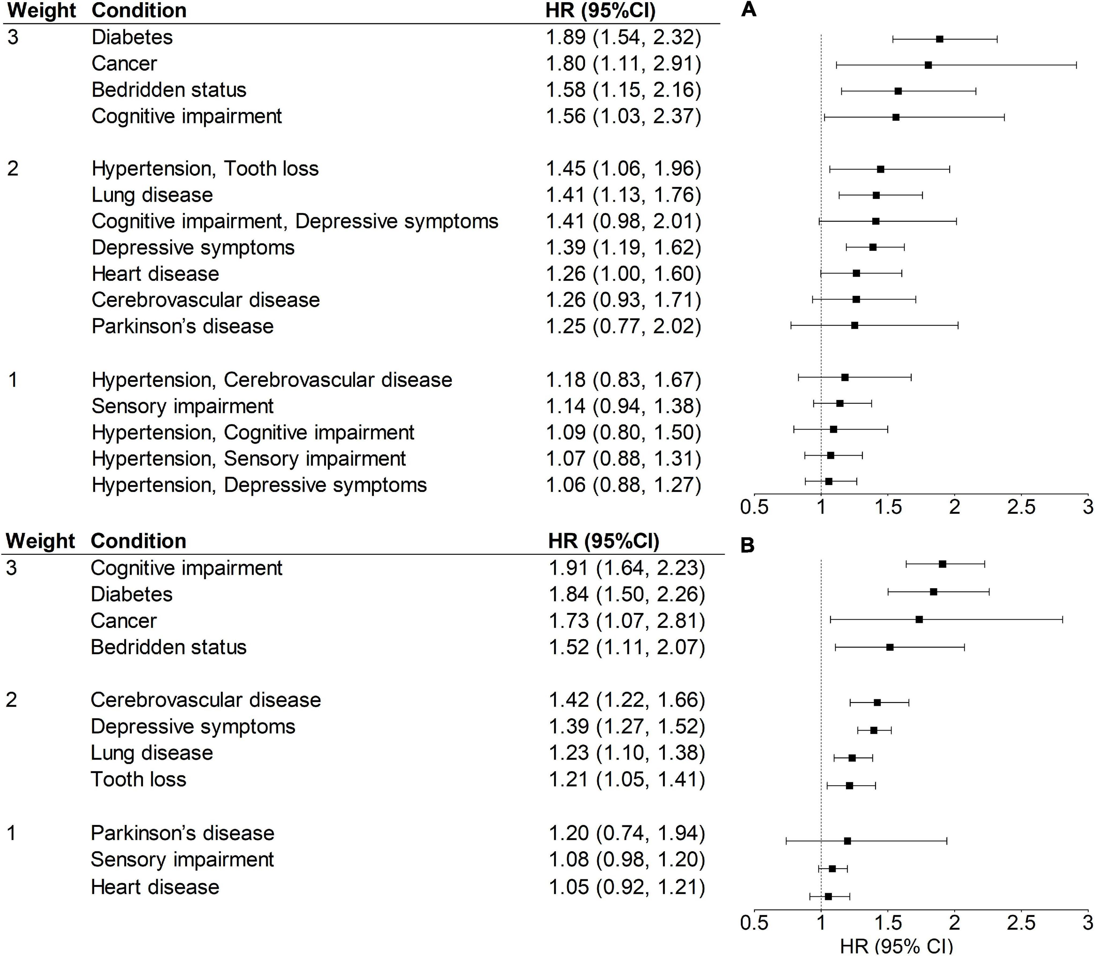
Association of condition or disease combination with 5-year mortality

Slide 4
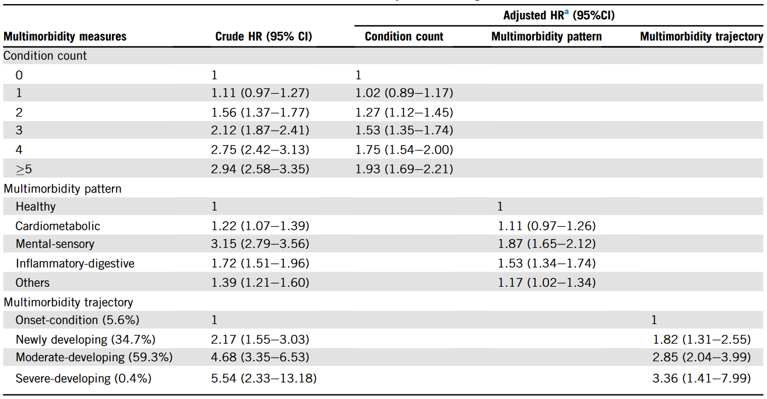
Association between multimorbidity measures and all-cause mortality

Slide 5
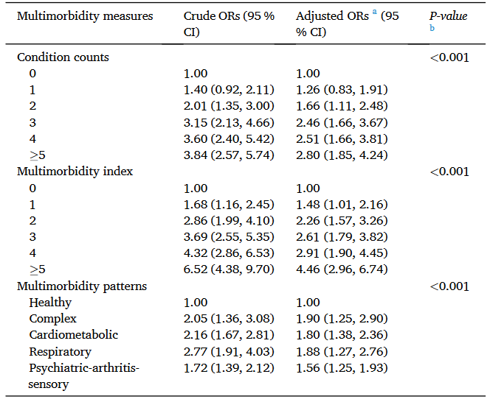
Association between multimorbidity measures and disability trajectories

Slide 6
Association of condition or disease combination with 5-year mortality
Association between multimorbidity measures and disability trajectories
Association between multimorbidity measures and all-cause mortality

Slide 7
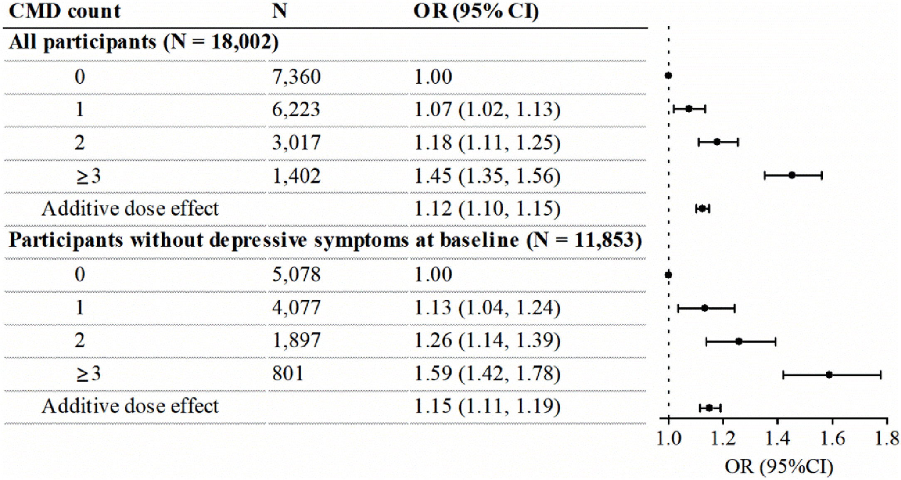
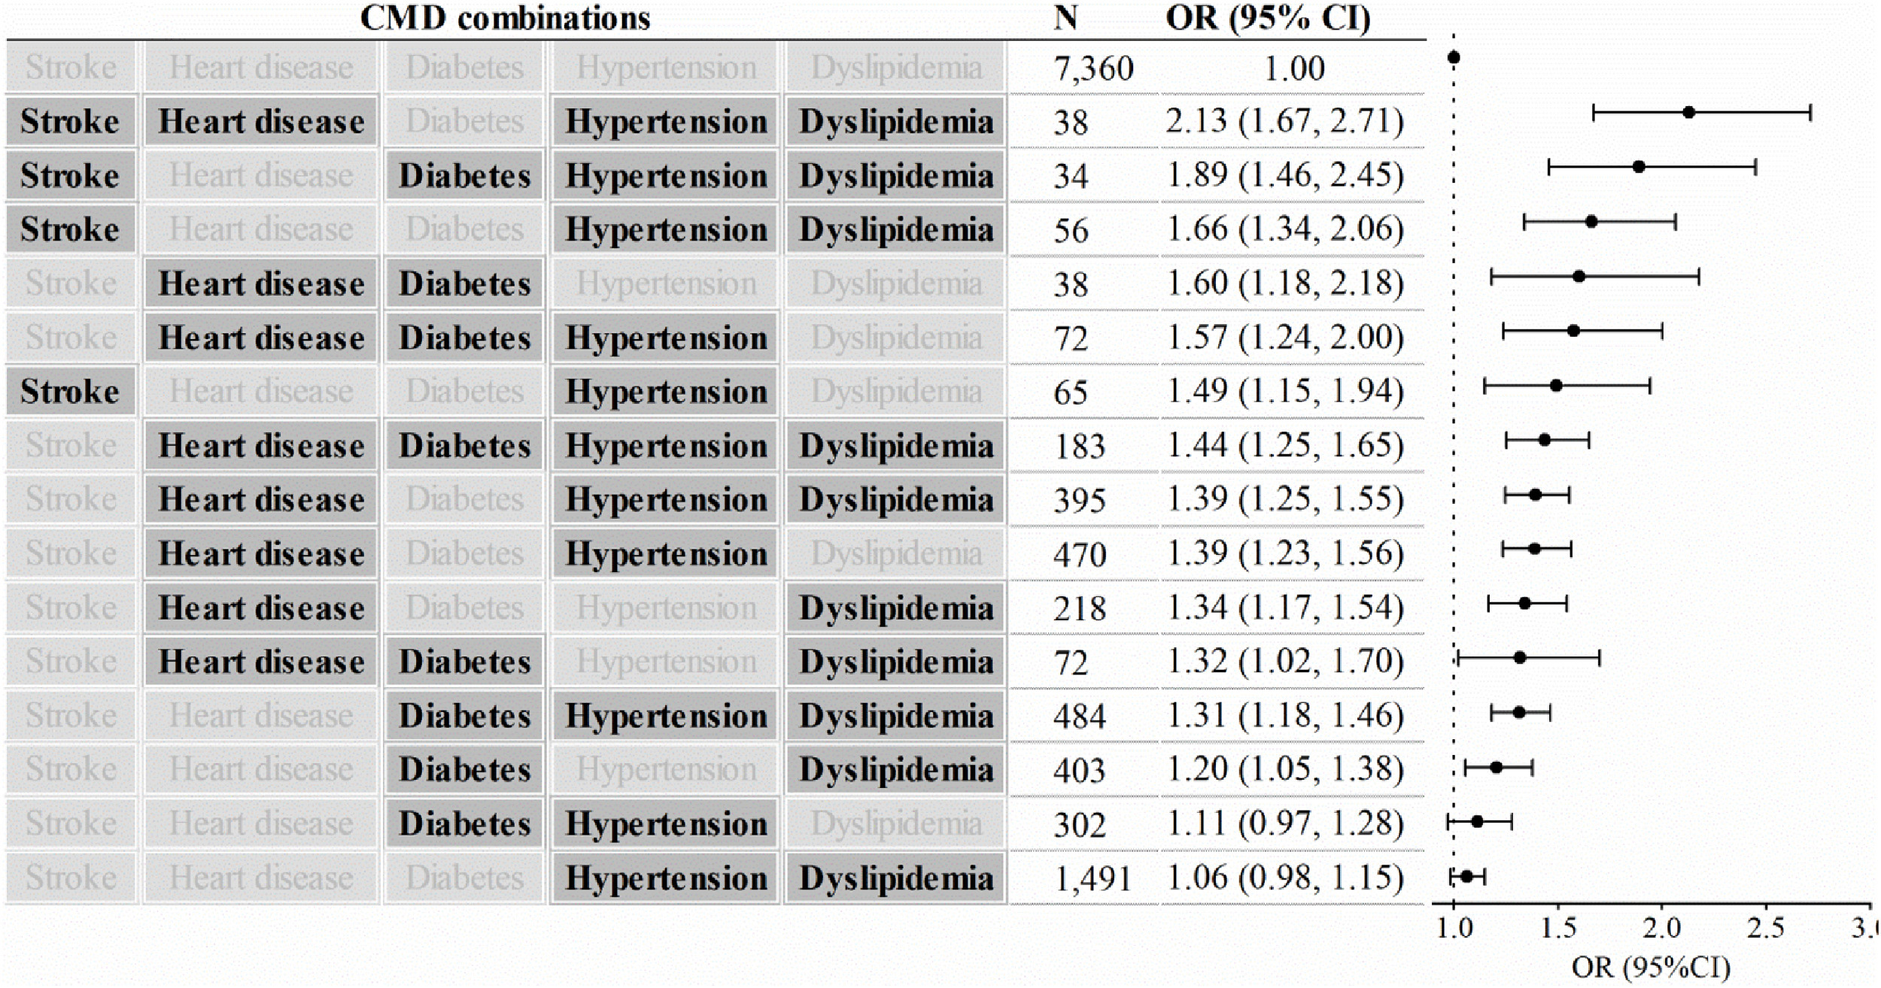
Associations between cardiometabolic disease count and depressive symptoms
Associations between cardiometabolic disease combinations and depressive symptoms

Slide 8



Slide 9


