Slide 1
Welcome to Shopplet

Slide 2


Hello!
INSERT
IMAGE
HERE
I am Yan Nazzim Gonzalez
I am here because I want to empower your buying and selling experience!.

Slide 3

Shopplet
Empowerin Users one purchase at a time!

Slide 4
Big concept
Empowering users through effortless appointments, seamless transactions, and customization

Slide 5
Mobile App Purpose
Shopplet revolutionizes user convenience by streamlining the buying and selling process. Our app's intuitive interface enables swift addition of items to the marketplace in just four clicks, ensuring efficiency without compromising quality. Moreover, booking appointments is just as rapid, allowing users to schedule engagements with the same level of speed and ease. With Shopplet, simplicity and speed are at the core of our mission, empowering users to transact and organize appointments seamlessly.

Slide 6
Mobile App Goal
Shopplet addresses the time-consuming process of online marketplace management and appointment scheduling by providing a streamlined, four-click solution for adding items and swift booking capabilities, saving users valuable time and effort.

Slide 7

Shopplet targets small business owners, fostering a community-driven approach to streamline online operations and appointment scheduling, ensuring minimal effort on the business end for enhanced success in today's economy.

Slide 8
Mobile App Features
Image Thumbnails
A large percentage of users like to shop with their eyes, and we intend to embrace that.
A Dynamic grid that grows as needed allows for the user to view many items at once then select one for more info
Dark Mode
One of many customization features which will help embrace our “Empower the User” message
Order/Appointment History Tracking
With this info the user can have a better understanding of their spending
But we also get analytics on how well items/services sell so our business owners can have a better understanding of their customer base

Slide 9
Competition Mapping
Ebay
A leading online marketplace for buying and selling a wide range of products globally.
Square Appointments
An app that simplifies appointment scheduling and management for businesses of all sizes.
OfferUp
A platform enabling local buying and selling of various items in a user-friendly interface.
Calendly
Streamlines scheduling by allowing easy appointment bookings and calendar integration.
Etsy
Focuses on handmade or vintage items, offering a marketplace for artisans and crafters.

Slide 10
Risks/Weaknesses
Intense Competition: Established marketplaces like eBay and Etsy pose a challenge to Shopplet's market entry and growth.
User Acquisition: Attracting and retaining a substantial user base from scratch might be a hurdle, requiring focused marketing efforts for Shopplet.
Security Concerns: Ensuring robust security measures for transactions and appointments is crucial for Shopplet to establish and maintain user trust.
Technical Glitches: Potential software bugs or technical issues could disrupt Shopplet's seamless functioning, impacting user experience.
Scalability: Shopplet needs to adapt to increased demand and expand its capabilities without compromising efficiency.
Monetization Strategy: Establishing a sustainable revenue model for Shopplet without burdening users requires careful planning and innovation.

Slide 11
Development process
Wireframing / Mock Up
Activity / UI Development
Coding Stage / App Functionality

Slide 12
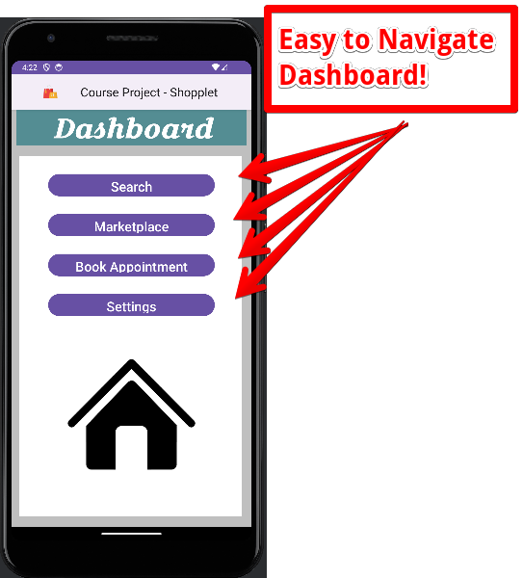
Android project

Slide 13
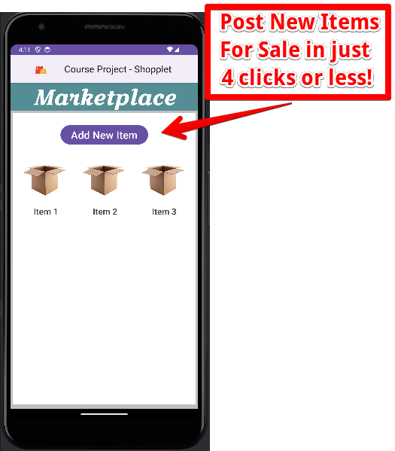
Android project

Slide 14
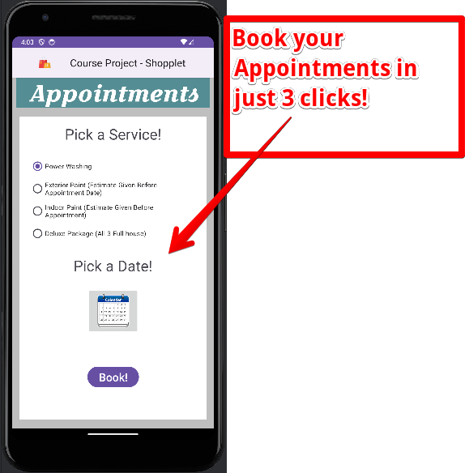
Android project

Slide 15
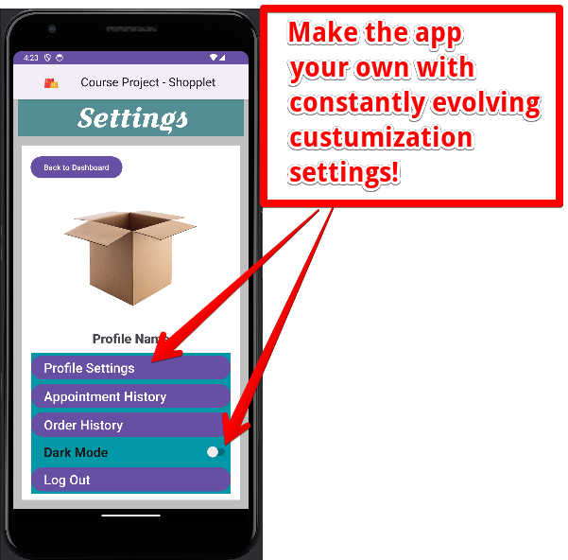
Android project

Slide 16
Thanks!
Any questions ?
You can find me at
Ygonz42@gmail.com yangon1530@students.ecpi.edu

