Slide 1

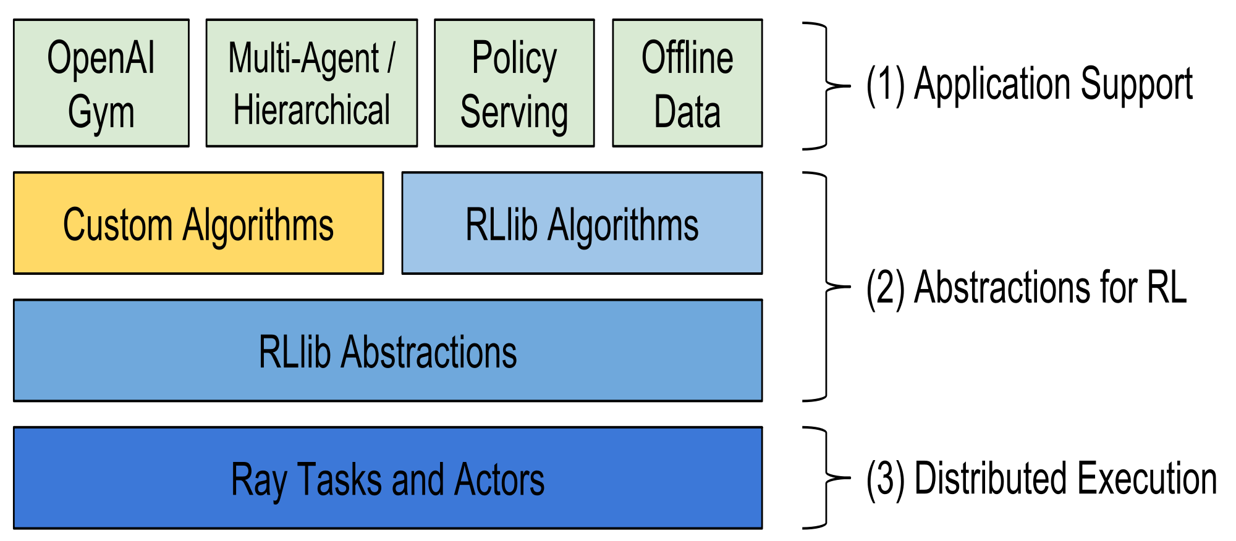
Report List for 20210720
1. Performance of DDPG with different reward functions based on RLlib
2. Hyperparameter optimization based on Ray.tune for machine learning
3. Preliminary results and Progress of programming Ray.tune

Slide 2
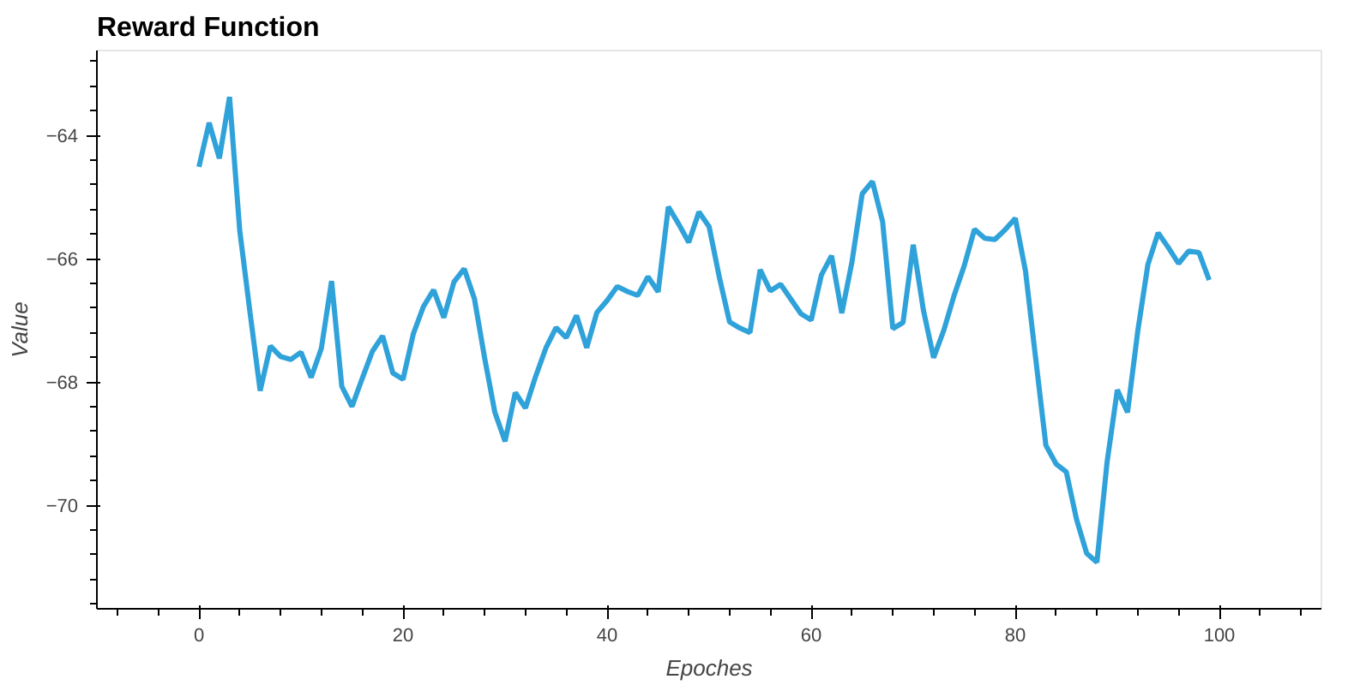
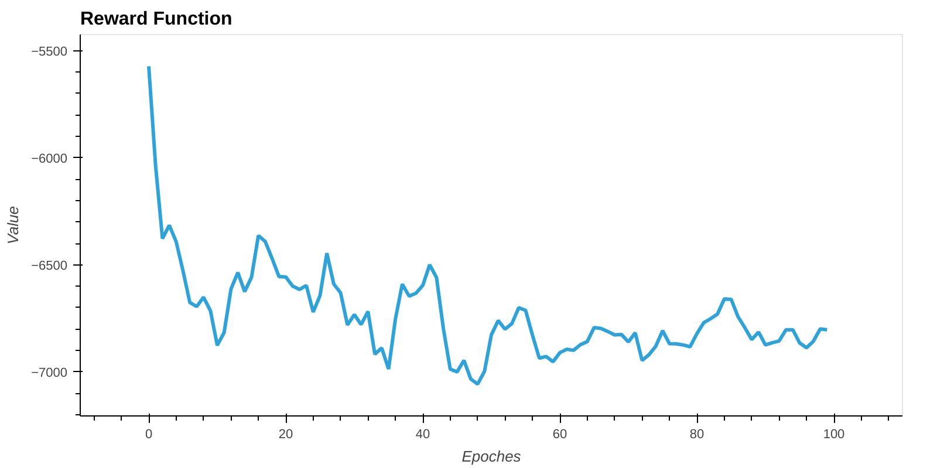
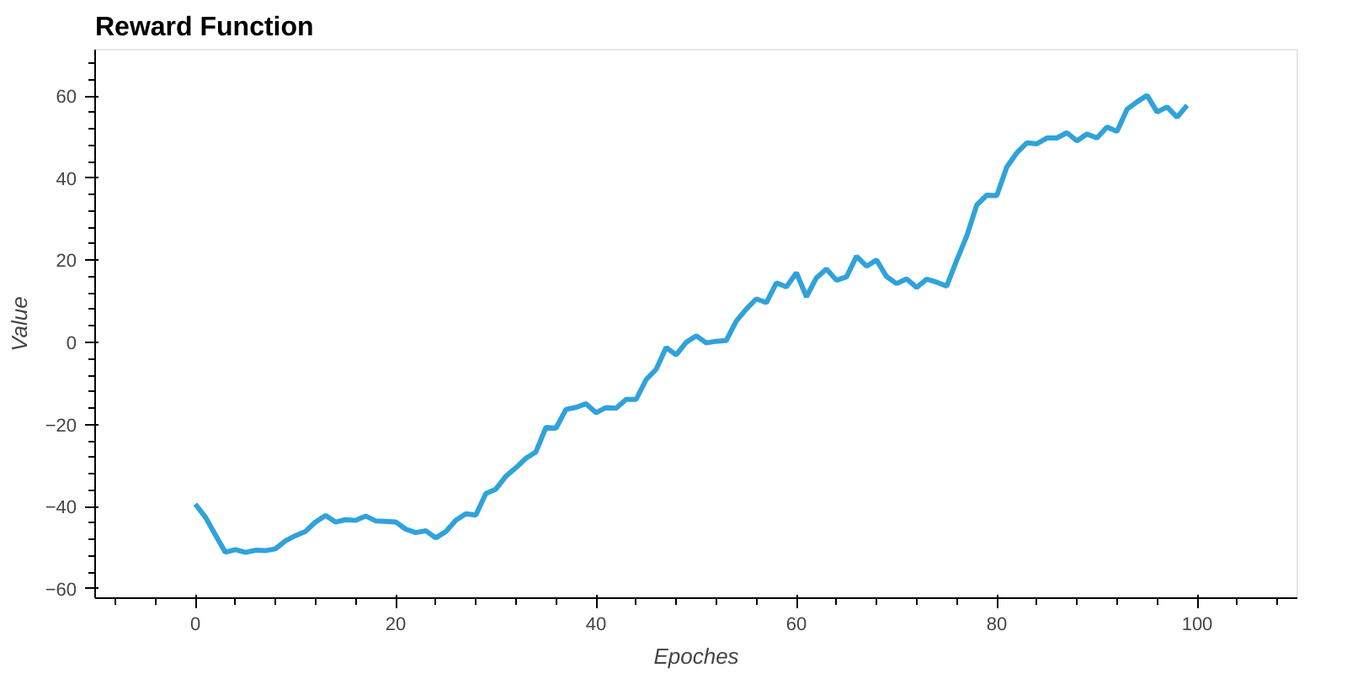
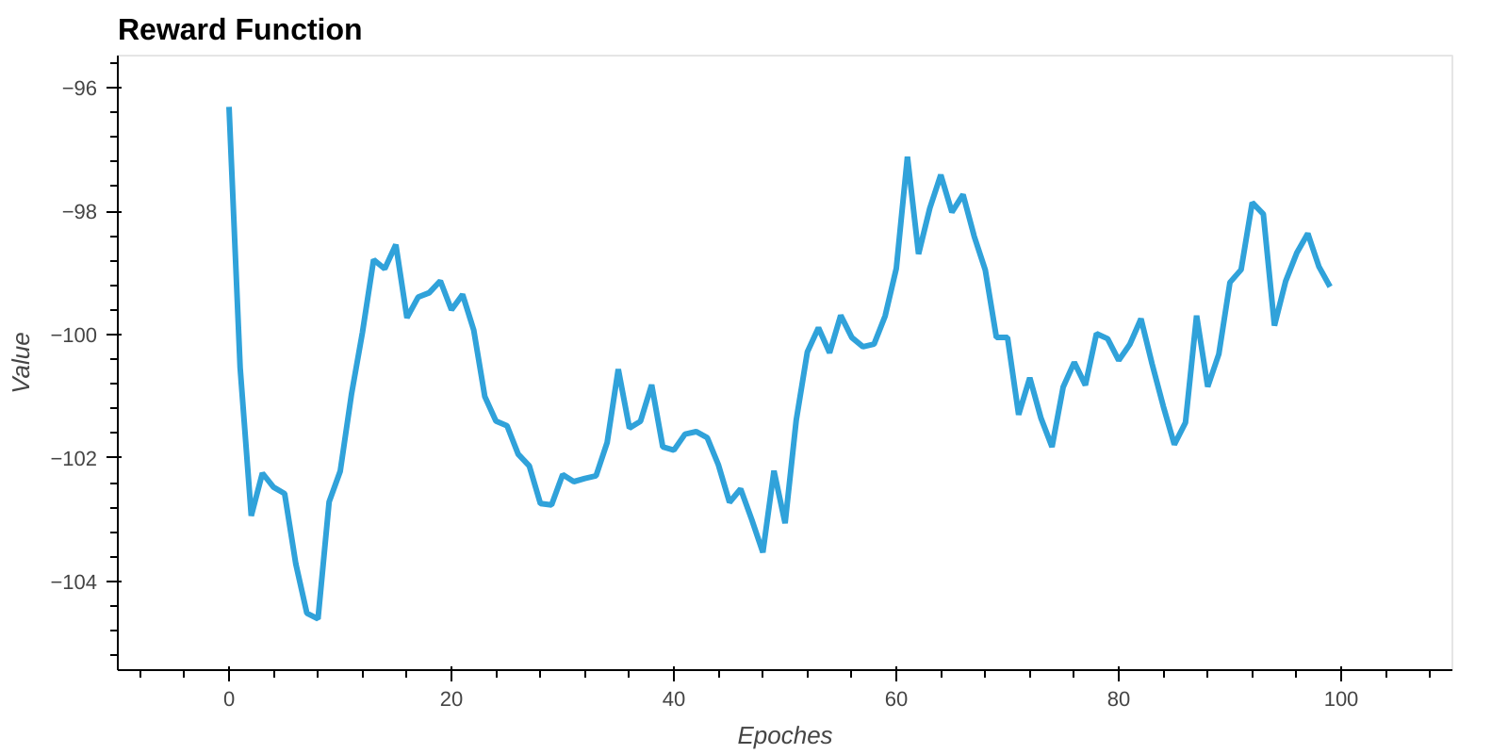
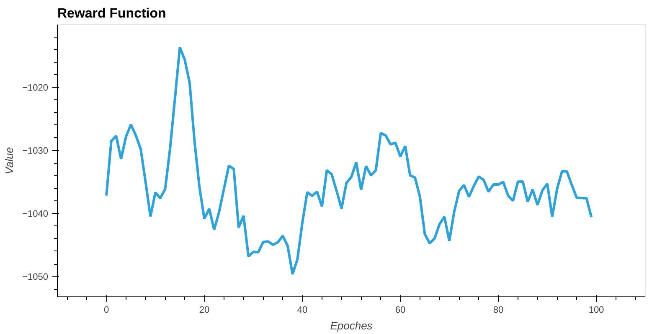
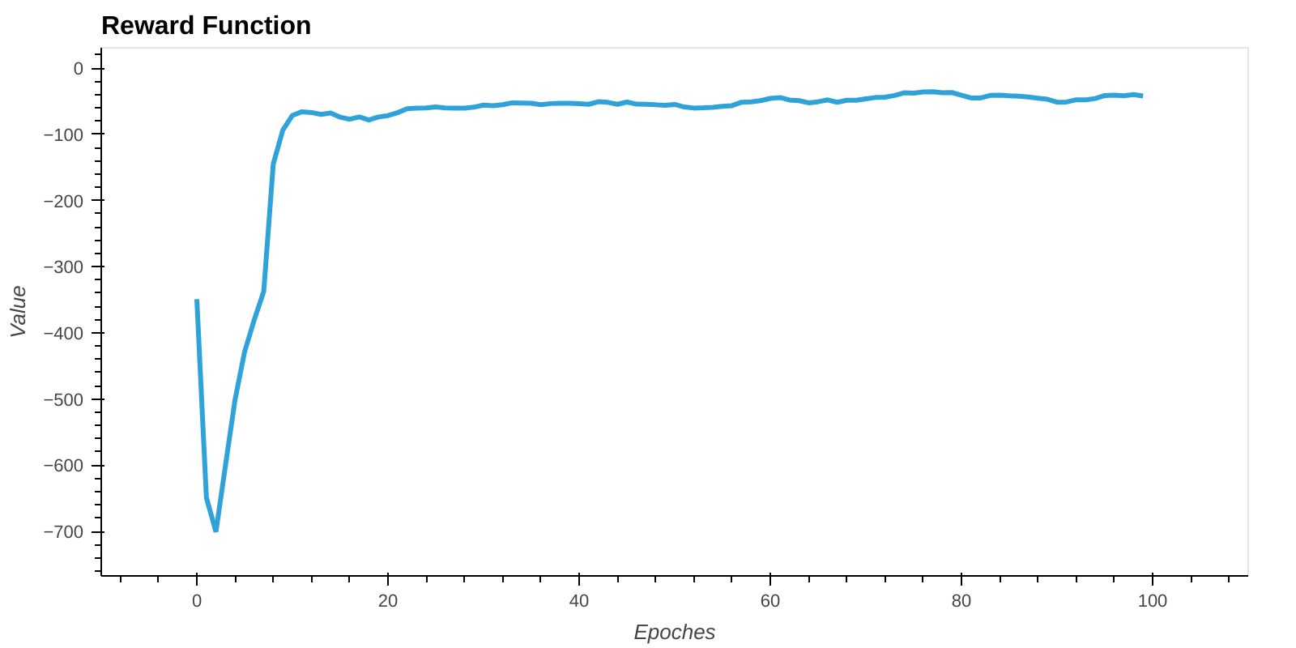
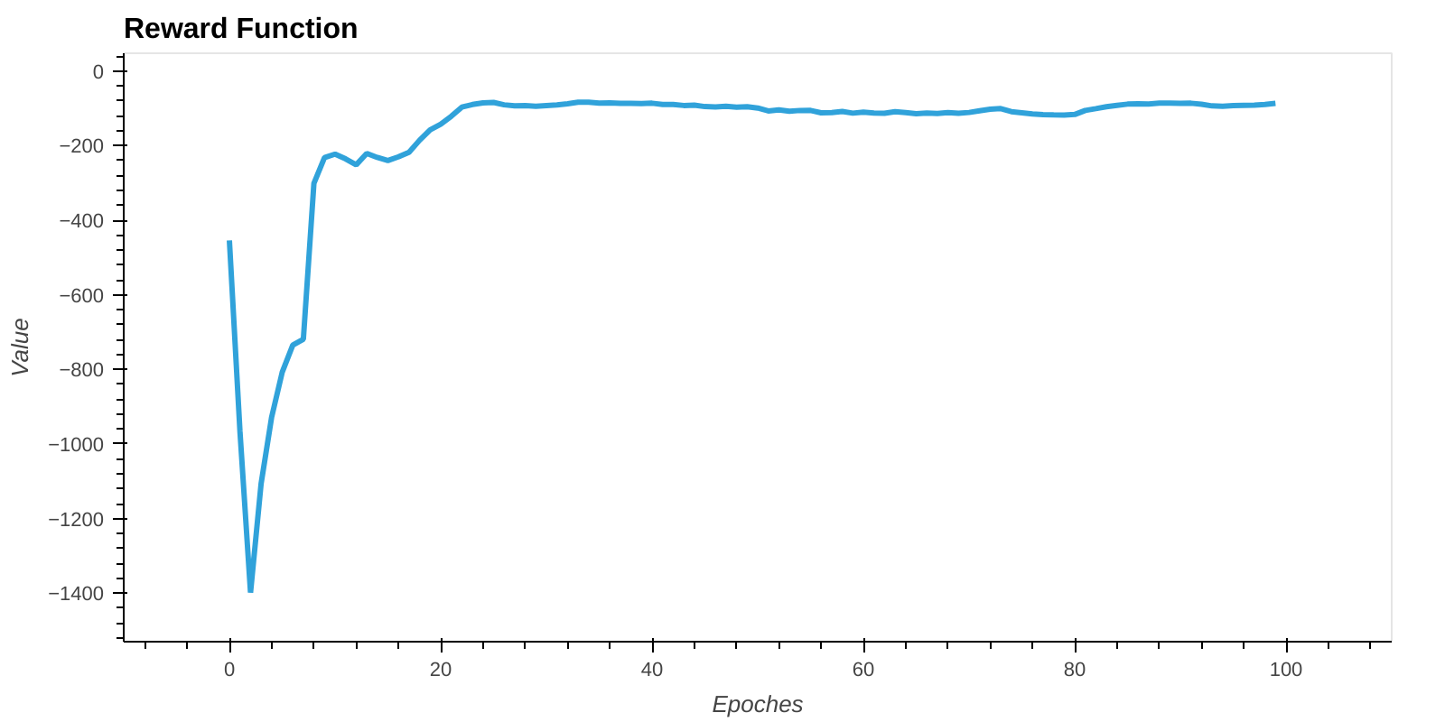
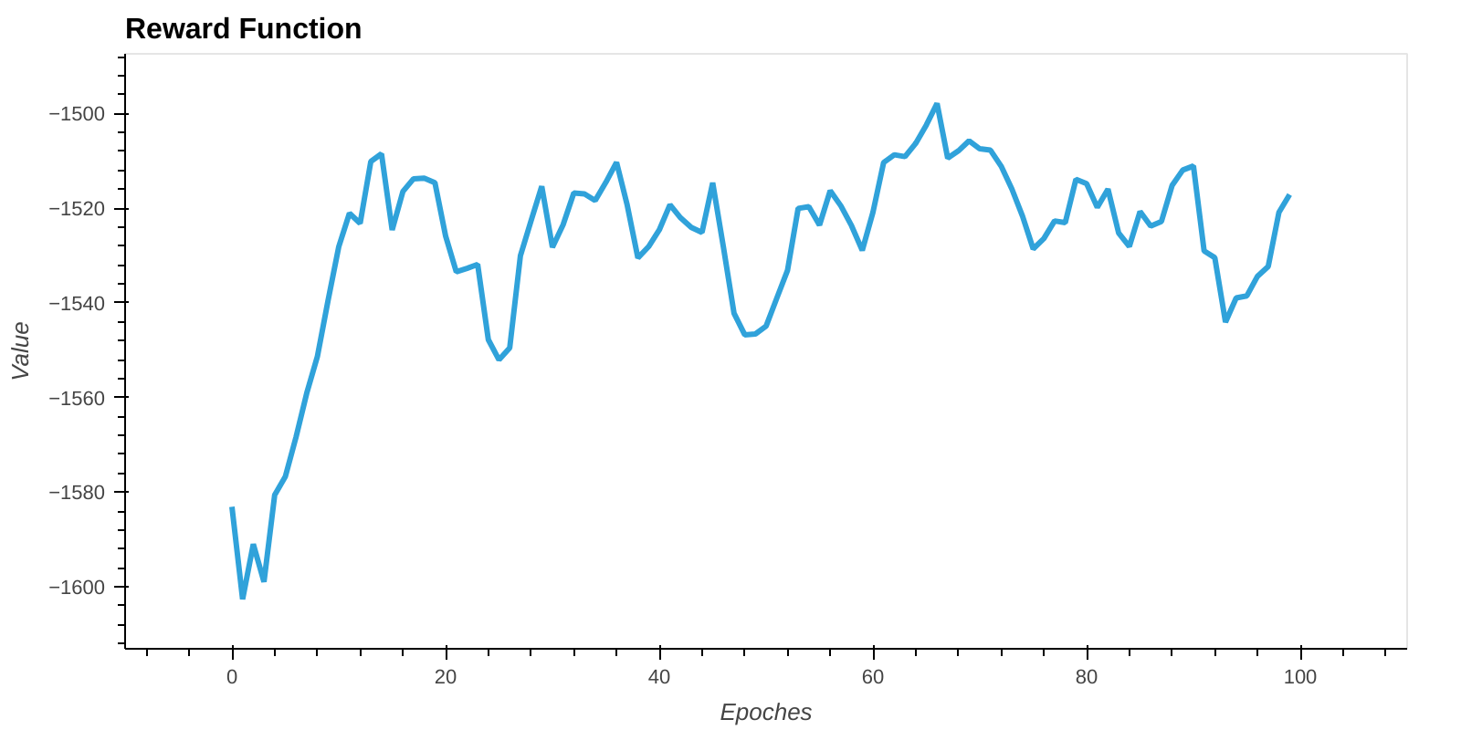
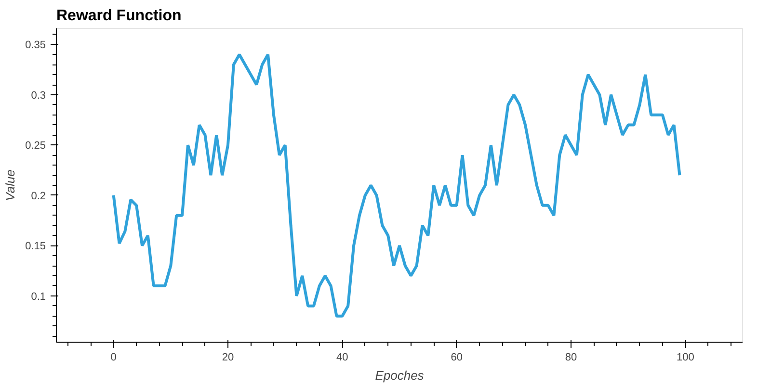
Performance of DDPG with different reward functions based on RLlib
Quadratic
Quadratic reward with bonus
Quadratic with ending penalty
Absolute
Quadratic with penalty
Normalized reward with bonus
Sparse reward
Normalized
Quadratic reward with exponential term

Slide 3
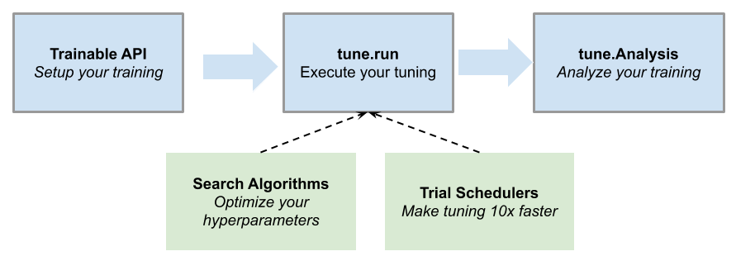
Hyperparameter optimization based on Ray.tune for machine learning
Hyperparameter tuning can make the difference between an average model and a highly accurate one. Often simple things like choosing a different learning rate or changing a network layer size can have a dramatic impact on your model performance.
tune-workflow
Ray Tune is an industry standard tool for distributed hyperparameter tuning. Ray Tune includes the latest hyperparameter search algorithms, integrates with TensorBoard and other analysis libraries, and natively supports distributed training through Ray’s distributed machine learning engine.

Slide 4
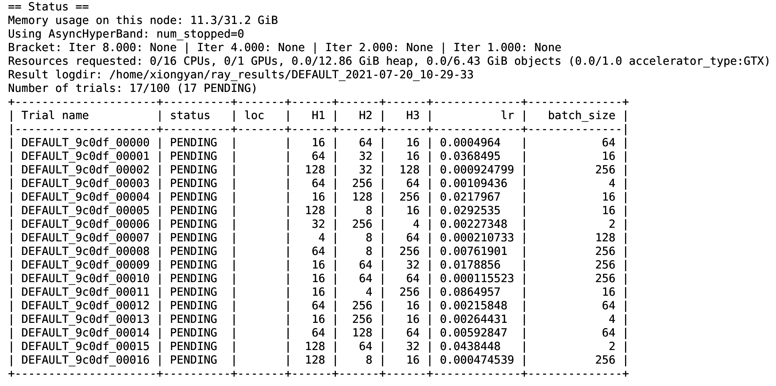
Preliminary results and Progress of programming Ray.tune
Search Algorithms
tune.run and Trials
Search spaces
Trial Schedulers
Trainables
Analysis

Slide 5
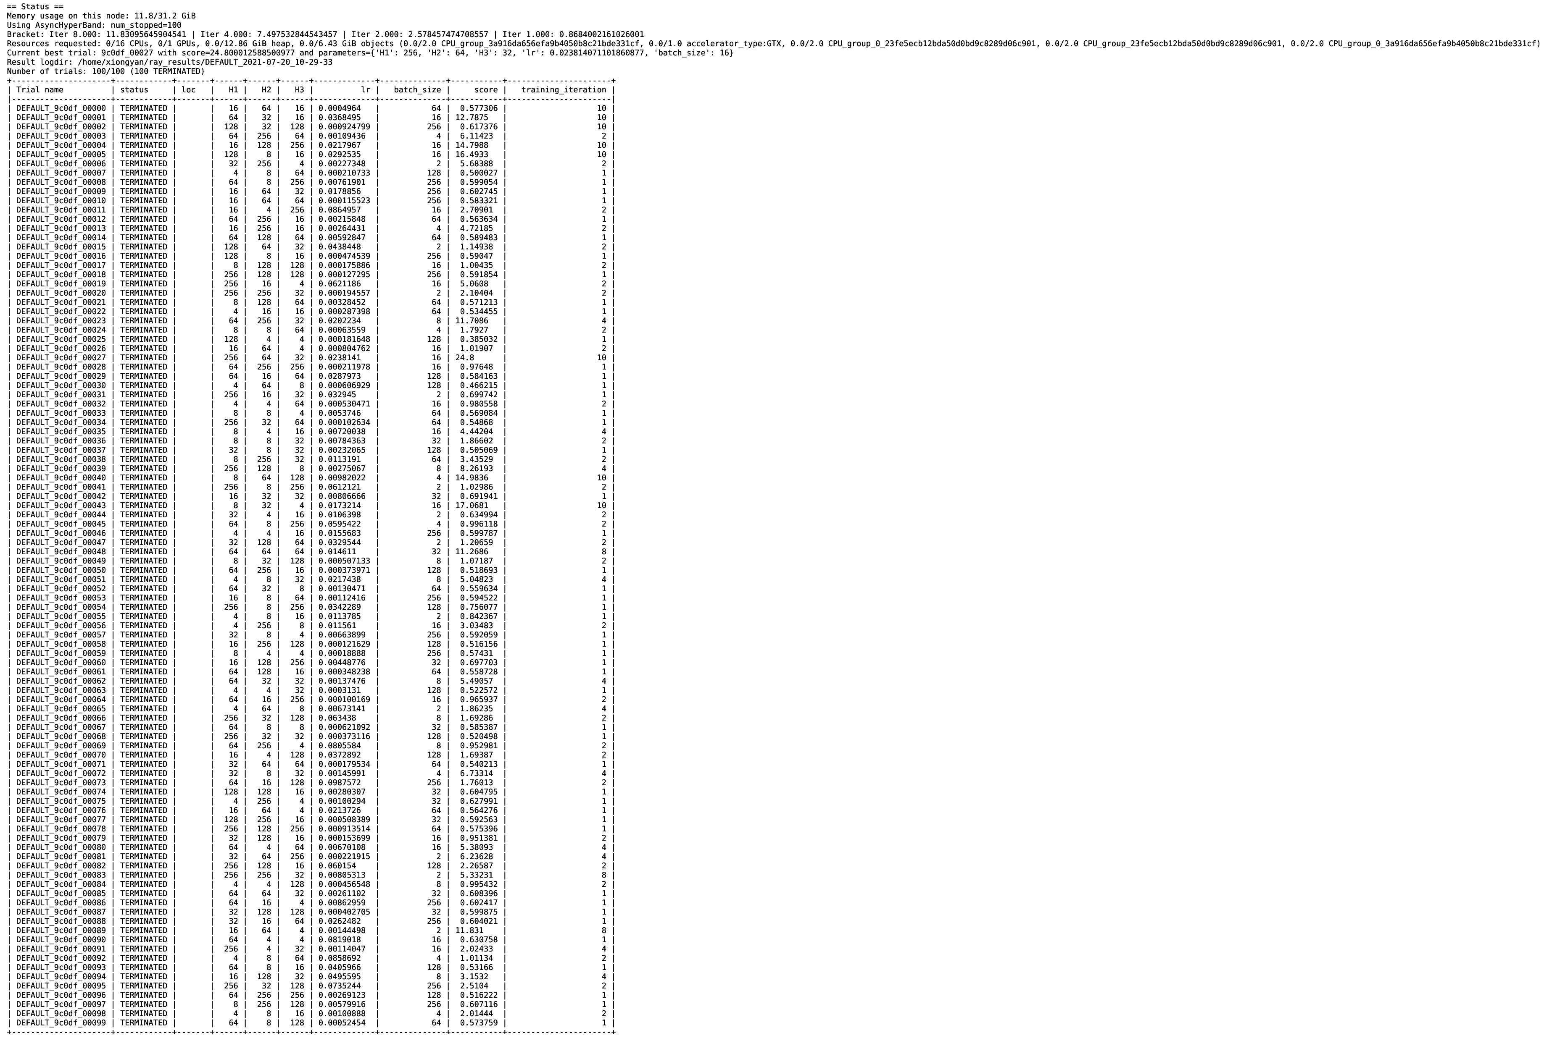
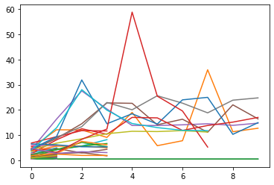
Terminating bad hyperparameter evaluations
Best Trials

