Slide 1

Statistic Method
for
Alexander Wald
Xuechun Li
Yiyuan Ma
Yan Zhao
Bikeshare Analysis

Slide 2

1
Introduction
CON-TENTS
2
Regression
3
Classification
4
Results

Slide 3
1
Intro

Slide 4
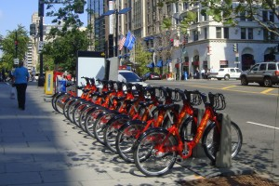
What is Bikeshare?
Systems that provide bikes for people to ride in cities
How it works
Take a bike from a dock
Ride for a short time
Return the bike to a different dock
Types of Users
Casual - user pays for each use
Registered - user registers for a year long subscription
Capital Bikeshare Dock

Slide 5
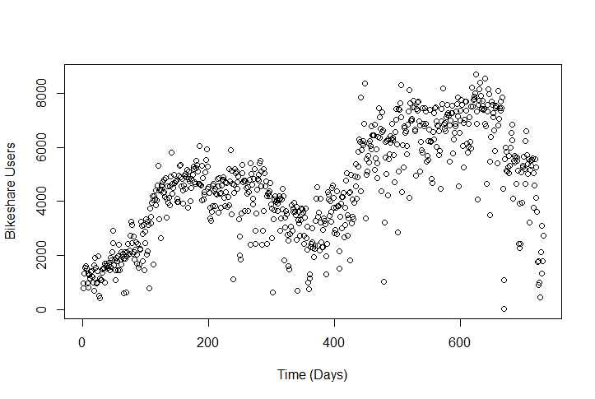
Bikeshare Dataset
Capital Bikeshare System in Washington D.C.
Collected from 2011 to 2012
One record per day
Variables
Season + Year + Month + Weekday
Holiday + Workingday
Weather
Type
Temperature + Humidity + Wind Speed (Normalized)
Users in a day (response):
Total, Registered, Casual
Total Bikeshare Users each Day over Two Years

Slide 6


DATA Preprocessing
Raw Data Set
Categorical Variables
Split Season, Weather Type, Month and Weekday.
Split into test and training sets
Example:
Season
Spring | 1
Summer | 2
Fall | 3
Winter | 4
Season | Spring | Summer | Fall | Winter
Spring | 1 | 0 | 0 | 0
Summer | 0 | 1 | 0 | 0
Fall | 0 | 0 | 1 | 0
Winter | 0 | 0 | 0 | 1
Falsely implies that
Spring is far from Winter

Slide 7
IMPORTANT QUESTIONS
CLASSIFICATION OF SHOPPING DATA
Questions
How to use weather related terms and date related terms to predict the total number of users?
What can we find by analyzing the number of registered users and casual users separately?
How we will attempt to answer them?
Regression model (Linear regression, regression tree & random forest)
Classification (LDA, QDA, KNN, logistic, classification tree & bagging)
Cross validation

Slide 8
2
Regression

Slide 9
LINEAR REGRESSION
How can we predict the number of bikeshare users with only time predictors?
Weather is unknown
Time Predictors
4 binary Season predictors
12 binary Month predictors
7 binary Weekday predictors
Holiday + Workday
Test Predictions
Training Predictions
Results from 20 Training-Test Sets
Error | Train | Test
Mean | 2.17 million | 2.24 million
Std Dev | 0.07 million | 0.22 million

Slide 10
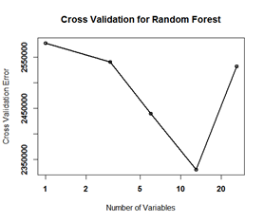
REGRESSION RANDOM FOREST
How can we predict the number of bikeshare users with only time predictors?
Predictors
4 binary Season predictors
12 binary Month predictors
7 binary Weekday predictors
Holiday + Weekday + Workday
Best Variables number = 13
Results from 20 Training-Test Sets
 | Train | Test
Error | 2.04 million | 1.96 million

Slide 11
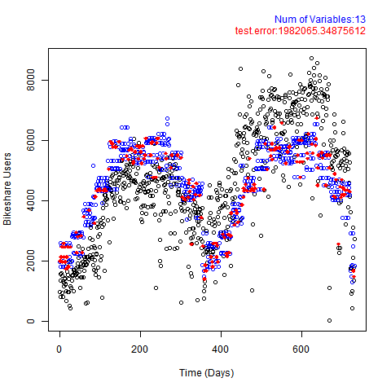
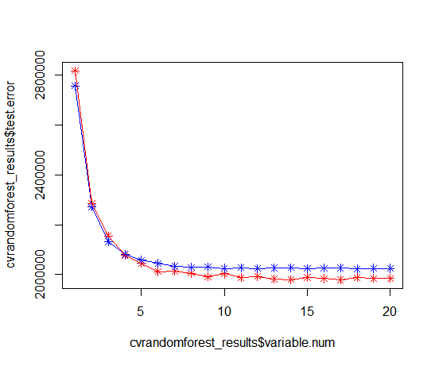
RANDOM FOREST PREDICTION
Test Predictions
Training Predictions
Testing Error
Training Error

Slide 12
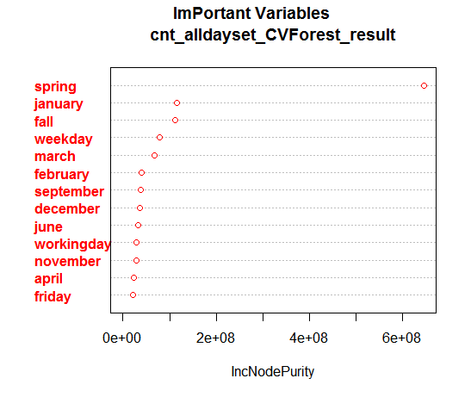
RANDOM FOREST RESULT

Slide 13
LINEAR REGRESSION
How can we predict the number of bikeshare users using time and weather?
Weather is unknown
Predictors
4 binary Season predictors
12 binary Month predictors
7 binary Weekday predictors
Holiday + Workday
Weather
Test Predictions
Training Predictions
Results from 20 Training-Test Sets
Error | Train | Test
Mean | 1.54 million | 1.66 million
Std Dev | 39000 | 143142

Slide 14
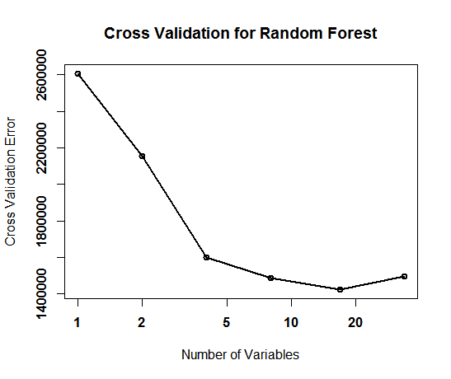

RANDOM FOREST
How can we predict the number of bikeshare users using time and weather?
Weather is unknown
Predictors
4 binary Season predictors
12 binary Month predictors
7 binary Weekday predictors
Holiday + Workday
Weather
Best variable number: 17
Results from 20 Training-Test Sets
 | Train | Test
Error | 0.30 million | 0.29 million

Slide 15
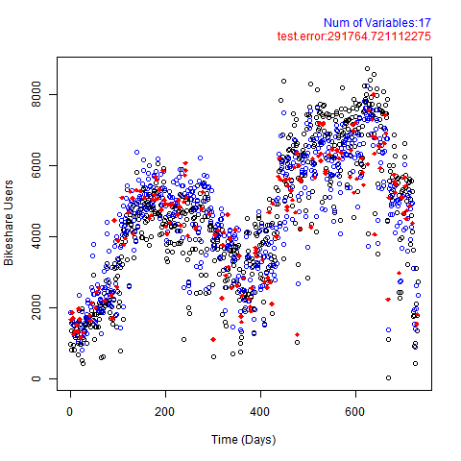
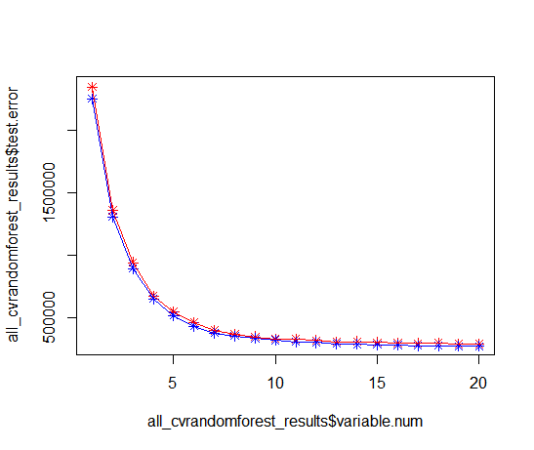
RANDOM FOREST PREDICTION
Test Predictions
Training Predictions
Testing Error
Training Error

Slide 16
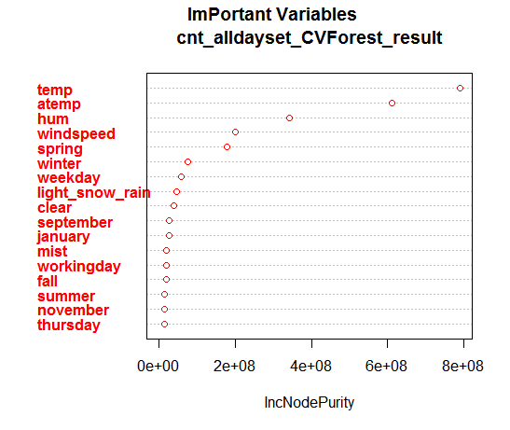
RANDOM FOREST RESULT

Slide 17
LINEAR REGRESSION—Best Subset
How can we predict the number of bikeshare users using time and weather?
Best Subset of 8 Predictors (BIC)
Time Category
Summer + Winter + September
Weekday
Weather
Light Snow or Rain
Temperature + Humidity + Wind speed
Test Predictions
Training Predictions
Results from 20 Training-Test Sets
Error | Train | Test
Mean | 1.62 million | 1.60 million
Std Dev | 48993 | 156069

Slide 18
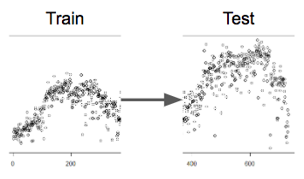
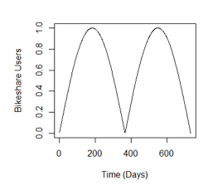
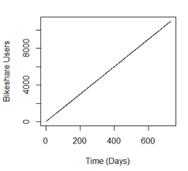
LINEAR REGRESSION
Long Term Predictions
Can we predict the second year from trends of the first year?
Test Predictions
Training Predictions
Yearly Trend
abs(sin(c*time))
Long Term Trend
time
Test Error
(Millions)

Slide 19
METHODS OF REGRESSION
Predicting Future Demand
How many people will use bikeshare 2 years from now? Best Subset of 8
Varying duration of the training set
Predictors
Instant (days elapsed)
abs(sin(instant / 731days))
Weather
Test Predictions
Training Predictions
Results from 20 Training-Test Sets
Error | Train | Test
Mean | 0.39 million | 1.29 million
Std Dev | 25076 | 78713

Slide 20
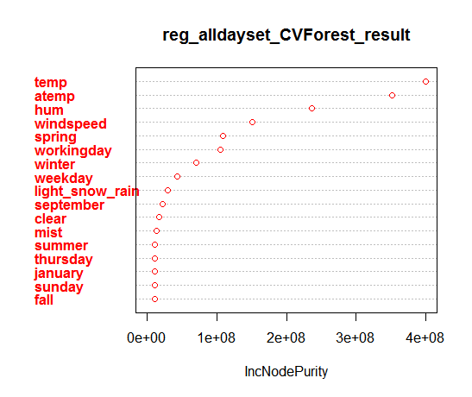
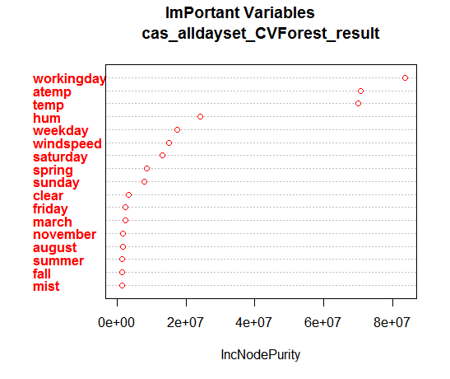
Important Variables

Slide 21
3
Classification

Slide 22
Classification -- LDA, QDA, logistic & KNN
Predict the category of cnt using all of the predictors denoted as cnt01
Cnt01[ cnt >= mean(cnt) ] = 1-- high demand
Cnt01[ cnt < mean(cnt) ] = 0 -- low demand
Best: LDA, QDA & logistic
test error = 0.148
Type I error = 0.131
Type II error = 0.161
Confusion Matrix
0 1 (prediction) 0 73 11 1 16 83
(actual)

Slide 23

Classification — LDA, QDA, logistic & KNN
How can we improve the classification?
Firstly, is that the cnt01 binary variable reasonable?

Slide 24
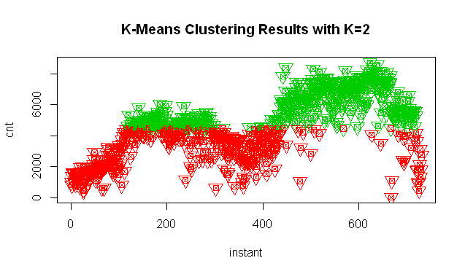
K-Means Clustering with cnt
-- original
-- k-means

Slide 25
Classification — binary to cluster
Predict the demand of cnt using all of the predictors with k-means clustering and keep other variables the same
Cluster 1 -- high demand
Cluster 2 -- low demand
Best: LDA, QDA & logistic
test error = 0.137 (smaller than the previous 0.148)
Type I error = 0.123
Type II error = 0.147
Better !!
Confusion Matrix
0 1 (prediction) 0 71 10 1 15 87
(actual)

Slide 26
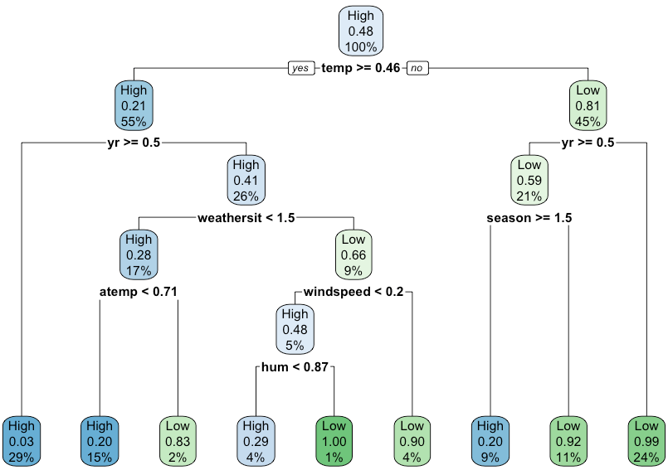
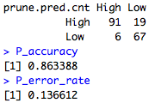
Classification Tree — Pruned（y =cnt）

Slide 27
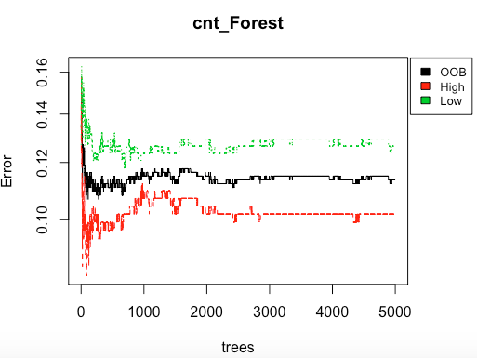
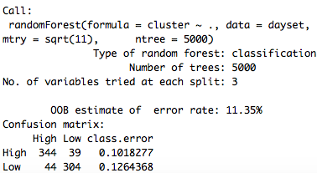
Classification— Random Forest (y =cnt)

Slide 28
Classification — binary to cluster
Predict the demand of cnt using all of the predictors with k-means clustering and keep other variables the same
Cluster 1 -- high demand
Cluster 2 -- low demand
Best: LDA, QDA & logistic
test error = 0.137 (smaller than the previous 0.148)
Type I error = 0.123
Type II error = 0.147
Better !!
Confusion Matrix
0 1 (prediction) 0 71 10 1 15 87
(actual)

Slide 29
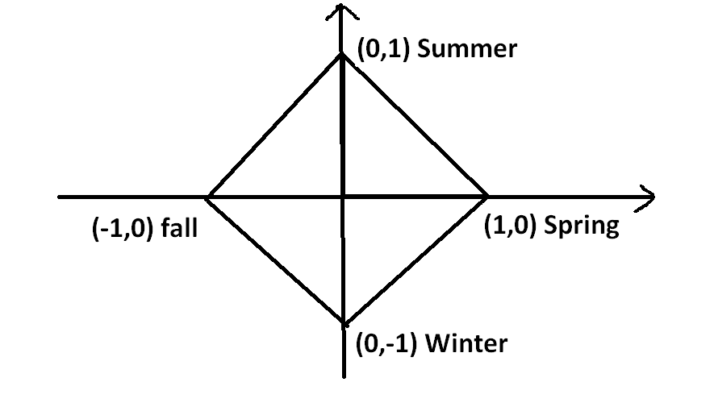
Season Encoding
Using diamond to represent seasons.
Differ in seasons
Keep the same distance between each season.
Season
Spring | 1 | 0
Summer | 0 | 1
Fall | -1 | 0
Winter | 0 | -1
2

Slide 30
Classification — change of season
Predict the demand of cnt using all of the predictors with the change of season and keep other variables the same
Best: LDA, QDA & logistic
test error = 0.148, larger than 0.137(previous)
Type I error = 0.136
Type II error = 0.157
Changing of season will not lead to a good result!
Confusion Matrix
0 1 (prediction) 0 70 11 1 16 86
(actual)

Slide 31
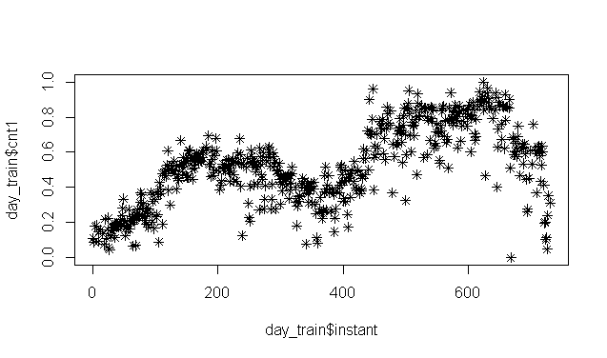
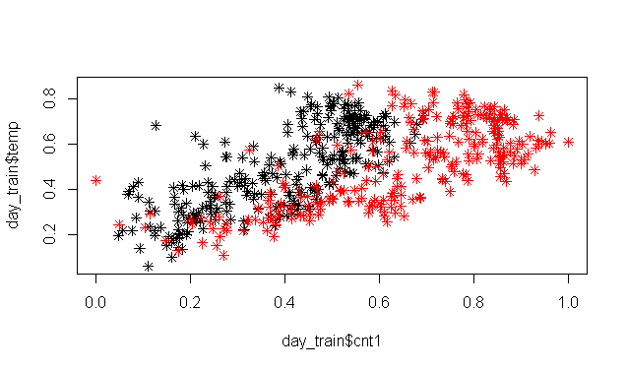
Plot — year
—— 1st year
—— 2nd year

Slide 32
Classification — using year2 data
Do the prediction again by focusing just on 2nd year’s data
Split 2nd year’s data set and reset the cnt
Why? Reduce noise!!
Best: LDA, QDA & logistic
test error = 0.087 smaller than 0.137(previous)
Type I error = 0.074
Type II error = 0.092
Confusion Matrix
0 1 (prediction) 0 25 2 1 6 59
(actual)
Much better!!

Slide 33
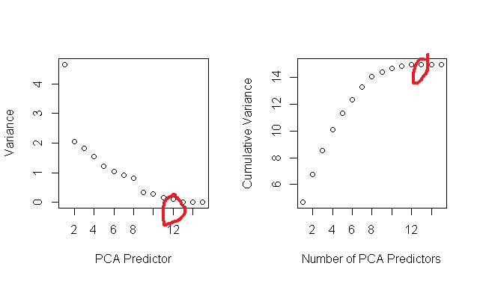
Classification — PCA

Slide 34
Classification — using year2 data
Predict the demand of cnt using 12 predictors from PCA: X1, X2, ……, X12
Best: logistic
test error = 0.016 smaller than 0.137
(prediction of cnt)
Type I error = 0.02
Type II error = 0.01
Confusion Matrix
0 1 (prediction) 0 85 2 1 1 95
(actual)
PCA is the best !!!!

Slide 35
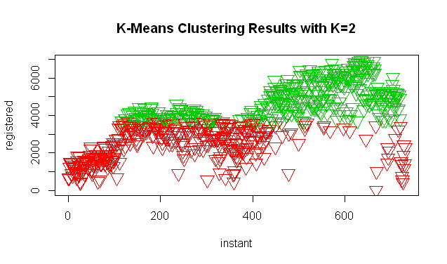
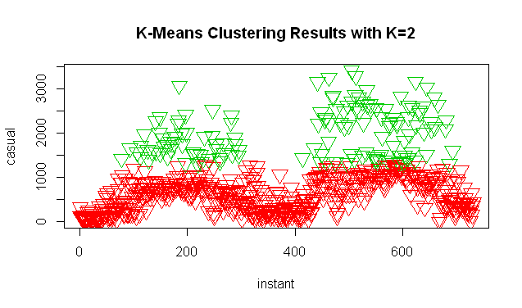
Classification — registered and casual users
We can have good prediction on the demand of users.
Can we get good prediction on registered users and casual users?

Slide 36
Classification — registered users
Predict the demand of registered users by using all of the predictors
Best: LDA
test error = 0.153 larger than 0.137(prediction of cnt)
Type I error = 0.18
Type II error = 0.13
Not as predictable as cnt !!
Confusion Matrix
0 1 (prediction) 0 68 13 1 15 87
(actual)

Slide 37
Classification —casual users
Predict the demand of casual users by using all of the predictors
Best: KNN
test error = 0.0765 much smaller than 0.137 (prediction of cnt)
K= 23
Predictable according to weather and time!!

Slide 38
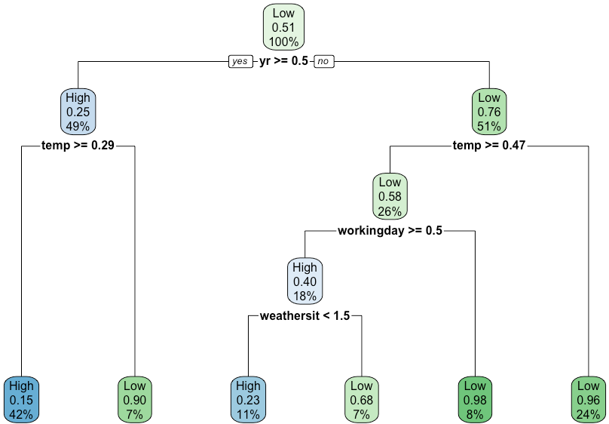
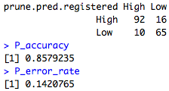
Classification Tree — Pruned（y =registered）

Slide 39
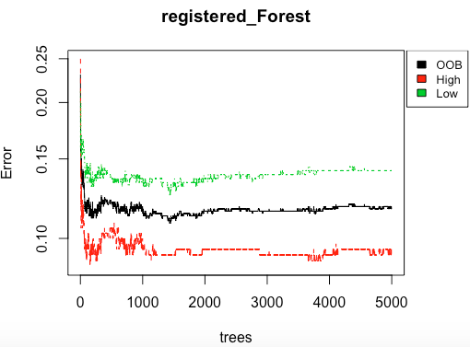
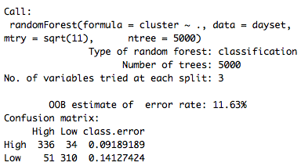
Classification— RandomForest (registered)

Slide 40
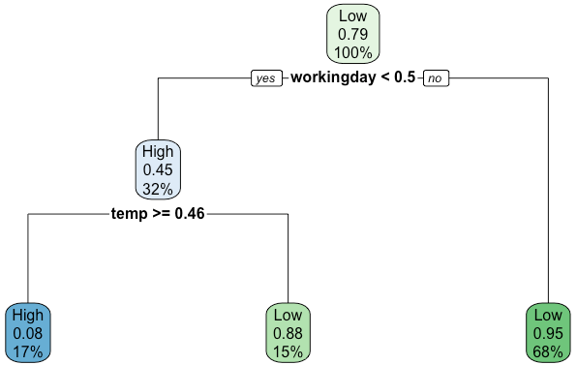
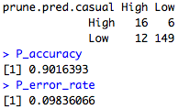
Classification Tree — Pruned（y =casual）

Slide 41
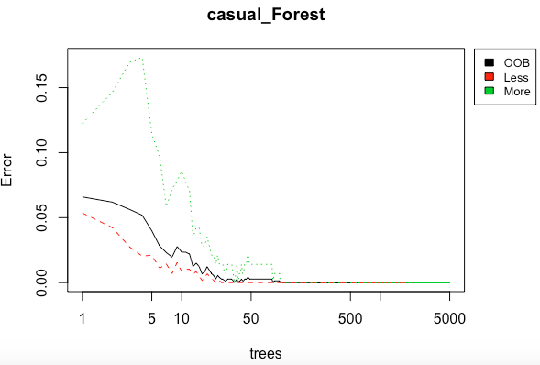
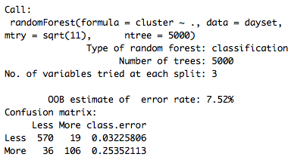
Classification— Random Forest (casual)

Slide 42
Registered and Casual Result
Registered users:
higher test error -- much harder to predict using past data -- flexible from time to time
Casual users:
lower test error -- much easier to predict using past data -- fixed pattern
To make money, to attract MORE REGISTERED!!!

Slide 43
Registered and Casual Result
Registered users:
higher test error -- much harder to predict using past data -- flexible from time to time
Casual users:
lower test error -- much easier to predict using past data -- fixed pattern
To make money, to attract MORE REGISTERED!!!

Slide 44
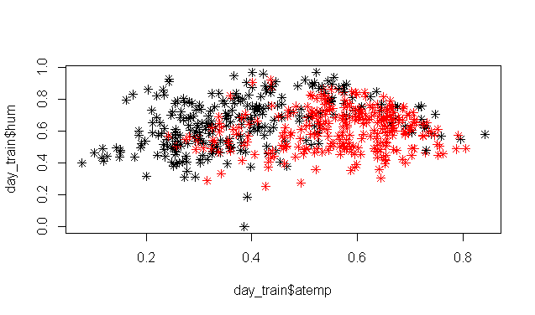
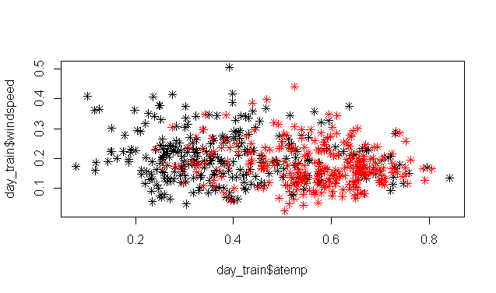
Logistic -- more
Using atemp to predict cnt: confidence of 0.743
—— higher demand
—— lower demand

Slide 45
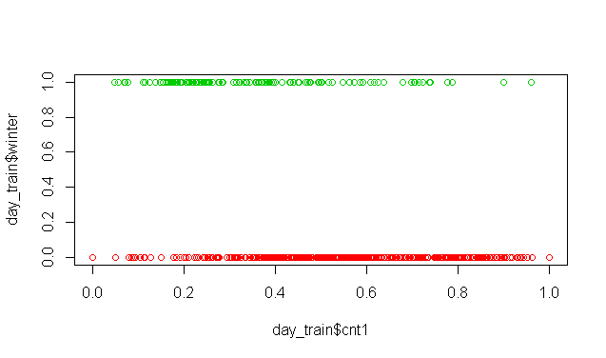
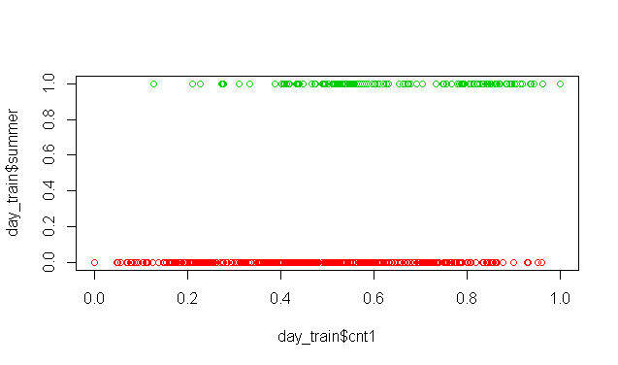
Logistic -- more
Using winter to predict cnt: confidence of 0.64
Using summer to predict cnt: confidence of 0.61

Slide 46
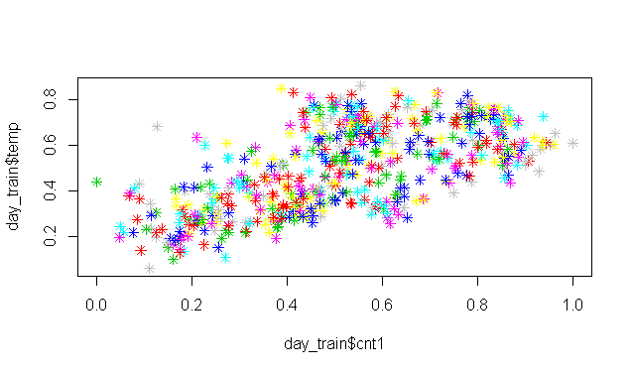
Classification -- more
Week -- Messed up!

Slide 47
4
Results
Summary

Slide 48
Regression
Results
When predicting number of Bikeshare Users (cnt)
Random Forest is better for considering the Weather
Linear Regression is better for considering long term trends
Summary
How can we predict the number of bikeshare users with only time predictors?
Linear Regression (mean test error = 2.24 million)
Random Forest (mean test error = 1.95million )
How can we predict the number of bikeshare users using time and weather?
Linear Regression (mean test error = 1.66 million)
Random Forest (mean test error = 0.29 million)
Can we predict the second year from trends of the first year?
Linear Regression (mean test error = 1.29 million)
Random Forest (unable to extrapolate for long term trends)

Slide 49
Classification
Results
Summary
When predicting the demand of number of bikeshare users (cnt)
PCA(with logistic) is the best one. Test Error: 0.016
Random forest better than tree, LDA, QDA & logistic
When predicting the demand of number of registered users
Random Forest performed better than others. Test Error: 0.1163
When predicting the demand of number of casual users .
Random Forest performed better than others—only a bit. Test Error: 0.0752
Normally, PCA >> Random Forest >> tree >> LDA, QDA & logistic

Slide 50
THANKS

