Slide 1

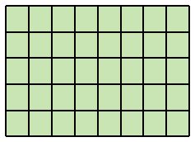
Batch
sample i
……
sample j
[1800,80]
[1800,80]
……
[175,768]
[1800,80]
pad
[175,768]
……
[175,768]
pad

Slide 2
Batch
sample i
……
sample j
align
s₁
s₁
[1800,80]
[1800,80]
[175,768]
[175,768]
……
……
pad
s_{k}
[1800,80]
[175,768]
pad

