Slide 1
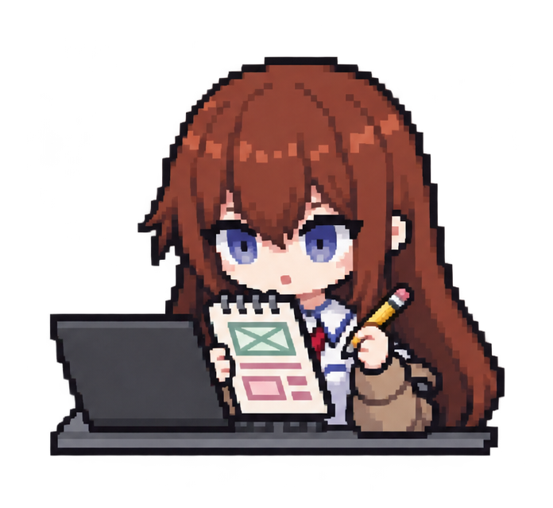

Skills developed
Interface planning
Data organization
There’s more
to explore!
Organize features into a clear user journey.
Manage characters, images, and saved designs.
Testing + debugging
AI-assisted workflow
Check behavior and investigate problems.
Direct, review, and refine generated output.
Next: more user testing and clearer first-use guidance.
KEYCRITTER • ERIC HAN
Notes:
This project gave me practice with planning a web interface, organizing character data and images, testing interactions, and investigating bugs. It also involved managing changes through GitHub and directing AI-assisted development. I should describe my own role accurately: choosing requirements, reviewing output, prioritizing changes, and checking results are distinct from writing every line manually. Next, I would test the experience with more users and improve first-use guidance.

