Slide 1
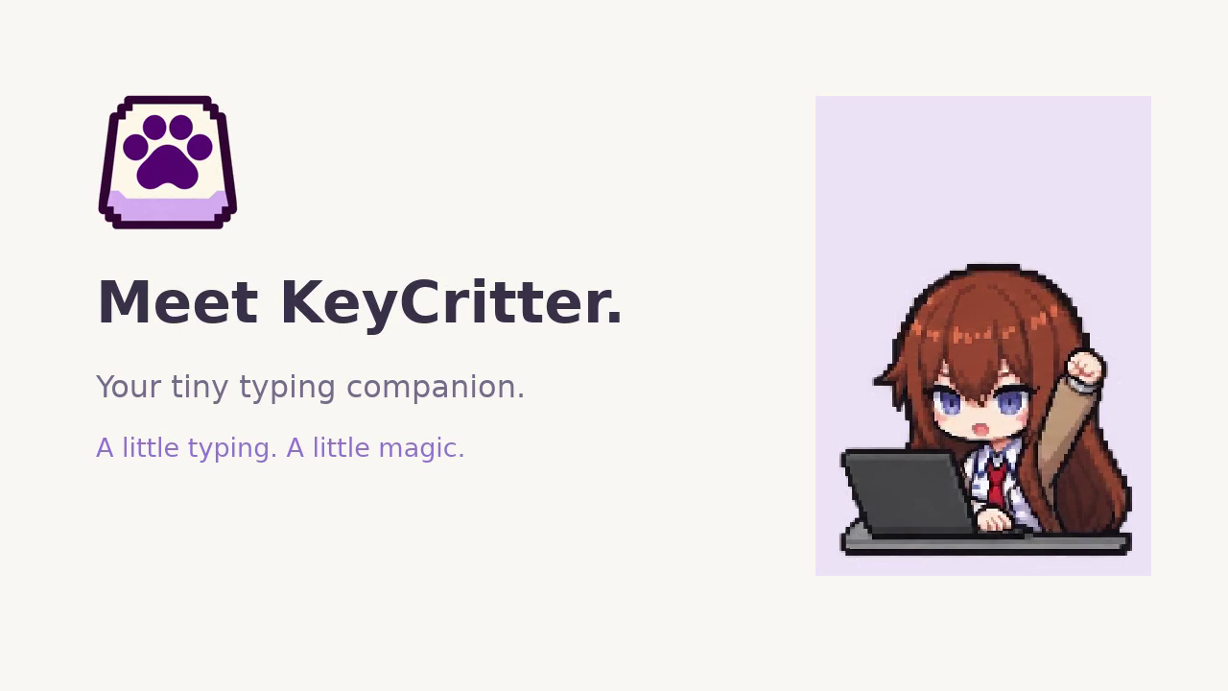
Notes:
This is a 45-second prerecorded demo ad. All footage, captions and audio are embedded, so no live typing or Internet connection is required after download. Use this slide instead of the live Demo Time section. In a compatible PowerPoint Slide Show the video is set to start on entry; if it does not start, click Play. A silent MP4 is included in the pack if you prefer to speak over it. Do not read the old live-demo script as well as playing the video.

