Slide 1



A little typing. A little magic.
KeyCritter
Hi! Let’s meet
KeyCritter!
Your tiny typing companion
Presented by Eric Han
KEYCRITTER • ERIC HAN
Notes:
Hi everyone. My project is KeyCritter, a tiny typing companion. Users can choose a character, personalize the room, and see reactions while typing. It includes a website designer and a Windows desktop app. I will explain the idea, demonstrate the experience, and discuss what building it taught me.

Slide 2


Problems while typing?
Repetition
Personalization
Typing could use
a little company…
Long typing sessions can feel repetitive.
Users may want a workspace that reflects their interests.
What if a companion reacted as you typed?
KEYCRITTER • ERIC HAN
Notes:
Typing can be repetitive, especially during long writing, study, or coding sessions. The goal was to make that everyday activity feel more personal and playful. KeyCritter adds a customizable character that reacts to what users already do. This is a design motivation, not a claim that productivity or wellbeing has been scientifically improved.

Slide 3

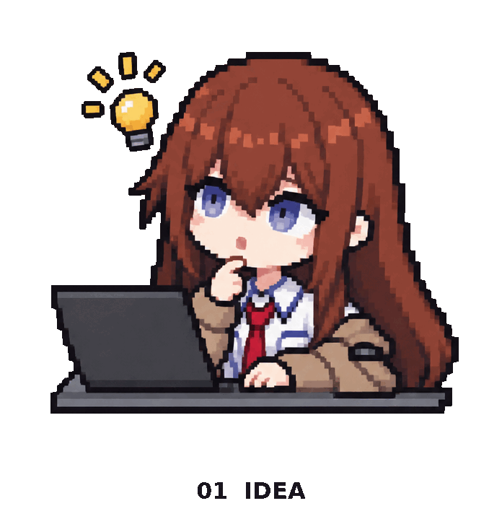



Creative process
01 Idea
Define the companion
and its visual style.
Idea → Design
Build → Improve
02 Design
Plan the library, room,
and key reactions.
03 Build
Connect artwork, typing,
saving, and desktop use.
04 Improve
Test behavior, fix bugs,
and refine the experience.
KEYCRITTER • ERIC HAN
Notes:
The process had four stages. Idea: define the companion experience and visual style. Design: plan the character library, room, and reaction controls. Build: connect the interface, artwork, typing events, saving, and desktop app. Improve: test behavior and use feedback to fix problems. The artwork on this slide shows the original guide acting out each stage.

Slide 4
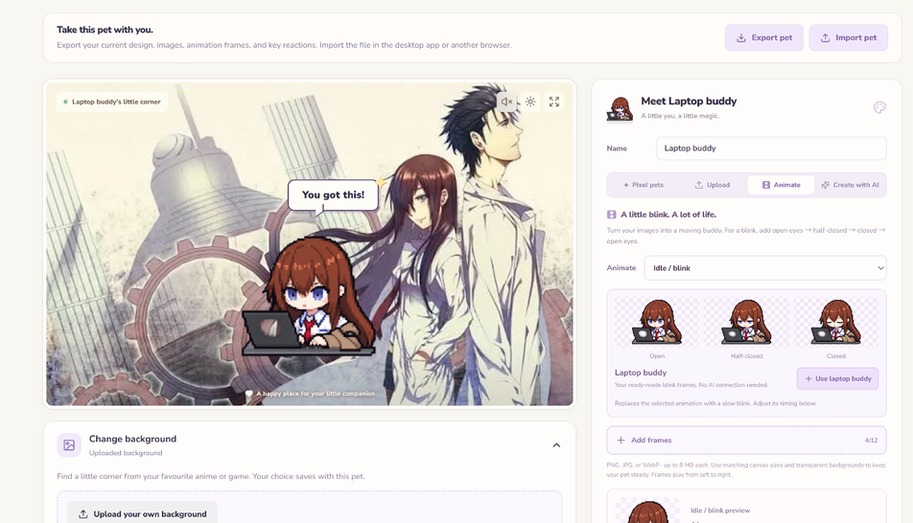


Demo time!
Try it
Let me show
you around!
1. Choose
2. Style
3. Type
4. Save
500 characters • 10 pose previews each • 22 scenes
KEYCRITTER • ERIC HAN
Notes:
For the live demo, I will choose a character, change the background, and type in the playground. Then I will trigger a configured reaction and save the pet. Enter can be assigned to Drink for an easy example. To carry the website design into the Windows app, Save my pet for desktop creates a pet file, and Import website pet opens it in the app. The screenshot is a backup if the live demo is unavailable.

Slide 5

Tools and technology
React + TypeScript
Vite
These tools
brought me to life.
Interface and pet behavior
Build the website
Electron
GitHub + Actions
Windows desktop app
Track code and publish
Playwright
Codex / AI tools
Browser tests and checks
Development assistance
KEYCRITTER • ERIC HAN
Notes:
React and TypeScript support the interface and settings. Vite builds the website. Electron provides the Windows desktop app. GitHub tracks code, and GitHub Actions builds, tests, and publishes releases. Playwright checks browser interactions and layout. Codex assisted development and artwork work; AI output still needed direction, review, testing, and refinement. These tools have different roles, so I have labeled them rather than showing unexplained logos.

Slide 6

Comparing virtual companions
Feature
KeyCritter
Clippy
Codex Pet
Let’s compare
our features.
Animated companion
✓
✓
✓
Desktop application
✓
✓
✓
Choose characters
✓
✓
✓
Upload pet artwork
✓
✕
✓
AI-assisted pet creation
✓
✕
✓
Our focus: custom typing reactions
and illustrated rooms.
Scope: classic Office assistants and the supplied built-in Codex pet selector.
KEYCRITTER • ERIC HAN
Notes:
This compares KeyCritter with classic Microsoft Office assistants and the built-in Codex pet selector shown in the supplied screenshot. Clippy was part of a desktop app and Office could offer alternative assistants. The Codex selector explicitly offers pet uploads and creation with ChatGPT. I have omitted claims about Codex background selection or custom key bindings because those features were not verified. KeyCritter’s own focus is configurable typing reactions and illustrated rooms.

Slide 7


Challenges faced
Artwork
Library size
Saved settings
This part took
some debugging…
Keep characters recognizable.
Use references and visual review.
Avoid loading every image at once.
Load small batches on demand.
Keep changes when updating or transferring.
Use migration and export/import.
KEYCRITTER • ERIC HAN
Notes:
Artwork consistency was a challenge because characters needed to remain recognizable across poses. References and visual review helped. Library size required organizing images into small batches loaded on demand. Saved settings also needed careful handling: older pets lacked new poses, and browser storage is separate from the desktop app. Migration updates and a clear export/import handoff helped preserve user work. This slide focuses on concrete problems encountered in the project.

Slide 8

“Key” takeaways
What did
we learn?
Listen
Test
Preserve
Turn feedback into clear improvements.
Find the real cause using evidence.
Add features without losing saved work.
A working feature must also work
for existing users.
KEYCRITTER • ERIC HAN
Notes:
The first lesson is to listen to feedback and turn it into specific improvements. The second is to test the details and identify the real cause of a problem rather than guessing. The third is to preserve existing user work. A feature may work for a new pet but fail with an older saved design. The project also reinforced that AI-assisted output needs checking and refinement.

Slide 9

Skills developed
Interface planning
Data organization
There’s more
to explore!
Organize features into a clear user journey.
Manage characters, images, and saved designs.
Testing + debugging
AI-assisted workflow
Check behavior and investigate problems.
Direct, review, and refine generated output.
Next: more user testing and clearer first-use guidance.
KEYCRITTER • ERIC HAN
Notes:
This project gave me practice with planning a web interface, organizing character data and images, testing interactions, and investigating bugs. It also involved managing changes through GitHub and directing AI-assisted development. I should describe my own role accurately: choosing requirements, reviewing output, prioritizing changes, and checking results are distinct from writing every line manually. Next, I would test the experience with more users and improve first-use guidance.

Slide 10
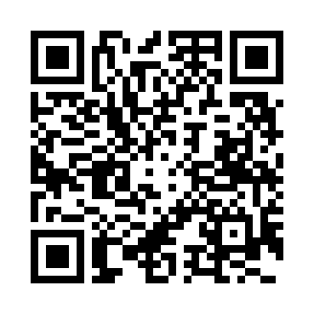

Thank you!
A little company. A lot of personality.
Thanks for
meeting me!
yana20091011.github.io/web
Try it, or ask a question!
KEYCRITTER • ERIC HAN
Notes:
Thank you for listening. KeyCritter started with the idea of making an everyday typing session feel a little more personal. Building it involved design, artwork, data organization, testing, and changes based on feedback. You can try the website using the link or QR code. I am happy to demonstrate the project or answer questions.

