Slide 1

Software Life Cycle Models

Slide 2
Types of Software developing life cycles (SDLC)
V - Model
Waterfall Model
Agile Model
Spiral Model
Iterative Model
Conclusion

Slide 3
V - Model
V - model is an expansion of classic waterfall model and it’s based on associated test stage for every development stage. This is a very strict model and the next stage is started only after the previous phase. This is also called “Validation and verification” model. Every stage has the current process control, to make sure that the conversion to the next stage is possible.

Slide 4
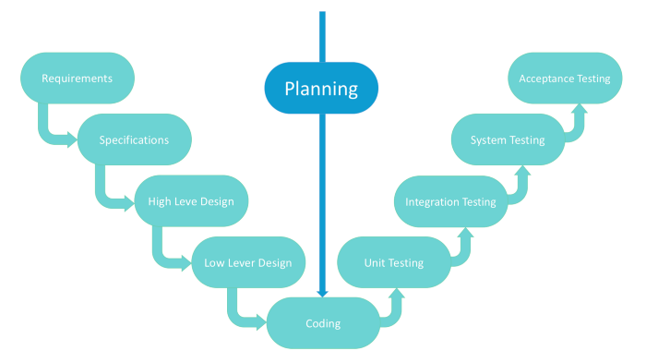
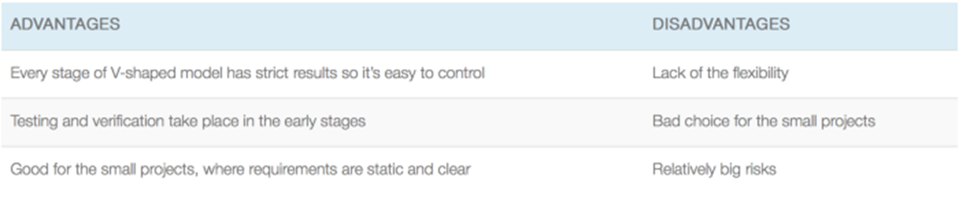

Slide 5
Use cases for the V-shaped model:
For the projects where an accurate product testing is required
For the small and mid-sized projects, where requirements are strictly predefined
The engineers of the required qualification, especially testers, are within easy reach.

Slide 6
Waterfall Model
Waterfall — is a cascade model, in which development process looks like the flow, moving step by step through the phases of analysis, projecting, realization, testing, implementation, and support. This SDLC model includes gradual execution of every stage completely. This process is strictly documented and predefined with features expected to every phase of this software development life cycle model.

Slide 7
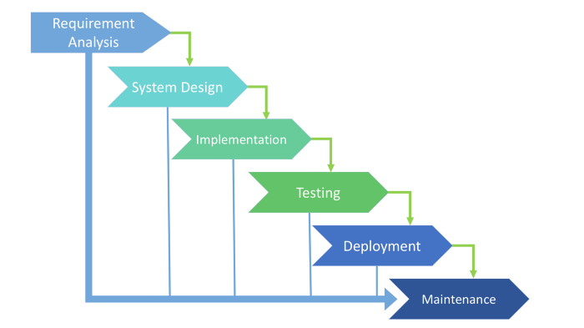

Slide 8
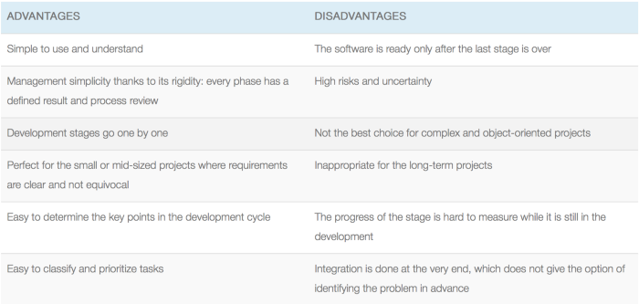

Slide 9
Use cases for the Waterfall model:
The requirements are precisely documented
Product definition is stable
The technologies stack is predefined which makes it not dynamic
No ambiguous requirements
The project is short

Slide 10
Agile Model
In the agile methodology after every development iteration, the customer is able to see the result and understand if he is satisfied with it or he is not. This is one of the advantages of the agile software development life cycle model. One of its disadvantages is that with the absence of defined requirements it is difficult to estimate the resources and development cost. Extreme programming is one of the practical use of the agile model. The basis of such model consists of short weekly meetings — Sprints which are the part of the Scrum approach.

Slide 11
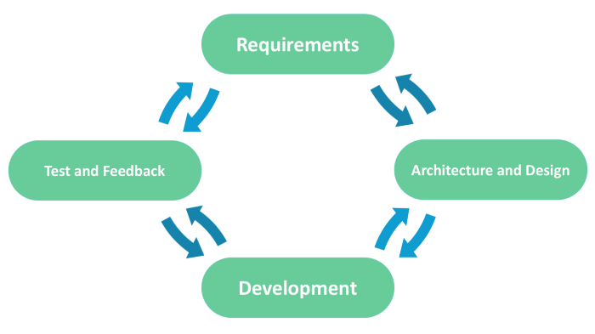
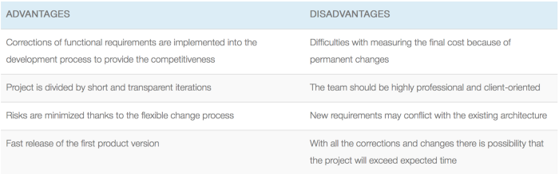

Slide 12
Use cases for the Agile model:
The users’ needs change dynamically
Less price for the changes implemented because of the many iterations
Unlike the Waterfall model, it requires only initial planning to start the project

Slide 13
Spiral Model
Spiral model — is model, which combines architecture and prototyping by stages. It is a combination of the Iterative and Waterfall models with the significant accent on the risk analysis. The main issue of the spiral model — is defining the right moment to make a step into the next stage. The preliminary set time frames are recommended as the solution to this issue. The shift to the next stage is done according to the plan, even if the work on the previous stage isn’t done yet. The plan is introduced basing on the statistic data, received during the previous projects even from the personal developer’s experience.

Slide 14
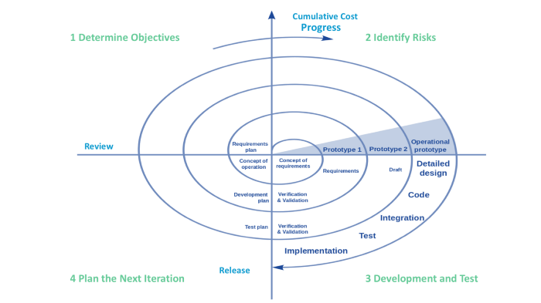

Slide 15
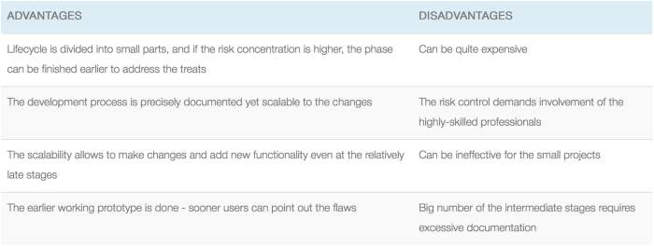

Slide 16
Use cases for the Spiral model
Customer isn’t sure about the requirements
Major edits are expected during the development cycle
The projects with mid or high-level risk, where it is important to prevent these risks
The new product that should be released in a few stages to have enough of client's feedback

Slide 17
Iterative Model
The Iterative model does not need the full list of requirements before the project starts. The development process may start with the requirements to the functional part, which can be expanded later. The process is repetitive, allowing to make new versions of the product for every cycle. Every iteration (which last from two to six weeks) includes the development of a separate component of the system, and after that, this component is added to the functional developed earlier. Speaking with math terminology, the iterative model is a realization of the sequential approximation method; that means a gradual closeness to the planned final product shape.

Slide 18
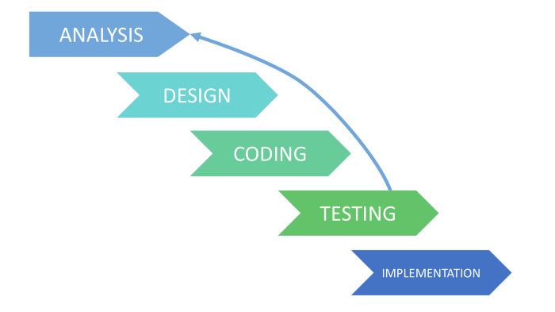
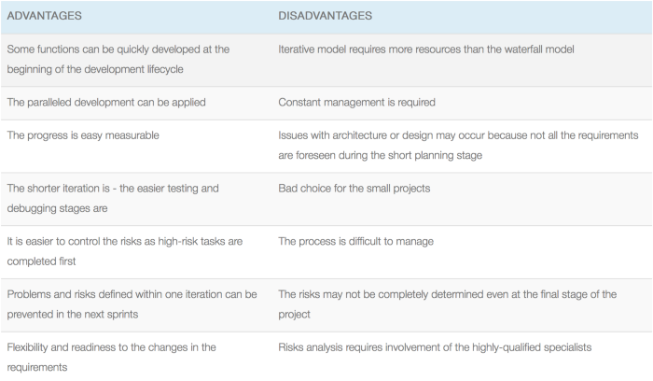

Slide 19
Use cases for the Iteration model:
The requirements to the final product are strictly predefined
Applied to the large-scale projects
The main task is predefined, but the details may advance with the time

Slide 21
Conclusion
During the years of the SDLC (Software Development Life Cycle) evolution, different models were developed from the basic cascade model to meet a huge variety of development requirements and expectations. There is no only one suitable model for all the projects, starting conditions and payment model. Even at the first sight, multi purpose Agile cannot be used widely because of some customers’ unpreparedness to scale the budget. The SDLC models often cross in the solutions and particularly look similar.

