Slide 1
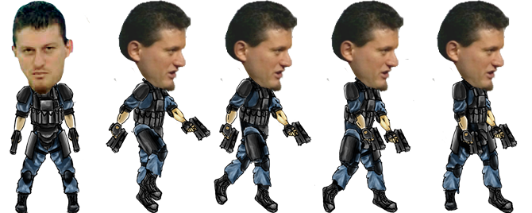
Nakov Sky
Team Carnation Mini-Alibi
Tsvetan Ganchev - ZvetanIG
Dimitar Bonev - Kibork
Yana Slavcheva - jabalka
Georgi Teoharov – Gteoharov
Alexander Pelev - apelev

Slide 2
Nakov Sky – main game idea
Your cannon is attacked by planes
Planes drop parachutists
All the parachutists are… NAKOV!!!
Nakov used to be immortal
Fortunately we fixed the collisions ☺
If 3 Nakovs reach the ground – you loose ☹

Slide 3
Where to find the game?
http://nakov-sky.slavcheva.net/
https://github.com/TeamCarnation-mini-Alibi/GAME

Slide 4
Nakov Sky
Demo

Slide 5
Team work
Tsvetan – a lot of JS work, design
Dimitar – a lot of JS work, design
Yana – JS work, design
Georgi – JS work, menu
Alexander – JS work
Excellent Teamwork, Excellent Team

Slide 6
Questions?

