Slide 1
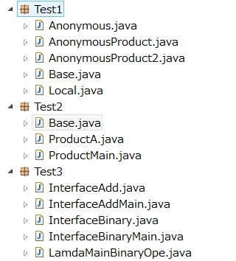
Index
1-1. Local Class
1-2. Super class , Sub class, Override
1-3. Abstract class
1-4. Interface
2-1. Abstract + Anonymous class
2-2. Abstract + Anonymous class
2-3. Object class + Anonymous Class
2-4. Interface + Anonymous class
3-1. Lamda
3-2. Lamda

Slide 2
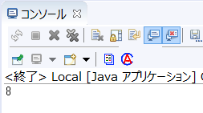
1-1. Local Class
In the main method,
① define class LocalTest1, ② instantation of LocalTest1, ③ call method f.
package Test1;
public class Local {
public static void main(String[] args) {
class LocalTest1{
public int f(int a, int b) {
return a + b;
}
}
LocalTest1 l1 = new LocalTest1();
System.out.println(l1.f(3, 5));
}
}
①
②
③

Slide 3
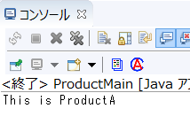
1-2. Super class , Sub class, Override
https://docs.oracle.com/javase/8/docs/api/java/lang/Override.html
Sperclass method is overwritten by Subclass method.
package Test2;
class base{
public void dispName(){
System.out.println
("Alert:Please define ProductName in sub class");
} }
Super
package Test2;
public class ProductA extends base {
@Override
public void dispName(){
System.out.println("This is ProductA");
};
}
package Test2;
public class ProductMain {
public static void main(String[] args) {
ProductA productname = new ProductA();
productname.dispName();
} }
Sub
Main

Slide 4
1-3. Abstract class
https://docs.oracle.com/javase/tutorial/java/IandI/abstract.html
An abstract class is a class that is declared abstract—it may or may not include abstract methods.
Abstract classes cannot be instantiated, but they can be subclassed.
An abstract method is a method that is declared without an implementation.
package Test2;
abstract class base{
abstract public void dispName();
}
Abstract
package Test2;
public class ProductA extends base {
public void dispName(){
System.out.println("This is ProductA");
};
}
package Test2;
public class ProductMain {
public static void main(String[] args) {
ProductA productname = new ProductA();
productname.dispName();
} }
Sub
Main

Slide 5
1-4. Interface
https://www.w3schools.com/java/java_interface.asp
Another way to achieve abstraction in Java, is with interfaces.
An interface is a completely "abstract class" that is used to group related methods with empty bodies:.
package Test2;
interface base{
void dispName();
}
Interface
Main
package Test2;
public class ProductMain {
public static void main(String[] args) {
ProductA productname = new ProductA();
productname.dispName();
}
}
package Test2;
class ProductA implements base {
@Override
public void dispName(){
System.out.println("This is ProductA");
};
}
Sub

Slide 6

2-1. Abstract + Anonymous class
Example-1
https://docs.oracle.com/javase/tutorial/java/javaOO/anonymousclasses.html#:~:text=Anonymous%20classes%20enable%20you%20to,a%20local%20class%20only%20once.
Anonymous classes enable you to make your code more concise.
They enable you to declare a class and instantiate a class at the same time.
They are like local classes except that they do not have a name. Use them if you need to use a local class only once.
① instantation
② override method and define method
③ call method
Main
package Test1;
abstract class base{
abstract public void dispName();
}
Abstract
package Test1;
public class AnonymousProduct {
public static void main(String[] args) {
base producta = new base(){ ①
@Override
public void dispName(){ ②System.out.println("This is ProductA");
}
};
producta.dispName();
}
}
There is not Subclass
package Test1;
public class ProductA extends base {
public void dispName(){
System.out.println("This is ProductA");
};
}
Anonymous class means…
actually instantation for
“class Anonymous extends base”
object name. method name
③

Slide 7

2-2. Abstract + Anonymous class
Example-2
Anonymous classes enable you to make your code more concise.
They enable you to declare a class and instantiate a class at the same time.
They are like local classes except that they do not have a name. Use them if you need to use a local class only once.
package Test1;
abstract class base{
abstract public void dispName();
}
① instantation of class w/o object name
② override method and define method
③ call method
Abstract
Main
package Test1;
public class AnonymousProduct {
public static void main(String[] args) {
new base(){
@Override ①
public void dispName(){ ②System.out.println("This is ProductA");
}
}.dispName();
}
}
There is not Subclass
object name
package Test1;
public class ProductA extends base {
public void dispName(){
System.out.println("This is ProductA");
};
}
Anonymous class means…
actually instantation for
“class Anonymous extends base”
③
. method name

Slide 8
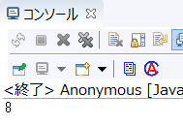
2-3. Object class + Anonymous Class
Example-3
Anonymous classes enable you to make your code more concise.
They enable you to declare a class and instantiate a class at the same time.
They are like local classes except that they do not have a name. Use them if you need to use a local class only once.
Class Object is the root of the class hierarchy. Every class has Object as a superclass.
https://docs.oracle.com/javase/8/docs/api/java/lang/Object.html
package Test1;
public class Anonymous {
public static void main(String[] args) {
int x = new Object() {
public int f(int a, int b) {
return a + b;
}
}.f(3, 5);
System.out.println(x);
}
}

Slide 9
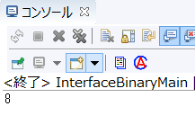
2-4. Interface + Anonymous class
Example-4
https://www.oracle.com/webfolder/technetwork/tutorials/obe/java/lambda-quickstart/index.html
Another way to achieve abstraction in Java, is with interfaces.
An interface is a completely "abstract class" that is used to group related methods with empty bodies.
Interface
Main
package Test3;
interface TestBinary {
public int inttest(int left, int right);
}
package Test3;
public class InterfaceBinaryMain {
public static void main(String[] args) {
TestBinary test = new TestBinary(){
public int inttest(int a, int b){
return a + b;
}
};
System.out.println(test.inttest(3,5));
}
}
①
②
① Instantation
② define inttest method and return
③ call method with argument int a & int b
③

Slide 10
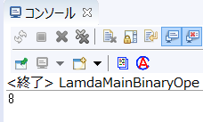
3-1. Lamda
Example-1
https://www.oracle.com/webfolder/technetwork/tutorials/obe/java/lambda-quickstart/index.html
Lambda expressions are a new and important feature included in Java SE 8.
They provide a clear and concise way to represent one method interface using an expression.
① instantation (w/o new)
② (type, argument) in f method in Interface
③ define method and return
④ call method with argument int a & int b
package Test3;
interface AddTest{
public int f(int a);
}
Interface
Main
package Test3;
public class InterfaceAddMain {
public static void main(String[] args) {
AddTest i1 = (int a)->{
return a + 5;
};
System.out.println(i1.f(10));
}
}
①
②
③
④
object name. method name

Slide 11
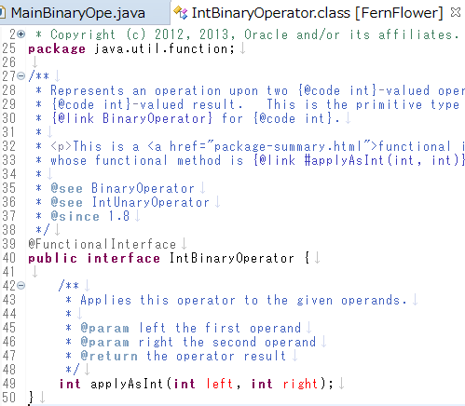
3-2. Lamda
Example-2
https://www.oracle.com/webfolder/technetwork/tutorials/obe/java/lambda-quickstart/index.html
Lambda expressions are a new and important feature included in Java SE 8.
They provide a clear and concise way to represent one method interface using an expression.
Functional interface in Java
Main
① instantation (w/o new)
② (type, argument) in applyAsInt method in Interface
③ define method and return
④ call method with argument int a & int b
package Test3;
import java.util.function.IntBinaryOperator;
public class LamdaMainBinaryOpe {
public static void main(String[] args) {
IntBinaryOperator i1 = (int a, int b)->{
return a + b;
};
System.out.println(i1.applyAsInt(3, 5));
} }
①
②
③
object name. method name
④

