Slide 1
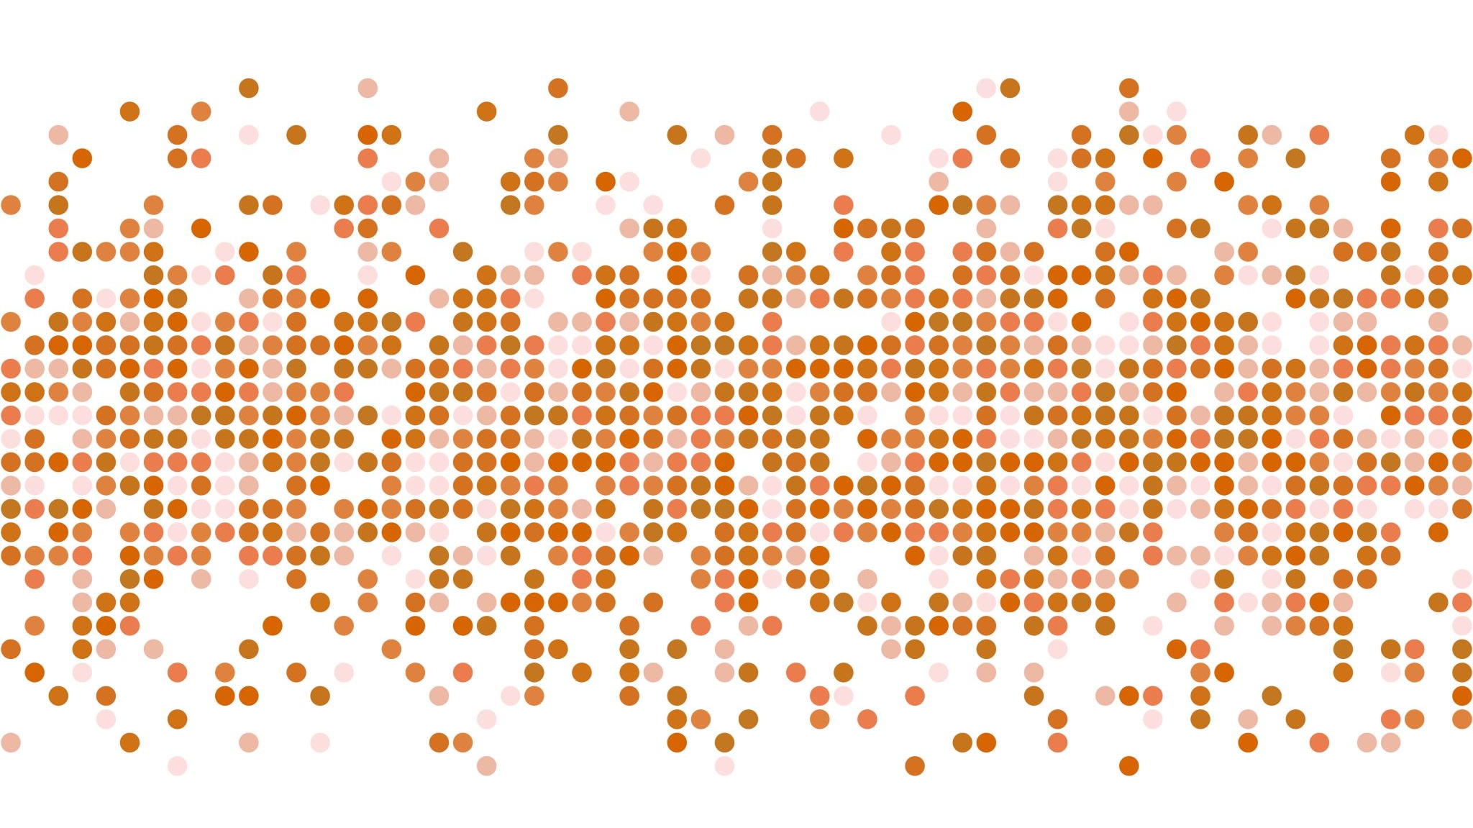
Redefining News Experience though AIoT

Slide 2

Redefining News Experience though AIoT

Slide 3
Service Model
News Aggregator

Slide 4
Design Objectives
Interaction metric: engagement, convenience, safety
Content metric: quality, productivity

Slide 5

Visual Output Design

Slide 6
Homepage
4 tabs (For You, Today, Discover, More)
For each tab, use “interactive” view. For example, grids containing titles, keywords, and short description. Grid size are variables based on some ranking algorithm (under criteria: user’s preference, other user in vicinity, hotness, latest, genre).

Slide 7
Individual Article
Default-mode: Reference provision (direct access to video, pictures, people (like Instagram) or other articles where reader can choose to view now, get short summary, or view later).
Speedy-mode: Keywords highlighting. Short summary.
Hands-free-mode: Eye-tracking supported auto-scroll, dynamic keywords highlighting.

Slide 8
User Feedback
Like/dislike (by swapping)
Comment
Bookmark
Share

Slide 9
Display Devices
Mobile
Desktop/Laptop
Smart TV

Slide 10
Support Devices
Smart watch
Smart bracelet

Slide 11
Voice Output Design

Slide 12
Wake-Up
Engage user in short convo:
“Hey, how you feeling today?”
“Tired, but need to rush to work. Sigh.”
“I have some selection for you. But would you like anything specific to start your day?”
“Hmm.. Is there anything to spice up my day? And I don’t want too serious stuff.”
“Sure thing!”
Proceeds to read a mixture of news in lighter genre, e.g. entertainment

Slide 13
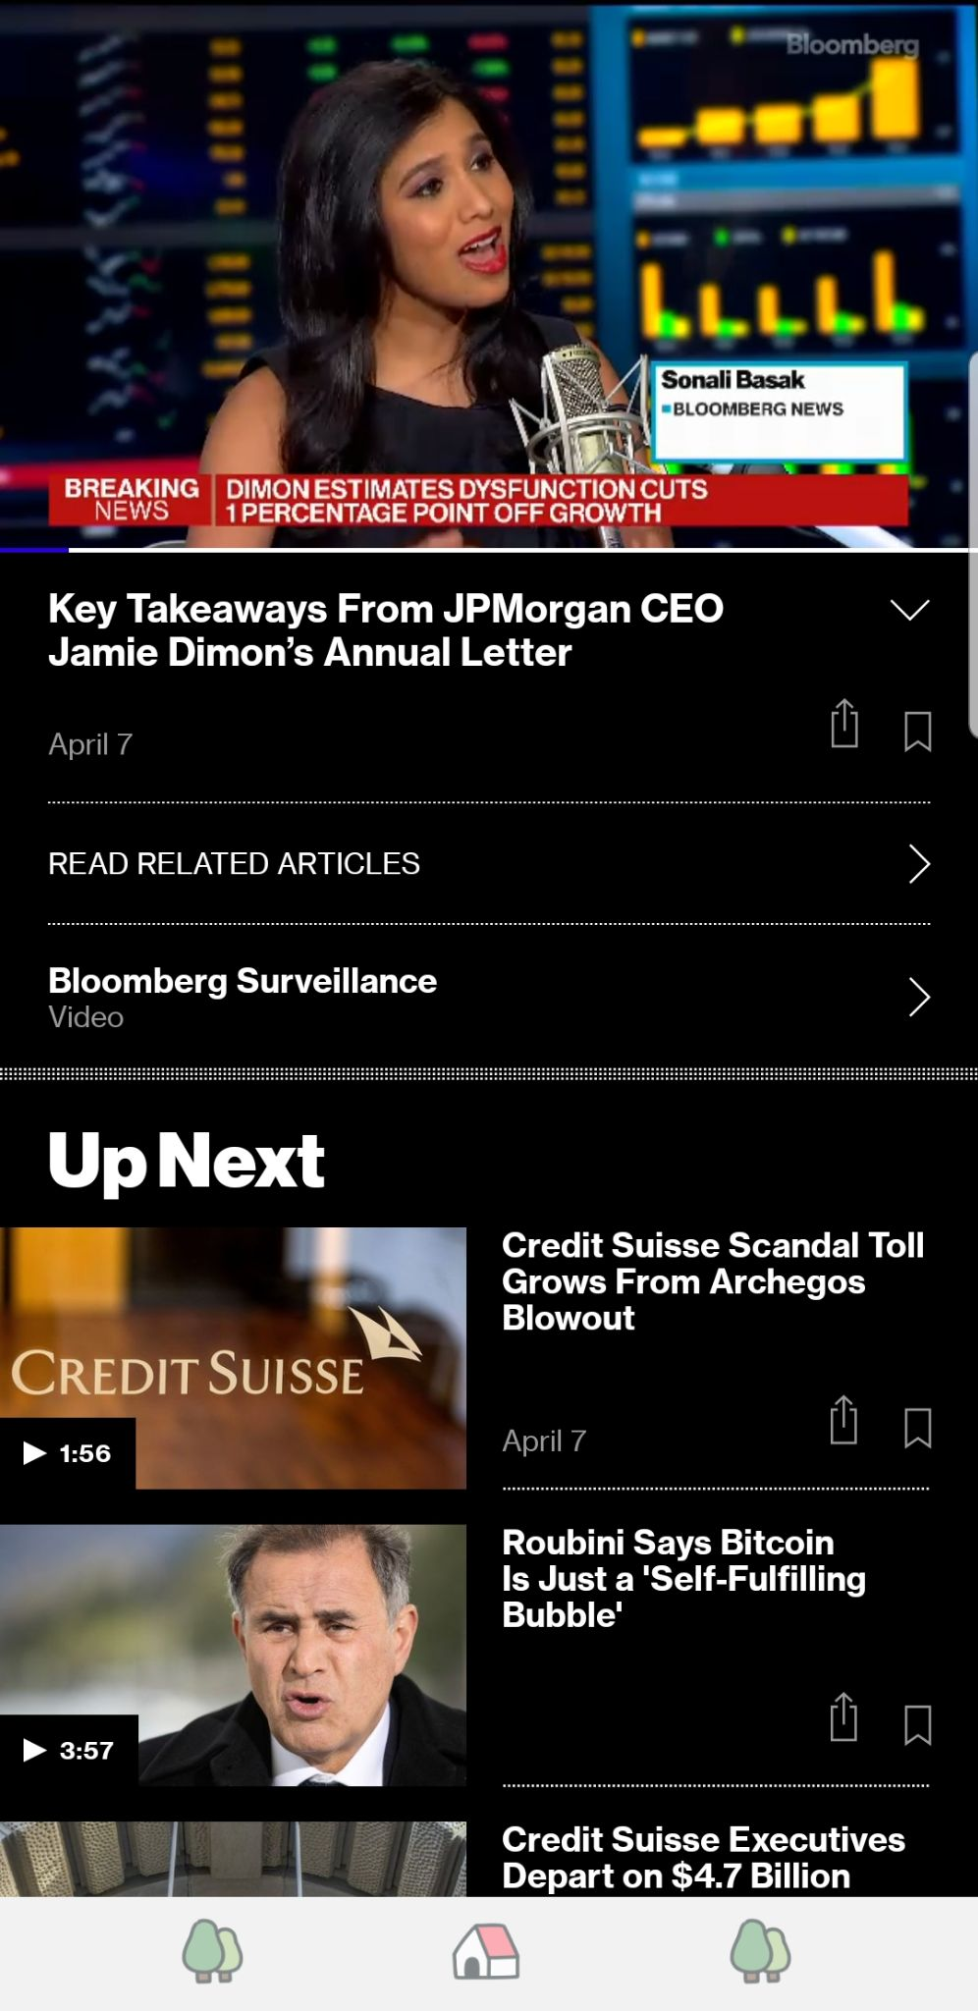
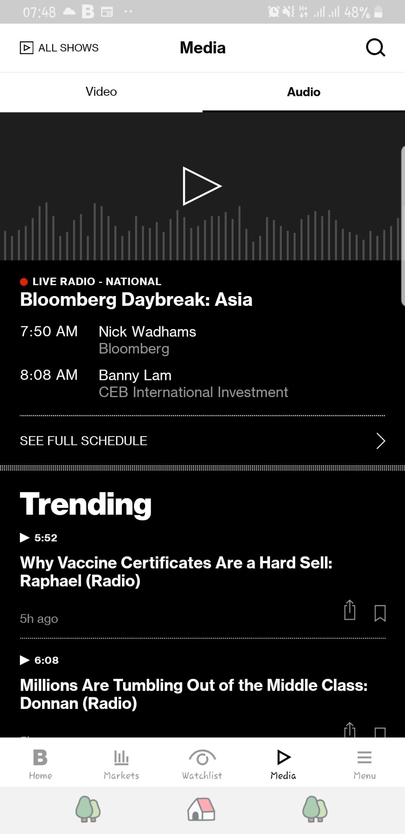
News Feed
This should function like homepage. It has been observed that nowadays news readers prefer quick, snappy format of reading.
We want a similar experience in the form of listening-mode.
Example: Bloomberg Surveillance, 1-min summary for each news articles.
Consistency; for each news article, there should exists its 1-min audio or ideally less than 3-mins video summary.

Slide 14
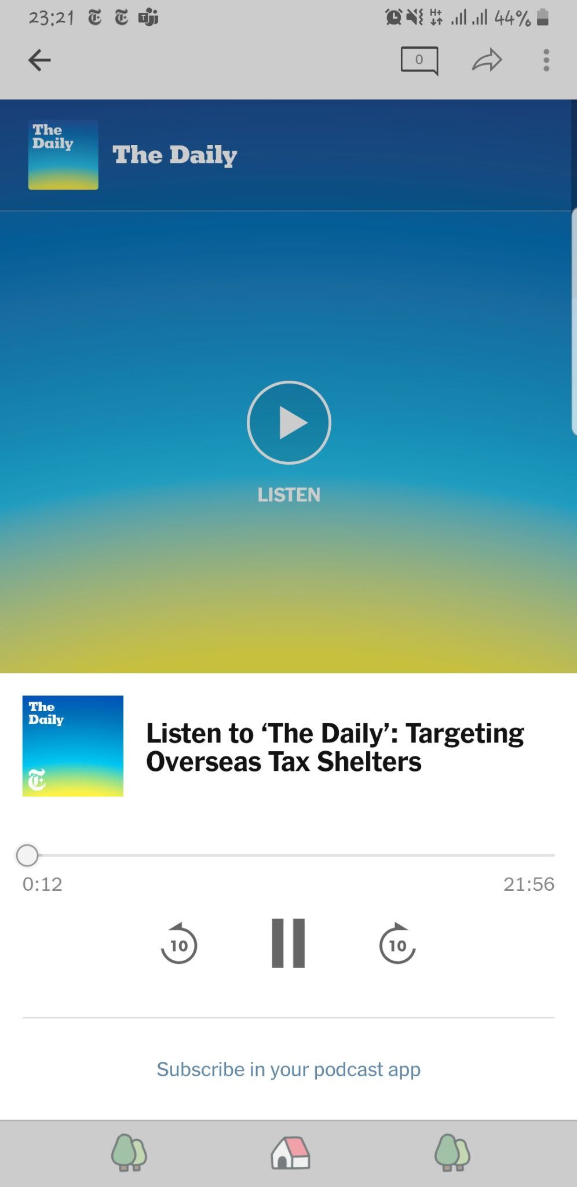
Individual Podcasts
Speedy-mode: Keywords highlighting. Short summary.
Leisure-mode: Reference provision (direct access to video, pictures, or other articles where reader can choose to view now, get short summary, or view later).
Translated content.
Rewind.
Reading speed (user can tweak on the fly).
Auto-next, auto-play.
(?) Should we differentiate the types of content for listening-mode? Personal opinion: podcasts tend to be boring and sleep-inducing. Technically, you cannot fast-scroll through the whole thing.

Slide 15
User Feedback
React (possible to do it on an exact instance, unlike articles where you can only like the WHOLE article. This can help algorithm to find more precisely what ‘engages’ the listener.)
Like/Dislike
Comment (auto-type)
Bookmark
Share

Slide 16
Output Devices
Stereo/speakers
Earphone/headphones/earbuds
Audio-supported devices, e.g. smartphone, car terminal, radio, etc.

Slide 17
Support Devices
Smart watch, earbuds, handpad, (wearable/attachable) touchpad

Slide 18
Interaction-related Functions

Slide 19
Context-Aware Command Recognition
Motivation.
NUI has been known to provide user with more intuitive way to interact with a device. However, human has limited memory and thus, a good NUI design should keep the variability of input to minimum. This complicates UI design as it needs to deal with “same command -> many actions” issue. This issue is emphasized when the system action space is significantly larger than the input space such as what we observe in AIoT system. Feeding context to the system helps to account for the limited user’s input space.

Slide 20
Context-Aware Command Recognition
Scenario 1. (Spatial)
Context
Spatial arrangements of output devices and user
Type of interaction and input device used to specify command
Command
VUI example: “Wake up!”, “Pause!”, etc.
Desirable Reaction
trigger only 1 output device to wake up, pause, etc.
prompt user for contextual information for tie-breaking.

Slide 21
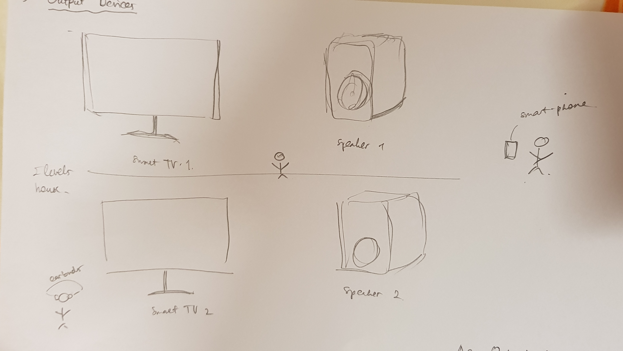

Slide 22
Context-Aware Command Recognition
Scenario 2. (Non-spatial)
Context
History of interactions
State of devices (active, passive)
Command
TUI example: tap on earbuds, tap on steer wheel; the same tap input can be mapped to many reactions e.g. {‘tap’: play, pause}
Desirable Reaction
Adjust to temporal relationship in the history of interactions.
Prompt user for contextual information for tie-breaking.

Slide 23
Near Hands-Free Gestures
Motivation.
Many scenarios necessitates the use of voice output for news consumption. For instance, Google Assistant provides “listen to news” services which allow you to play, pause, search, etc. through a series of podcasts. We try the service and notice some interaction-related issues. To mention a few:
commands such as ‘pause’ or ‘play’ cannot function when the news is being read and no mic to pick up user’s voice
commands are limited to specific sentences; users are asked to re-input based on the suggestions
some accentuated languages are not well-understood; e.g. English command made by non-native
And yet, this is coming from the voice assistant with the best NLP accuracy. To address this issue, we can integrate mic-supported VUI with a more accurate input method such as TUI.

Slide 24
Near Hands-Free Gestures
However, the situation that calls for the Voice Output is normally hands-occupying. Thus, we need to design small, easy-to-make gestures and a supporting device that integrates naturally with the scenario.
Example scenarios.
Jogging: smart watch, earbuds
Driving: touchpad (insertable to car steer), handpad
It’s especially interesting to explore the potential of handpad (spatial memory, virtual finger mapping) to aid natural navigation of listen-to-news beyond the basic “play-pause” under restrictive driving condition. Ideas to explore include spatial memory and AR/VR mapping. Additionally, we observe the recurring issue of small input space here where we can apply contextual information such as interaction history.

Slide 25
Smartwatch as GUI
Making visual display
On such a small space, what kind of information should you display?
; can display slideshow of news headlines.

Slide 26
Context-Aware Functions

Slide 27
Context-Aware Actions
Auto volume adjustment.
Example of events.
Driving: conversation, phone call.
Jogging: someone is talking, car is honking.

Slide 28
Context-Aware Actions
Auto play/pause.
Example of events.
Home: prolonged immobility (sleeping, away).
Car: when listen-to-news is integrated into car terminal; e.g. car door is opened, machine is started.

Slide 29
Context-Aware Actions
Adaptive and reactive hints/menu.
Example of events.
Addressing user’s confusion trying to relocate a function; can be triggered by anomaly such as “Wake Up!” then silence…..
Randomly introducing rarely used functions; as user may not be aware they exist.
Auto-correcting user erroneous response; e.g. jogging and visual mode is on.

Slide 30
Context-Aware Actions
Eye-tracker-supported functions.
auto-scroll
dynamic keyword highlighting
Example of events.

Slide 31
Context-Aware Actions
Biometrics-supported news personalization.
Example of events.
User is cold; show relevant news about weather conditions.

Slide 32
Multi-Apps Interactions

Slide 33
Sync
Calendar/reminder on homepage/wake-up.
Do not repeat viewed news on other apps, e.g. FB, linkedin.
Utilize info from other apps to provide better recommendations.

Slide 34
Context-Aware Transfer of Control
The goal is to have no two devices being “active” at the same time. “Active” here means in the middle of presenting information to user using the same output interface. For instance, in car scenario, this could be your GPS and listen-to-news assistant talking at the same time.

Slide 35
Multi-User Interactions

Slide 36
Follow
The main point here is to be able to follow articles “public figures” interact to or topics they follow. The challenge is to improve the user base.
Should we generalize “public figures” to general mass?
Will this function deviate from the main “news app” theme?
There might be privacy issue where we should draw a line.

Slide 37
Content-related Functions

Slide 38
Brief Overview
Genre-specific recommendations (user optimized)
Mixture recommendations (user optimized)
Randomized reading list/storyboard (explore)
Discover today (explore)
Classified news articles

Slide 39
Topics
Include opinions
These topics tag should be included

Slide 40
Algorithmic HCI

Slide 41
Personalization
Description.
Personalization is nothing new in the news services. However, most apps have focused on content-based personalization and only recently does UI research community recognize the potential in personalized UI. This is motivated by how different people have different behaviour in using the app itself (not only choosing what stories to read). For instance, [ref] has identified 3 different types of user only based on their interaction: the Trackers, the Reviewers, and the Dippers. It has also been mentioned that more granularity is desirable.
Example.
An interactive grid-style presentation of news feed (e.g. Netflix) for people that find surfing the news and choosing stories more enjoyable than deep-dive on one particular story.
A curated offerings of news summaries being sent to mailbox or devices at set time for those who like to keep up-to-date with the news (usually shown by how they react if these contents are sent to them once/twice a day) but somehow rarely open the app itself.

Slide 42
Collaborative Goal Discovery
Description.
Interestingly, while in the UI space personalization is desirable. The classic personalized content offering has been receiving criticisms lately. The reason for this is that personalization tends to limit user’s news consumption scope and if not done properly, personalization will result in lack of variation and seemingly repetitive offerings. Think of the vicious feedback loop happening between the app and human where any mild personalization will end up being extreme after some time. This issue is more apparent due to the increasing number of the Surfer type of user, those that feel most enjoyment from the browsing and choosing aspect of news experience.
This suggests that a good balance between personalization and exploration is necessary but should still be done based on the user’s type. In a broader sense, we are looking at the familiar Human-Robot Interaction paradigm of collaborative goal discovery.

Slide 43
Incentivization
Description.
A good app design should have a high engagement metric and thus, the recurring theme of personalization. Basically, it However, news services by default is far from engaging.
Examples.
Random generator of quizzes/poll/mini-games.
Scoring-board system.
Toggle
Incentivization through engaging content/interaction design; e.g. quizzes/poll/games/scoring-board

