Slide 1
Service—news
Input | Output
Tap sequence | Audio
Voice command | Text and picture
Screen input | Video

Slide 2
Content Overview
Category-specific recommendations (user optimized)
Mixture recommendations (user optimized)
Randomized reading list/storyboard (explore)
Discover today (explore)
Relevant news, next-viewing/next-playing (user optimized)

Slide 3





Navigate
NewsRack.
Tracks your interactions
Organizes your content-based interactions in an easy-to-navigate bookshelf style
Dynamically reports your news consumption stats
Homepage.
Notes:
Surfing the news app. ELEMENTAL PAGES.

Slide 4





Navigate
In-article, in-podcast.
Social.
News feed-like homepage
Follow public users (user can opt out of public profile)
Share news -> sync to news feed

Slide 5



Basic Functions
Surfing the news.
User feedback (like, share, comment, review).
Highlight/mark, later-viewing.
Notes:
Needs user input

Slide 6




AIoT Enhanced Functions
SmartSync (Inter-/Intra-App).
Utilize info from other devices/apps to provide better content.
Calendar/reminder on homepage/wake-up.
Do not repeat viewed news on other apps.
Notes:
Non-user

Slide 7
Overall Design
Device synchro
News-related functions
Sharing
Liking
Later-viewing
News searching
Related news
Multiple input method
Intelligent output
Voice self-adjustment
Auto-interruption
Notes:
What is multiple input?

Slide 8
Read-mode

Slide 9
Homepage
Default:
5 tabs (For You, Today, Discover, NewsRack/Profile, Socials)
For each tab, use “interactive” view. For example, grids containing titles, keywords, and short description. Grid size are variables based on some ranking algorithm (under criteria: user’s preference, other user in vicinity, hotness, latest, genre).

Slide 10
Individual Article
Default-mode: Reference provision (direct access to video, pictures, people (like Instagram) or other articles where reader can choose to view now, get short summary, or view later).
Speedy-mode: Keywords highlighting. Short summary.
Hands-free-mode: Eye-tracking supported auto-scroll, dynamic keywords highlighting.

Slide 11
User Feedback
Like/dislike (by swapping)
Comment
Review
Share

Slide 12
Display Devices
Each device should have different ways of presenting information: based on the size of display
Mobile
Desktop/Laptop
Smart TV
Smartwatch

Slide 13
Paired Devices
Input: Smart watch/bracelet, touchpad/hand-pad, AR glass
Support: earbuds, speaker for audio/video content, VR/AR glass for immersive experience (say in a meeting room)
IoT/Sensing: eye-tracker, biometric tracker, smart watch/bracelets
Different combination of devices will also affect the each page display, homepage, navigation.

Slide 14
Listening-mode

Slide 15
Homepage
Upon wakeup, engage user in short convo:
“Hey, how you feeling today?”
“Tired, but need to rush to work. Sigh.”
“I have some selection for you. But would you like anything specific to start your day?”
“Hmm.. Is there anything to spice up my day? And I don’t want too serious stuff.”
“Sure thing!”
Proceeds to read a mixture of news in lighter genre, e.g. entertainment

Slide 16
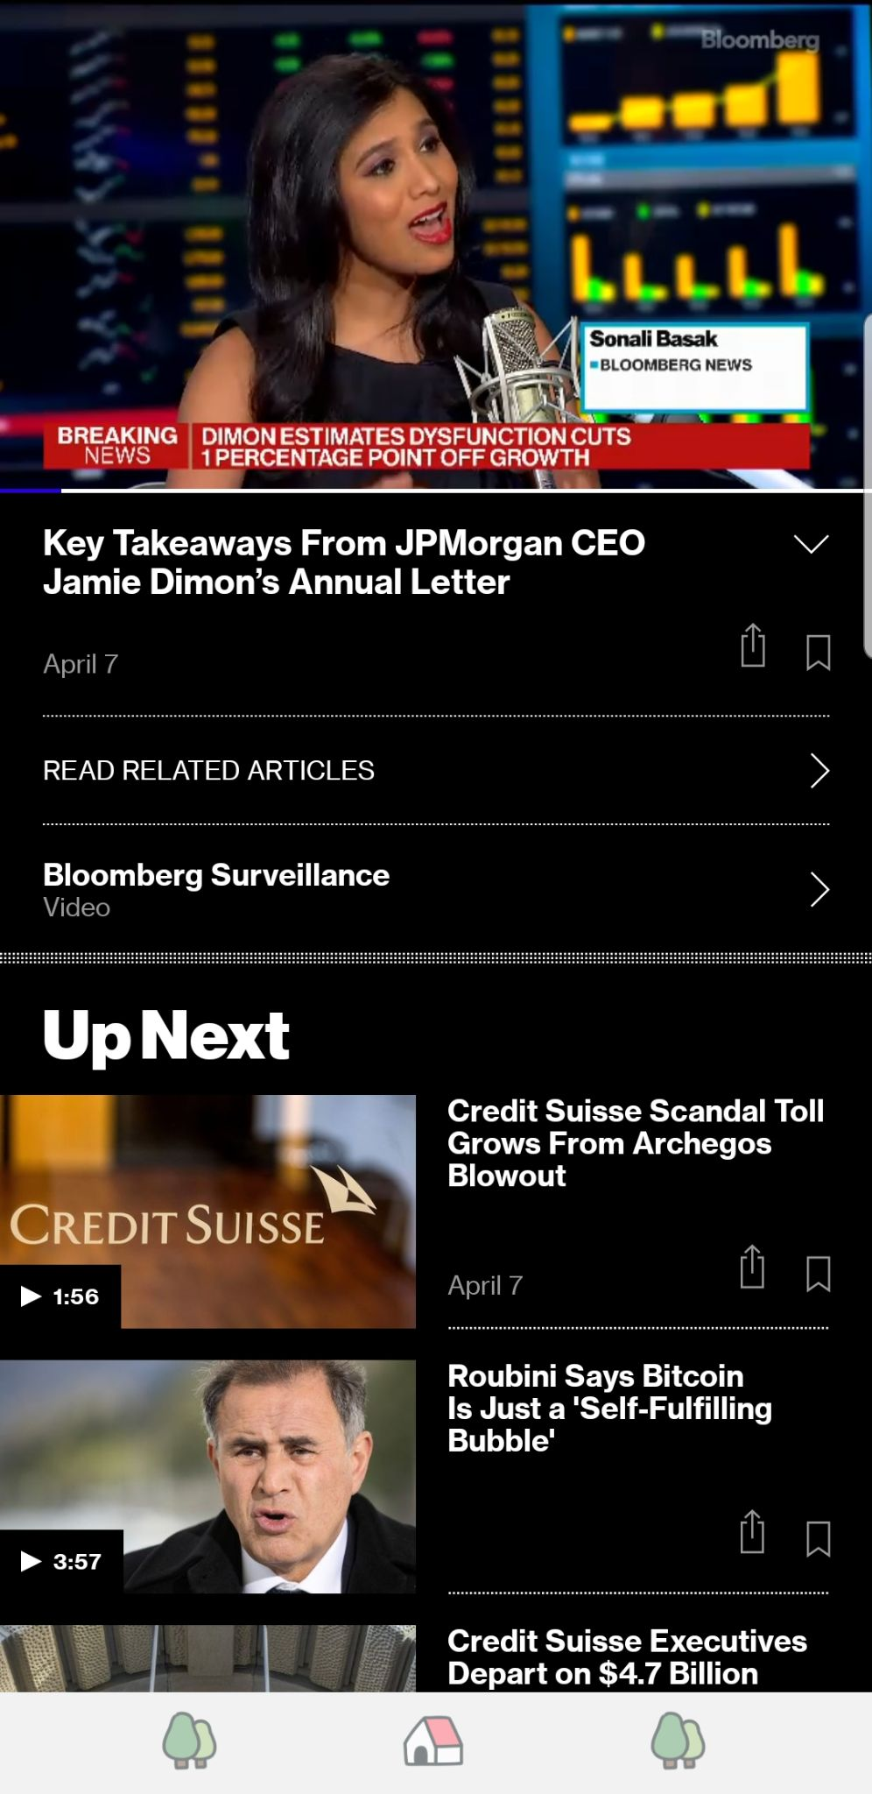
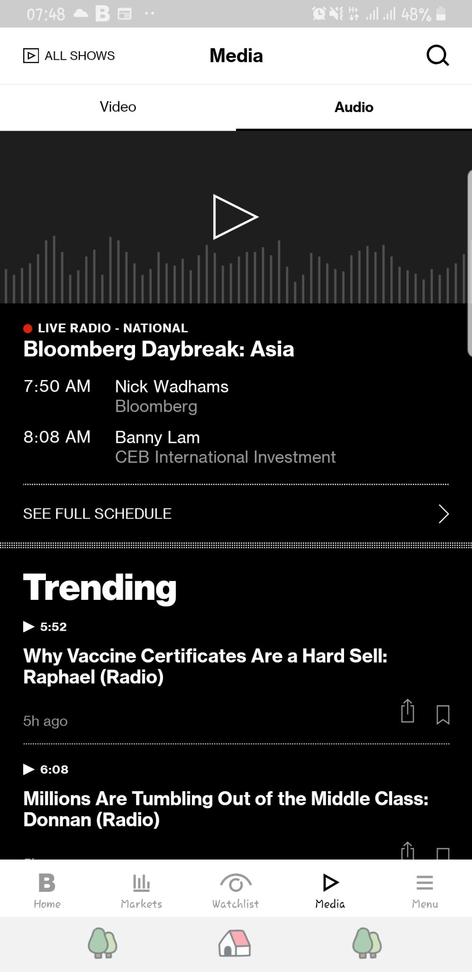
Podcast Feed
This is the visual display.
We want a similar experience in the form of listening-mode.
Example: Bloomberg Surveillance, 1-min summary for each news articles.
Consistency; for each news article, there should exists its 1-min audio or ideally less than 3-mins video summary.

Slide 17
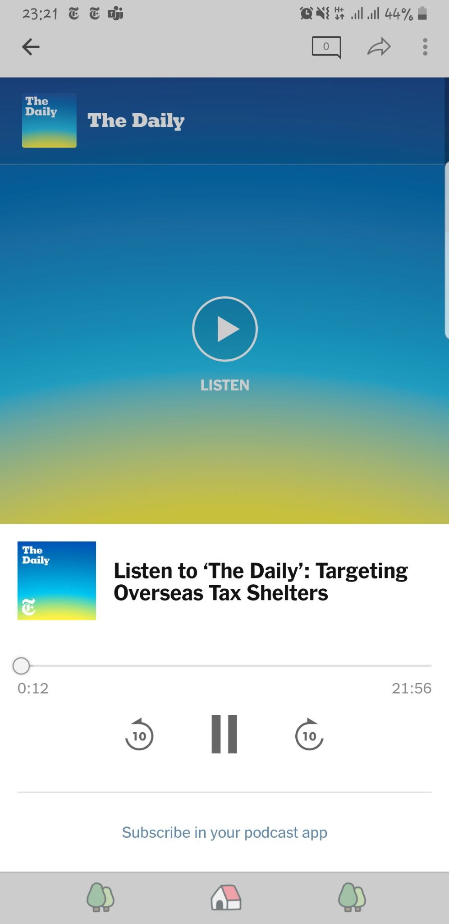
Individual Podcasts
Speedy-mode: Keywords highlighting. Short summary.
Leisure-mode: Reference provision (direct access to video, pictures, or other articles where reader can choose to view now, get short summary, or view later).
Translated content.
Rewind.
Reading speed (user can tweak on the fly).
Auto-next, auto-play.
(?) Should we differentiate the types of content for listening-mode? Personal opinion: podcasts tend to be boring and sleep-inducing. Technically, you cannot fast-scroll through the whole thing.

Slide 18
User Feedback
React (possible to do it on an exact instance, unlike articles where you can only like the WHOLE article. This can help algorithm to find more precisely what ‘engages’ the listener.)
Like/Dislike
Comment (auto-type)
Bookmark
Share

Slide 19
Output Devices
Stereo/speakers
Earphone/headphones/earbuds
Audio-supported devices, e.g. smartphone, car terminal, radio, etc.

Slide 20
Support Devices
Smart watch,
earbuds,
handpad,
(wearable/attachable) touchpad

Slide 21
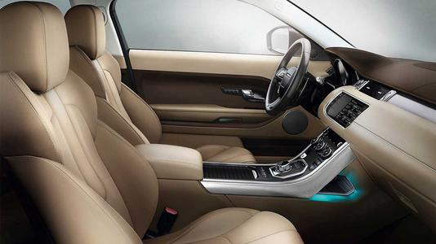
Scenario 1: In Car

Slide 22
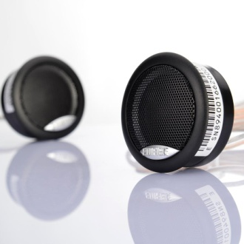
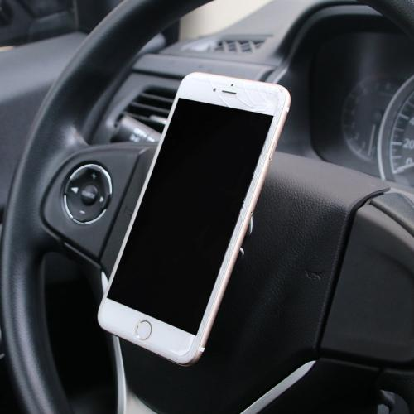
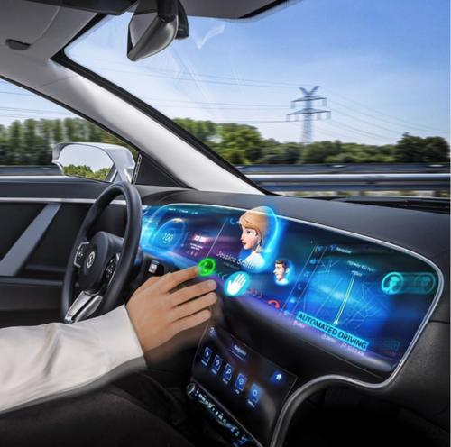
Devices
Car stereo
Smartphone/onboard touch screen
Functions
Basic functions
News-related functions
Auto-wake-up
Volume self-adjustment
Auto-interruption
Auto-correct
Input (specified later)
Output
Audio news through car stereo
Visual contents through smartphone/onboard touch screen

Slide 23
Functions
Auto wake-up
Devices:
Context: when listen-to-news is integrated into car terminal; e.g. car door is opened, engine is started.
Notes:
Task: surfing news, liking/sharing/commenting/reviewing, highlight/mark, later-viewing, adjust volume manually

Slide 24
Functions
Auto volume adjustment.
Example of events.
Context: conversation, phone call.

Slide 25
Functions
Auto interruption, follow-up.
Example of events.
Context: when GPS and listen-to-news assistant talking at the same time (devices communicating)

Slide 26
Scenario 1.1
Devices: Touchpad/hand-pad (I) -> car terminal, stereo (O)
Context: User make mildly erroneous gestures with touchpad/hand-pad to play/pause/search, etc. ->
(1) predict user’s intention based on the auto-corrected gesture -> feedback (to the user-learning algo | to the user).
(2) menu pops up on car terminal/stereo to clarify prediction.
(3) menu pops up on car terminal/stereo to suggest input corrections

Slide 27
Scenario 1.2
Devices: mic-supported VUI, touchpad/hand-pad, car terminal (I) -> car stereo, car terminal (O)
Context: User performs gestures to navigate with hand-pad/ touchpad attached to car steer -> app needs to tie-break ->
Present menu suggestions on car stereo -> user can respond on the car terminal itself, or with near hands-free gestures on the touchpad/hand-pad
Use voice output to give suggestions -> user respond by talking or making near hands-free gestures on the touchpad/hand-pad.

Slide 28

Scenario 2: Home

Slide 29
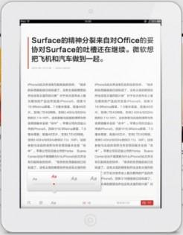
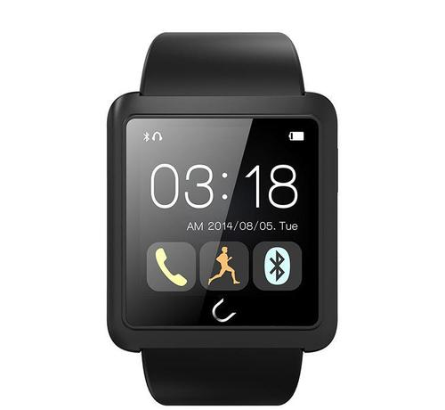
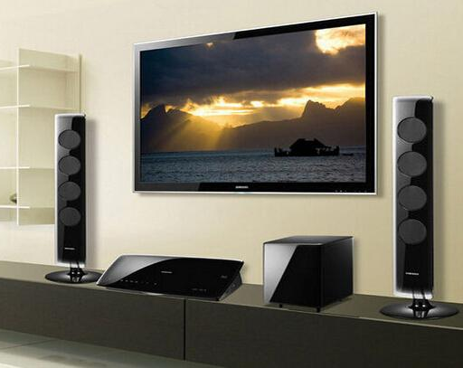
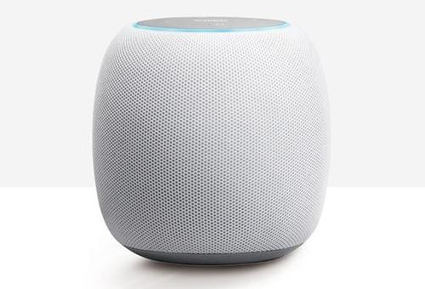
Devices
Smartphone/pad/PC
Smartwatch/bracelet
Smart TV
Bluetooth Speaker/earphones
Hand-pad/Attachable Touchpad
Functions
Basic functions
News-related functions
Transfer of control and content between devices
Separate Input/Output device (Remote control)
Transfer of voice output between stereos according to location
Auto-pause
Auto-correct
Input (specified later)
Output
News with texts and pictures through smartphone/pad/PC
Video news through smartphone/pad/PC and smart TV
Audio news mainly through Bluetooth Speaker/earphones

Slide 30
Scenario 2.1
Devices: NA (I) -> Smartphone, Smart TVs, Bluetooth stereos (O)
Context: Listening-mode is on, user moves around the house -> spatial sensing ->
Active stereo changes following the user’s movement.

Slide 31
Scenario 2.2
Devices: Smart watch (I) -> Smartphone, Smart TVs, Bluetooth stereos (O)
Context: reading-mode is on at Smart TV1 -> user moves away -> app auto-pauses -> user makes “wake-up gestures” on smartwatch to wake up -> spatial sensing ->
Smart TV2 / smartphone (only 1!) wakes up -> do follow-up.

Slide 32
Scenario 2.3
Devices: Mic-supported VUI, smartwatch (I) -> Mic-supported Speakers, Earbuds (O)
Context: prolonged immobility (sleeping, away) -> biometric sensing ->
Pause, mark the in-article/podcast, save to later-viewing -> on next “wake-up”, follow-up by prompting user if he wants to access the last article/podcast.

Slide 33
Scenario 2.4
Devices: touchpad/handpad (I) -> Smartphone, laptop, smart TV (O)
Context: User make mildly erroneous gestures with touchpad/hand-pad to highlight/mark in-article/in-podcast -> use NLP & data from read-trackers ->
Pseudo-highlight/prompt pops up at the ‘correct’ location on the output device to clarify prediction.

Slide 34

Scenario 3: Exercising

Slide 35
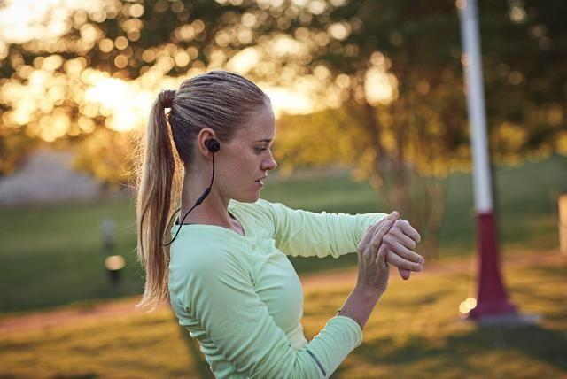
Devices
Smartphone
Smartwatch
Earphones
AR glass
Functions
Basic functions
News-related functions
Volume self-adjustment
Auto-correction
Input (specified later)
Output
Audio news through earphones

Slide 36
Scenario 3.1
Devices: Smartphone VUI (I) -> Earbuds (O)
Context: App was in reading-mode -> user command app to wake-up in the middle of jogging -> motion sensing ->
Prompt user to clarify listening-mode.

Slide 37
Scenario 3.2
Devices: Smartwatch, hands-pad, AR glass (I) -> Earbuds, AR glass (O)
Context: User performs gestures to navigate with hand-pad operations -> app needs to tie-break ->
Present menu suggestions on AR glass -> user can respond on the glass itself, on smart watch, or with hand-pad operation.

Slide 38
Scenario 2
Auto volume adjustment.
Devices:
Context: someone is talking, car is honking.

Slide 39
Input – Basic functions
Functions | Interaction | Scenario 1 In Car | Scenario 2 Home | Scenario 3 Exercising
Wake up | ① Knock twice with the smartwatch | ①② | ①② | ①
 | ② Say “Hi, New”
Play/Pause | ① Say “Play”/”Pause” | ① | ①② | ③
 | ② Press the button on smartwatch screen (specified later)
 | ③ Knock "xx“ on smartwatch
Turn to next news | ① Say “Next” | ① | ①② | ③
 | ② Press the button on smartwatch screen (specified later)
 | ③ Knock “x xx“ on smartwatch

Slide 40
Input – Basic functions
Functions | Interaction | Scenario 1 In Car | Scenario 2 Home | Scenario 3 Exercising
Volume adjustment | ① Say “Up”/“Down”: increase or decrease of the volume is positively proportional with the length of the voice command. | ①②③ | ①③④ | ③④
 | ② Slide up/down with the thumb on the steering wheel, with a sensor or gesture detection camera
 | ③ Drag on smartwatch screen (specified later)
 | ④ Punch up/down with the smartwatch
Choose news genres | ① Choose on the smartphone | ①②③ | ①②③ | ②
 | ② Choose on smartwatch screen
 | ③ Say “Change”

Slide 41
Input – News-related functions
Functions | Interaction | Scenario 1 In Car | Scenario 2 Home | Scenario 3 Exercising
Later viewing | ① Say “Save” | ① | ①② | ②
 | ② Press on the smartphone for 2 seconds
Sharing | ① Share on the smartphone through later-viewing | ①② | ①② | ①
 | ② -User: “Share” -System: “Who do you want to share with?” -User: “XXX“ (with a list of people user often shares news to)
News searching | -User: "Search“ -System: "What do you want to search?“ -User: "KEYWORD" | ● | ●
Related news | Say "Related news" to enter this mode Say "Stop" to exit this mode | ● | ●

Slide 42
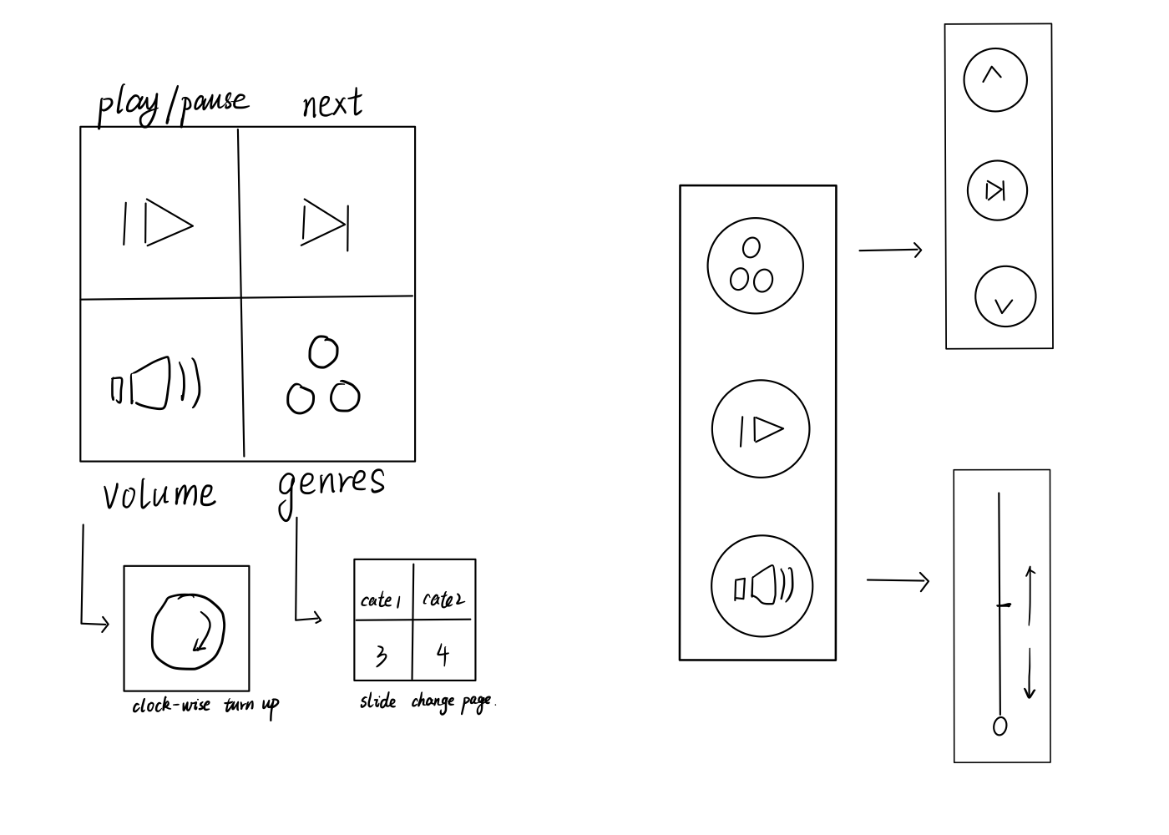
Smartwatch GUI

Slide 43
Context-Aware TUI
Scenario: CAR
Devices: touchpad/hand-pad (I) -> car stereo, terminal (O)
Task: Navigate, Like, share, mark, undo (listening-mode)
Near Hands-Free Gestures
Hand-pad/Touch-pad TUI: Swap right, tap, 2x tap, draw tick/star, swap left (customizable)
Easy navigate as long as no parallel decision to be made. In driving scenario, safety metrics > efficiency -> flipping magazine style of navigating.
If parallel -> present menu. Keep length to minimum.
Notes:
It’s especially interesting to explore the potential of hand-pad to aid natural navigation of listen-to-news beyond the basic “play-pause” under restrictive driving condition. Navigating means moving between pages. While GPS is naturally integrated with the driving’s main task, and thus using both visual and voice output work. Ideas to explore include spatial memory and AR/VR mapping.
Near Hands-free gestures.
- Sensing device: hand-pad/attachable touch-pad (possibly with icons for thumb operations).
- Gesture: finger-based operations, not intrusive to the driving task. This include: swipe right/left, tap sequence, draw easy shape (circle/tick/cross).
- Challenge: there may only limited number of these simple finger-based operations. While there are many functions in the app.
For instance, in-podcast will have play, pause, repeat, adjust volume, skip as basic functions, like, share, comment as feedback functions, and mark, later viewing. And while we can have VUI to help us interact naturally, the accuracy of voice assistant drops when we are in-podcast.
Solution:
Have the icons to help increasing the number of combinations. Some side benefits are accuracy and familiarity. For instance, we can design the touchpad to have the same feeling as using mouse scroll, or we can also include vibration (ref: @table later-viewing 2 can be done on the touchpad).
1. Collapse as many functions as many functions as possible into 1 gesture , {1: play & pause
VUI command: any natural language, ideally. But we don’t know the capacity of voice assistant, so may need to design easy input command.

Slide 44
Context-Aware TUI
Scenario: EXERCISE
Devices: Hand-pad, Smart watch/bracelet, AR glass (I) -> AR glass, earbuds (O)
Task: Navigate, Like, share, mark, undo (listening-mode)
In-Motion Gestures
Hand-pad TUI: bigger gestures since user is moving.
Easy navigate as long as no parallel decision to be made (see: CAR)
Menu-style suggestions on AR glass. User can then respond on the glass itself (touching the menu), on smart watch, or do a hands-pad operation. See: hand-pad below.
Notes:
Smart watch TUI: swap right, tap icon, tap icon, draw tick/star, swap left (maybe customizable?)
Depending on the type of exercise, smart watch/bracelet may not be realistic to use as input -> hand-pad (smart gloves). However, unlike in driving, we don’t have car steer (hard surface) to perform the task on. Also now, user is moving. Imagine making the ‘tap’, ‘swap’ gestures floating, while jogging. ☹
We need different operation! Basically need to use a bigger movement (say, wrist-based). Compare:
Finger-based | Wrist-based
swap right | thumbs up, rotate wrist to right
A gesture list: close fist, snap fingers
Ideas to explore include input icons given smart watch/bracelet. spatial memory and AR/VR mapping.

Slide 45

Context-Aware Command Recognition
Devices: mic-supported VUI, hand-pad, touchpad (I) -> Car stereo, terminal (O)
Task: Like, share, mark, etc. (listening-mode)
UI Design Space
TUI: tap on steer wheel; the same tap input can be mapped to many reactions e.g. {‘swap’: (like, unlike) , ‘tap’: (mark, unmark)}
Predict user’s intent based on the history of interactions.
Notes:
Task: surfing news, liking/sharing/commenting/reviewing, highlight/mark, later-viewing, adjust volume manually

Slide 46

Context-Aware Command Recognition
Devices: Hand-pad, touchpad (I) -> Smart TVs, smartphones (O)
Task: Like, share, comment, review, etc. (reading-mode)
UI Design Example
TUI : the same input can be mapped to many reactions e.g. {‘swap’: (like, unlike) , ‘tap’: (mark, unmark)}
VUI: same as TUI, e.g. {“Wake up!”: (Smart TV 1, Smartphone, ..)}
Predict user’s intent based on the spatial arrangements between IoT devices & user, history of interactions.
Notes:
Task: surfing news, liking/sharing/commenting/reviewing, highlight/mark, later-viewing, adjust volume manually

