Slide 1
IMPROVING DOSE CONFORMALITY FOR PROTON LATTICE VIA PROTON ARC THERAPY
Yanan Zhu¹, Weijie Zhang¹, Jufri Setianegara¹, Yuting Lin¹, Erik Traneus², Yong Long³, Xiaoqun Zhang³, Rejeev Badkul², David Akhavan¹, Fen Wang¹, Ronald Chen¹, and Hao Gao¹
¹University of Kansas Medical Center, ²RaySearch Laboratories AB, ³Shanghai Jiao Tong University

Slide 2


Disclosure
NIH: R37CA250921, R01CA261964
Research collaborations with IBA and RaySearch
FLASH research funding from IBA

Slide 3
Background and Motivations

Slide 4
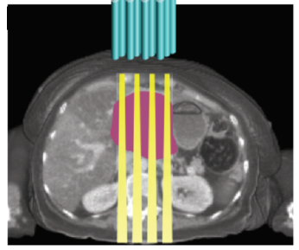
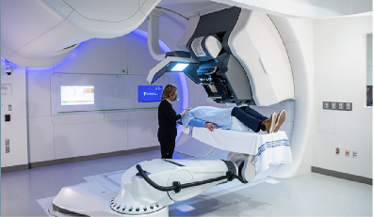
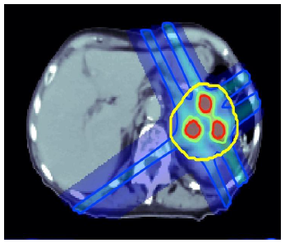
Spatially Fractionated RT (SFRT)
Treat bulky tumors
Heterogenous dose distribution in the target or OAR
Biological mechanism
1

Slide 5
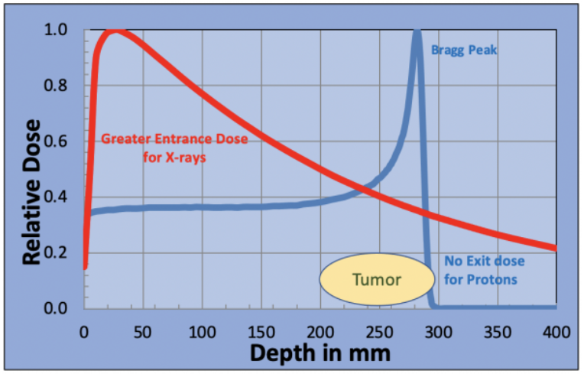
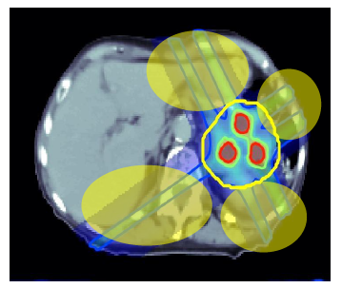
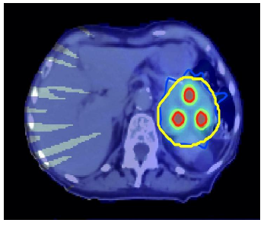
Proton v.s. Photon
Goal
Increase the dose conformality of proton LATTICE by using ARC
Apply energy layer optimization in pursuit of delivery efficiency within ARC
2

Slide 6
Models and Methods

Slide 7
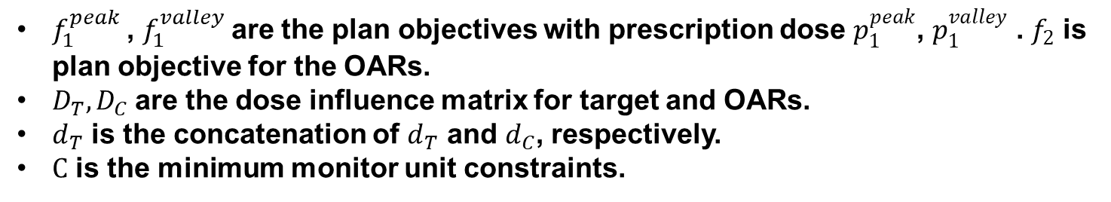
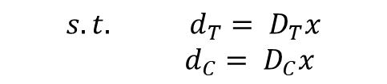
LATTICE Model
The mathematical model of LATTICE takes the following form
$$\min_{x∈C}{ f}_{1}^{peak}\left(d_{T}^{peak},p_{1}^{peak}\right)+f_{1}^{valley}\left(d_{T}^{valley},p_{1}^{valley}\right)+f_{2}(d_{OAR})$$
ADMM
$$s.t. d_{T}= D_{T}x$$
$d_{C}= D_{C}x$
peak
where
Valley
$f_{1}^{peak}$, $f_{1}^{valley}$are the plan objectives with prescription dose $p_{1}^{peak}$, $p_{1}^{valley}$ . $f_{2}$ is plan objective for the OARs.
$D_{T},D_{C}$are the dose influence matrix for target and OARs.
$d_{T}$ is the concatenation of $d_{T}$ and $d_{C}$, respectively.
$C$ is the minimum monitor unit constraints.
NB: $D_{T} and D_{C}$ have more number of columns in ARC than in IMPT
3

Slide 8
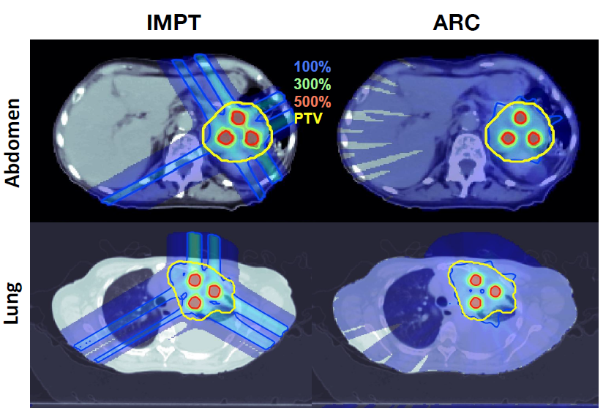
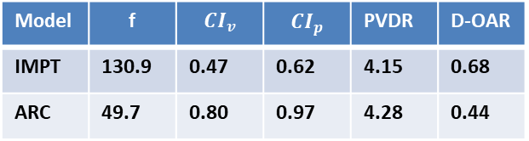
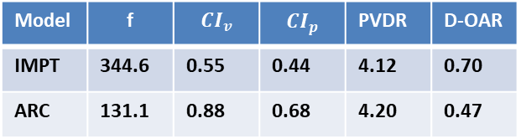
LATTICE Model
Abdomen
Model | f | $${CI}_{v}$$ | $${CI}_{p}$$ | PVDR | D-OAR
IMPT | 344.6 | 0.55 | 0.44 | 4.12 | 0.70
ARC | 131.1 | 0.88 | 0.68 | 4.20 | 0.47
Lung
Model | f | $${CI}_{v}$$ | $${CI}_{p}$$ | PVDR | D-OAR
IMPT | 130.9 | 0.47 | 0.62 | 4.15 | 0.68
ARC | 49.7 | 0.80 | 0.97 | 4.28 | 0.44
${CI}_{v}$is conformal index for valley region and${ CI}_{p}$ is conformal index for valley region
D-OAR are mean dose for stomach in abdomen and esophagus in lung.
4

Slide 9
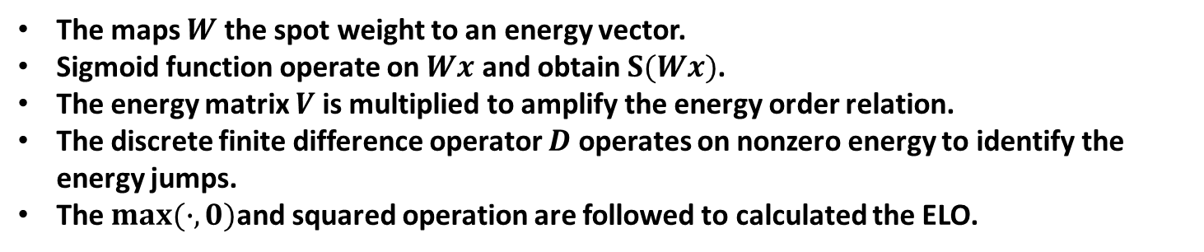
Energy layer Optimization
The ELO model takes the following form
$$ELO\left(x\right)={max⁡(D\left(V\left(S\left(Wx\right)\right)\right),0)}^{2}$$
where
The maps $W$ the spot weight to an energy vector.
Sigmoid function operate on $Wx$ and obtain $S(Wx)$.
The energy matrix $V$ is multiplied to amplify the energy order relation.
The discrete finite difference operator $D$ operates on nonzero energy to identify the energy jumps.
The $max(∙,0)$and squared operation are followed to calculated the ELO.
Zhang, G., Long, Y., Lin, Y., Chen, R. C., Gao, H., 2023. A treatment plan optimization method with direct minimization of number of energy jumps for proton arc therapy. Physics in Medicine & Biology, 68(8), 08500
5

Slide 10
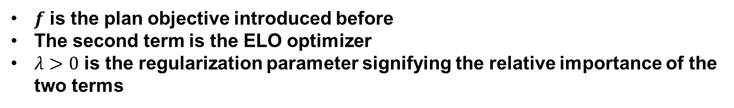
ELO model for Proton LATTICE ARC
The LATTICE ARC with ELO model takes the following form
$$\min_{x∈C} f\left(x\right)+λELO(x)$$
where
$f$ is the plan objective introduced before
The second term is the ELO optimizer
$λ>0$ is the regularization parameter signifying the relative importance of the two terms
Proximal Gradient Descent/ FISTA
6

Slide 11
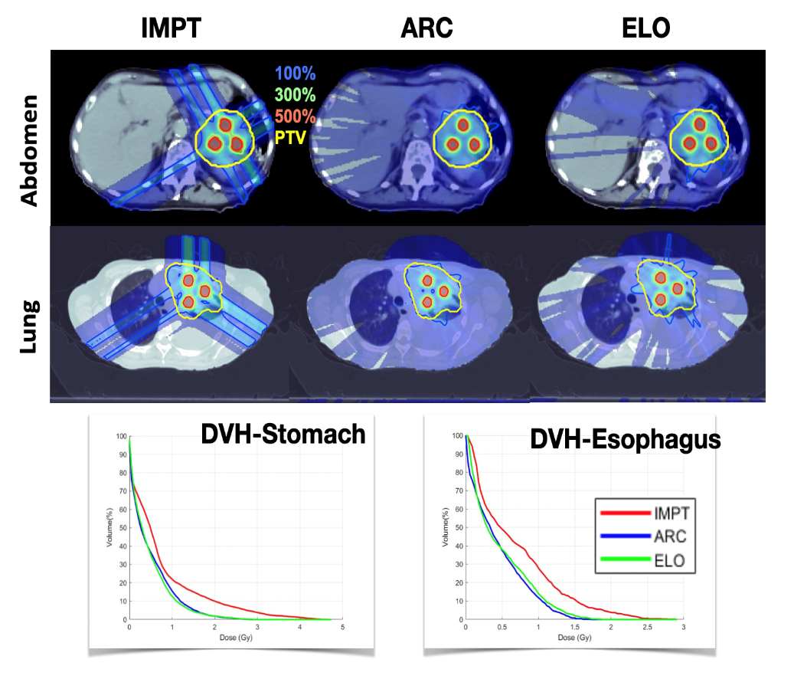
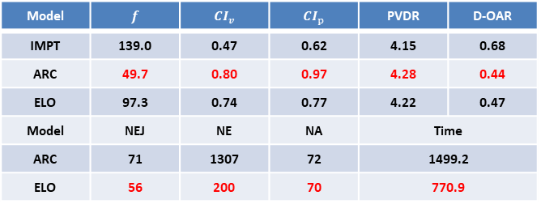
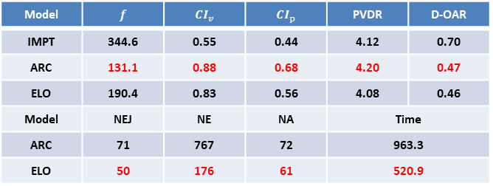
ELO model for Proton LATTICE ARC
Abdomen
Model | $$f$$ | $${CI}_{v}$$ | $${CI}_{p}$$ | PVDR | D-OAR
IMPT | 344.6 | 0.55 | 0.44 | 4.12 | 0.70
ARC | 131.1 | 0.88 | 0.68 | 4.20 | 0.47
ELO | 190.4 | 0.83 | 0.56 | 4.08 | 0.46
Model | NEJ | NE | NA | Time
ARC | 71 | 767 | 72 | 963.3
ELO | 50 | 176 | 61 | 520.9
Lung
Model | $$f$$ | $${CI}_{v}$$ | $${CI}_{p}$$ | PVDR | D-OAR
IMPT | 139.0 | 0.47 | 0.62 | 4.15 | 0.68
ARC | 49.7 | 0.80 | 0.97 | 4.28 | 0.44
ELO | 97.3 | 0.74 | 0.77 | 4.22 | 0.47
Model | NEJ | NE | NA | Time
ARC | 71 | 1307 | 72 | 1499.2
ELO | 56 | 200 | 70 | 770.9
7

Slide 12
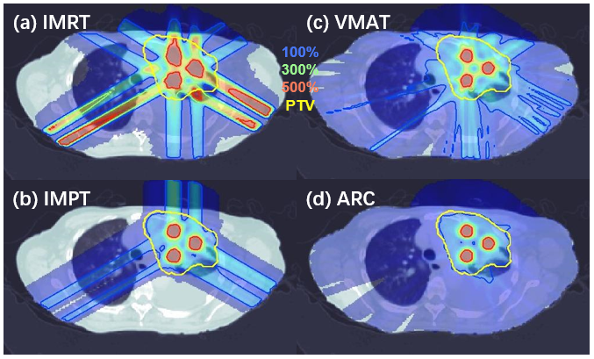
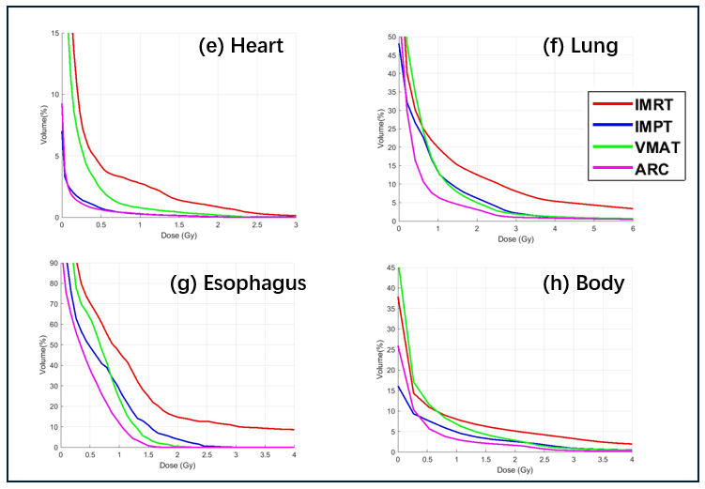
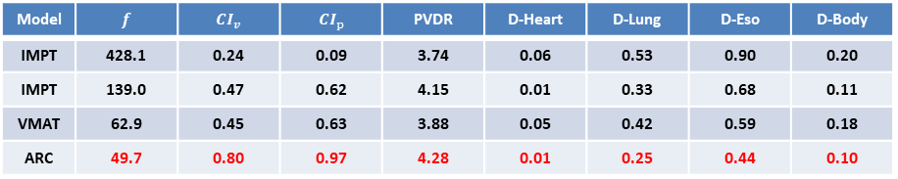
Comparisons
Model | $$f$$ | $${CI}_{v}$$ | $${CI}_{p}$$ | PVDR | D-Heart | D-Lung | D-Eso | D-Body
IMPT | 428.1 | 0.24 | 0.09 | 3.74 | 0.06 | 0.53 | 0.90 | 0.20
IMPT | 139.0 | 0.47 | 0.62 | 4.15 | 0.01 | 0.33 | 0.68 | 0.11
VMAT | 62.9 | 0.45 | 0.63 | 3.88 | 0.05 | 0.42 | 0.59 | 0.18
ARC | 49.7 | 0.80 | 0.97 | 4.28 | 0.01 | 0.25 | 0.44 | 0.10
8

Slide 13
Conclusions

Slide 14
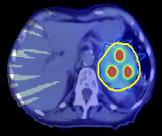
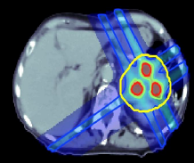
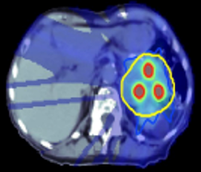
Conclusions
Problem
Models & Methods
Results
Abdomen
PGD
Conformal
RT
SFRT
LATTICE
LATTICE ARC
ELO
Exp
Efficiency
ADMM
Lung
9

Slide 15
Thank You!

