Slide 1
Airbnb
Personal project

Slide 2
OKR Model
Objectives:
Key Results:
● Increase the number of bookings in Rio de
Janeiro (RDJ).
● Attract new & retain existing customers in
the RDJ market.
● Improve the guest-host matching process
(speed + convenience).
● Total bookings increases over time.
● Cumulative customer base grows.
● Booking conversion increases over time.

Slide 3
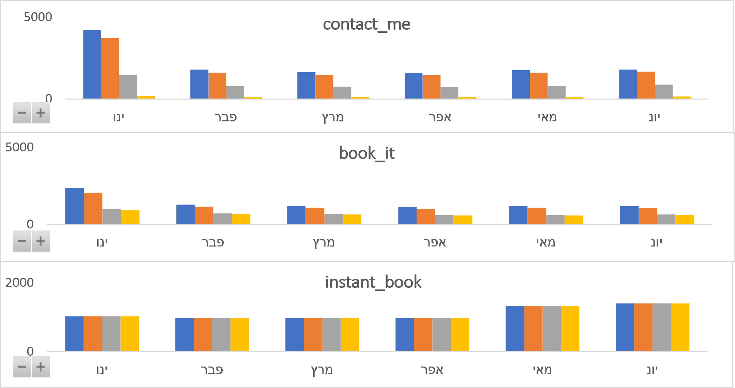
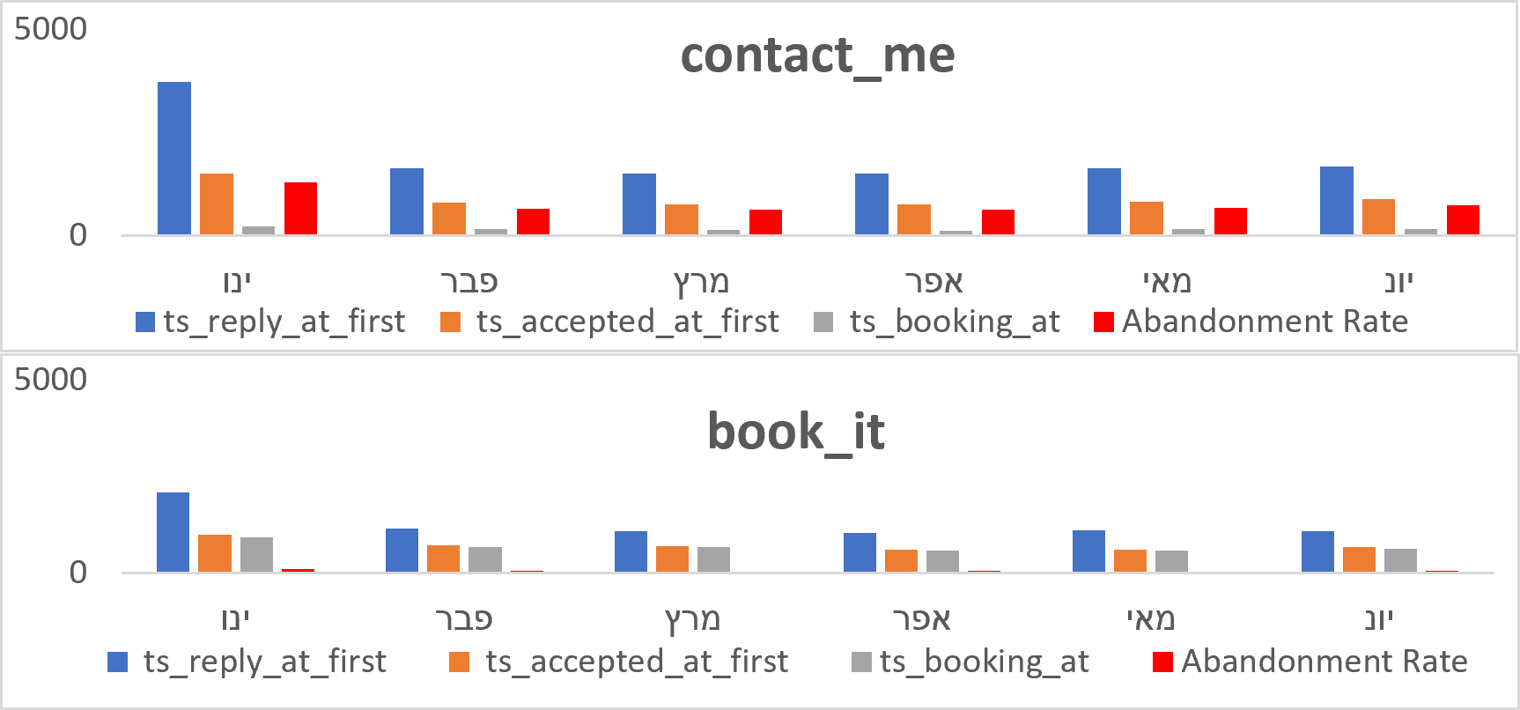
“Contact Me” performs poorly
For “Contact Me” channel ,there exists biggest drop-off last stage of booking funnel (yellow); that is , host accepts guest request, but guest does not convert (abandoned).
- Observe the abandonment (red; above), we see that for the “Contact Me” channel ,this metric is more then ~10x the same “Book It”.
- Drop-off between reply → acceptance (blue → orange) is about the same for both.

Slide 4
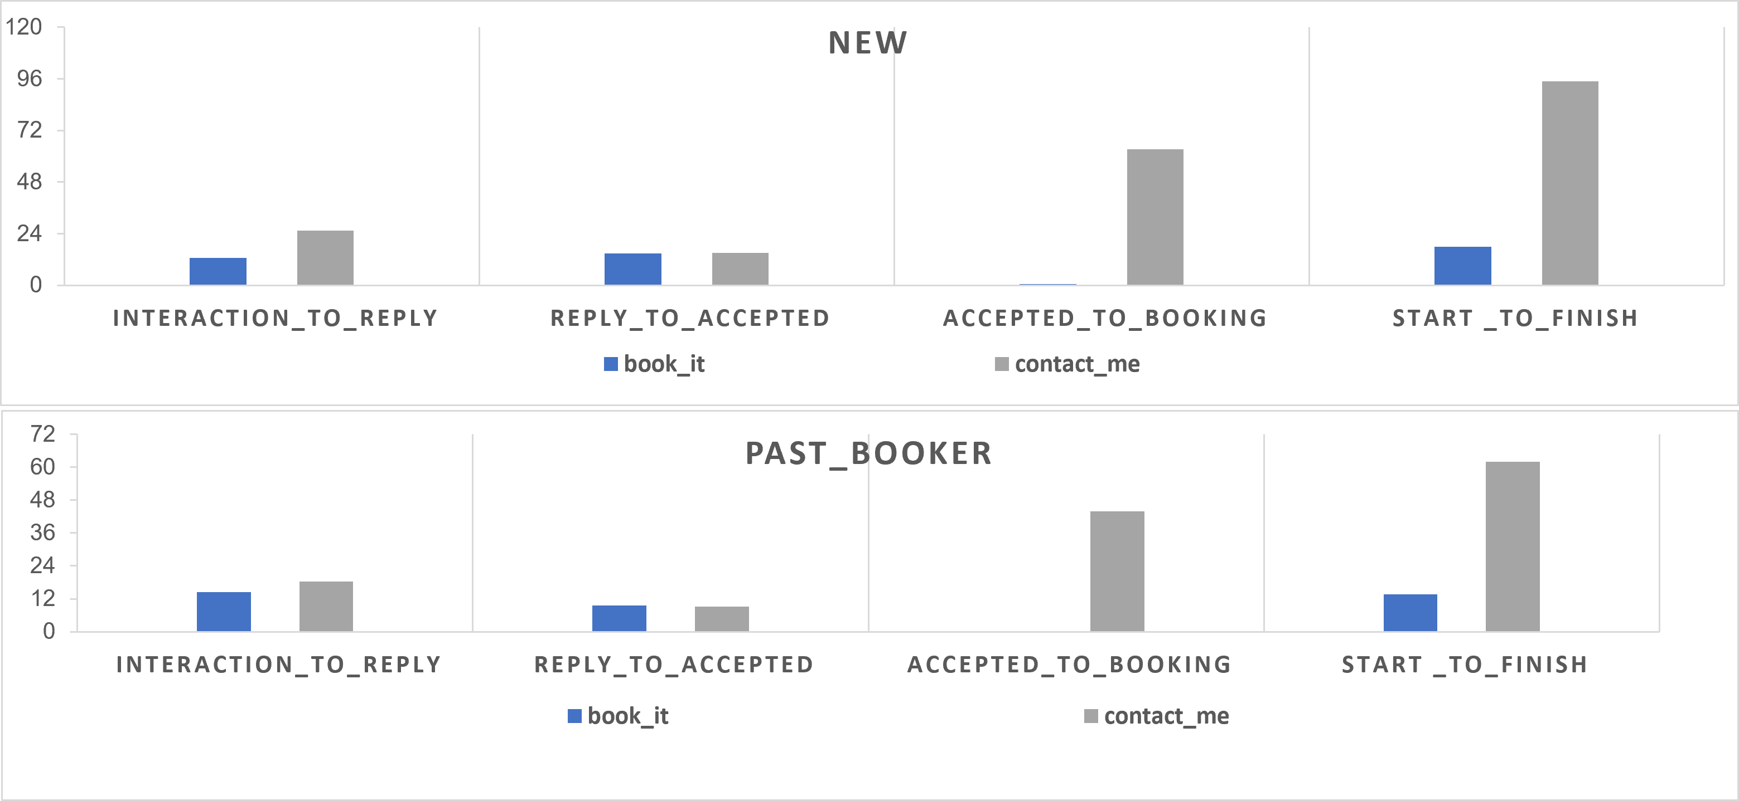
Contact Me vs Book it performs
● For new & past bookers alike, the average time it takes from
initial contact to 1st reply for the "Contact Me" channel
(gray) is much slower than "Book It" (2x slower for new!)
● Terrible customer experience for guests when seeking
travel accommodations (Why wait upwards of an entire day
just for a response?)
● Those who used “Contact Me” are waiting a very long time
(2+ days in some instances) after getting their booking
accepted by host to actually confirm, if at all. Speculation:
guests are indecisive.
● Total time spent in booking flow is 6x longer for
“Contact Me” than “Book It”.
Recommendation: Remove the “Contact Me” flow
altogether in favor of “Book It” and “Instant Book”
(where available).

Slide 5
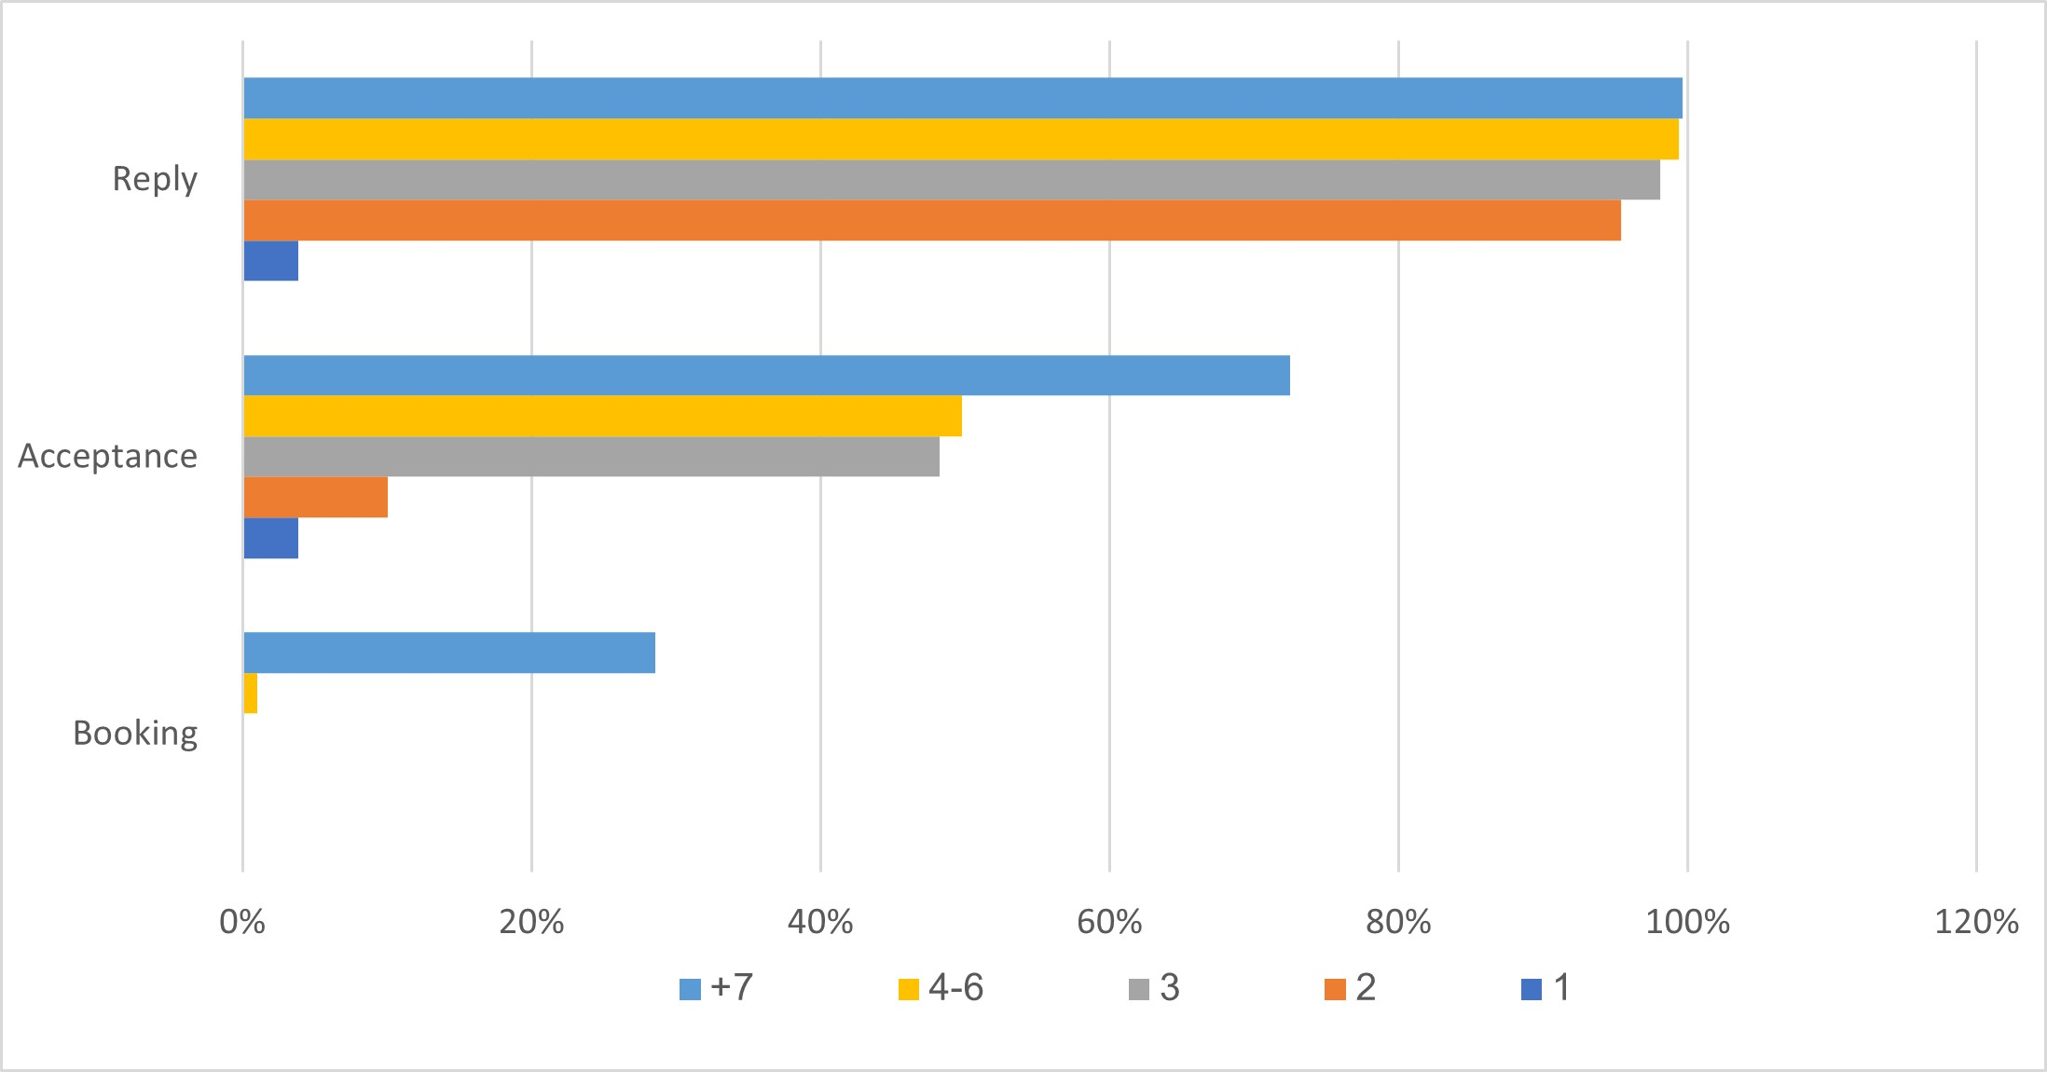
Impact of active communication between guests/hosts
If a company wants to continue with ‘Contact Me’ . Goal then becomes: Improve conversion improve conversion and understand at what stages we are losing potential customers.
Q: We will use the number of host/guest interactions to understand what impact the "active" has on reply/accept/booking rates?
We see that the more host/guest interaction it has a positive effect on both parties, hosts are more likely to accept bookings and guests are more likely to book when the number of interactions is 7+, where we have the highest booking conversion rate.
Recommendation: Require hosts to respond to initial message and encourage active communication between guests and hosts.

Slide 6
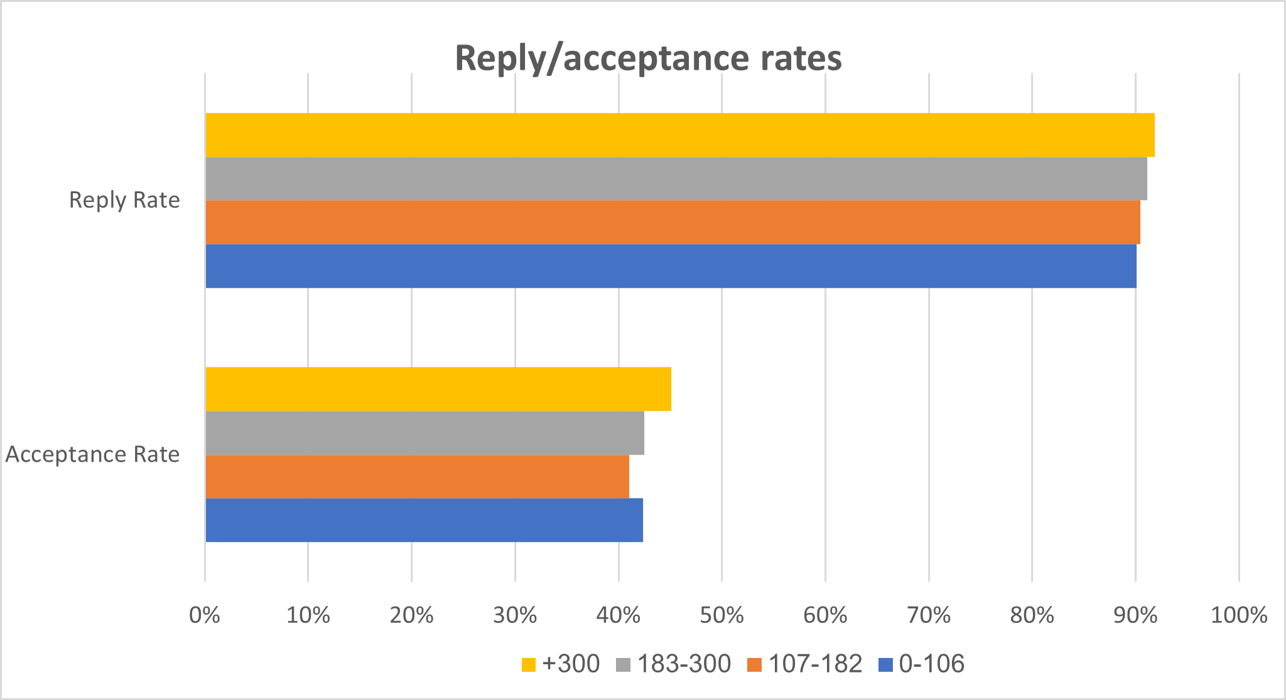
Impact of "m_first_message_length_in_characters"on reply & Booking Rates?
As we’ve shown, active communication between guest & host plays a significant
role in whether a booking is ultimately accepted/booked.
Q: In previous, we saw that many initial messages are never replied to. What
lever(s) can we pull to change that?
In the graph, we see that there is an effect on the number of characters for intelligence, the chances of response and acceptance by the host, as the guest provides the host with more information about which he tends to respond and accept his invitation.
Recommendation: Recommend that guests leave a certain number of characters.

Slide 7
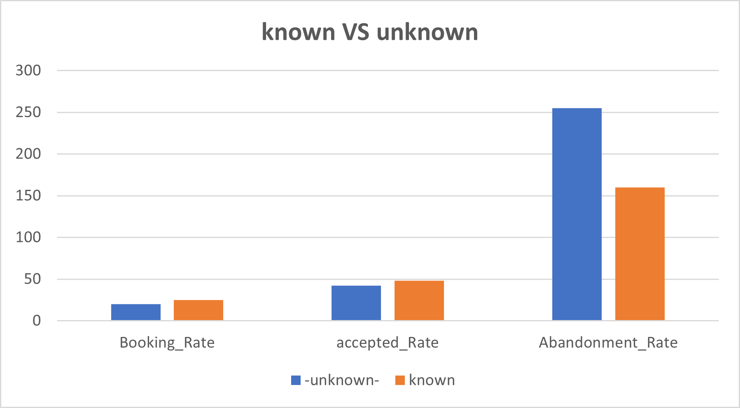
Does the neighborhood, known VS unknown , make a guest more likely to book?
We see very high abandonment rates when the neighborhood is unknown.
In addition, the acceptance and booking rates are low compared to the neighborhoods they are known.
Recommendation: Change the listing neighborhood to mandatory.

Slide 8
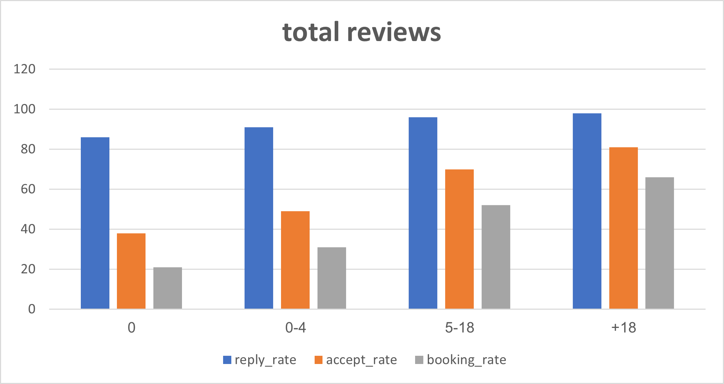
Does the amount of total reviews, make a guest more likely to book?
As the number of responses increases, we see that the rate of conversion to an order increases.
I guess it's because it makes the guest feel more secure when they hear about satisfied customers.
Recommendation: encourage customers to write comments By emphasizing the leave a comment button or by encouraging guests to leave a comment by giving them the opportunity to earn a point for every comment they leave and many other ways.

Slide 9
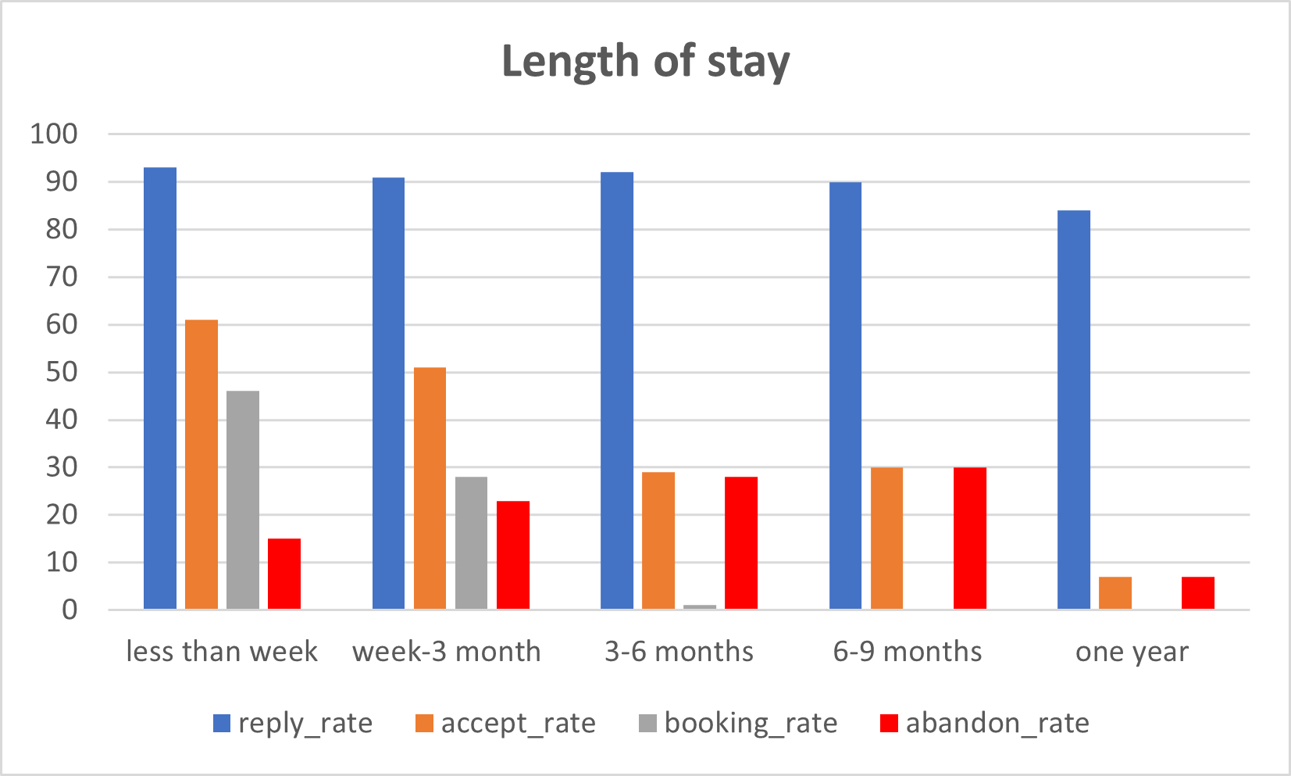
Length of stay
Equal to zero - one percent of orders, which means we have no success in long-term orders.
We see very high abandonment rates in orders of more than three months.
In addition, we will note that the acceptance percentage of the hosts is correspondingly smaller.
The big drop reads between the host's reply and his acceptance of the request.
For orders that are over three months old, it seems that the hosts are in no rush to accept the order.

Slide 10
Length of stay
Following on from the previous slide we saw that the longer the stay period, the lower the conversion to order.
I chose to check which contact channel the hosts use and found that from three months onward the hosts choose to use mainly/only contact me channel.
Recommendation: This reinforces our recommendation to initially stop using contact me channel.
But another figure that should be noted is that the demand rate for periods of more than three months is less than half a percent
Length_of_stay | contact_channel_first | order quantity rate | booking_rate
less than week/week | contact_me | 41 | 7
 | book_it | 31 | 49
 | instant_book | 27 | 100
week-3 month | book_it | 26 | 41
 | contact_me | 59 | 6
 | instant_book | 13 | 100
3-6 months | contact_me | 87 | 0
 | book_it | 12 | 9
6-9 months | contact_me | 100 | 0
ONE YEAR | contact_me | 100 | 0

