Slide 1
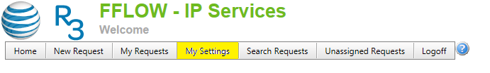
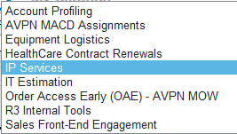


http://fflow.web.att.com/Default.aspx
For your initial set up, you will need to select your default Organization, which for INSTAR Tier 2
will be “IP SERVICES”. For your initial setup, use the following instructions:
Click “My Settings” menu item
Select the “Organization” you want to access from the dropdown (if you don’t see more than one entry in the dropdown then you are assigned to only one)
Click “Change Organization”. Note the Title of the form changes to the organization that you want to access
Start using the organization's features

Slide 2

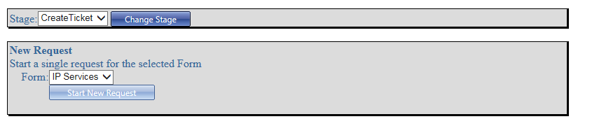
Create A new Request:
1. To create a new request, click on New Request from the menu bar.
2. Click Start New Request

Slide 3
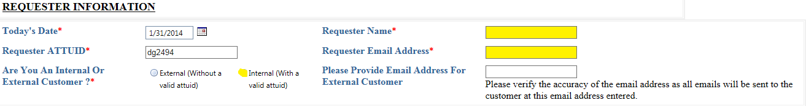
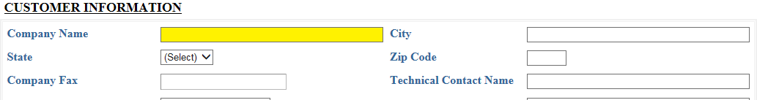
Complete Form
1. For Form Selection – Select No Specific Form Needed
2. For Requester Information– Fill out highlighted fields with your information
3. For Customer Information– You only need to provide customer name to save input time

Slide 4
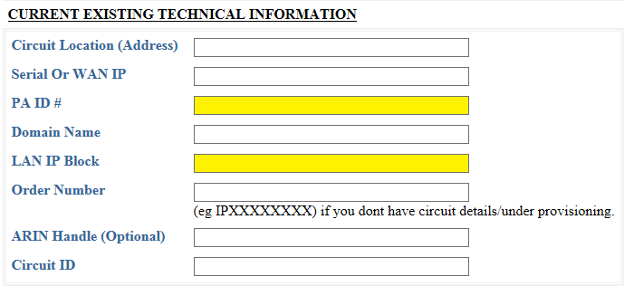
4. For Current Existing Technical Information – For requests to the IP Application Team for the
release of LAN IPs, please provide a minimum of the PAID and LAN IP Block

Slide 5
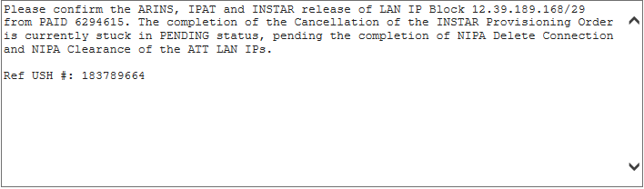
5. Populate the comment section below with a statement to request to the IP Applicatopn Team to release the LAN IP Block similar to the following:
Please confirm the ARINS, IPAT and INSTAR release of LAN IP Block 12.39.189.168/29 from PAID 6294615. The completion of the Cancellation of the INSTAR Provisioning Order is currently stuck in PENDING status, pending the completion of NIPA Delete Connection and NIPA Clearance of the ATT LAN IPs.
6. Click the Create Request button

