Slide 1
Attention Is All You Need
DUT
Academic
Ashish Vaswani, Noam Shazeer, Niki Parmar, Jakob Uszkoreit,
Llion Jones, Aidan N. Gomez, Łukasz Kaiser, Illia Polosukhin
Google Brain; Google Research; University of Toronto;
Independent (work performed while at Google Research)
31st Conference on Neural Information Processing Systems (NeurIPS 2017)
A new simple network architecture,
the Transformer, based solely on
attention mechanisms, dispensing with
recurrence and convolutions entirely.
自强不息 知行合一
Academic Presentation
1

Slide 2
Background: Sequence Transduction is Fundamental
DUT
Sequence tasks like translation are NLP's core; RNN encoder-decoder architectures dominated for a decade before attention improved them.
Core Tasks
RNN Era
Step Processing
Tasks like machine
The dominant approach
RNNs process sequences
translation, text
for over a decade:
step-by-step, maintaining
summarization, and
Recurrent Neural
a hidden state that
speech recognition
Networks (RNNs,
encodes history.
are core to NLP.
LSTMs, GRUs).
Encoder-Decoder
Attention
The encoder-decoder
Attention mechanisms were
framework became standard:
later added, allowing the
an encoder reads the
decoder to focus on
input, a decoder
relevant parts of the
generates the output.
input sequence.
海纳百川
2024
2

Slide 3
The Problem: The Sequential Computation Bottleneck
Sequential processing limits model scalability and training efficiency.
Key Challenges
Table 1: Maximum path lengths, per-layer complexity and minimum
number of sequential operations for different layer types.
1. RNNs are inherently sequential: to process
Layer Type
Complexity per Layer
Sequential Operations
Max Path Length
position 'n', you must first process
positions 1 through n-1.
Self-Attention
O(n² · d)
O(1)
O(1)
2. This results in O(n) sequential operations,
Recurrent
O(n · d²)
O(n)
O(n)
severely limiting parallelization during training.
3. Long training times for long sequences
Convolutional
O(k · n · d)
O(1)
O(logₖ(n))
become a major practical constraint.
4. Convolutional approaches (ByteNet, ConvS2S)
Self-Attention (restricted)
O(r · n · d)
O(1)
O(n/r)
enable parallel computation but introduce
another issue...
Note: n = sequence length, d = representation dimension, k = kernel size, r = neighborhood size
Source: Vaswani et al., "Attention Is All You Need" (2017)
5. The number of operations needed to connect
海纳百川 · 自强不息
2024
distant positions grows with distance
03 / 16
(e.g., O(logₖ(n))).

Slide 4
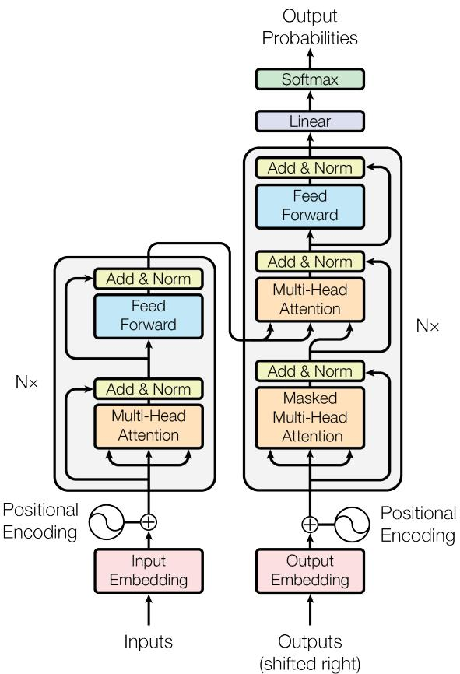
Our Solution: The Transformer
DUT
▸ Replaces recurrence & convolution with a purely attention-based, highly parallelizable encoder-decoder architecture.
Core Idea
Rely solely on attention mechanisms to compute
representations. No recurrence, no
convolution.
Architecture
1
Maintains the proven encoder-decoder
structure, but both are stacks of identical
layers.
2
Each layer has two sub-layers: Multi-Head
Self-Attention and a Position-wise
Feed-Forward Network.
3
Residual connections and layer normalization
are used around each sub-layer.
Sequence Order
To inject sequence order, we add Positional
海纳百川 · 自强不息
Encodings to the input embeddings.
2024
4
The Transformer - model architecture.

Slide 5
Technical Core: Scaled Dot-Product Attention
▸ Attention computes weighted values based on query-key compatibility, scaled by √dₖ for stability.
What is Attention
Weighted Sum
Matrix Form
Attention is a function that
The output is a weighted sum
We compute this for a matrix
maps a query and a set of
of the values, where the
of queries Q, keys K, and
key-value pairs to an output.
weight is the compatibility of
values V simultaneously.
the query with each key.
Attention(Q,K,V) = softmax
(QKT/√dk)V
The two most commonly used attention functions are additive attention and dot-product (multiplicative) attention.
Dot-product attention is identical to our algorithm, except for the scaling factor of 1/√dₖ.
While similar in theoretical complexity, dot-product attention is much faster and more space-efficient in practice.
海纳百川 · 自强不息
2024
05 / 16

Slide 6
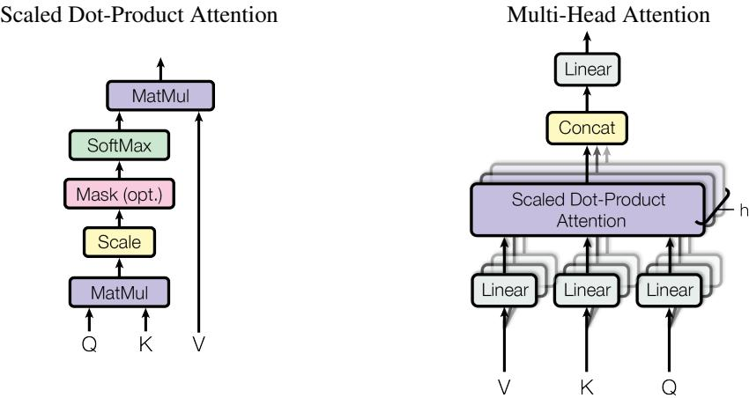
Technical Core: Multi-Head Attention
多头注意力让模型并行学习多组查询、键、值投影，增强表达能力
核心概念
模型能力
结构示意
1. 单注意力头执行加权平均，
3. 使模型能够同时关注来自
可能受到限制。
不同表示子空间的信息。
2. 多头注意力并行运行'h'个
4. 所有头的输出被拼接并
注意力头，每个头有独立的
投影到最终维度。
学习线性投影。
MultiHead(Q,K,V) =
(左) 缩放点积注意力
Concat(head₁,...,headₕ)Wᴼ
(右) 多头注意力并行运行
where headᵢ = Attention
(QWᵢᵠ, KWᵢᴷ, VWᵢⱽ)
海纳百川 · 自强不息
2024
06 / 16

Slide 7
Model Details: Positional Encoding & Feed-Forward Network
▸ Sinusoidal encodings provide order; position-wise FFN adds non-linear processing — together they enable sequence modeling without recurrence.
Problem
Encoding
Benefits & FFN
Since the model has no recurrence
We use sinusoidal positional
These encodings allow the model
or convolution, we must explicitly
encodings added to the input
to easily learn to attend by
inject information about the order
embeddings.
relative positions and generalize
of the sequence.
to longer sequences.
PE(pos,2i) = sin(pos/10000^(2i/d))
Each layer also contains a
PE(pos,2i+1) = cos(pos/10000^(2i/d))
Position-wise Feed-Forward
Sine and cosine functions of different frequencies
Network (FFN): a simple two-
layer MLP with ReLU, applied
identically to each position.
海纳百川 自强不息
2024
Source: Vaswani et al., 'Attention Is All You Need', 2017
7

Slide 8
Experimental Setup
We evaluate on standard translation benchmarks, compare against SOTA baselines, and use a carefully tuned learning rate schedule.
Tasks & Data
Evaluation & Baselines
Training Details
Machine Translation on
Evaluation Metric:
Optimizer: Adam
two major benchmarks:
BLEU score
β₁ = 0.9, β₂ = 0.98
ε = 10⁻⁹
• WMT 2014 EN-DE
Baselines:
Learning rate schedule:
4.5M sentence pairs
State-of-the-art
warmup then decay
• WMT 2014 EN-FR
models including:
lrate = d_model⁻⁰·⁵
36M sentence pairs
• GNMT+RL
· min(step_num⁻⁰·⁵,
• ConvS2S
step_num · warmup_steps⁻¹·⁵)
warmup_steps = 4000
• Their ensembles
Linear warmup for first warmup_steps,
then inverse square root decay.
大连理工大学 | WMT 2014 Benchmark
[Presentation Date]
8

Slide 9
Key Result: New State-of-the-Art in Translation
Transformer big sets new SOTA BLEU scores with a fraction of the training cost (FLOPs) of prior best ensembles.
BLEU Score & Training Cost Comparison
Model
EN-DE
EN-FR
EN-DE FLOPs
EN-FR FLOPs
BLEU
BLEU
ByteNet [18]
23.75
—
—
—
Deep-Att + PosUnk [39]
—
39.2
—
1.0·10²⁰
GNMT + RL [38]
24.6
39.92
2.3·10¹⁹
1.4·10²⁰
ConvS2S [9]
25.16
40.46
9.6·10¹⁸
1.5·10²⁰
MoE [32]
26.03
40.56
2.0·10¹⁹
1.2·10²⁰
Deep-Att + PosUnk Ensemble [39]
—
40.4
—
8.0·10²⁰
GNMT + RL Ensemble [38]
26.30
41.16
1.8·10²⁰
1.1·10²¹
ConvS2S Ensemble [9]
26.36
41.29
7.7·10¹⁹
1.2·10²¹
Transformer (base model)
27.3
38.1
—
3.3·10¹⁸
Transformer (big)
28.4
41.8
—
2.3·10¹⁹
EN-DE: Performance Lead
EN-FR: Efficiency Breakthrough
Conclusion
Transformer (big) scores 28.4
Achieves SOTA (41.8 BLEU)
Not just better, but vastly
BLEU, beating prior best by
with ~1/35th the FLOPs of
more efficient. A new
海纳百川
2023.10
+2.04 points.
best previous ensemble.
paradigm for NMT.
9
Source: Vaswani et al., 'Attention Is All You Need' (2017), Table 2

Slide 10
Ablation Study: Validating Design Choices
▸ 8 attention heads, sufficient dimensionality, and dropout are optimal; larger models perform better as expected.
Key Findings
• 8 heads optimal • d_k reduction hurts quality • Larger models perform better
• Dropout crucial for preventing overfitting • Sinusoidal ≈ learned positional encoding
Table 3: Transformer Architecture Ablation Study
N
d_model
d_ff
h
d_k
d_v
P_drop
ε_ls
train steps
PPL (dev)
BLEU (dev)
params×10⁶
base
6
512
8
64
64
0.1
0.1
100K
4.92
25.8
65
1
512
512
0.1
0.1
100K
5.29
24.9
-
4
128
128
0.1
0.1
100K
5.00
25.5
-
(A)
16
32
32
0.1
0.1
100K
4.91
25.8
-
32
16
16
0.1
0.1
100K
5.01
25.4
-
(B)
8
16
64
0.1
0.1
100K
5.16
25.1
58
8
32
64
0.1
0.1
100K
5.01
25.4
60
2
512
8
64
64
0.1
0.1
100K
6.11
23.7
36
4
512
8
64
64
0.1
0.1
100K
5.19
25.3
50
8
512
8
64
64
0.1
0.1
100K
4.88
25.5
80
Source: Vaswani et al., 'Attention Is All You Need' (2017)
Table 3: Variations on the Transformer architecture. Unlisted values are identical to those of the base model.
[Presentation Date]
All metrics are on the English-to-German translation development set, newstest2013.
10

Slide 11
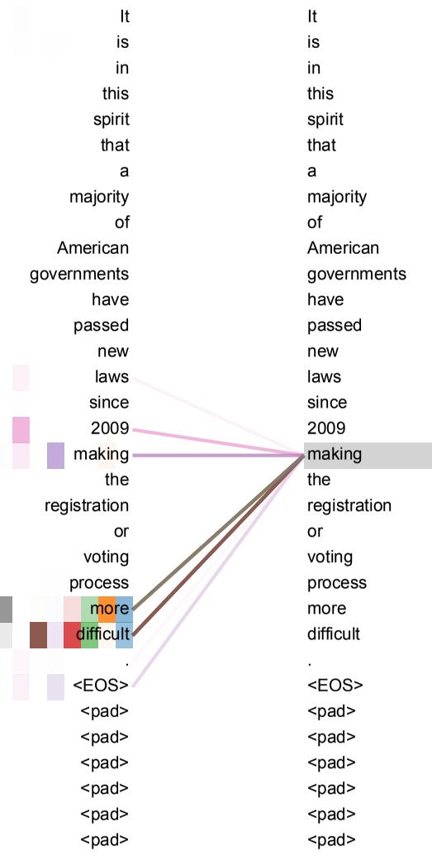
Interpretability: What Do the Attention Heads Learn?
Attention heads specialize in distinct linguistic functions, enabling interpretable model behavior.
Multi-Head Attention
Syntactic Dependencies
Anaphora Resolution
• Effective and interpretable
• Long-range verb linking
• Pronoun antecedent linking
• Heads specialize in tasks
• E.g., 'making' → 'difficult'
• E.g., 'its' → 'Law', 'application'
• Attend to neighbors or boundaries, capturing structural patterns
学而时习之，不亦说乎
Attention mechanism showing long-distance dependencies
11 / 16

Slide 12
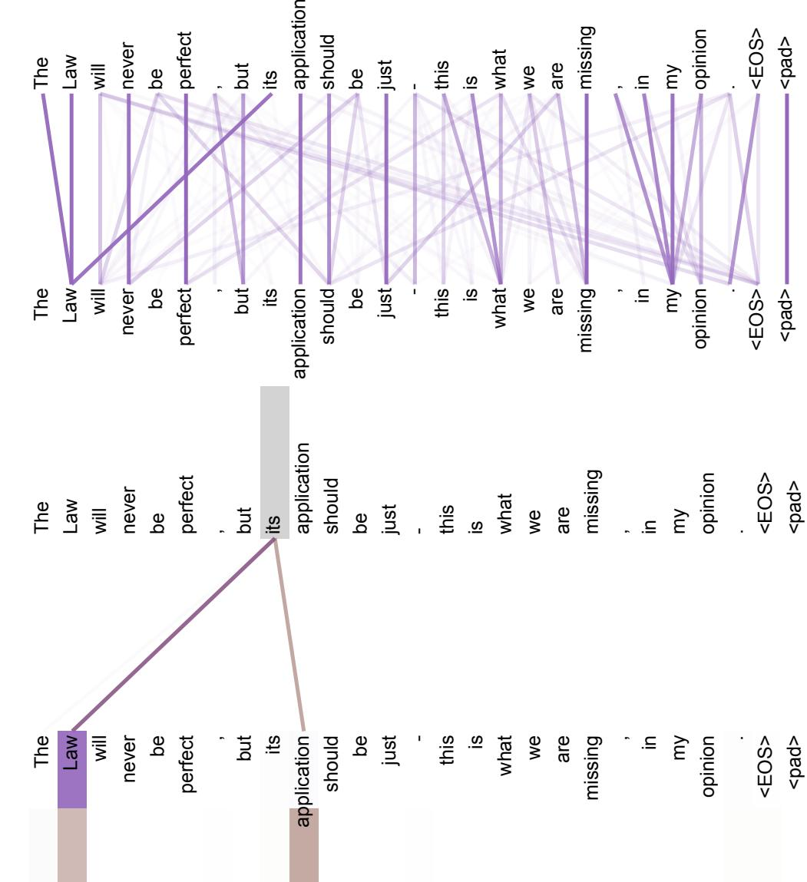
Interpretability: Specialized Attention Heads
Different attention heads specialize in distinct linguistic patterns, enabling nuanced understanding.
Local Bigram
Global Scope
Multi-Head Design
• Attends to immediate next word
• Broad attention to sentence end
• Different subspaces capture
• Learns local patterns
• Captures sentential structure
• Various relationships effectively
Two attention heads in layer 5 resolving anaphora. Head 5 focuses on 'Law', head 6 on 'application'.
Source: Attention is All You Need (Vaswani et al., 2017)
学而时习之 不亦说乎
12 / 16

Slide 13
Generalization: Strong Performance on Parsing
The Transformer demonstrates strong generalization capabilities in English constituency parsing.
Task Overview
Results
Conclusion
• Predict syntactic tree structure
• 91.3 F1 with 40K training sentences
• Proves Transformer’s versatility
• Applied to English constituency parsing
• Outperforms Berkeley Parser (90.4)
• Beyond machine translation tasks
• Semi-supervised: 92.7 F1
Table 4: The Transformer generalizes well to English constituency parsing
(Results are on Section 23 of WSJ)
Parser
Training
WSJ 23 F1
Vinyals & Kaiser el al. (2014) [37]
WSJ only, discriminative
88.3
Petrov et al. (2006) [29]
WSJ only, discriminative
90.4
Zhu et al. (2013) [40]
WSJ only, discriminative
90.4
Dyer et al. (2016) [8]
WSJ only, discriminative
91.7
Transformer (4 layers)
WSJ only, discriminative
91.3
Zhu et al. (2013) [40]
semi-supervised
91.3
学术严谨，追求卓越
Huang & Harper (2009) [14]
semi-supervised
91.3
13 / 16
McClosky et al. (2006) [26]
semi-supervised
92.1

Slide 14
Conclusion & Core Contributions
The Transformer fundamentally changed how we approach sequence modeling through attention mechanisms.
The Transformer
Key Contributions
Further Impact
• Introduced a paradigm shift: attention mechanisms alone are sufficient for state-of-the-art sequence modeling.
• Architecture: A novel, recurrence-free, convolution-free encoder-decoder model based solely on attention.
• Modeling: Constant operational path length between any two positions, facilitating learning of long-range dependencies.
• Efficiency: Massively parallelizable, leading to drastically reduced training times.
• Performance: Achieved new SOTA results on major machine translation benchmarks with lower cost.
• Generality: Demonstrated strong performance on English constituency parsing.
Dalian University of Technology
14 / 16

Slide 15
Impact & Future Directions
This work defined a new paradigm in NLP, powering the LLM revolution.
Impact
Future Directions
Notes
• The Transformer has become the foundational architecture for nearly all modern NLP (BERT, GPT, T5, etc.).
• Extending attention to other modalities (images, audio, video).
This work didn't just propose a model;
• Investigating efficient (local/restricted) attention for very long sequences.
it defined a new paradigm.
• Exploring non-autoregressive or less sequential generation methods.
Its impact is immense, powering the LLM
• The paper's final sentence: 'We leave this for future work.'
revolution. The future directions it
outlined are still active areas of
research today.
Dalian University of Technology
15 / 16

Slide 16
Questions & Discussion
▸ This discussion will address key questions and gather insights to shape our strategy.
Questions & Discussion
Thank you for your attention!
Questions and feedback are welcome.
Insights & Findings
Thank you for your attention!
Questions and feedback are welcome.
Slide 16 / 16

