Slide 1
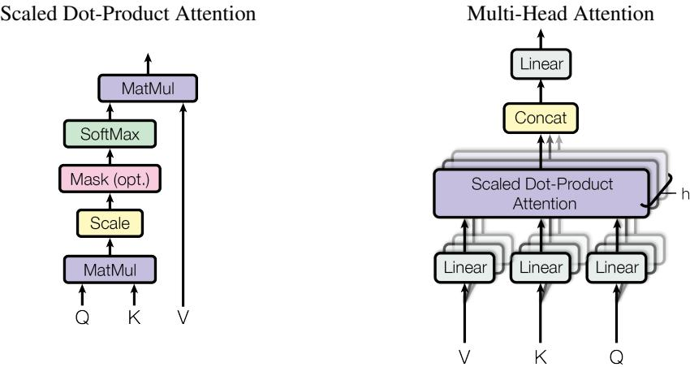
Technical Approach: Transformer Architecture
The Transformer consists of an encoder-decoder structure usingstacked self-attention and point-wise, fully connected layers.
Key components include multi-head attention, scaled dot-productattention, and position-wise feed-forward networks.
Positional encodings are used to inject sequence orderinformation.
(left) Scaled Dot-Product Attention. (right) Multi-Head Attention consists of several attention layers running in parallel.
4

