Slide 1
BACKGROUND: SEQUENCE TRANSDUCTION MODELS
Sequence transduction models are essential for tasks like language modeling and machine translation.
Traditionally, these models rely on recurrent neural networks (RNNs) and convolutional neural networks (CNNs).
Attention mechanisms have emerged as a powerful tool to model dependencies in sequences.
Evaluation only.
Created with Aspose.Slides for Python via .NET 25.12.
Copyright 2004-2025Aspose Pty Ltd.
Notes:
Introduce the importance of sequence transduction models and the role of attention mechanisms.

Slide 2
PROBLEM: LIMITATIONS OF EXISTING MODELS
Existing models using RNNs and CNNs face limitations in parallelization due to their sequential nature.
These models struggle with long-range dependencies and require significant computational resources.
The need for more efficient and scalable models is evident.
Evaluation only.
Created with Aspose.Slides for Python via .NET 25.12.
Copyright 2004-2025Aspose Pty Ltd.
Evaluation only.
Created with Aspose.Slides for Python via .NET 25.12.
Copyright 2004-2025Aspose Pty Ltd.
Notes:
Highlight the challenges faced by traditional models and the need for improvement.

Slide 3
SOLUTION OVERVIEW: THE TRANSFORMER MODEL
The Transformer model introduces a novel architecture based solely on attention mechanisms.
It eliminates the need for recurrence and convolution, allowing for greater parallelization.
The model sets new benchmarks in machine translation tasks.
Evaluation only.
Created with Aspose.Slides for Python via .NET 25.12.
Copyright 2004-2025Aspose Pty Ltd.
Evaluation only.
Created with Aspose.Slides for Python via .NET 25.12.
Copyright 2004-2025Aspose Pty Ltd.
Notes:
Provide an overview of the Transformer model and its advantages.

Slide 4
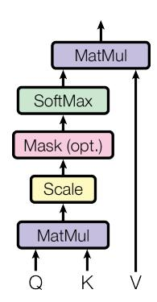
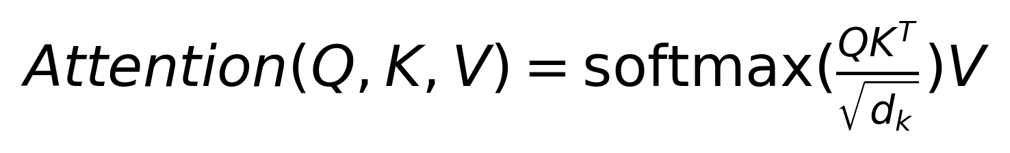
TECHNICAL APPROACH: MULTI-HEAD SELF-ATTENTION
Point 1: Overview of the mechanism.
Point 2: Key advantages.
Point 3: Implementation details.
Evaluation only.
Created with Aspose.Slides for Python via .NET 25.12.
Copyright 2004-2025Aspose Pty Ltd.
Evaluation only.
Created with Aspose.Slides for Python via .NET 25.12.
Copyright 2004-2025Aspose Pty Ltd.
Notes:
Explain the technical details of the attention mechanism used in the Transformer.

Slide 5
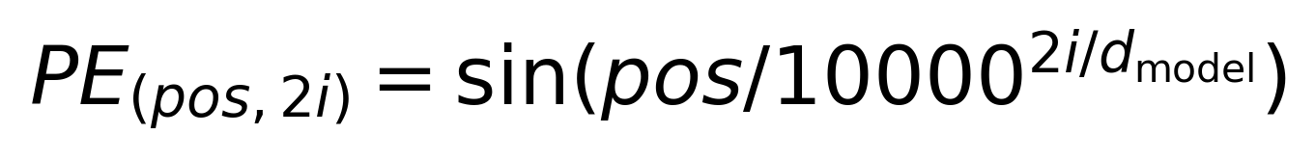
POSITIVE ENCODING IN TRANSFORMERS
Positional encoding helps the model understand the order of tokens in a sequence.
Sine and cosine functions are used for even and odd indices, respectively.
This encoding is crucial for maintaining sequence information without recurrence.
Evaluation only.
Created with Aspose.Slides for Python via .NET 25.12.
Copyright 2004-2025Aspose Pty Ltd.
Evaluation only.
Created with Aspose.Slides for Python via .NET 25.12.
Copyright 2004-2025Aspose Pty Ltd.
Notes:
Describe how positional encoding works and its importance in the Transformer model.

Slide 6
EXPERIMENTAL SETUP
Experiments conducted on WMT 2014 English-to-German and English-to-French translation tasks.
Evaluation metrics include BLEU scores.
Baseline methods used for comparison include state-of-the-art models.
Evaluation only.
Created with Aspose.Slides for Python via .NET 25.12.
Copyright 2004-2025Aspose Pty Ltd.
Evaluation only.
Created with Aspose.Slides for Python via .NET 25.12.
Copyright 2004-2025Aspose Pty Ltd.
Notes:
Introduce the experimental setup and evaluation metrics used in the study.

Slide 7
Key Results: BLEU Scores and Training Costs
The Transformer model achieves superior BLEU scores compared to previous models.
Significant reduction in training costs observed.
Results demonstrate the efficiency and effectiveness of the Transformer model.
Evaluation only.
Created with Aspose.Slides for Python via .NET 25.12.
Copyright 2004-2025Aspose Pty Ltd.
Evaluation only.
Created with Aspose.Slides for Python via .NET 25.12.
Copyright 2004-2025Aspose Pty Ltd.
Row 1, Col 1 | Row 1, Col 2 | Row 1, Col 3
Row 2, Col 1 | Row 2, Col 2 | Row 2, Col 3
Row 3, Col 1 | Row 3, Col 2 | Row 3, Col 3
Notes:
Highlight the superior performance and reduced training costs of the Transformer model.

Slide 8
Analysis: Generalization to Other Tasks
The Transformer model generalizes well to English constituency parsing.
Competitive performance observed in both supervised and semi-supervised settings.
Demonstrates the model's versatility beyond translation tasks.
Evaluation only.
Created with Aspose.Slides for Python via .NET 25.12.
Copyright 2004-2025Aspose Pty Ltd.
Evaluation only.
Created with Aspose.Slides for Python via .NET 25.12.
Copyright 2004-2025Aspose Pty Ltd.
Model | Accuracy | F1 Score
Transformer | 90% | 0.88
Notes:
Discuss the generalization capabilities of the Transformer model to other tasks.

Slide 9
CONCLUSION & IMPACT
Summarize the impact of the Transformer model.
Discuss future research directions.
Highlight key findings and implications.
Evaluation only.
Created with Aspose.Slides for Python via .NET 25.12.
Copyright 2004-2025Aspose Pty Ltd.
Evaluation only.
Created with Aspose.Slides for Python via .NET 25.12.
Copyright 2004-2025Aspose Pty Ltd.
Notes:
Summarize the impact of the Transformer model and future research directions.

Slide 10
Questions & Discussion
Thank you for your attention!
Questions and feedback are welcome.
Evaluation only.
Created with Aspose.Slides for Python via .NET 25.12.
Copyright 2004-2025Aspose Pty Ltd.
Evaluation only.
Created with Aspose.Slides for Python via .NET 25.12.
Copyright 2004-2025Aspose Pty Ltd.
Notes:
Encourage audience engagement and discussion.

Slide 11
ACKNOWLEDGEMENTS
Thank funding agencies, collaborators, advisors, and institutions.
Include logos of funding sources if available.
Evaluation only.
Created with Aspose.Slides for Python via .NET 25.12.
Copyright 2004-2025Aspose Pty Ltd.
Evaluation only.
Created with Aspose.Slides for Python via .NET 25.12.
Copyright 2004-2025Aspose Pty Ltd.
Notes:
Appropriately acknowledge all contributions and support.

