Slide 1
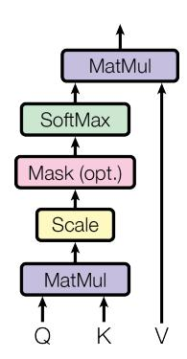
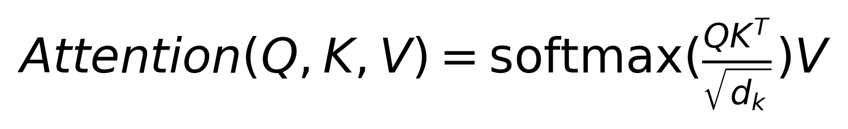
TECHNICAL APPROACH: MULTI-HEAD SELF-ATTENTION
Point 1: Overview of the mechanism.
Point 2: Key advantages.
Point 3: Implementation details.
Notes:
Explain the technical details of the attention mechanism used in the Transformer.

