Slide 1
Background: Sequence Transduction is Transforming the World
Sequence transduction is crucial for tasks like language modeling and machine translation.
Sequence transduction is crucial for tasks like language modeling and machine translation.
Traditionally, RNNs and CNNs have been the state-of-the-art methods.
Attention mechanisms have been used to improve performance in these models.
Evaluation only.
Created with Aspose.Slides for Python via .NET 25.12.
Copyright 2004-2025Aspose Pty Ltd.

Slide 2
The Problem: Limitations of Existing Methods
RNNs and CNNs face limitations in parallelization due to their sequential nature.
RNNs and CNNs face limitations in parallelization due to their sequential nature.
These limitations restrict computational efficiency and scalability, especially for long sequences.
A new approach is needed to overcome these constraints.
Evaluation only.
Created with Aspose.Slides for Python via .NET 25.12.
Copyright 2004-2025Aspose Pty Ltd.
Evaluation only.
Created with Aspose.Slides for Python via .NET 25.12.
Copyright 2004-2025Aspose Pty Ltd.

Slide 3
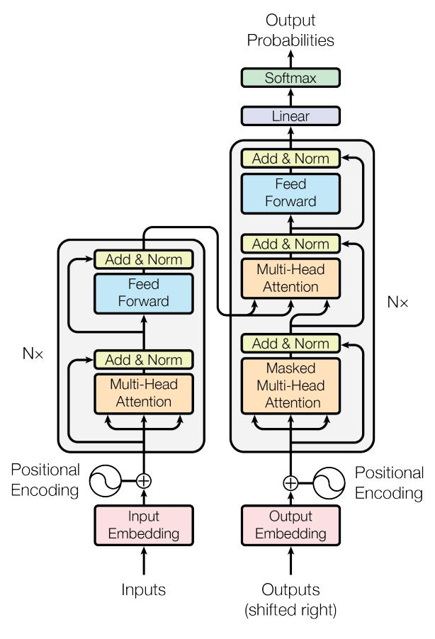
Our Core Contribution: The Transformer Model
Introduced a novel architecture based solely on attention mechanisms.
Eliminates the need for recurrence and convolution.
Allows for greater parallelization and improved translation quality.
Evaluation only.
Created with Aspose.Slides for Python via .NET 25.12.
Copyright 2004-2025Aspose Pty Ltd.
Evaluation only.
Created with Aspose.Slides for Python via .NET 25.12.
Copyright 2004-2025Aspose Pty Ltd.

Slide 4
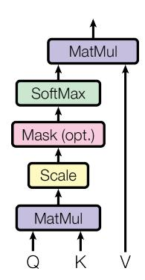
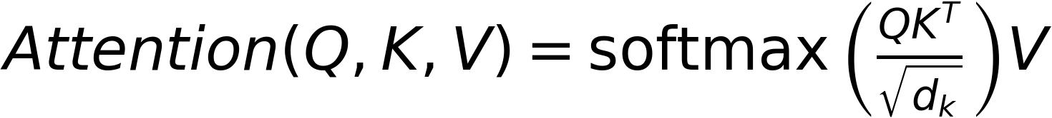
Methodology: Attention Mechanisms
The Transformer uses a multi-head attention mechanism.
Includes scaled dot-product attention and positional encoding.
Handles sequence order without recurrence.
Evaluation only.
Created with Aspose.Slides for Python via .NET 25.12.
Copyright 2004-2025Aspose Pty Ltd.
Evaluation only.
Created with Aspose.Slides for Python via .NET 25.12.
Copyright 2004-2025Aspose Pty Ltd.

Slide 5
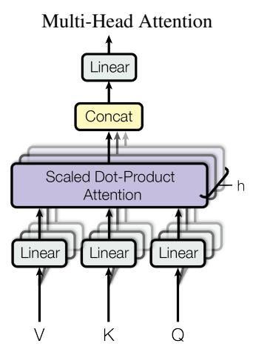
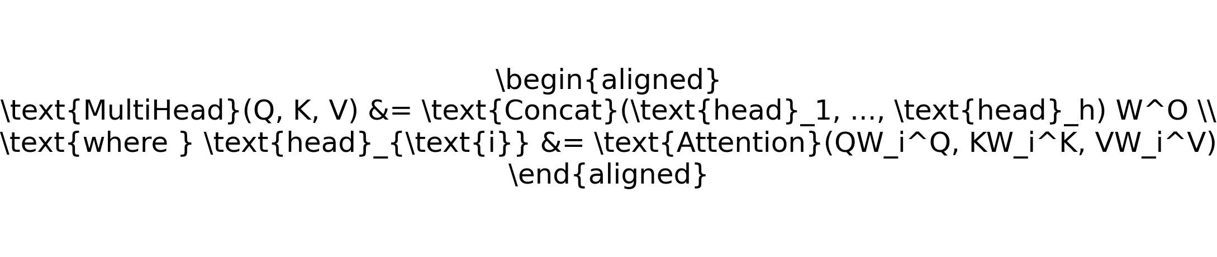
Technical Approach: Multi-Head Attention
Multi-head attention allows the model to attend to different parts of the input sequence simultaneously.
Each head performs scaled dot-product attention.
Results are concatenated and linearly transformed.
Evaluation only.
Created with Aspose.Slides for Python via .NET 25.12.
Copyright 2004-2025Aspose Pty Ltd.
Evaluation only.
Created with Aspose.Slides for Python via .NET 25.12.
Copyright 2004-2025Aspose Pty Ltd.

Slide 6
Experimental Setup
Experiments conducted on WMT 2014 English-to-German and English-to-French translation tasks.
Evaluation metrics include BLEU scores.
Baseline methods include state-of-the-art models like GNMT and ConvS2S.
Evaluation only.
Created with Aspose.Slides for Python via .NET 25.12.
Copyright 2004-2025Aspose Pty Ltd.
Evaluation only.
Created with Aspose.Slides for Python via .NET 25.12.
Copyright 2004-2025Aspose Pty Ltd.

Slide 7
Key Results: BLEU Scores and Training Efficiency
The Transformer achieves superior BLEU scores compared to previous models.
Significantly reduced training costs and time.
Demonstrates the model's efficiency and effectiveness.
Evaluation only.
Created with Aspose.Slides for Python via .NET 25.12.
Copyright 2004-2025Aspose Pty Ltd.
Evaluation only.
Created with Aspose.Slides for Python via .NET 25.12.
Copyright 2004-2025Aspose Pty Ltd.
Model | BL | EU | Training C | Training Cost (FLOPs)

Slide 8
Ablation Study: Component Effectiveness
Ablation studies confirm the effectiveness of various model components.
Multi-head attention and positional encoding are critical for performance.
The model's architecture allows for efficient parallelization.
Evaluation only.
Created with Aspose.Slides for Python via .NET 25.12.
Copyright 2004-2025Aspose Pty Ltd.
Evaluation only.
Created with Aspose.Slides for Python via .NET 25.12.
Copyright 2004-2025Aspose Pty Ltd.
Table 3: Variations on the Transformer architecture.

Slide 9
Conclusion and Future Directions
The Transformer model offers a more efficient and scalable approach to sequence transduction.
Achieved state-of-the-art results in machine translation tasks.
Future work includes exploring other applications and further optimizing the model.
Evaluation only.
Created with Aspose.Slides for Python via .NET 25.12.
Copyright 2004-2025Aspose Pty Ltd.
Evaluation only.
Created with Aspose.Slides for Python via .NET 25.12.
Copyright 2004-2025Aspose Pty Ltd.

Slide 10
Questions & Discussion
Thank you for your attention!
Questions and feedback are welcome.
Evaluation only.
Created with Aspose.Slides for Python via .NET 25.12.
Copyright 2004-2025Aspose Pty Ltd.
Evaluation only.
Created with Aspose.Slides for Python via .NET 25.12.
Copyright 2004-2025Aspose Pty Ltd.

