Slide 1
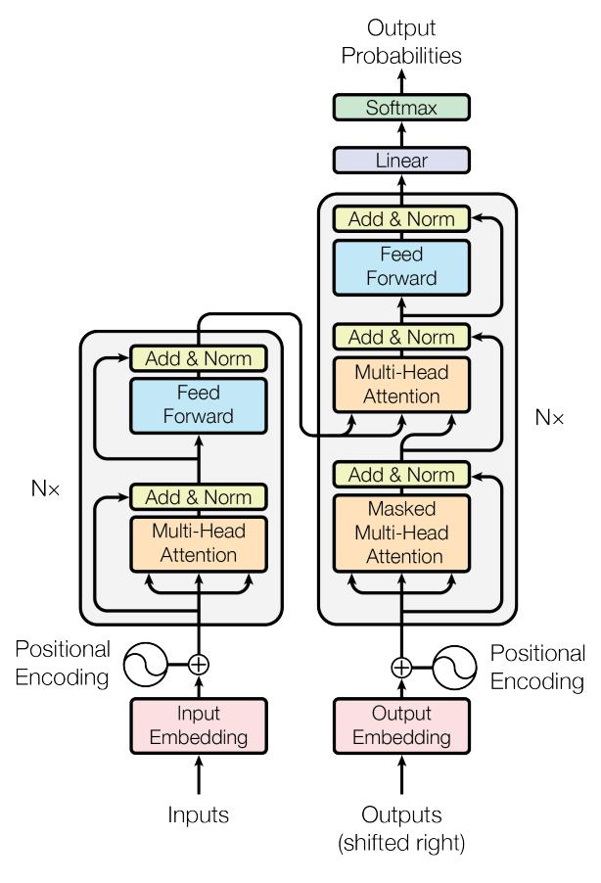
Our Core Contribution: The Transformer Model
Introduced a novel architecture based solely on attention mechanisms.
Eliminates the need for recurrence and convolution.
Allows for greater parallelization and improved translation quality.

