Slide 1
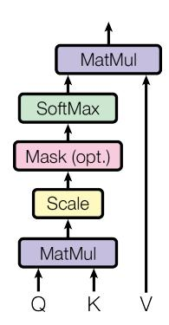
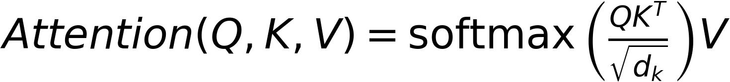
Methodology: Attention Mechanisms
The Transformer uses a multi-head attention mechanism.
Includes scaled dot-product attention and positional encoding.
Handles sequence order without recurrence.

