Slide 1
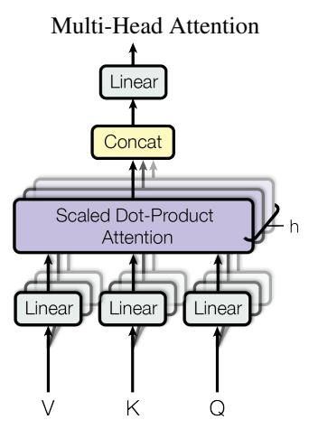
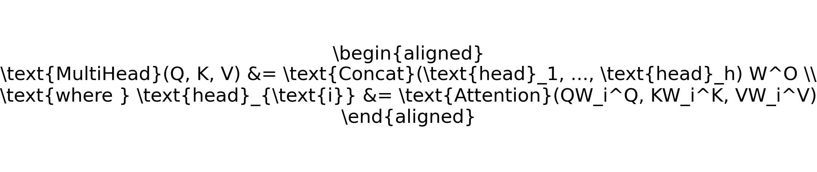
Technical Approach: Multi-Head Attention
Multi-head attention allows the model to attend to different parts of the input sequence simultaneously.
Each head performs scaled dot-product attention.
Results are concatenated and linearly transformed.

