Slide 1
Background: Sequence Transduction Models in AI
Sequence transduction models are foundational for tasks like language modeling, machine translation, and parsing.
Traditional models rely on recurrent neural networks (RNNs) and convolutional neural networks (CNNs), which are computationally intensive.
Attention mechanisms have emerged as a powerful tool to model dependencies in sequences, enabling more efficient computation.
Notes:
Introduce the audience to the importance of sequence transduction models and the role of attention mechanisms in advancing the field.

Slide 2
Problem: Limitations of Traditional Models
RNNs and CNNs face challenges in parallelization due to their sequential nature, which affects training efficiency and scalability. These models struggle with long-range dependencies, requiring significant computational resources. A more efficient and scalable approach is needed to address these limitations.
Academic Blue Professional Theme
Notes:
Highlight the specific challenges faced by traditional models and set the stage for the proposed solution.

Slide 3
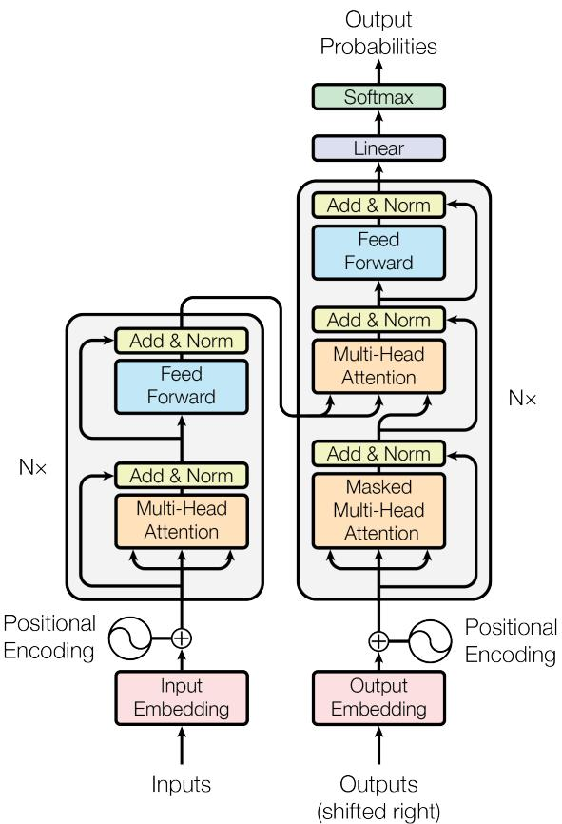
Solution Overview: The Transformer Model
The Transformer introduces a novel architecture based entirely on attention mechanisms, eliminating recurrence and convolution.
This approach enhances parallelization, reduces training time, and improves translation quality.
Key innovations include multi-head self-attention and positional encoding to capture sequence order.
The Transformer - model architecture.
Academic Blue Professional Theme
Notes:
Provide a high-level overview of the Transformer model and its key innovations, supported by the architecture diagram.

Slide 4
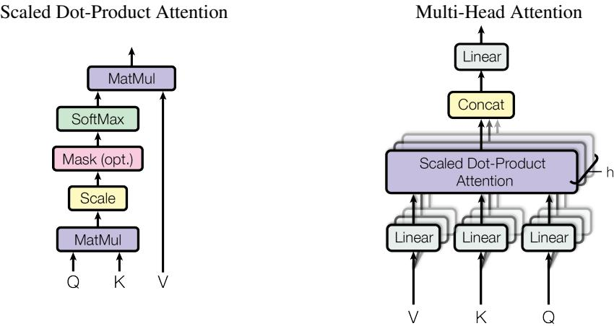
Methodology: Attention Mechanisms
The Transformer uses scaled dot-product attention to compute attention weights efficiently.
Multi-head attention allows the model to focus on different parts of the input sequence simultaneously.
Positional encoding helps the model understand the order of tokens in a sequence.
(left) Scaled Dot-Product Attention. (right) Multi-Head Attention consists of several attention layers running in parallel.
Notes:
Explain the core attention mechanisms used in the Transformer, supported by visual illustrations.

Slide 5
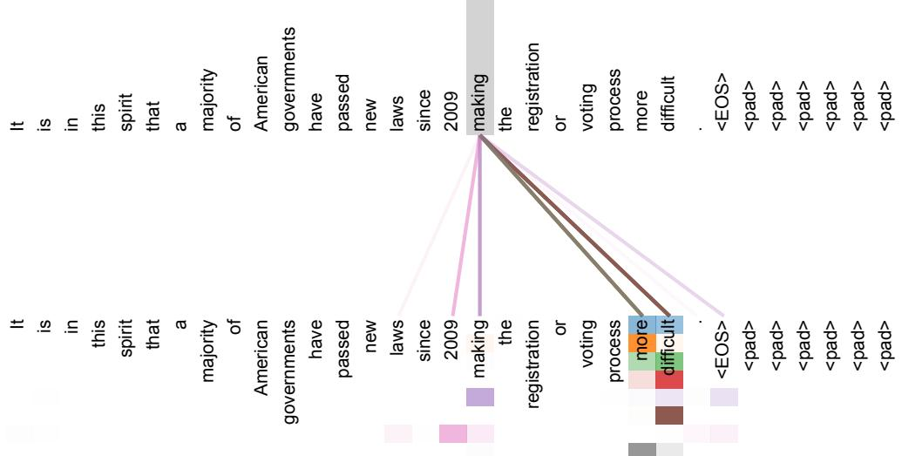
Technical Details: Self-Attention and Positional Encoding
Self-attention enables the model to capture dependencies between tokens, regardless of their distance in the sequence.
Positional encoding uses sine and cosine functions to represent the position of tokens.
These components work together to model sequence order and relationships effectively.
Presenter Name | Slide Number
An example of the attention mechanism following long-distance dependencies in the encoder self-attention in layer 5 of 6.
Notes:
Dive deeper into self-attention and positional encoding, using a figure to illustrate long-distance dependencies.

Slide 6
Experimental Setup: Datasets and Metrics
Experiments were conducted on WMT 2014 English-to-German and English-to-French translation tasks.
BLEU scores were used as the primary evaluation metric to measure translation quality.
Baseline methods included state-of-the-art RNN and CNN models.
Footer text
Notes:
Provide an overview of the experimental setup, including datasets, metrics, and baseline methods.

Slide 8
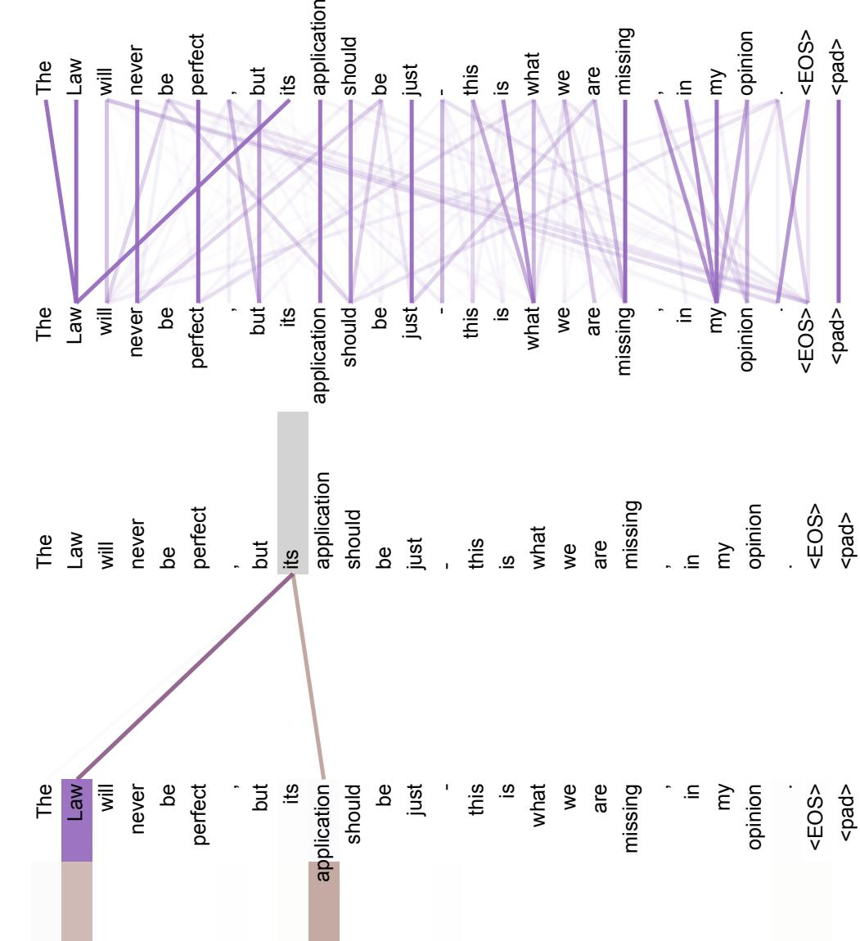
Analysis: Attention Mechanism Insights
Attention heads capture long-distance dependencies, crucial for understanding complex sentence structures. Some attention heads specialize in tasks like anaphora resolution and syntactic structure modeling. These insights demonstrate the versatility and effectiveness of the attention mechanism.
Slide 8 | Academic Blue Professional Theme
Two attention heads, also in layer 5 of 6, apparently involved in anaphora resolution.
Notes:
Discuss the qualitative insights gained from analyzing attention heads, supported by visual examples.

Slide 9
Conclusion: Impact and Future Directions
The Transformer sets a new benchmark for sequence transduction models, offering faster training and improved performance.
Future work includes extending the model to other modalities like images and audio.
Exploring restricted attention mechanisms for large inputs is another promising direction.
Generated by Python-pptx
Notes:
Summarize the impact of the Transformer and outline potential future research directions.

Slide 10
Questions & Discussion
Thank you for your attention!
Questions and feedback are welcome.
Slide 10 | Academic Blue Professional Theme
Notes:
Encourage audience engagement and discussion.

