Slide 1
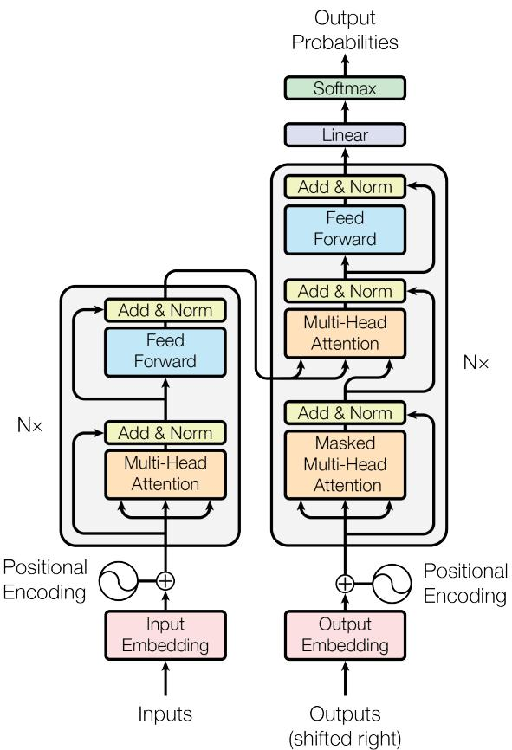
Solution Overview: The Transformer Model
The Transformer introduces a novel architecture based entirely on attention mechanisms, eliminating recurrence and convolution.
This approach enhances parallelization, reduces training time, and improves translation quality.
Key innovations include multi-head self-attention and positional encoding to capture sequence order.
The Transformer - model architecture.
Academic Blue Professional Theme
Notes:
Provide a high-level overview of the Transformer model and its key innovations, supported by the architecture diagram.

