Slide 1
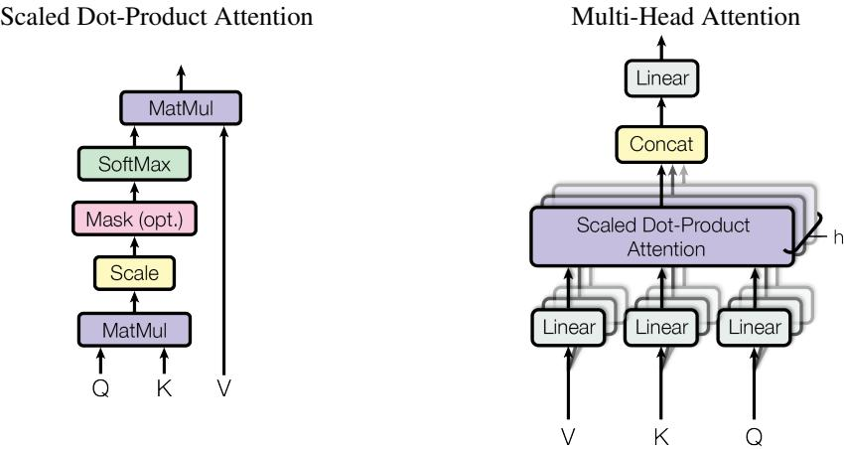
Methodology: Attention Mechanisms
The Transformer uses scaled dot-product attention to compute attention weights efficiently.
Multi-head attention allows the model to focus on different parts of the input sequence simultaneously.
Positional encoding helps the model understand the order of tokens in a sequence.
(left) Scaled Dot-Product Attention. (right) Multi-Head Attention consists of several attention layers running in parallel.
Notes:
Explain the core attention mechanisms used in the Transformer, supported by visual illustrations.

