Slide 1
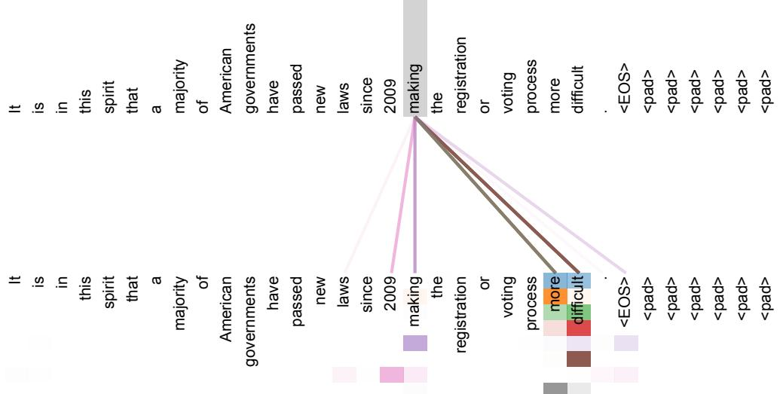
Technical Details: Self-Attention and Positional Encoding
Self-attention enables the model to capture dependencies between tokens, regardless of their distance in the sequence.
Positional encoding uses sine and cosine functions to represent the position of tokens.
These components work together to model sequence order and relationships effectively.
Presenter Name | Slide Number
An example of the attention mechanism following long-distance dependencies in the encoder self-attention in layer 5 of 6.
Notes:
Dive deeper into self-attention and positional encoding, using a figure to illustrate long-distance dependencies.

