Slide 1
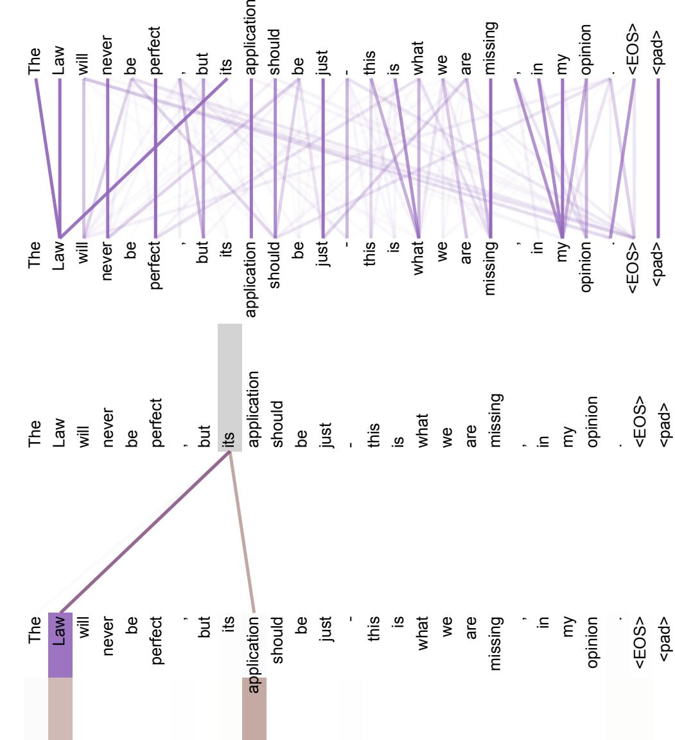
Analysis: Attention Mechanism Insights
Attention heads capture long-distance dependencies, crucial for understanding complex sentence structures. Some attention heads specialize in tasks like anaphora resolution and syntactic structure modeling. These insights demonstrate the versatility and effectiveness of the attention mechanism.
Slide 8 | Academic Blue Professional Theme
Two attention heads, also in layer 5 of 6, apparently involved in anaphora resolution.
Notes:
Discuss the qualitative insights gained from analyzing attention heads, supported by visual examples.

