Slide 1

Image and Video Compression Laboratory
Optimization
Final Presentation: Yanchen Huang, Chang Liu

Slide 2
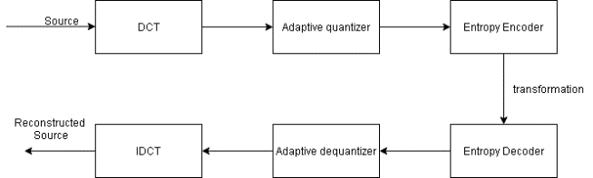
Adaptive quantization
Sparsity of each block
2. determine a suitable qScale
Block
Rec_block
Adaptive quantization factor

Slide 3
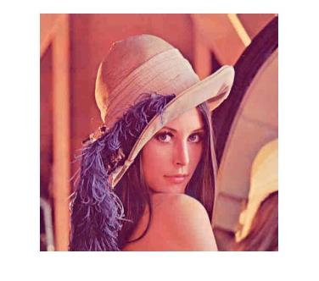


Sparsity
The complexity of each DCT block is different
The more big coefficients after DCT
More details

Slide 4
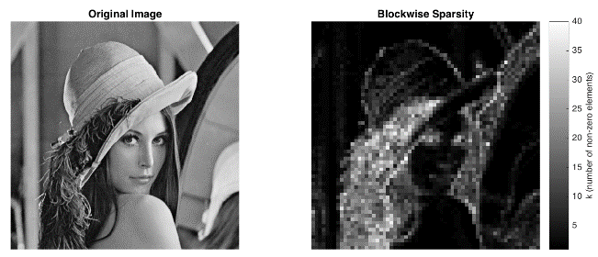
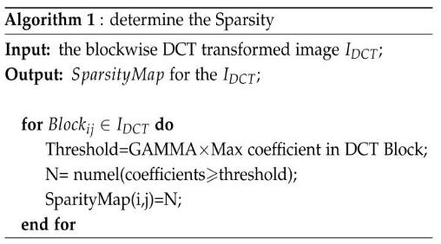
Sparsity

Slide 5
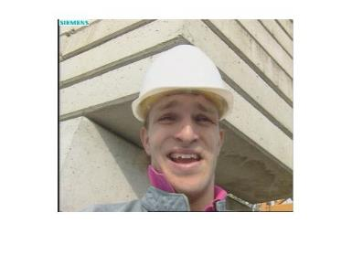
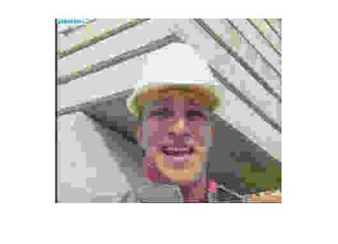
suitable qScale
qScale: Factor of standard quantization table，
more bits for “Detail” block， less bits for “simple” block.
small qScale
large qScale
small qScale
lager qScale

Slide 6
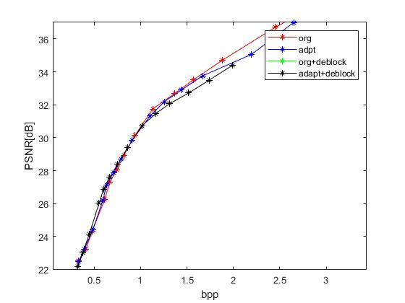
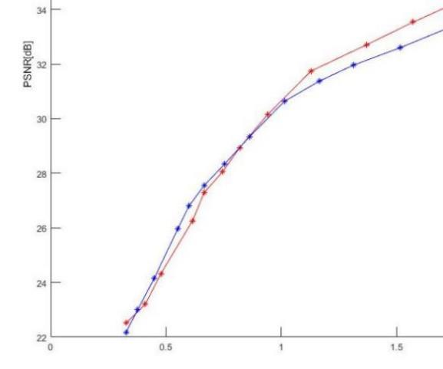
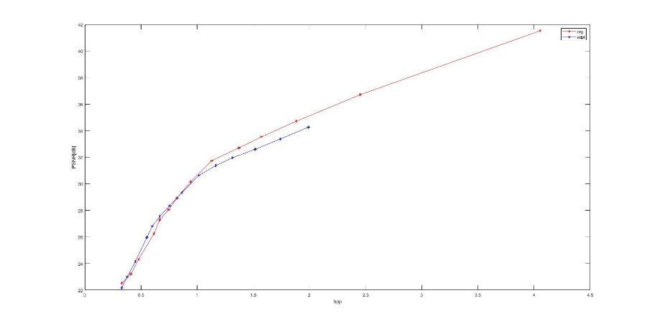
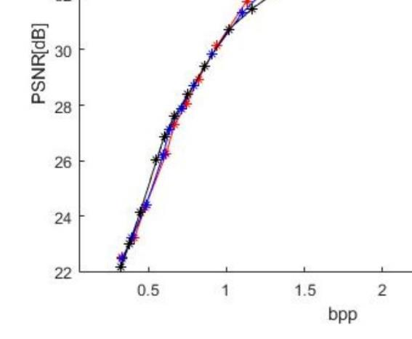
Result of still image compression

Slide 7
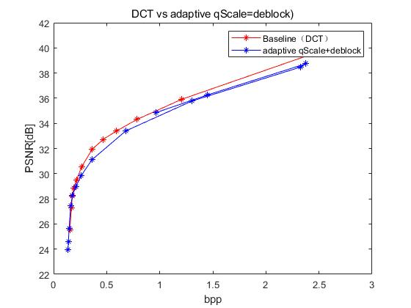
Result of video compression (foreman sequance)

Slide 8
Summary of adptive quantization
Advantage:
In over compressed image/video performed relative well
blocking artifact(partly reduced by deblocking)
Disadvantage:
Detail information loss in „Simple“ block bad performance at high bpp
Time cost ,due to sparsity determination.
Only suitable for still image

Slide 9
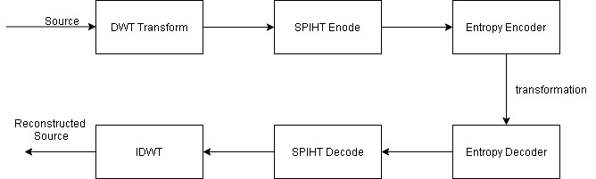
DWT + SPIHT
Filter generation
DWT transform
SPIHT encoding
Image
Rec_image

Slide 10
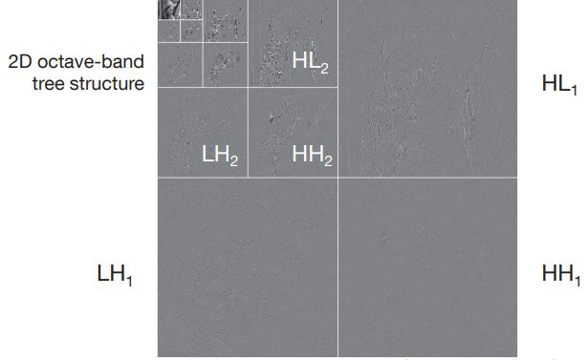
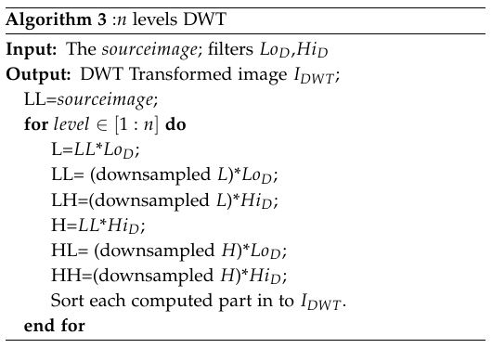
DWT transformation
Filter: bior 4.4(jpeg 2000)
Ref： Prof. Dr.-Ing. Eckehard Steinbach. MDSP lecture Skript page:133

Slide 11
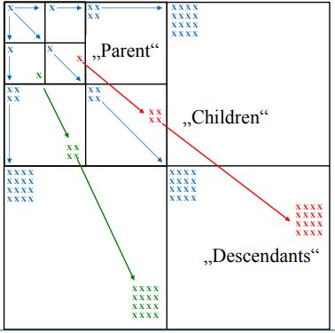
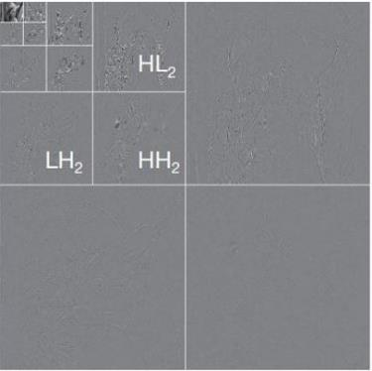
SPIHT Encode
Based on EZW algorithm.
patial orientation tree Structure
Ref： Prof. Dr.-Ing. Eckehard Steinbach. IVC lecture Skript page:93

Slide 12
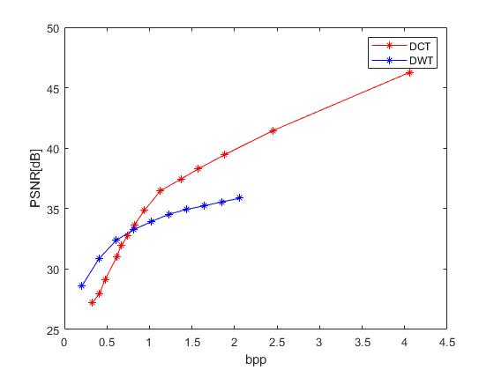
Result of still image compression(Formann)

Slide 13
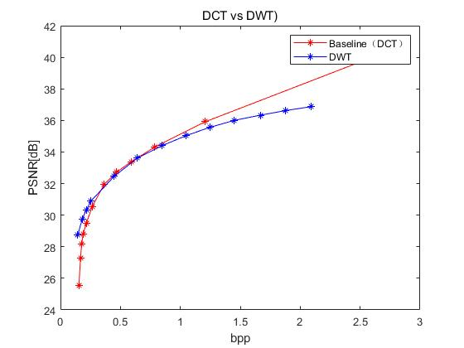
Result of video compression(Formann)

Slide 14
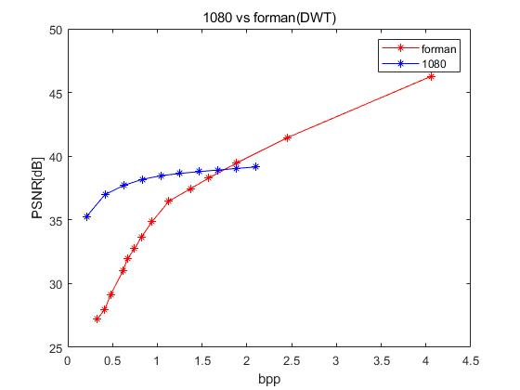
1080 P Video sequence
Better PSNR performance in high resolution image compression

Slide 15
Summary of DWT+SPIHT
Advantag:
Quicker (only 1/3 time of DCT)
Better performance in low bpp
Disadvantg:
Relative low PSNR in High bpp
Higher complexity
Filter variant(bior 4.4 not always optimal )

Slide 16
Summary
Used method: PAC + adaptive quantization + deblock, DWT +SPIHT
Both improved PSNR value in low bpp, but bad PSNR performance in high bpp.
The time cost of DWT is less, since the original method do DCT for each block, but the DWT is applied in hole image.
Possible further optimization
Compresse sensing + DWT

Slide 17
Reference
[1] Li, Manman. A Better Color Space Conversion Based on Learned Variances For Image Compression. CVPR Workshops (2019).
[2] H.264/AVC Loop Filter. https://www.vcodex.com/h264avc-loop-filter/. Accessed 02.02.2020.
[3] Youngjun Yoo Antonio O. and Bin Yu. adptive quantization of image subbands with efﬁcient overhead rate selection.
[4] K. S. Thyagarajan. Still Image and video compression with Matlab. ISBN 978-0-470-48416-6
[5] David Fridovich-Keil and Grace Kuo. Compressed Sensing for Image Compression.
[6] Gregory Wallace, The JPEG Still Image Compression Standard,
[7] Prof. Dr.-Ing. Eckehard Steinbach. Multidimensional signal 17processing Lecture Skript
[8] SPHIT Algorithm. http://www.ws.binghamton.edu/fowler/fowler%2

