Slide 1

Image and Video Compression Laboratory
Optimization
Final Presentation: Yanchen Huang, Chang Liu

Slide 2
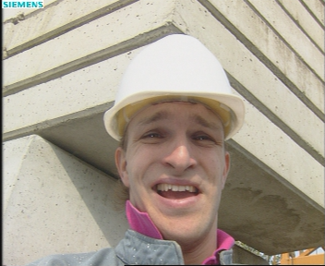
Outline of implemented Techniques
Color Space Conversion: PCA
Deblocking Filter
Adaptive quantization
DWT + SPIHT

Slide 3

Color Space Conversion: PCA
RGB -> YCbCr : ITU-R BT.601 standard
Challenge:
Fixed conversion matrix does not preserve color properties for individual picture.
Motivation

Slide 4

Color Space Conversion: PCA
RGB -> YCbCr : optimal convert matrix $T_{enc}$ and $Offset_{enc}$
Challenge:
Each row in $T_{enc}$ is the direction of the new YCbCr space’s base axis.
Problem definition

Slide 5
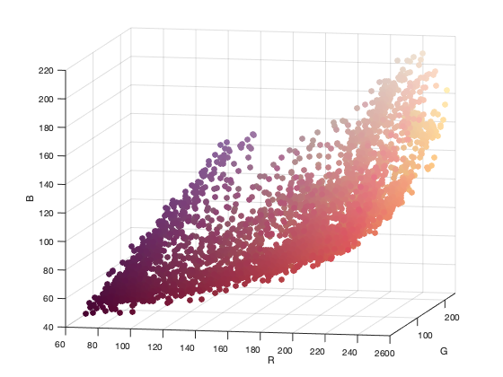
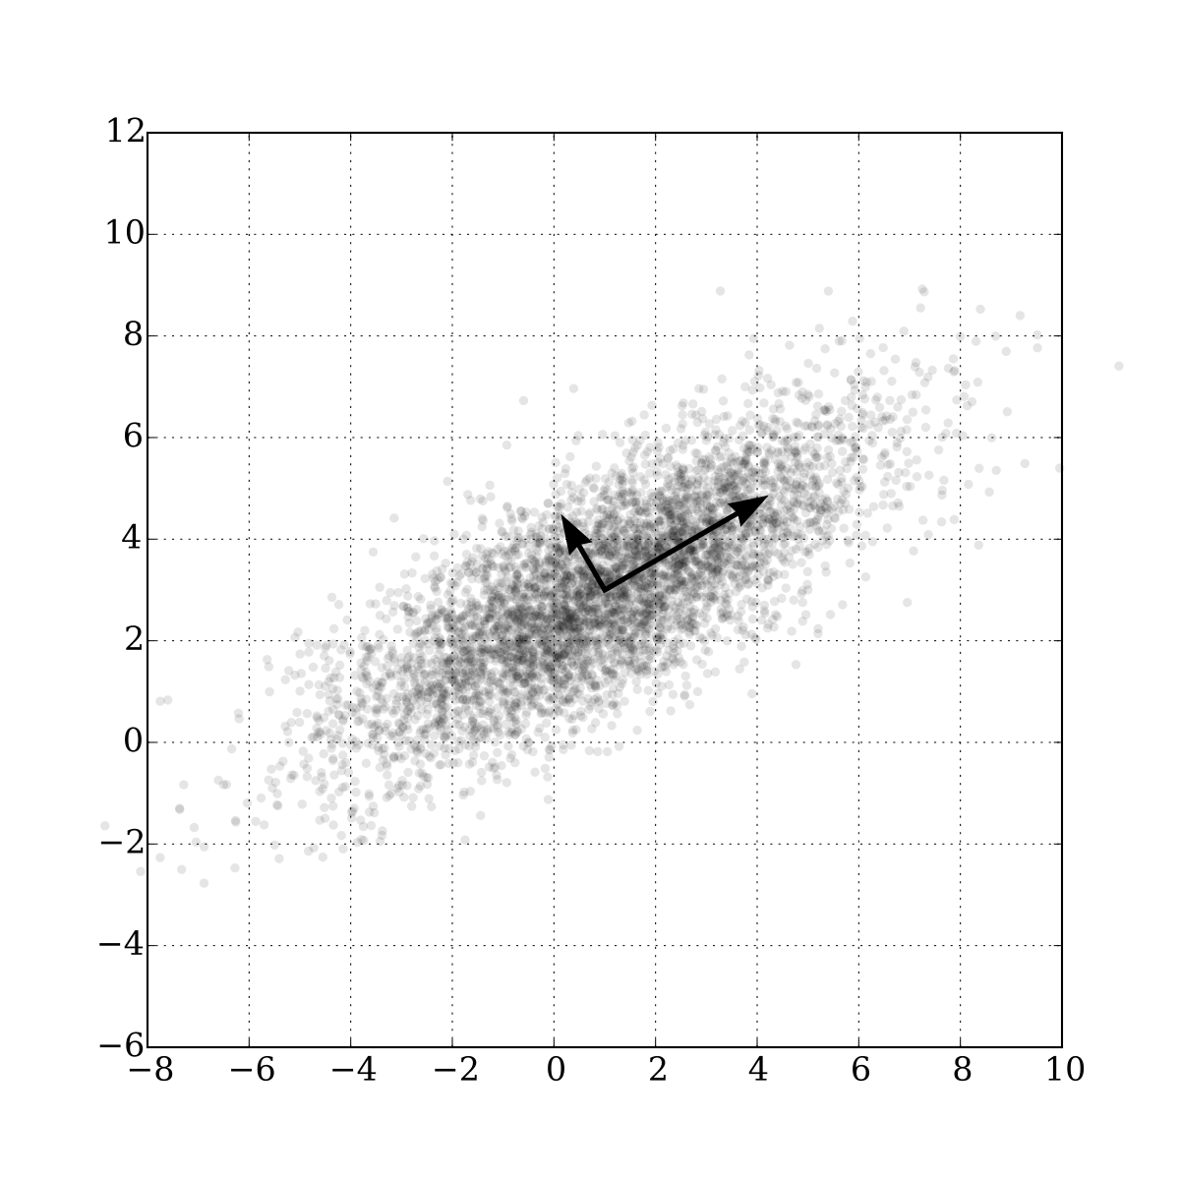
Color Space Conversion: PCA
Lena scatter plot
PCA of a Gaussian distribution
PCA

Slide 6

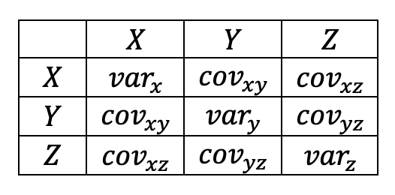
Color Space Conversion: PCA
Divide into 8*8 grids
Minus mean value within the grid
Compute 3*3 Covariance matrix
Implementation

Slide 7


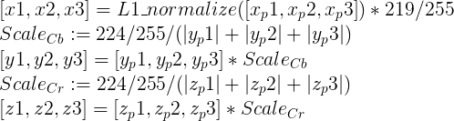
Color Space Conversion: PCA
$$T_{pca}$$
$$Offset_{enc}$$
$$T_{enc}$$
Implementation

Slide 8
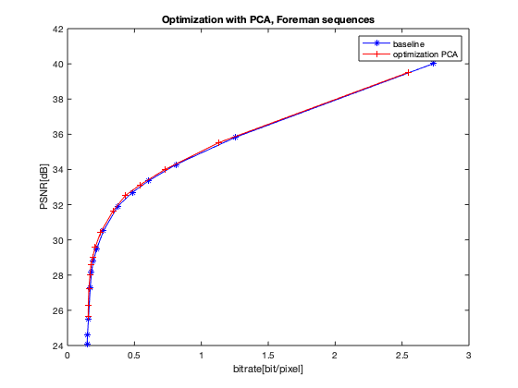
Color Space Conversion: PCA
Result

Slide 9
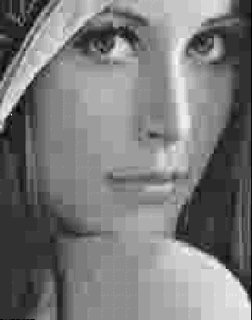
Deblocking filter
Reduce blocking distortion
Smooth block edges, improving the appearance of decoded image (particular at higher compression ratios)
Motivation

Slide 10
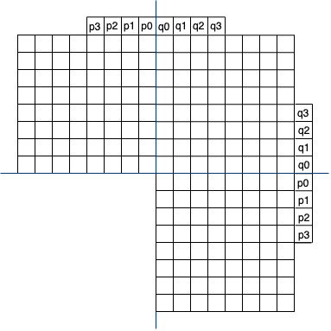
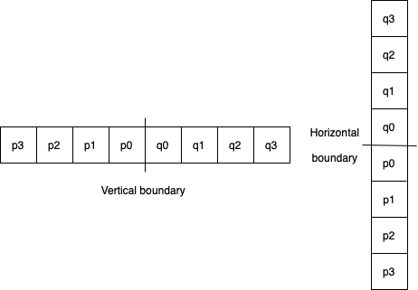
Deblocking filter
Divide into 8*8 grids
Pixels adjacent to vertical and horizontal boundaries
Implementation

Slide 11
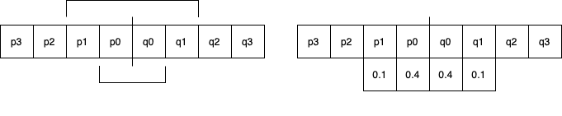
Deblocking filter
$$|p1-q1|<β$$
$$|p0-q0|<α$$
Determine the true boundary based on:
$$|p0-q0|<α$$
$$|p1-q1|<β$$
Apply a 4-tap linear filter with inputs p1,p0,q0,q1
Assign new value to position p0, q0
Implementation

Slide 12
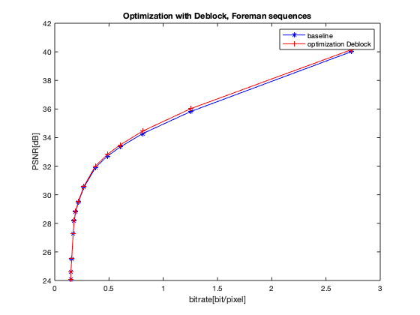
Deblocking filter
Result

Slide 13
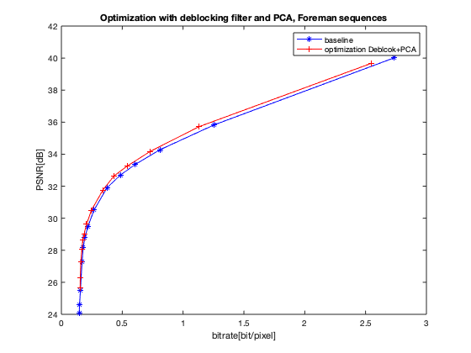
Deblocking filter + PCA
Result

Slide 14
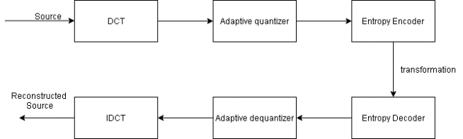
Adaptive quantization
Sparsity of each block
2. determine a suitable qScale
Block
Rec_block
Adaptive quantization factor

Slide 15
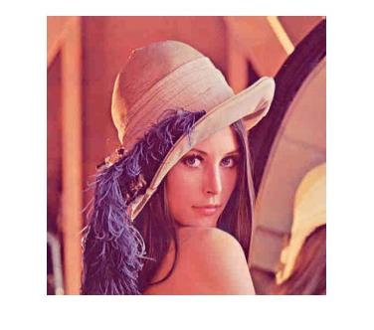


Sparsity
The complexity of each DCT block is different
The more big coefficients after DCT
More details

Slide 16
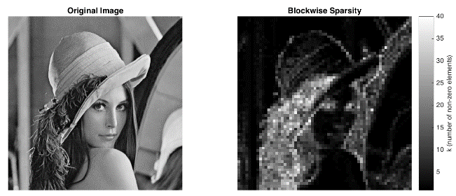
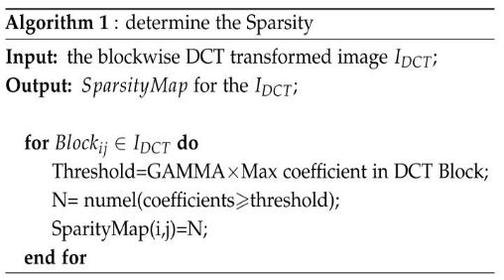
Sparsity

Slide 17
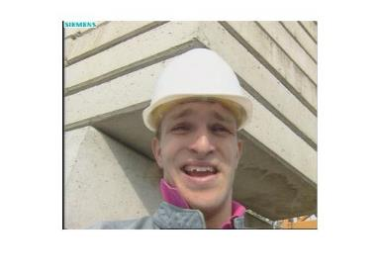
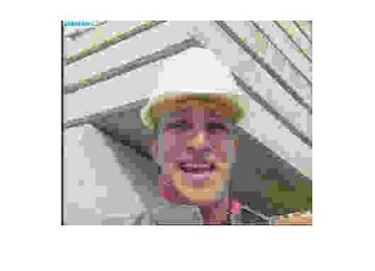
suitable qScale
qScale: Factor of standard quantization table，
more bits for “Detail” block， less bits for “simple” block.
small qScale
large qScale
small qScale
lager qScale

Slide 18
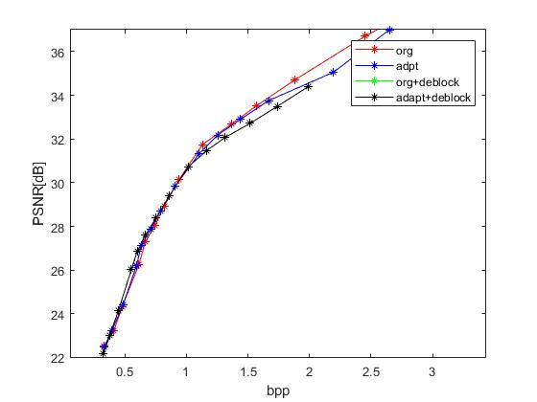
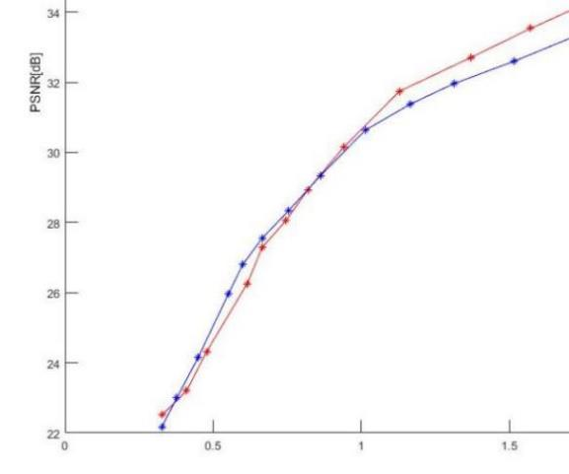
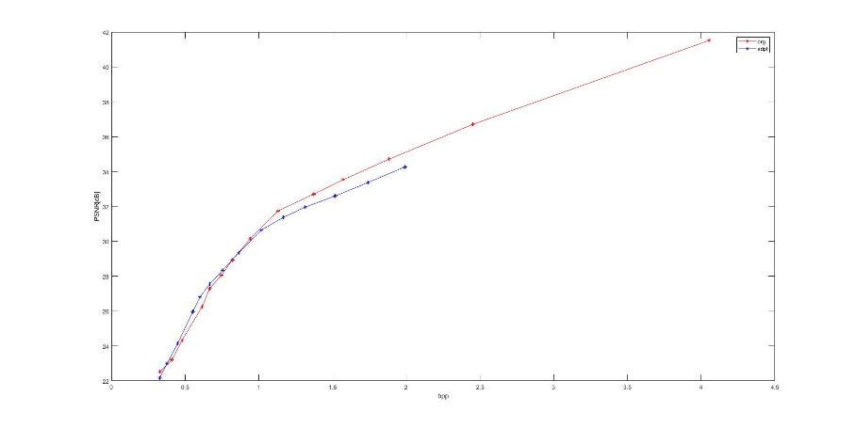
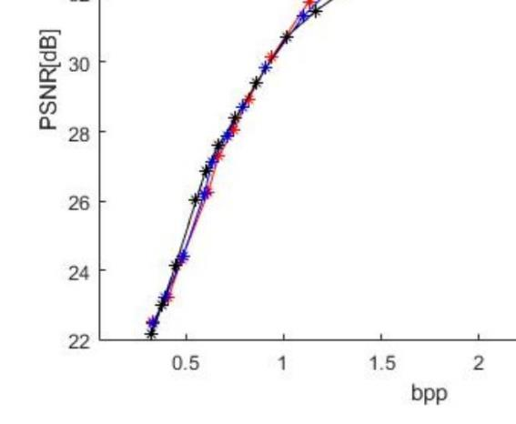
Result of still image compression

Slide 19
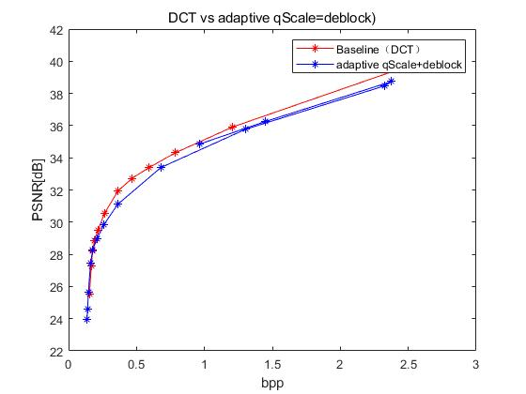
Result of video compression (foreman sequence)

Slide 20
Summary of adaptive quantization
Advantage:
In over compressed image/video performed relative well
blocking artifact(partly reduced by deblocking)
Disadvantage:
Detail information loss in „Simple“ block bad performance at high bpp
Time cost ,due to sparsity determination.
Only suitable for still image

Slide 21
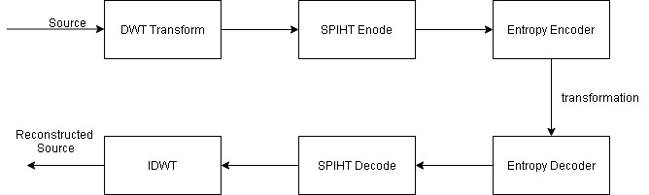
DWT + SPIHT
Filter generation
DWT transform
SPIHT encoding
Image
Rec_image

Slide 22
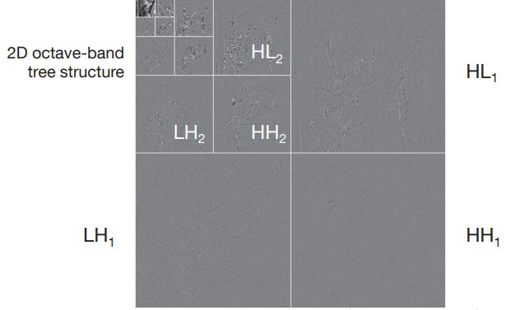
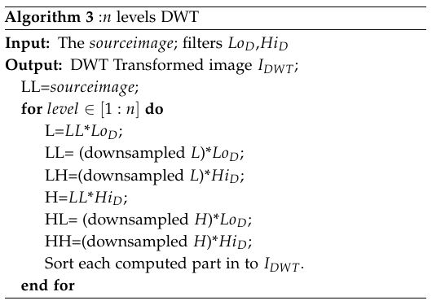
DWT transformation
Filter: bior 4.4(jpeg 2000)
Ref： Prof. Dr.-Ing. Eckehard Steinbach. MDSP lecture Skript page:133

Slide 23
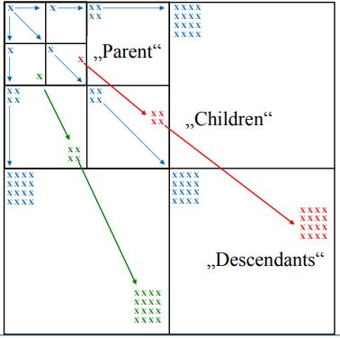
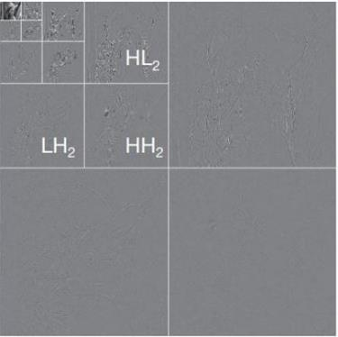
SPIHT Encode
Based on EZW algorithm.
patial orientation tree Structure
Ref： Prof. Dr.-Ing. Eckehard Steinbach. IVC lecture Skript page:93

Slide 24
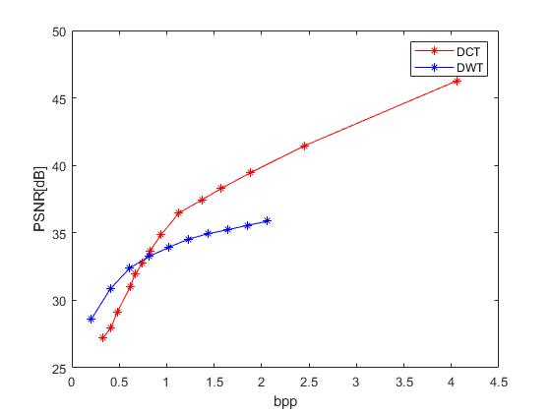
Result of still image compression(Foreman)

Slide 25
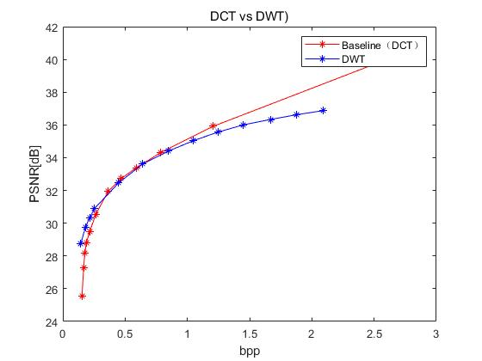
Result of video compression(Foreman)

Slide 26
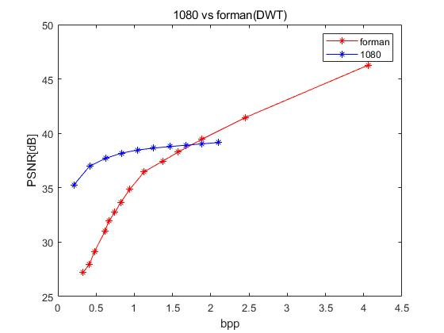
1080P Video sequence
Better PSNR performance in high resolution image compression

Slide 27
Summary of DWT+SPIHT
Advantag:
Quicker (only 1/3 time of DCT)
Better performance in low bpp
Disadvantg:
Relative low PSNR in High bpp
Higher complexity
Filter variant(bior 4.4 not always optimal )

Slide 28
Summary
Used method: PCA + adaptive quantization + deblock, DWT +SPIHT
Both improved PSNR value in low bpp, but bad PSNR performance in high bpp.
The time cost of DWT is less, since the original method do DCT for each block, but the DWT is applied in hole image.
Possible further optimization
Compresse sensing + DWT

Slide 29
Reference
[1] Li, Manman. A Better Color Space Conversion Based on Learned Variances For Image Compression. CVPR Workshops (2019).
[2] H.264/AVC Loop Filter. https://www.vcodex.com/h264avc-loop-filter/. Accessed 02.02.2020.
[3] Youngjun Yoo Antonio O. and Bin Yu. adptive quantization of image subbands with efﬁcient overhead rate selection.
[4] K. S. Thyagarajan. Still Image and video compression with Matlab. ISBN 978-0-470-48416-6
[5] David Fridovich-Keil and Grace Kuo. Compressed Sensing for Image Compression.
[6] Gregory Wallace, The JPEG Still Image Compression Standard,
[7] Prof. Dr.-Ing. Eckehard Steinbach. Multidimensional signal 17processing Lecture Skript
[8] SPHIT Algorithm. http://www.ws.binghamton.edu/fowler/fowler%2

