Slide 1
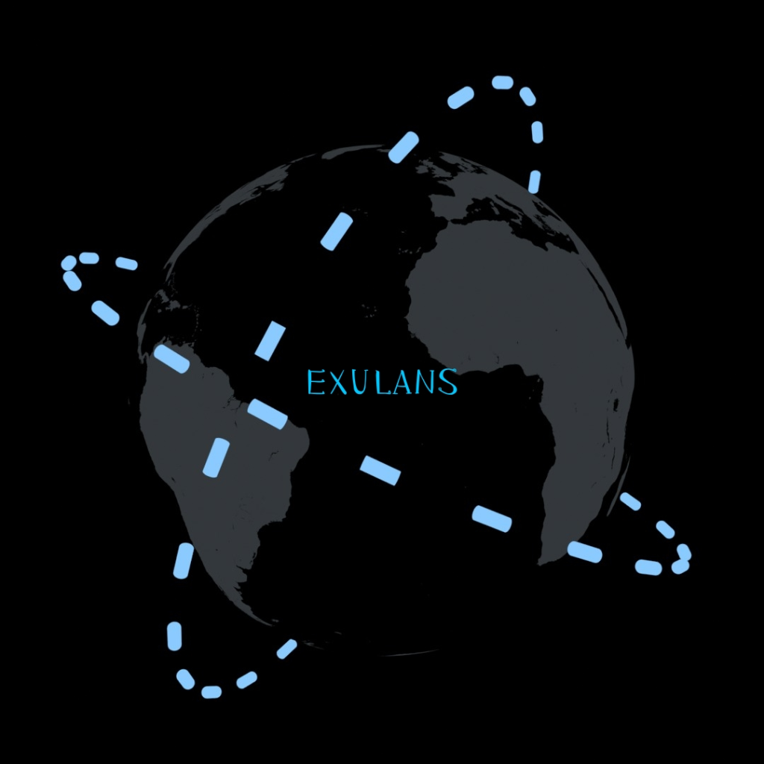
NASA INTERNATIONAL SPACE APPS CHALLENGE 2026
Hunting Planet X with SPHEREx
A Public Infrared Photometry Workstation for Multi-Epoch Sky Analysis & Transient Discovery
Challenge: Planet X and SPHEREx · Team: Exulans · Track: Astrophysics & Planetary Science
Live Deployment: https://spherex-photometry.vercel.app · Open Source: github.com/Yancovert/spherex-photometry

Slide 2
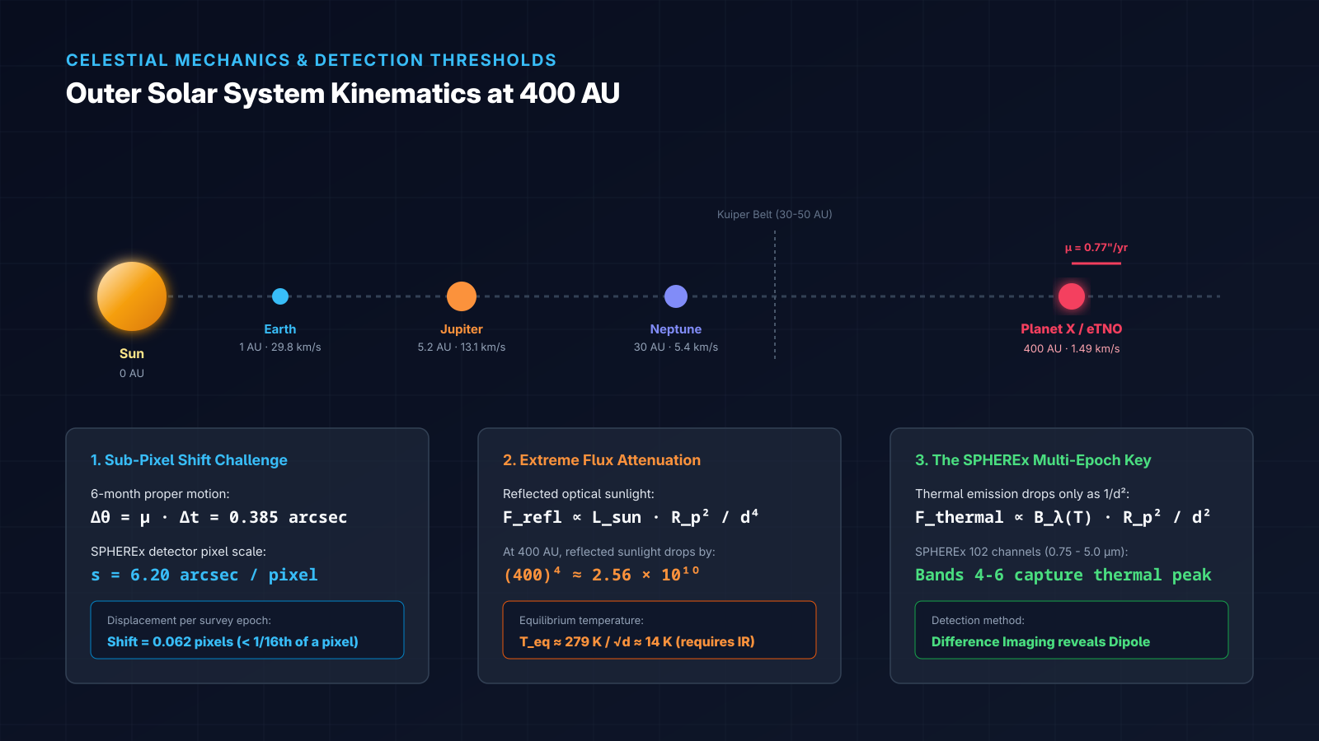
THE CHALLENGE & ORBITAL KINEMATICS
Finding What Moves in a Billion-Object Sky
The Physical Detection Barriers:
• Sub-Pixel Proper Motion: At 400 AU, Planet X shifts only 0.385 arcseconds over SPHEREx's 6-month survey cadence. With a 6.20"/px detector pitch, this displacement is 0.062 pixels (< 1/16th of a single pixel).
• Extreme Optical Dimming (1/d^4): Reflected sunlight scales inversely with the fourth power of distance. At 400 AU, optical flux is attenuated by a factor of 2.56 x 10^10 compared to 1 AU.
• Infrared Thermal Dominance (1/d^2): Thermal blackbody radiation drops only as 1/d^2, peaking beyond 3.5 um (SPHEREx Bands 4-6) at equilibrium temperatures T_eq ≈ 14-40 K.
• The Tooling Gap: Before our work, no public, lightweight web tool existed allowing researchers and citizen scientists to blink SPHEREx epochs and extract calibrated aperture photometry.
NASA International Space Apps Challenge 2026 · Team Exulans · Slide 2 of 7

Slide 3
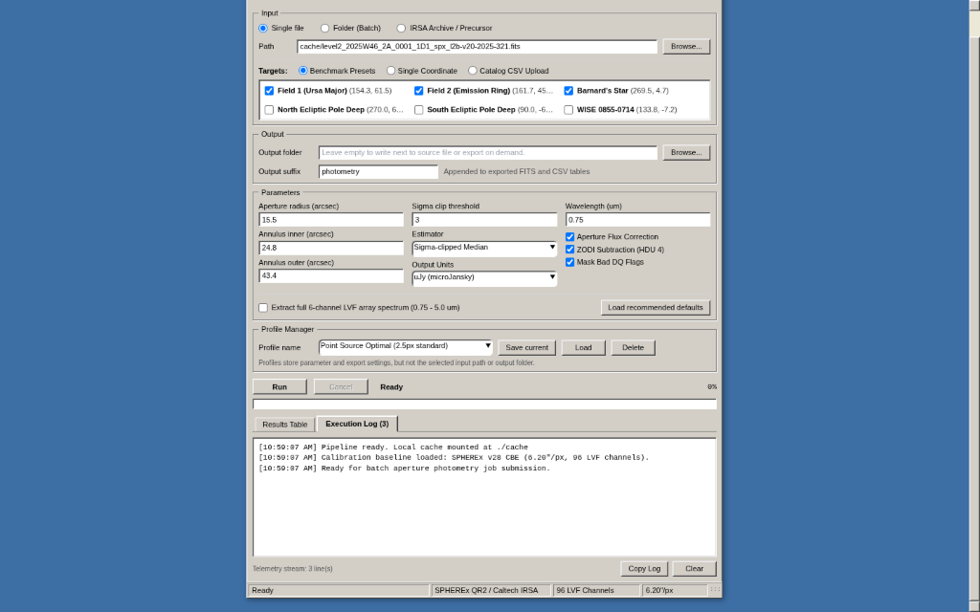
ARCHITECTURE & USER EXPERIENCE
Authentic Win32 Scientific Discovery Workstation
Zero Modern Web Bloat. Real Science:
• Multi-Epoch Blink Comparator: WiseView-heritage 4-epoch blinking at 1-10 Hz. Supports 8 scientific colormaps (Monochrome, Viridis, Inferno, Turbo) and asinh/linear contrast stretches.
• Difference Imaging Mode: Instant signed epoch differencing (E2 - E1) that cancels static stars and isolates transient and moving-body dipole signatures.
• Batch Aperture Photometry Engine: Sub-pixel circular aperture integration with MAD sigma-clipped sky background estimation across all 96 LVF channels.
• Gaia DR3 & NEOSSat Cross-Matching: Real-time coordinate queries to ESA Gaia DR3 for proper motion verification and CSA NEOSSat asteroid orbits.
NASA International Space Apps Challenge 2026 · Team Exulans · Slide 3 of 7

Slide 4
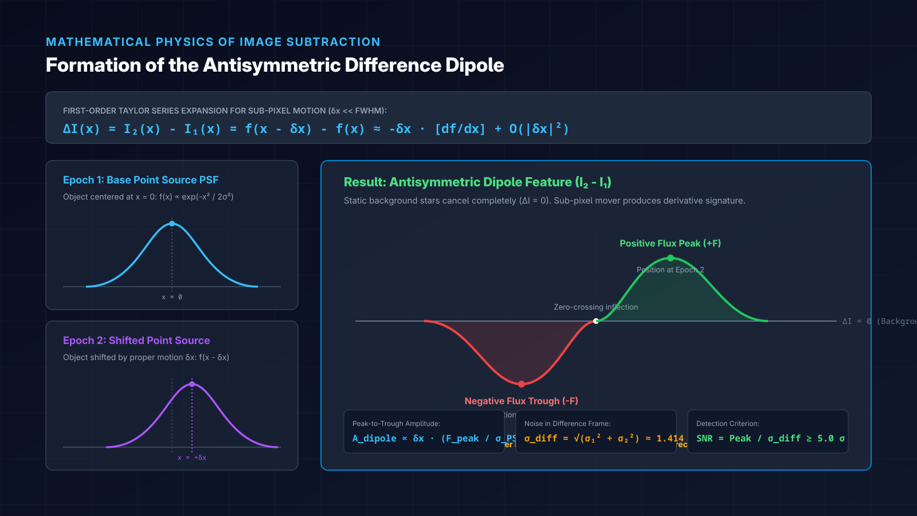
MATHEMATICAL PHYSICS
Image Differencing & Dipole Formation
First-Order Taylor Series Derivation:
• Epoch Image Formulation: Let I_1(x) = f(x) be the point source at Epoch 1. At Epoch 2, it shifts by proper motion dx: I_2(x) = f(x - dx).
• Difference Image Residual: ΔI(x) = I_2(x) - I_1(x) = f(x - dx) - f(x). For small shifts dx << FWHM, expanding via Taylor series yields:
ΔI(x) ≈ -dx · [df/dx] + O(|dx|^2)
• The Antisymmetric Dipole: The residual profile is proportional to the spatial derivative of the telescope PSF. This produces an antisymmetric dipole: a positive flux peak (+F) right next to a negative trough (-F).
• Background Cancellation: Stationary background stars have dx = 0 and vanish completely (ΔI = 0). Noise adds in quadrature: σ_diff = √(σ_1^2 + σ_2^2) ≈ 1.414 · σ_0.
NASA International Space Apps Challenge 2026 · Team Exulans · Slide 4 of 7

Slide 5
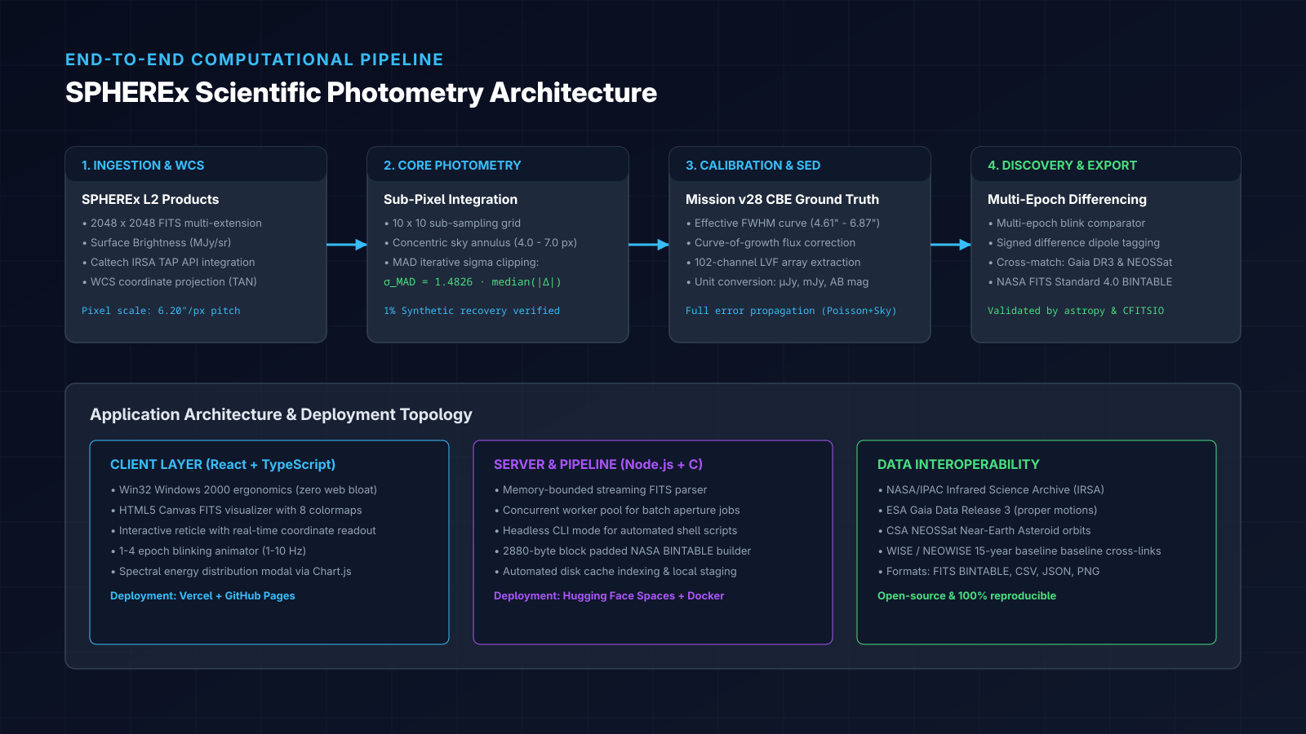
PIPELINE ARCHITECTURE & CALIBRATIONS
From Raw FITS Images to Calibrated Flux Catalogs
NASA International Space Apps Challenge 2026 · Team Exulans · Slide 5 of 7

Slide 6
SCIENTIFIC IMPACT & OUTREACH
Democratizing All-Sky Infrared Astrophysics
1. Citizen Science Discovery
• Brings professional-grade astronomical blink inspection to anyone with a browser.
• Zero installation or coding barrier: runs on Vercel, GitHub Pages, and Hugging Face.
• Inspect billions of sky positions across 4 survey epochs with 8 colormaps and reticle WCS.
• Enables crowdsourced candidate classification for faint asteroids and distant perturbers.
2. Undergraduate Educational Foundation
• Backed by a complete undergraduate research paper authored alongside the tool.
• Covers Keplerian celestial mechanics, thin-film Fabry-Perot optics, and blackbody physics.
• Provides clear mathematical derivations of difference imaging and Taylor-series dipoles.
• Serves as an open curriculum module for observational astrophysics students.
3. Cross-Survey Astronomical Synergies
• Extends a 15-year baseline by cross-linking SPHEREx multi-epoch data with NASA WISE (2010).
• At 400 AU, 15 years yields > 11 arcsec of motion (nearly 2 full SPHEREx pixels).
• Bridges optical surveys (Vera C. Rubin LSST) with continuous 102-channel infrared spectra.
• NASA-standard FITS BINTABLE outputs ensure immediate plug-and-play with Astropy pipelines.
NASA International Space Apps Challenge 2026 · Team Exulans · Slide 6 of 7

Slide 7
OPEN SCIENCE & RESOURCES
Live Deployments, Source Code & Data Citations
Try the Live Platform & Inspect Source Code:
Web Application (Vercel):
https://spherex-photometry.vercel.app
Alternative Mirror (GitHub Pages):
https://yancovert.github.io/spherex-photometry/
Cloud Container (Hugging Face):
https://huggingface.co/spaces/Yancovert/spherex-photometry
Source Code (MIT License):
https://github.com/Yancovert/spherex-photometry
Research Paper:
spherex_research_paper.md / .tex / .docx (in repo)
Mandatory Data & Mission Citations:
• NASA / IPAC Infrared Science Archive (IRSA): SPHEREx Level 2 Calibrated Images, Public-products v28 Current Best Estimate (CBE) calibration tables, and TAP API.
• ESA Gaia Mission (Gaia Collaboration): Gaia Data Release 3 (DR3) astrometric proper motion catalogs and cross-match reference frames.
• Canadian Space Agency (CSA): NEOSSat (Near-Earth Object Surveillance Satellite) public orbital archives for asteroid verification.
• Theoretical Framework: Batygin & Brown (2016, 2021) 'Orbit of Planet Nine', AJ; Bock et al. (2018) 'SPHEREx All-Sky Spectral Survey'; Alard & Lupton (1998) 'Optimal Image Subtraction'.
• Team Exulans: Developed for NASA Space Apps Challenge 2026. Team logo designed by Freund0815.
NASA International Space Apps Challenge 2026 · Team Exulans · Slide 7 of 7

