Slide 1
EDA (Exploratory Data Analysis) on Gene Expression Data
Yingxin Xu
21/03/2024

Slide 2
Variable: predictors
Cell-line: The two cell line types used for the experiment, Wild-type and Cell-type 101.
Treatment: This variable describes whether to add new treatment.
Added: Activating factor 42;
Not added: Placebo (we add saline instead).
Name: Names of different cell lines.
There are two cell lines for each identical cell line type and the same treatment.
There were 8 cell lines in total.
Conc: different concentration of a growth factor, from 0 to 10.

Slide 3
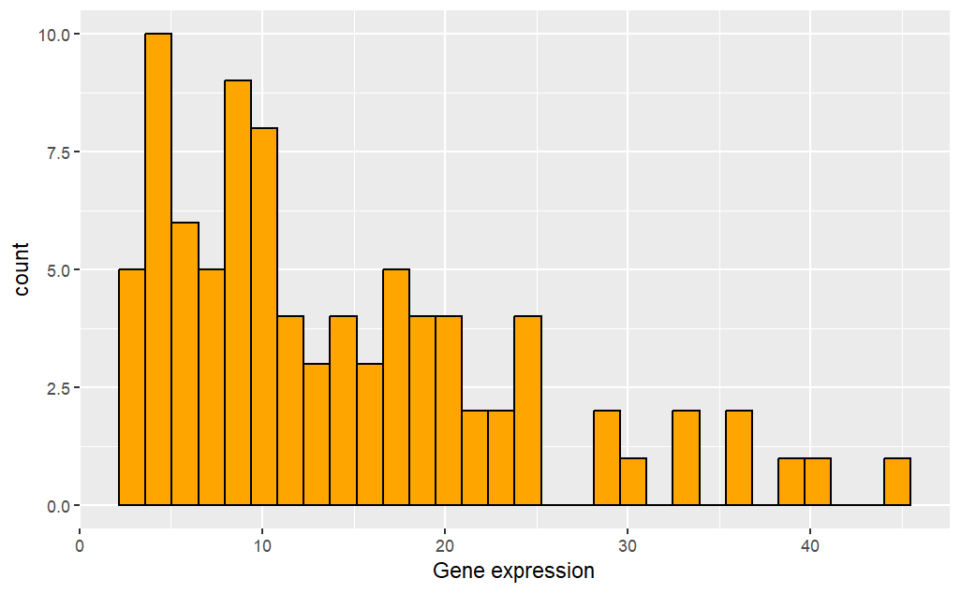
Response variable: gene expression
Gene expression takes value from 2.58 to 44.44.
This histogram indicates that this variable is a uni-model right-skewed variable. Most of the data values are small, but there are some larger values present.

Slide 4
Table: Skim of variable types and values
Variable name | Type | Number of categories | Number of data in each category | Min | Max | Mean
cell_line | categorical variable | 2 | 44
treatment | categorical variable | 2 | 44
name | categorical variable | 8 | 11
conc | number |  |  | 0 | 10 | 5
gene_expression | number |  |  | 2.58 | 44.44 | 14.31

Slide 5
Table: Parameters corresponding to different cell lines
cell line name | cell line type | treatment
GL-XIB, GL-CDZ | Wild-type | Placebo
GL-RJS, GL-XIK | Wild-type | Activating factor 42
GL-CWN, GL-KYH | Cell-type 101 | Placebo
GL-ZHW, GL-MFA | Cell-type 101 | Activating factor 42

Slide 6
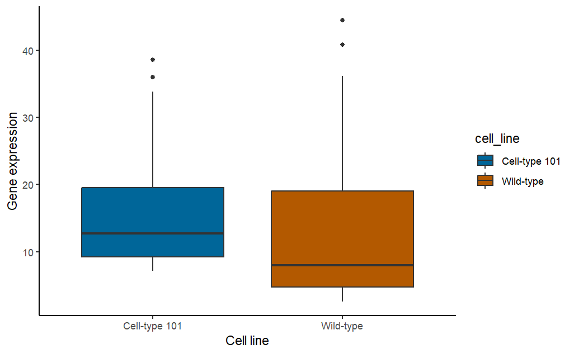
Boxplot: Cell line type vs Gene expression
Box plots grouped by cell line type.
The median and minimum gene expression values of Cell-type 101 are both greater than that of Wild-type.
The maximum gene expression value of Wild-type is greater than that of Cell-type 101.
The data for Wild-type is more dispersed.
Both categories have outliers.

Slide 7
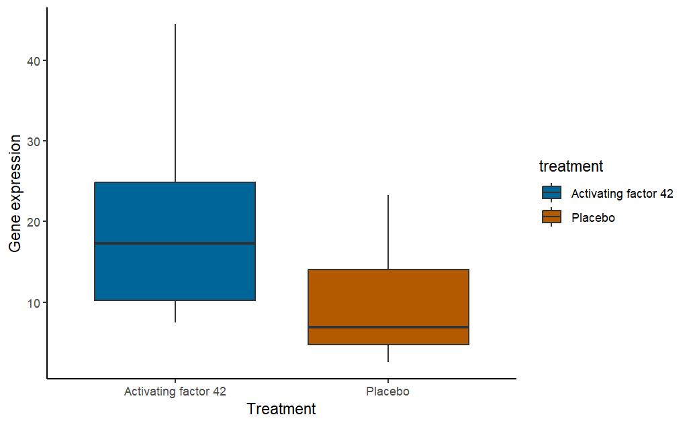
Boxplot: Treatment vs Gene expression
Box plots grouped by treatment.
For the experimental subjects treated with Activating factor 42, the minimum, upper quartile, median, lower quartile, and maximum gene expression values are all greater than those treated with Placebo.

Slide 8
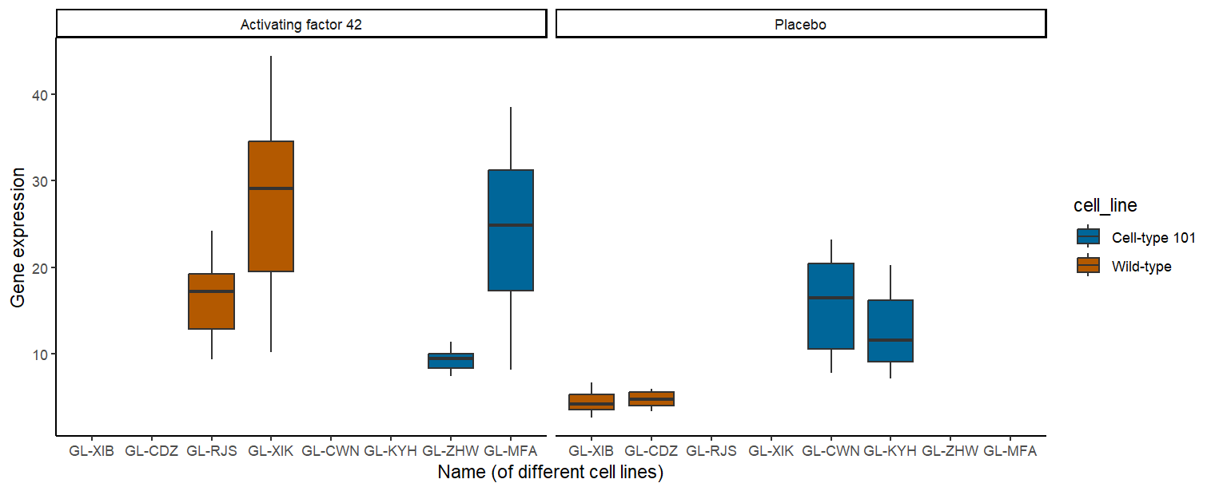
Boxplot: Cell line vs Gene expression
See next slide for interpretation.

Slide 9
Boxplot: Cell line vs Gene expression
Box plots grouped by cell line names and separated by treatment, with different colors representing different cell line types.
Comparing orange boxes: The gene expression levels of Wild-type are generally low in the Placebo, and significantly increased in the Activating factor 42 group.
Comparing blue boxes: Compared to Placebo, the use of Activating factor 42 has led to increased gene expression levels in Cell-type 101 cell lines. However, there is also a cell line (GL-ZHW) in the Activating factor 42 group with low gene expression level.

Slide 10
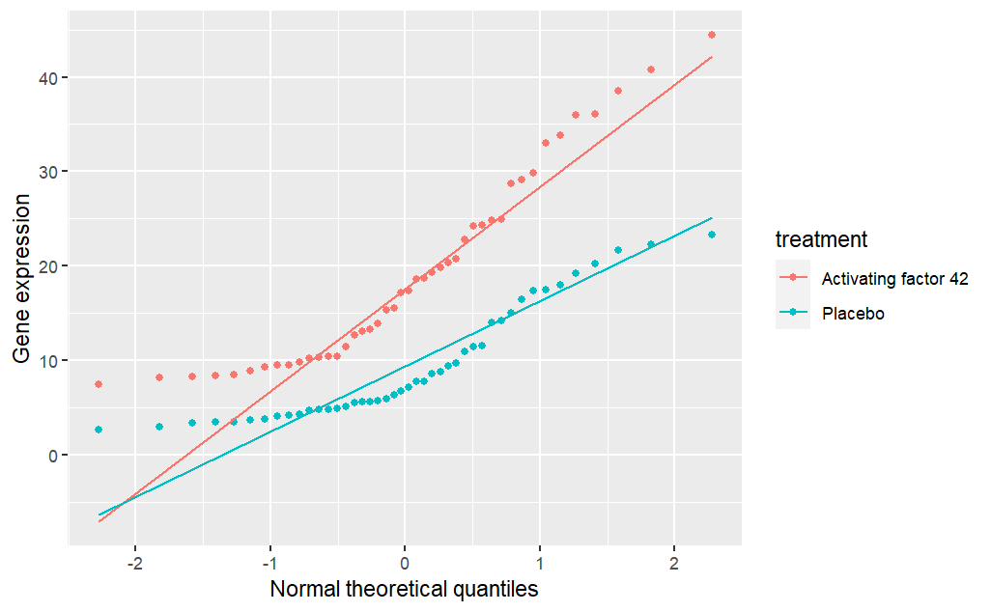
QQ-plot
QQ plot grouped by treatment.
It can be observed that the gene expression data does not follow a normal distribution (as can also be seen in the previous histogram).

Slide 11
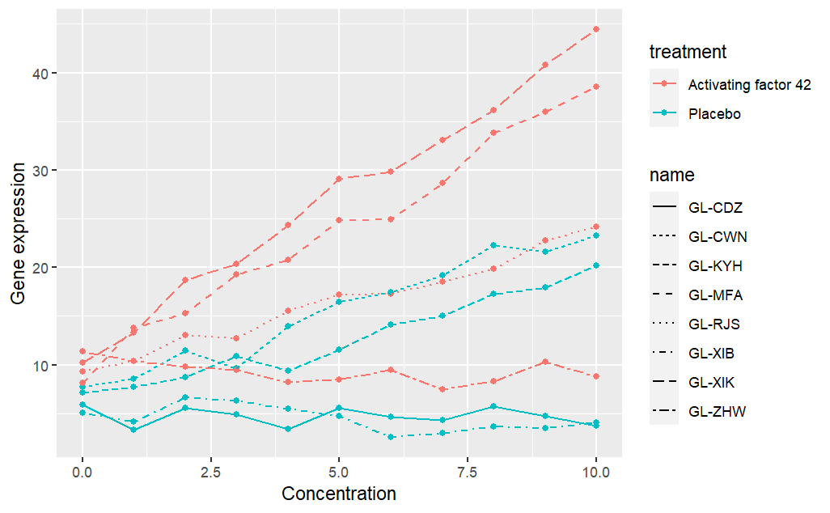
Line graph
Line graph grouped by treatment, with different cell line types represented by different line styles.
With concentration increasing, the gene expression levels of 5 cell lines show an overall increasing trend. 3 of them used the Activating factor 42, while 2 used a placebo.
With concentration increasing, the gene expression levels of 3 cell lines didn’t show an increasing trend. 1 of them used the Activating factor 42, while 2 used a placebo.

Slide 12
Summary
Overall, the gene expression levels of Wild-type in Activating factor 42 are higher than those of Cell-type 101.
Cell-type 101 has higher gene expression levels in Placebo compared to Wild-type. The new treatment Activating factor 42 has a promoting effect on gene expression in cell lines but is not absolute.
The new treatment Activating factor 42 indeed enhances the effect of increasing growth factor concentration on gene expression levels.

Slide 13
Thank you

