Slide 1
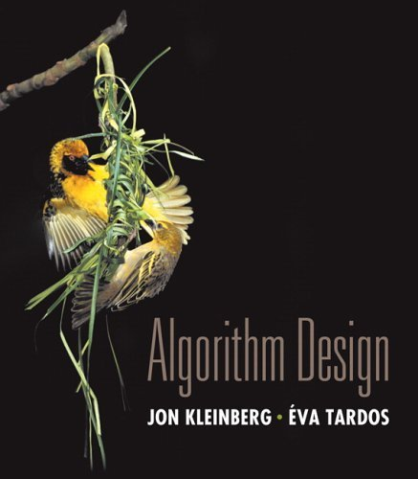

Chapter 2 Basics of Algorithm Analysis
Slides by Kevin Wayne. Copyright © 2005 Pearson-Addison Wesley. All rights reserved.

Slide 2
Algorithms
Algorithm.
[webster.com] A procedure for solving a mathematical problem (as of finding the greatest common divisor) in a finite number of steps that frequently involves repetition of an operation.
[Knuth, TAOCP] An algorithm is a finite, definite, effective procedure, with some input and some output.
Great algorithms are the poetry of computation. Just like verse, they can be terse, allusive, dense, and even mysterious. But once unlocked, they cast a brilliant new light on some aspect of computing. - Francis Sullivan
Notes:
http://portal.newman.wa.edu.au/technology/12infsys/html/KWH2003/KnuthAlgorDef.htm
"Finite: there must be an end to it within a reasonable time.
Definite: precisely definable in clearly understood terms, no pinch of salt type vagaries, or possible ambiguities
Effective: the steps must be actually be able to be carried out. [simple enough for someone using pencil and paper to carry out in a finite amount of time]
Procedure: the sequence of specific steps arranged in a logical order.
Output: unless there is something coming out of the process, the result will remain unknown! "

Slide 3
Algorithmic Paradigms
Design and analysis of computer algorithms.
Greedy.
Divide-and-conquer.
Dynamic programming.
Network flow.
Randomized algorithms.
Intractability.
Coping with intractability.
Critical thinking and problem-solving.
Notes:
* broad algorithmic themes and design principles
* paradigmatic problems and approaches that illustrate, with minimal amount of irrelevant detail, basic approaches in designing efficient algorithms. At the same time, it would be pointless to pursue design principles in a vacuum - we consider problems drawn from fundamental issues that arise throughout cs and elsewhere
* we also address fundamental barriers that prevent design of efficient algorithms

Slide 4
Applications
Wide range of applications.
Caching.
Compilers.
Databases.
Scheduling.
Networking.
Data analysis.
Signal processing.
Computer graphics.
Scientific computing.
Operations research.
Artificial intelligence.
Computational biology.
. . .
We focus on algorithms and techniques that are useful in practice.

Slide 5
2.1 Computational Tractability
Brute force. For many non-trivial problems, there is a natural brute force search algorithm that checks every possible solution.
Typically takes 2^{N} time or worse for inputs of size N.
Unacceptable in practice.
Desirable scaling property. When the input size doubles, the algorithm should only slow down by some constant factor C.
Def. An algorithm is poly-time if the above scaling property holds.
n ! for stable matching with n men and n women
There exists constants c > 0 and d > 0 such that on every input of size N, its running time is bounded by c N^{d} steps.
choose C = 2^{d}
Notes:
focusing on worst-case poly-time is a subtle modeling decision - we try to justify it here

Slide 6
Worst-Case Analysis
Worst case running time. Obtain bound on largest possible running time of algorithm on input of a given size N.
Generally captures efficiency in practice.
Draconian view, but hard to find effective alternative.
Average case running time. Obtain bound on running time of algorithm on random input as a function of input size N.
Hard (or impossible) to accurately model real instances by random distributions.
Algorithm tuned for a certain distribution may perform poorly on other inputs.

Slide 7
Worst-Case Polynomial-Time
Def. An algorithm is efficient if its running time is polynomial.
Justification: It really works in practice!
Although 6.02 × 10²³ × N²⁰ is technically poly-time, it would be useless in practice.
In practice, the poly-time algorithms that people develop almost always have low constants and low exponents.
Breaking through the exponential barrier of brute force typically exposes some crucial structure of the problem.
The definition is model-independent and closed under certain operations.
Exceptions.
Some poly-time algorithms do have high constants and/or exponents, and are useless in practice.
Some exponential-time (or worse) algorithms are widely used because the worst-case instances seem to be rare.
simplex method

Slide 8
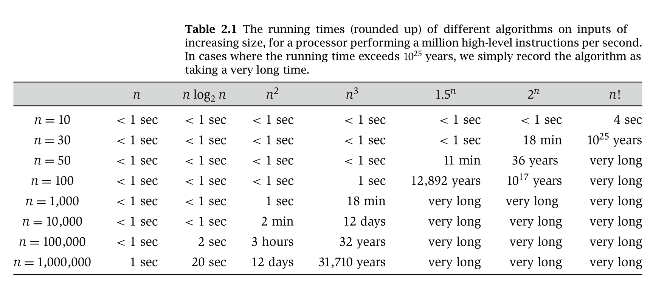
Why It Matters
Notes:
table taken from More Programming Pearls, p. 82, 400MhZ Pentium II scaled up
one step takes one nanosecond
msec = millisecond

Slide 9
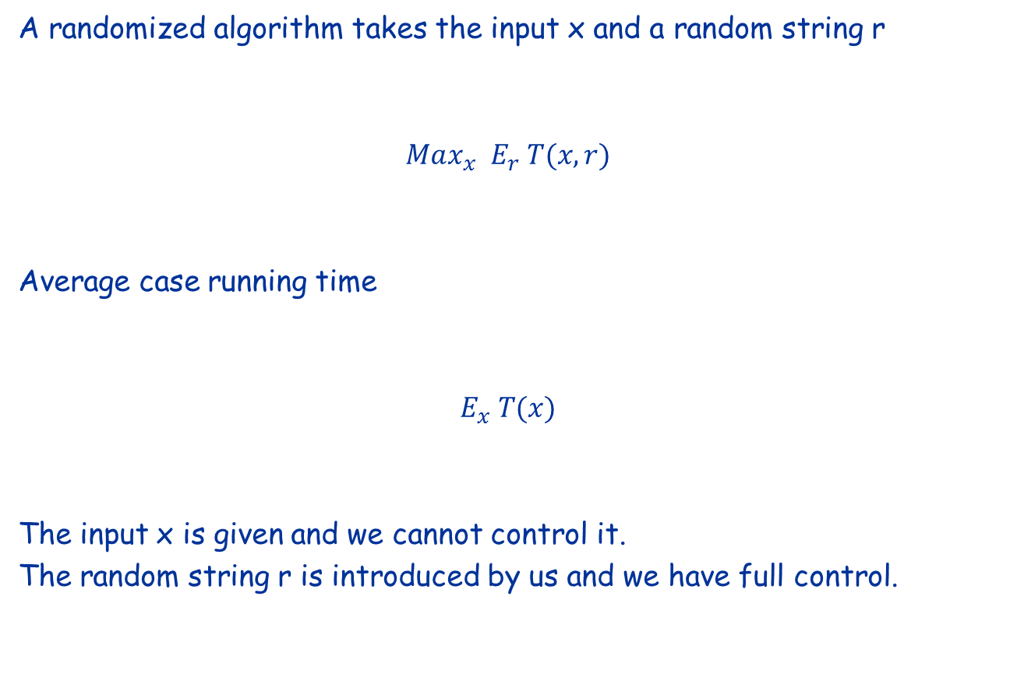
Randomized algorithm vs Average case running time

Slide 10
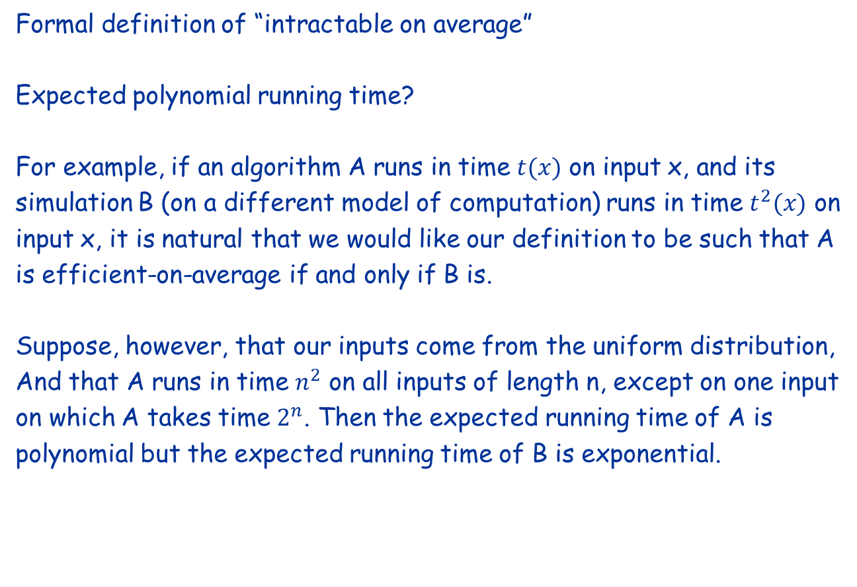
Average case complexity
Formal definition of “intractable on average”
Expected polynomial running time?
For example, if an algorithm A runs in time $t(x)$ on input x, and its
simulation B (on a different model of computation) runs in time $t^{2}(x)$ on
input x, it is natural that we would like our definition to be such that A
is efficient-on-average if and only if B is.
Suppose, however, that our inputs come from the uniform distribution,
And that A runs in time $n^{2}$ on all inputs of length n, except on one input
on which A takes time $2^{n}$. Then the expected running time of A is
polynomial but the expected running time of B is exponential.

Slide 11
Average case complexity
Formal definition of “intractable on average”
Median running time?
If an algorithm runs in polynomial time on 70% of the inputs, and in
exponential time on 30% of the inputs, it seems not right to consider it
an efficient-on-average algorithm.

Slide 12
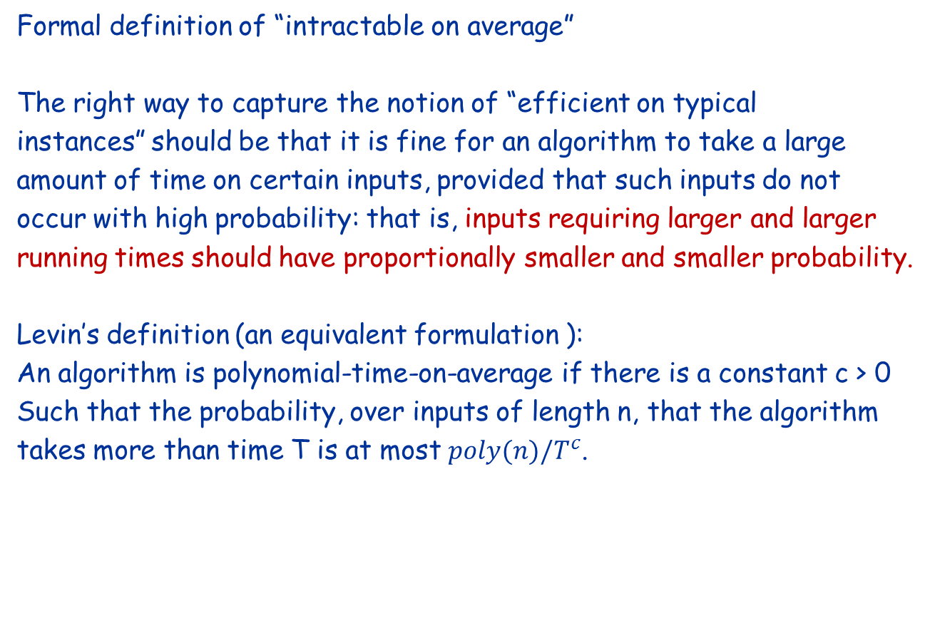
Average case complexity
Formal definition of “intractable on average”
The right way to capture the notion of “efficient on typical
instances” should be that it is fine for an algorithm to take a large
amount of time on certain inputs, provided that such inputs do not
occur with high probability: that is, inputs requiring larger and larger
running times should have proportionally smaller and smaller probability.
Levin’s definition (an equivalent formulation ):
An algorithm is polynomial-time-on-average if there is a constant c > 0
Such that the probability, over inputs of length n, that the algorithm
takes more than time T is at most $poly(n)/T^{c}$.

Slide 13

Smoothed Complexity
By Shang-Hua Teng and Daniel Spielman
worst case
max_{x} T(x)
average case
E_{r} T(r)
smoothed complexity

Slide 14
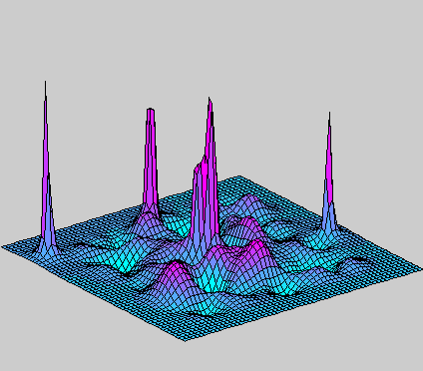
Complexity Landscape
run time
input space

Slide 15
Complexity Landscape
worst case
run time
input space

Slide 16
Complexity Landscape
worst case
run time
average case
input space

Slide 17
Smoothed Complexity Landscape
run time
input space

Slide 18
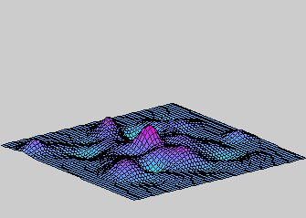
Smoothed Complexity Landscape
run time
smoothed
complexity
input space

Slide 19
2.2 Asymptotic Order of Growth

Slide 20
Asymptotic Order of Growth
Upper bounds. T(n) is O(f(n)) if there exist constants c > 0 and n₀ ≥ 0 such that for all n ≥ n₀ we have T(n) ≤ c · f(n).
Lower bounds. T(n) is Ω(f(n)) if there exist constants c > 0 and n₀ ≥ 0 such that for all n ≥ n₀ we have T(n) ≥ c · f(n).
Tight bounds. T(n) is Θ(f(n)) if T(n) is both O(f(n)) and Ω(f(n)).
Ex: T(n) = 32n² + 17n + 32.
T(n) is O(n²), O(n³), Ω(n²), Ω(n), and Θ(n²) .
T(n) is not O(n), Ω(n³), Θ(n), or Θ(n³).

Slide 21
Notation
Slight abuse of notation. T(n) = O(f(n)).
Not transitive:
f(n) = 5n³; g(n) = 3n²
f(n) = O(n³) = g(n)
but f(n) ≠ g(n).
Better notation: T(n) ∈ O(f(n)).
Meaningless statement. Any comparison-based sorting algorithm requires at least O(n log n) comparisons.
Statement doesn't "type-check."
Use Ω for lower bounds.

Slide 22
Properties
Transitivity.
If f = O(g) and g = O(h) then f = O(h).
If f = Ω(g) and g = Ω(h) then f = Ω(h).
If f = Θ(g) and g = Θ(h) then f = Θ(h).
Additivity.
If f = O(h) and g = O(h) then f + g = O(h).
If f = Ω(h) and g = Ω(h) then f + g = Ω(h).
If f = Θ(h) and g = O(h) then f + g = Θ(h).

Slide 23
Asymptotic Bounds for Some Common Functions
Polynomials. a₀ + a₁n + … + a_{d}n^{d} is Θ(n^{d}) if a_{d} > 0.
Polynomial time. Running time is O(n^{d}) for some constant d independent of the input size n.
Logarithms. O(log _{a} n) = O(log _{b} n) for any constants a, b > 0.
Logarithms. For every x > 0, log n = O(n^{x}).
Exponentials. For every r > 1 and every d > 0, n^{d} = O(r^{n}).
can avoid specifying the base
log grows slower than every polynomial
every exponential grows faster than every polynomial

Slide 24
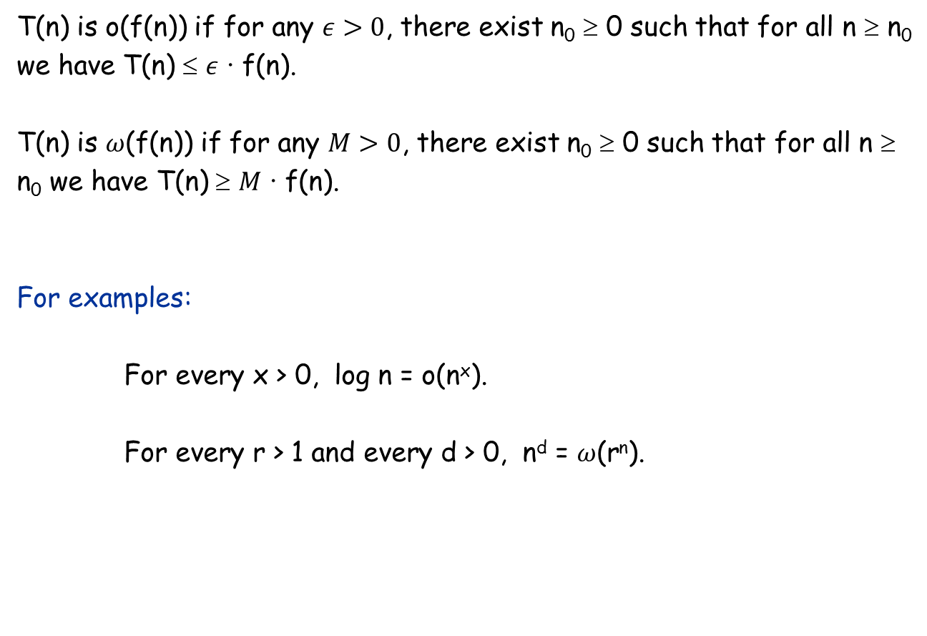
Two additional bounds
T(n) is o(f(n)) if for any $ε>0$, there exist n₀ ≥ 0 such that for all n ≥ n₀ we have T(n) ≤ $ε$ · f(n).
T(n) is $ω$(f(n)) if for any $M>0$, there exist n₀ ≥ 0 such that for all n ≥ n₀ we have T(n) ≥ $M$ · f(n).
For examples:
For every x > 0, log n = o(n^{x}).
For every r > 1 and every d > 0, n^{d} = $ω$(r^{n}).

Slide 25
2.4 A Survey of Common Running Times

Slide 26
Linear Time: O(n)
Linear time. Running time is proportional to input size.
Computing the maximum. Compute maximum of n numbers a₁, …, a_{n}.
max ← a₁
for i = 2 to n {
if (a_{i} > max)
max ← a_{i}
}

Slide 27
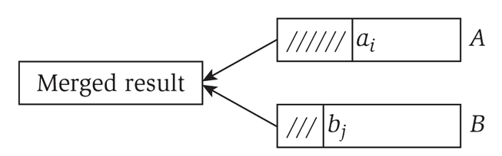
Linear Time: O(n)
Merge. Combine two sorted lists A = a₁,a₂,…,a_{n} with B = b₁,b₂,…,b_{n} into sorted whole.
Claim. Merging two lists of size n takes O(n) time.
Pf. After each comparison, the length of output list increases by 1.
i = 1, j = 1
while (both lists are nonempty) {
if (a_{i} ≤ b_{j}) append a_{i} to output list and increment i
else(a_{i} ≤ b_{j})append b_{j} to output list and increment j
}
append remainder of nonempty list to output list

Slide 28
O(n log n) Time
O(n log n) time. Arises in divide-and-conquer algorithms.
Sorting. Mergesort and heapsort are sorting algorithms that perform O(n log n) comparisons.
Largest empty interval. Given n time-stamps x₁, …, x_{n} on which copies of a file arrive at a server, what is largest interval of time when no copies of the file arrive?
O(n log n) solution. Sort the time-stamps. Scan the sorted list in order, identifying the maximum gap between successive time-stamps.
also referred to as linearithmic time

Slide 29
Quadratic Time: O(n²)
Quadratic time. Enumerate all pairs of elements.
Closest pair of points. Given a list of n points in the plane (x₁, y₁), …, (x_{n}, y_{n}), find the pair that is closest.
O(n²) solution. Try all pairs of points.
Remark. Ω(n²) seems inevitable, but this is just an illusion.
min ← (x₁ - x₂)² + (y₁ - y₂)²
for i = 1 to n {
for j = i+1 to n {
d ← (x_{i} - x_{j})² + (y_{i} - y_{j})²
if (d < min)
min ← d
}
}
don't need to take square roots
see chapter 5

Slide 30
Cubic Time: O(n³)
Cubic time. Enumerate all triples of elements.
Set disjointness. Given n sets S₁, …, S_{n} each of which is a subset of 1, 2, …, n, is there some pair of these which are disjoint?
O(n³) solution. For each pairs of sets, determine if they are disjoint.
foreach set S_{i} {
foreach other set S_{j} {
foreach element p of S_{i} {
determine whether p also belongs to S_{j}
}
if (no element of S_{i} belongs to S_{j})
report that S_{i} and S_{j} are disjoint
}
}

Slide 31
Polynomial Time: O(n^{k}) Time
Independent set of size k. Given a graph, are there k nodes such that no two are joined by an edge?
O(n^{k}) solution. Enumerate all subsets of k nodes.
Check whether S is an independent set = O(k²).
Number of k element subsets =
O(k² n^{k} / k!) = O(n^{k}).
k is a constant
foreach subset S of k nodes {
check whether S in an independent set
if (S is an independent set)
report S is an independent set
}
}
poly-time for k=17, but not practical

Slide 32
Exponential Time
Independent set. Given a graph, what is maximum size of an independent set?
O(n² 2^{n}) solution. Enumerate all subsets.
S* ← φ
foreach subset S of nodes {
check whether S in an independent set
if (S is largest independent set seen so far)
update S* ← S
}
}

