Slide 1
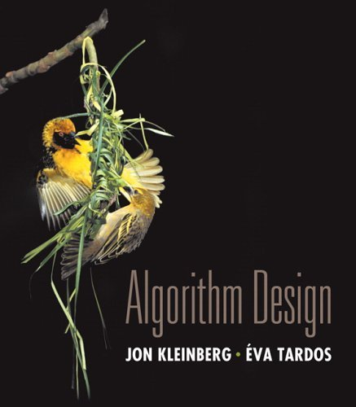

Chapter 4 Greedy Algorithms
Slides by Kevin Wayne. Copyright © 2005 Pearson-Addison Wesley. All rights reserved.

Slide 2
4.1 Interval Scheduling

Slide 3
Interval Scheduling
Interval scheduling.
Job j starts at s_{j} and finishes at f_{j}.
Two jobs compatible if they don't overlap.
Goal: find maximum subset of mutually compatible jobs.
a
b
c
d
e
f
g
h
Time
0
1
2
3
4
5
6
7
8
9
10
11
Notes:
Activity selection = interval scheduling
OPT = B, E, H
Note: smallest job (C) is not in any optimal solution, job that starts first (A) is not in any optimal solution.

Slide 4
Interval Scheduling: Greedy Algorithms
Greedy template. Consider jobs in some natural order. Take each job provided it's compatible with the ones already taken.
[Earliest start time] Consider jobs in ascending order of s_{j}.
[Earliest finish time] Consider jobs in ascending order of f_{j}.
[Shortest interval] Consider jobs in ascending order of f_{j} - s_{j}.
[Fewest conflicts] For each job j, count the number of conflicting jobs c_{j}. Schedule in ascending order of c_{j}.

Slide 5
Interval Scheduling: Greedy Algorithms
Greedy template. Consider jobs in some natural order. Take each job provided it's compatible with the ones already taken.
counterexample for earliest start time
counterexample for shortest interval
counterexample for fewest conflicts

Slide 6
Interval Scheduling: Greedy Algorithm
Greedy algorithm. Consider jobs in increasing order of finish time. Take each job provided it's compatible with the ones already taken.
Implementation. O(n log n).
Remember job j* that was added last to A.
Job j is compatible with A if s_{j} ≥ f_{j*}.
Sort jobs by finish times so that f₁ ≤ f₂ ≤ ... ≤ f_{n}.
A ← φ
for j = 1 to n {
if (job j compatible with A)
A ← A ∪ {j}
}
return A
set of jobs selected

Slide 7
Interval Scheduling: Analysis
Theorem. Greedy algorithm is optimal.
Pf. (by contradiction)
Assume greedy is not optimal, and let's see what happens.
Let i₁, i₂, ... i_{k} denote set of jobs selected by greedy.
Let j₁, j₂, ... j_{m} denote set of jobs in the optimal solution with i₁ = j₁, i₂ = j₂, ..., i_{r} = j_{r} for the largest possible value of r.
job i_{r+1} finishes before j_{r+1}
Greedy:
i₁
i₂
i_{r}
i_{r+1}
OPT:
j₁
j₂
j_{r}
j_{r+1}
. . .
why not replace job j_{r+1} with job i_{r+1}?

Slide 8
Interval Scheduling: Analysis
Theorem. Greedy algorithm is optimal.
Pf. (by contradiction)
Assume greedy is not optimal, and let's see what happens.
Let i₁, i₂, ... i_{k} denote set of jobs selected by greedy.
Let j₁, j₂, ... j_{m} denote set of jobs in the optimal solution with i₁ = j₁, i₂ = j₂, ..., i_{r} = j_{r} for the largest possible value of r.
job i_{r+1} finishes before j_{r+1}
Greedy:
i₁
i₂
i_{r}
i_{r+1}
OPT:
j₁
j₂
j_{r}
i_{r+1}
. . .
solution still feasible and optimal, but contradicts maximality of r.

Slide 9
4.1 Interval Partitioning

Slide 10
Interval Partitioning
Interval partitioning.
Lecture j starts at s_{j} and finishes at f_{j}.
Goal: find minimum number of classrooms to schedule all lectures so that no two occur at the same time in the same room.
Ex: This schedule uses 4 classrooms to schedule 10 lectures.
4
e
j
3
c
d
g
2
b
h
1
a
f
i
9
9:30
10
10:30
11
11:30
12
12:30
1
1:30
2
2:30
3
3:30
4
4:30
Time

Slide 11
Interval Partitioning
Interval partitioning.
Lecture j starts at s_{j} and finishes at f_{j}.
Goal: find minimum number of classrooms to schedule all lectures so that no two occur at the same time in the same room.
Ex: This schedule uses only 3.
3
c
d
f
j
2
b
g
i
1
a
e
h
9
9:30
10
10:30
11
11:30
12
12:30
1
1:30
2
2:30
3
3:30
4
4:30
Time

Slide 12
Interval Partitioning: Lower Bound on Optimal Solution
Def. The depth of a set of open intervals is the maximum number that contain any given time.
Key observation. Number of classrooms needed ≥ depth.
Ex: Depth of schedule below = 3 ⇒ schedule below is optimal.
Q. Does there always exist a schedule equal to depth of intervals?
a, b, c all contain 9:30
3
c
d
f
j
2
b
g
i
1
a
e
h
9
9:30
10
10:30
11
11:30
12
12:30
1
1:30
2
2:30
3
3:30
4
4:30
Time

Slide 13
Interval Partitioning: Greedy Algorithm
Greedy algorithm. Consider lectures in increasing order of start time: assign lecture to any compatible classroom.
Implementation. O(n log n).
For each classroom k, maintain the finish time of the last job added.
Keep the classrooms in a priority queue.
Sort intervals by starting time so that s₁ ≤ s₂ ≤ ... ≤ s_{n}.
d ← 0
for j = 1 to n {
if (lecture j is compatible with some classroom k)
schedule lecture j in classroom k
else
allocate a new classroom d + 1
schedule lecture j in classroom d + 1
d ← d + 1
}
number of allocated classrooms
Notes:
priority queue keyed by the finish time of the last job added

Slide 14
Interval Partitioning: Greedy Analysis
Observation. Greedy algorithm never schedules two incompatible lectures in the same classroom.
Theorem. Greedy algorithm is optimal.
Pf.
Let d = number of classrooms that the greedy algorithm allocates.
Classroom d is opened because we needed to schedule a job, say j, that is incompatible with all d-1 other classrooms.
These d jobs each end after s_{j}.
Since we sorted by start time, all these incompatibilities are caused by lectures that start no later than s_{j}.
Thus, we have d lectures overlapping at time s_{j} + ε.
Key observation ⇒ all schedules use ≥ d classrooms. ▪

Slide 15
4.2 Scheduling to Minimize Lateness

Slide 16
Scheduling to Minimizing Lateness
Minimizing lateness problem.
Single resource processes one job at a time.
Job j requires t_{j} units of processing time and is due at time d_{j}.
If j starts at time s_{j}, it finishes at time f_{j} = s_{j} + t_{j}.
Lateness: _{j} = max { 0, f_{j} - d_{j} }.
Goal: schedule all jobs to minimize maximum lateness L = max _{j}.
Ex:
1
2
3
4
5
6
t_{j}
3
2
1
4
3
2
d_{j}
6
8
9
9
14
15
lateness = 2
lateness = 0
max lateness = 6
d₃ = 9
d₂ = 8
d₆ = 15
d₁ = 6
d₅ = 14
d₄ = 9
0
1
2
3
4
5
6
7
8
9
10
11
12
13
14
15
Notes:
Note: finding a maximal size subset of jobs that meet deadline is NP-hard.

Slide 17
Minimizing Lateness: Greedy Algorithms
Greedy template. Consider jobs in some order.
[Shortest processing time first] Consider jobs in ascending order of processing time t_{j}.
[Earliest deadline first] Consider jobs in ascending order of deadline d_{j}.
[Smallest slack] Consider jobs in ascending order of slack d_{j} - t_{j}.

Slide 18
Minimizing Lateness: Greedy Algorithms
Greedy template. Consider jobs in some order.
[Shortest processing time first] Consider jobs in ascending order of processing time t_{j}.
[Smallest slack] Consider jobs in ascending order of slack d_{j} - t_{j}.
1
2
t_{j}
1
10
counterexample
d_{j}
100
10
1
2
t_{j}
1
10
counterexample
d_{j}
2
10

Slide 19
Minimizing Lateness: Greedy Algorithm
Greedy algorithm. Earliest deadline first.
Sort n jobs by deadline so that d₁ ≤ d₂ ≤ … ≤ d_{n}
t ← 0
for j = 1 to n
Assign job j to interval [t, t + t_{j}]
s_{j} ← t, f_{j} ← t + t_{j}
t ← t + t_{j}
output intervals [s_{j}, f_{j}]
max lateness = 1
d₁ = 6
d₂ = 8
d₃ = 9
d₄ = 9
d₅ = 14
d₆ = 15
0
1
2
3
4
5
6
7
8
9
10
11
12
13
14
15

Slide 20
Minimizing Lateness: No Idle Time
Observation. There exists an optimal schedule with no idle time.
Observation. The greedy schedule has no idle time.
d = 4
d = 6
d = 12
0
1
2
3
4
5
6
7
8
9
10
11
d = 4
d = 6
d = 12
0
1
2
3
4
5
6
7
8
9
10
11
Notes:
"machine not working for some reason, yet work still to be done"

Slide 21
Minimizing Lateness: Inversions
Def. Given a schedule S, an inversion is a pair of jobs i and j such that: i < j but j scheduled before i.
Observation. Greedy schedule has no inversions.
Observation. If a schedule (with no idle time) has an inversion, it has one with a pair of inverted jobs scheduled consecutively.
inversion
f_{i}
before swap
j
i
[ as before, we assume jobs are numbered so that d₁ ≤ d₂ ≤ … ≤ d_{n} ]
Notes:
Recall: jobs sorted in ascending order of due dates

Slide 22
Minimizing Lateness: Inversions
Def. Given a schedule S, an inversion is a pair of jobs i and j such that: i < j but j scheduled before i.
Claim. Swapping two consecutive, inverted jobs reduces the number of inversions by one and does not increase the max lateness.
Pf. Let  be the lateness before the swap, and let  ' be it afterwards.
● '_{k} = _{k} for all k ≠ i, j
● '_{i} ≤ _{i}
If job j is late:
inversion
f_{i}
before swap
j
i
after swap
i
j
f'_{j}
Notes:
fi - di <= max {0, fi - di} = li

Slide 23
Minimizing Lateness: Analysis of Greedy Algorithm
Theorem. Greedy schedule S is optimal.
Pf. Define S* to be an optimal schedule that has the fewest number of inversions, and let's see what happens.
Can assume S* has no idle time.
If S* has no inversions, then S = S*.
If S* has an inversion, let i-j be an adjacent inversion.
swapping i and j does not increase the maximum lateness and strictly decreases the number of inversions
this contradicts definition of S* ▪

Slide 24
Greedy Analysis Strategies
Greedy algorithm stays ahead. Show that after each step of the greedy algorithm, its solution is at least as good as any other algorithm's.
Structural. Discover a simple "structural" bound asserting that every possible solution must have a certain value. Then show that your algorithm always achieves this bound.
Exchange argument. Gradually transform any solution to the one found by the greedy algorithm without hurting its quality.
Other greedy algorithms. Kruskal, Prim, Dijkstra, Huffman, …
Notes:
Hard, if not impossible, to precisely define "greedy algorithm." Though there are some formalizations, e.g., matroids.
myopic
greed: "at every iteration, the algorithm chooses the best morsel it can swallow, without worrying about the future"
Objective function. Does not explicitly appear in greedy algorithm!

Slide 25
4.3 Optimal Caching

Slide 26
Optimal Offline Caching
Caching.
Cache with capacity to store k items.
Sequence of m item requests d₁, d₂, …, d_{m}.
Cache hit: item already in cache when requested.
Cache miss: item not already in cache when requested: must bring requested item into cache, and evict some existing item, if full.
Goal. Eviction schedule that minimizes number of cache misses.
Ex: k = 2, initial cache = ab, requests: a, b, c, b, c, a, a, b.
Optimal eviction schedule: 2 cache misses.
red = cache miss
a
a
b
b
a
b
c
c
b
b
c
b
c
c
b
a
a
b
a
a
b
b
a
b
requests
cache

Slide 27
Optimal Offline Caching: Farthest-In-Future
Farthest-in-future. Evict item in the cache that is not requested until farthest in the future.
Theorem. [Bellady, 1960s] FF is optimal eviction schedule.
Pf. Algorithm and theorem are intuitive; proof is subtle.
current cache:
a
b
c
d
e
f
future queries:
g a b c e d a b b a c d e a f a d e f g h ...
cache miss
eject this one

Slide 28
Reduced Eviction Schedules
Def. A reduced schedule is a schedule that only inserts an item into the cache in a step in which that item is requested.
Intuition. Can transform an unreduced schedule into a reduced one with no more cache misses.
a
a
b
c
a
a
b
c
a
a
x
c
a
a
b
c
c
a
d
c
c
a
b
c
d
a
d
b
d
a
d
c
a
a
c
b
a
a
d
c
b
a
x
b
b
a
d
b
c
a
c
b
c
a
c
b
a
a
b
c
a
a
c
b
a
a
b
c
a
a
c
b
an unreduced schedule
a reduced schedule

Slide 29
Reduced Eviction Schedules
Claim. Given any unreduced schedule S, can transform it into a reduced schedule S' with no more cache misses.
Pf. (by induction on number of unreduced items)
Suppose S brings d into the cache at time t, without a request.
Let c be the item S evicts when it brings d into the cache.
Case 1: d evicted at time t', before next request for d.
Case 2: d requested at time t' before d is evicted. ▪
doesn't enter cache at requested time
S
S'
S
S'
c
c
c
c
t
t
t
t
d
d
t'
t'
t'
t'
e
d evicted at time t', before next request
e
d requested at time t'
d
Case 1
Case 2
Notes:
Note: can't assume a priori that events in unreduced schedule occur solely at request times

Slide 30
Farthest-In-Future: Analysis
Theorem. FF is optimal eviction algorithm.
Pf. (by induction on number or requests j)
Let S be reduced schedule that satisfies invariant through j requests. We produce S' that satisfies invariant after j+1 requests.
Consider (j+1)^{st} request d = d_{j+1}.
Since S and S_{FF} have agreed up until now, they have the same cache contents before request j+1.
Case 1: (d is already in the cache). S' = S satisfies invariant.
Case 2: (d is not in the cache and S and S_{FF} evict the same element). S' = S satisfies invariant.
Invariant: There exists an optimal reduced schedule S that makes the same eviction schedule as S_{FF} through the first j+1 requests.

Slide 31
Farthest-In-Future: Analysis
Pf. (continued)
Case 3: (d is not in the cache; S_{FF} evicts e; S evicts f ≠ e).
begin construction of S' from S by evicting e instead of f
now S' agrees with S_{FF} on first j+1 requests; we show that having element f in cache is no worse than having element e
j
same
e
f
same
e
f
S
S'
j+1
same
e
d
same
d
f
j
S
S'

Slide 32
Farthest-In-Future: Analysis
Let j' be the first time after j+1 that S and S' take a different action, and let g be item requested at time j'.
Case 3a: g = e. Can't happen with Farthest-In-Future since there must be a request for f before e.
Case 3b: g = f. Element f can't be in cache of S, so let e' be the element that S evicts.
if e' = e, S' accesses f from cache; now S and S' have same cache
if e' ≠ e, S' evicts e' and brings e into the cache; now S and S' have the same cache
must involve e or f (or both)
j'
same
e
same
f
S
S'
Note: S' is no longer reduced, but can be transformed into a reduced schedule that agrees with S_{FF} through step j+1

Slide 33
Farthest-In-Future: Analysis
Let j' be the first time after j+1 that S and S' take a different action, and let g be item requested at time j'.
Case 3c: g ≠ e, f. S must evict e. Make S' evict f; now S and S' have the same cache. ▪
must involve e or f (or both)
j'
same
e
same
f
S
S'
otherwise S' would take the same action
j'
same
g
same
g
S
S'

Slide 34
Caching Perspective
Online vs. offline algorithms.
Offline: full sequence of requests is known a priori.
Online (reality): requests are not known in advance.
Caching is among most fundamental online problems in CS.
LIFO. Evict page brought in most recently.
LRU. Evict page whose most recent access was earliest.
Theorem. FF is optimal offline eviction algorithm.
Provides basis for understanding and analyzing online algorithms.
LRU is k-competitive. [Section 13.8]
LIFO is arbitrarily bad.
FF with direction of time reversed!

Slide 35
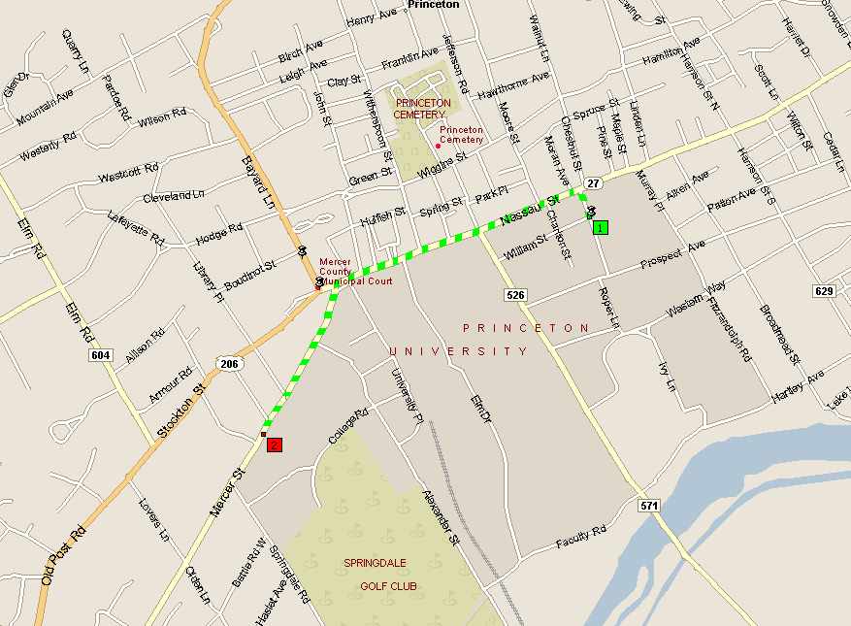
4.4 Shortest Paths in a Graph
shortest path from Princeton CS department to Einstein's house
Notes:
map from Microsoft Streets and Trips

Slide 36
Shortest Path Problem
Shortest path network.
Directed graph G = (V, E).
Source s, destination t.
Length _{e} = length of edge e.
Shortest path problem: find shortest directed path from s to t.
cost of path = sum of edge costs in path
2
23
3
9
s
18
Cost of path s-2-3-5-t = 9 + 23 + 2 + 16 = 50.
14
2
6
6
30
11
4
19
15
5
5
20
16
6
7
44
t

Slide 37
Dijkstra's Algorithm
Dijkstra's algorithm.
Maintain a set of explored nodes S for which we have determined the shortest path distance d(u) from s to u.
Initialize S = { s }, d(s) = 0.
Repeatedly choose unexplored node v which minimizes add v to S, and set d(v) = π(v).
shortest path to some u in explored part, followed by a single edge (u, v)
_{e}
v
d(u)
u
S
s

Slide 38
Dijkstra's Algorithm
Dijkstra's algorithm.
Maintain a set of explored nodes S for which we have determined the shortest path distance d(u) from s to u.
Initialize S = { s }, d(s) = 0.
Repeatedly choose unexplored node v which minimizes add v to S, and set d(v) = π(v).
shortest path to some u in explored part, followed by a single edge (u, v)
_{e}
v
d(u)
u
S
s
Notes:
S is only needed for the proof of correctness, not the algorithm itself

Slide 39
Dijkstra's Algorithm: Proof of Correctness
Invariant. For each node u ∈ S, d(u) is the length of the shortest s-u path.
Pf. (by induction on |S|)
Base case: |S| = 1 is trivial.
Inductive hypothesis: Assume true for |S| = k ≥ 1.
Let v be next node added to S, and let u-v be the chosen edge.
The shortest s-u path plus (u, v) is an s-v path of length π(v).
Consider any s-v path P. We'll see that it's no shorter than π(v).
Let x-y be the first edge in P that leaves S, and let P' be the subpath to x.
P is already too long as soon as it leaves S.
P
P'
x
y
s
S
u
● (P) ≥  (P') +  (x,y) ≥ d(x) +  (x, y) ≥ π(y) ≥ π(v)
v
nonnegative weights
inductive hypothesis
defn of π(y)
Dijkstra chose v instead of y
Notes:
Consider any path P from s to v. It is already at least as long as π(v) by the time it leaves S.

Slide 40
Dijkstra's Algorithm: Implementation
For each unexplored node, explicitly maintain
Next node to explore = node with minimum π(v).
When exploring v, for each incident edge e = (v, w), update
Efficient implementation. Maintain a priority queue of unexplored nodes, prioritized by π(v).
Priority Queue
PQ Operation
Dijkstra
Array
Binary heap
d-way Heap
Fib heap †
Insert
n
n
log n
d log _{d} n
1
ExtractMin
n
n
log n
d log _{d} n
log n
ChangeKey
m
1
log n
log _{d} n
1
IsEmpty
n
1
1
1
1
Total
n²
m log n
m log _{m/n} n
m + n log n
† Individual ops are amortized bounds

Slide 41


Coin Changing
Greed is good. Greed is right. Greed works. Greed clarifies, cuts through, and captures the essence of the evolutionary spirit.
- Gordon Gecko (Michael Douglas)
Notes:
"michael douglas played gordon gecko in iconic movie of the 1980's that embodied Reagan era"
also starring charlie and martin sheen, directed by Oliver Stone

Slide 42







Coin Changing
Goal. Given currency denominations: 1, 5, 10, 25, 100, devise a method to pay amount to customer using fewest number of coins.
Ex: 34¢.
Cashier's algorithm. At each iteration, add coin of the largest value that does not take us past the amount to be paid.
Ex: $2.89.
Notes:
most of us solve this kind of problem every day without thinking twice, unconsciously using an obvious greedy algorithm
http://www.frbatlanta.org/publica/brochure/fundfac/html/coinfaces.html

Slide 43
Coin-Changing: Greedy Algorithm
Cashier's algorithm. At each iteration, add coin of the largest value that does not take us past the amount to be paid.
Q. Is cashier's algorithm optimal?
Sort coins denominations by value: c₁ < c₂ < … < c_{n}.
S ← φ
while (x ≠ 0) {
let k be largest integer such that c_{k} ≤ x
if (k = 0)
return "no solution found"
x ← x - c_{k}
S ← S ∪ {k}
}
return S
coins selected
Notes:
takes O(n log n) + |S| where S is the number of coins taken by greedy
Note: can be sped up somewhat by using integer division

Slide 44
Coin-Changing: Analysis of Greedy Algorithm
Theorem. Greed is optimal for U.S. coinage: 1, 5, 10, 25, 100.
Pf. (by induction on x)
Consider optimal way to change c_{k} ≤ x < c_{k+1} : greedy takes coin k.
We claim that any optimal solution must also take coin k.
if not, it needs enough coins of type c₁, …, c_{k-1} to add up to x
table below indicates no optimal solution can do this
Problem reduces to coin-changing x - c_{k} cents, which, by induction, is optimally solved by greedy algorithm. ▪
k
c_{k}
All optimal solutions must satisfy
Max value of coins 1, 2, …, k-1 in any OPT
1
1
P ≤ 4
-
2
5
N ≤ 1
4
3
10
N + D ≤ 2
4 + 5 = 9
4
25
Q ≤ 3
20 + 4 = 24
5
100
no limit
75 + 24 = 99
Notes:
P = pennies, N = nickels, D = dimes, Q = quarters

Slide 45
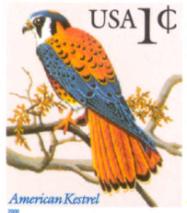
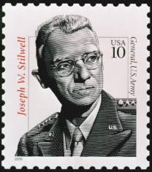
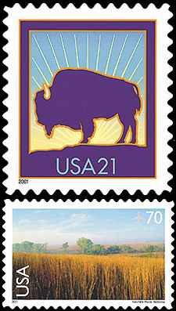





Coin-Changing: Analysis of Greedy Algorithm
Observation. Greedy algorithm is sub-optimal for US postal denominations: 1, 10, 21, 34, 70, 100, 350, 1225, 1500.
Counterexample. 140¢.
Greedy: 100, 34, 1, 1, 1, 1, 1, 1.
Optimal: 70, 70.
Notes:
note: may not even lead to *feasible* solution if c_1 > 1!
Ex. C = {7, 8, 9}, x = 15

Slide 46
Selecting Breakpoints

Slide 47
Selecting Breakpoints
Selecting breakpoints.
Road trip from Princeton to Palo Alto along fixed route.
Refueling stations at certain points along the way.
Fuel capacity = C.
Goal: makes as few refueling stops as possible.
Greedy algorithm. Go as far as you can before refueling.
C
C
C
C
Princeton
C
C
C
Palo Alto
1
2
3
4
5
6
7
Notes:
applications: communication server sending information in chunks of size at most C

Slide 48
Selecting Breakpoints: Greedy Algorithm
Truck driver's algorithm.
Implementation. O(n log n)
Use binary search to select each breakpoint p.
Sort breakpoints so that: 0 = b₀ < b₁ < b₂ < ... < b_{n} = L
S ← {0}
x ← 0
while (x ≠ b_{n})
let p be largest integer such that b_{p} ≤ x + C
if (b_{p} = x)
return "no solution"
x ← b_{p}
S ← S ∪ {p}
return S
breakpoints selected
current location

Slide 49
Selecting Breakpoints: Correctness
Theorem. Greedy algorithm is optimal.
Pf. (by contradiction)
Assume greedy is not optimal, and let's see what happens.
Let 0 = g₀ < g₁ < . . . < g_{p} = L denote set of breakpoints chosen by greedy.
Let 0 = f₀ < f₁ < . . . < f_{q} = L denote set of breakpoints in an optimal solution with f₀ = g₀, f₁= g₁ , . . . , f_{r} = g_{r} for largest possible value of r.
Note: g_{r+1} > f_{r+1} by greedy choice of algorithm.
g₀
g₁
g₂
g_{r}
g_{r+1}
Greedy:
OPT:
. . .
f₀
f₁
f₂
f_{r}
f_{r+1}
f_{q}
why doesn't optimal solution drive a little further?

Slide 50
Selecting Breakpoints: Correctness
Theorem. Greedy algorithm is optimal.
Pf. (by contradiction)
Assume greedy is not optimal, and let's see what happens.
Let 0 = g₀ < g₁ < . . . < g_{p} = L denote set of breakpoints chosen by greedy.
Let 0 = f₀ < f₁ < . . . < f_{q} = L denote set of breakpoints in an optimal solution with f₀ = g₀, f₁= g₁ , . . . , f_{r} = g_{r} for largest possible value of r.
Note: g_{r+1} > f_{r+1} by greedy choice of algorithm.
g₀
g₁
g₂
g_{r}
g_{r+1}
Greedy:
OPT:
. . .
f₀
f₁
f₂
f_{r}
f_{q}
another optimal solution has one more breakpoint in common ⇒ contradiction

Slide 51
4.5 Minimum Spanning Tree

Slide 52
Minimum Spanning Tree
Minimum spanning tree. Given a connected graph G = (V, E) with real-valued edge weights c_{e}, an MST is a subset of the edges T ⊆ E such that T is a spanning tree whose sum of edge weights is minimized.
Cayley's Theorem. There are n^{n-2} spanning trees of K_{n}.
4
24
4
6
23
9
9
18
6
5
11
5
11
16
8
8
14
7
7
10
21
G = (V, E)
T, Σ_{e∈T} c_{e} = 50
can't solve by brute force
Notes:
Cayley (1821-1895) was one of great mathematicians of 19th century, but his 1889 paper did not contain a rigorous proof of Cayley's Theorem.

Slide 53
Applications
MST is fundamental problem with diverse applications.
Network design.
telephone, electrical, hydraulic, TV cable, computer, road
Approximation algorithms for NP-hard problems.
traveling salesperson problem, Steiner tree
Indirect applications.
max bottleneck paths
LDPC codes for error correction
image registration with Renyi entropy
learning salient features for real-time face verification
reducing data storage in sequencing amino acids in a protein
model locality of particle interactions in turbulent fluid flows
autoconfig protocol for Ethernet bridging to avoid cycles in a network
Cluster analysis.
Notes:
Applications: http://www1.ics.uci.edu/~eppstein/gina/mst.html, Ahuja, Magnanti, Orlin Section 13.2

Slide 54
Greedy Algorithms
Kruskal's algorithm. Start with T = φ. Consider edges in ascending order of cost. Insert edge e in T unless doing so would create a cycle.
Reverse-Delete algorithm. Start with T = E. Consider edges in descending order of cost. Delete edge e from T unless doing so would disconnect T.
Prim's algorithm. Start with some root node s and greedily grow a tree T from s outward. At each step, add the cheapest edge e to T that has exactly one endpoint in T.
Remark. All three algorithms produce an MST.

Slide 55
Greedy Algorithms
Simplifying assumption. All edge costs c_{e} are distinct.
Cut property. Let S be any subset of nodes, and let e be the min cost edge with exactly one endpoint in S. Then the MST contains e.
Cycle property. Let C be any cycle, and let f be the max cost edge belonging to C. Then the MST does not contain f.
C
f
S
e
e is in the MST
f is not in the MST
Notes:
Note: simplifying assumption guarantees that MST in unique so it make sense to refer to "the MST"

Slide 56
Cycles and Cuts
Cycle. Set of edges the form a-b, b-c, c-d, …, y-z, z-a.
Cutset. A cut is a subset of nodes S. The corresponding cutset D is the subset of edges with exactly one endpoint in S.
2
3
1
6
4
Cycle C = 1-2, 2-3, 3-4, 4-5, 5-6, 6-1
5
7
8
2
3
1
Cut S = { 4, 5, 8 }
Cutset D = 5-6, 5-7, 3-4, 3-5, 7-8
6
4
5
7
8

Slide 57
Cycle-Cut Intersection
Claim. A cycle and a cutset intersect in an even number of edges.
Pf. (by picture)
2
3
1
Cycle C = 1-2, 2-3, 3-4, 4-5, 5-6, 6-1 Cutset D = 3-4, 3-5, 5-6, 5-7, 7-8 Intersection = 3-4, 5-6
6
4
5
7
8
C
S
V - S

Slide 58
Greedy Algorithms
Simplifying assumption. All edge costs c_{e} are distinct.
Cut property. Let S be any subset of nodes, and let e be the min cost edge with exactly one endpoint in S. Then the MST T* contains e.
Pf. (exchange argument)
Suppose e does not belong to T*, and let's see what happens.
Adding e to T* creates a cycle C in T*.
Edge e is both in the cycle C and in the cutset D corresponding to S ⇒ there exists another edge, say f, that is in both C and D.
T' = T* ∪ { e } - { f } is also a spanning tree.
Since c_{e} < c_{f}, cost(T') < cost(T*).
This is a contradiction. ▪
f
S
e
T*

Slide 59
Greedy Algorithms
Simplifying assumption. All edge costs c_{e} are distinct.
Cycle property. Let C be any cycle in G, and let f be the max cost edge belonging to C. Then the MST T* does not contain f.
Pf. (exchange argument)
Suppose f belongs to T*, and let's see what happens.
Deleting f from T* creates a cut S in T*.
Edge f is both in the cycle C and in the cutset D corresponding to S ⇒ there exists another edge, say e, that is in both C and D.
T' = T* ∪ { e } - { f } is also a spanning tree.
Since c_{e} < c_{f}, cost(T') < cost(T*).
This is a contradiction. ▪
f
S
e
T*

Slide 60
Prim's Algorithm: Proof of Correctness
Prim's algorithm. [Jarník 1930, Dijkstra 1957, Prim 1959]
Initialize S = any node.
Apply cut property to S.
Add min cost edge in cutset corresponding to S to T, and add one new explored node u to S.
S

Slide 61
Implementation: Prim's Algorithm
Implementation. Use a priority queue ala Dijkstra.
Maintain set of explored nodes S.
For each unexplored node v, maintain attachment cost a[v] = cost of cheapest edge v to a node in S.
O(n²) with an array; O(m log n) with a binary heap.
Prim(G, c) {
foreach (v ∈ V) a[v] ← ∞
Initialize an empty priority queue Q
foreach (v ∈ V) insert v onto Q
Initialize set of explored nodes S ← φ
while (Q is not empty) {
u ← delete min element from Q
S ← S ∪ { u }
foreach (edge e = (u, v) incident to u)
if ((v ∉ S) and (c_{e} < a[v]))
decrease priority a[v] to c_{e}
}

Slide 62
Kruskal's Algorithm: Proof of Correctness
Kruskal's algorithm. [Kruskal, 1956]
Consider edges in ascending order of weight.
Case 1: If adding e to T creates a cycle, discard e according to cycle property.
Case 2: Otherwise, insert e = (u, v) into T according to cut property where S = set of nodes in u's connected component.
v
e
S
e
u
Case 1
Case 2

Slide 63
Implementation: Kruskal's Algorithm
Implementation. Use the union-find data structure.
Build set T of edges in the MST.
Maintain set for each connected component.
O(m log n) for sorting and O(m α (m, n)) for union-find.
m ≤ n² ⇒ log m is O(log n)
essentially a constant
Kruskal(G, c) {
Sort edges weights so that c₁ ≤ c₂ ≤ ... ≤ c_{m}.
T ← φ
foreach (u ∈ V) make a set containing singleton u
for i = 1 to m
(u,v) = e_{i}
if (u and v are in different sets) {
T ← T ∪ {e_{i}}
merge the sets containing u and v
}
return T
}
are u and v in different connected components?
merge two components

Slide 64
Lexicographic Tiebreaking
To remove the assumption that all edge costs are distinct: perturb all edge costs by tiny amounts to break any ties.
Impact. Kruskal and Prim only interact with costs via pairwise comparisons. If perturbations are sufficiently small, MST with perturbed costs is MST with original costs.
Implementation. Can handle arbitrarily small perturbations implicitly by breaking ties lexicographically, according to index.
e.g., if all edge costs are integers, perturbing cost of edge e_{i} by i / n²
boolean less(i, j) {
if (cost(e_{i}) < cost(e_{j})) return true
else if (cost(e_{i}) > cost(e_{j})) return false
else if (i < j) return true
else return false
}

Slide 65
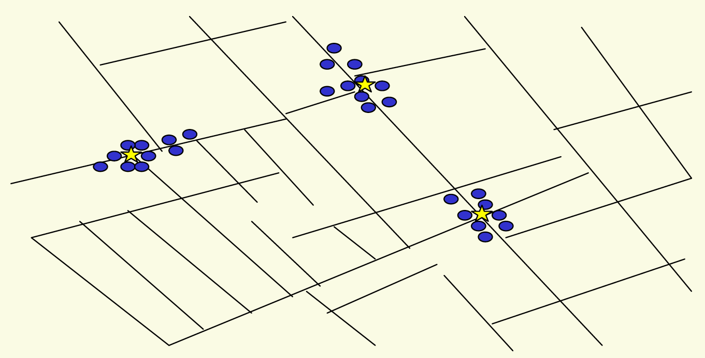
4.7 Clustering
Outbreak of cholera deaths in London in 1850s. Reference: Nina Mishra, HP Labs
Notes:
History: London physicist John Snow plotted outbreak of cholera deaths on map in 1850s
location indicated that clusters were around certain intersections with polluted wells; this exposed the problem and solution!

Slide 66
Clustering
Clustering. Given a set U of n objects labeled p₁, …, p_{n}, classify into coherent groups.
Distance function. Numeric value specifying "closeness" of two objects.
Fundamental problem. Divide into clusters so that points in different clusters are far apart.
Routing in mobile ad hoc networks.
Identify patterns in gene expression.
Document categorization for web search.
Similarity searching in medical image databases
Skycat: cluster 10⁹ sky objects into stars, quasars, galaxies.
photos, documents. micro-organisms
number of corresponding pixels whose
intensities differ by some threshold
Notes:
skycat: 7 dimensional vectors, each coordinate represents radiation in some band of the spectrum
Sloan Sky Survey: cluster entire visible universe

Slide 67
Clustering of Maximum Spacing
k-clustering. Divide objects into k non-empty groups.
Distance function. Assume it satisfies several natural properties.
d(p_{i}, p_{j}) = 0 iff p_{i} = p_{j} (identity of indiscernibles)
d(p_{i}, p_{j}) ≥ 0 (nonnegativity)
d(p_{i}, p_{j}) = d(p_{j}, p_{i}) (symmetry)
Spacing. Min distance between any pair of points in different clusters.
Clustering of maximum spacing. Given an integer k, find a k-clustering of maximum spacing.
spacing
k = 4
Notes:
semimetric: not necessarily a metric space (no triangle inequality)
Ex: assumes Euclidean distance function

Slide 68
Greedy Clustering Algorithm
Single-link k-clustering algorithm.
Form a graph on the vertex set U, corresponding to n clusters.
Find the closest pair of objects such that each object is in a different cluster, and add an edge between them.
Repeat n-k times until there are exactly k clusters.
Key observation. This procedure is precisely Kruskal's algorithm (except we stop when there are k connected components).
Remark. Equivalent to finding an MST and deleting the k-1 most expensive edges.
Notes:
Agglomerative clustering. Build tree bottom up.
Divisive clustering. Build tree top down.

Slide 69
Greedy Clustering Algorithm: Analysis
Theorem. Let C* denote the clustering C*₁, …, C*_{k} formed by deleting the k-1 most expensive edges of a MST. C* is a k-clustering of max spacing.
Pf. Let C denote some other clustering C₁, …, C_{k}.
The spacing of C* is the length d* of the (k-1)^{st} most expensive edge.
Let p_{i}, p_{j} be in the same cluster in C*, say C*_{r}, but different clusters in C, say C_{s} and C_{t}.
Some edge (p, q) on p_{i}-p_{j} path in C*_{r} spans two different clusters in C.
All edges on p_{i}-p_{j} path have length ≤ d* since Kruskal chose them.
Spacing of C is ≤ d* since p and q are in different clusters. ▪
C_{s}
C_{t}
C*_{r}
p_{i}
p
q
p_{j}

Slide 70
MST Algorithms: Theory
Deterministic comparison based algorithms.
O(m log n) [Jarník, Prim, Dijkstra, Kruskal, Boruvka]
O(m log log n). [Cheriton-Tarjan 1976, Yao 1975]
O(m β(m, n)). [Fredman-Tarjan 1987]
O(m log β(m, n)). [Gabow-Galil-Spencer-Tarjan 1986]
O(m α (m, n)). [Chazelle 2000]
Holy grail. O(m).
Notable.
O(m) randomized. [Karger-Klein-Tarjan 1995]
O(m) verification. [Dixon-Rauch-Tarjan 1992]
Euclidean.
2-d: O(n log n). compute MST of edges in Delaunay
k-d: O(k n²). dense Prim
Notes:
Idea for O(m log log n): combine Boruvka + Prim. (see CLR 24-2)
Chazelle: soft heaps, lower bound tight over arbitrary semi-group

Slide 71
Matroid

Slide 72
Matroid: definition and examples
Defn.: A matroid (U,I) consists of a universe of elements and a family of distinguished subsets called independent sets which satisfy:
Subsets of independent sets are independent.
Exchange property: If S,T are independent and |S| < |T| then S U {t} is independent for some t in T.
Examples:
Graphical Matroid:
Elements are the edges of an undirected graph G = (V;E)
Set of edges is independent if it does not contain a cycle
Matric Matroid:
Elements (items) are vector in a linear space
Set of elements is independent if they are linear independent
Uniform Matroid
Partition Matroid

Slide 73
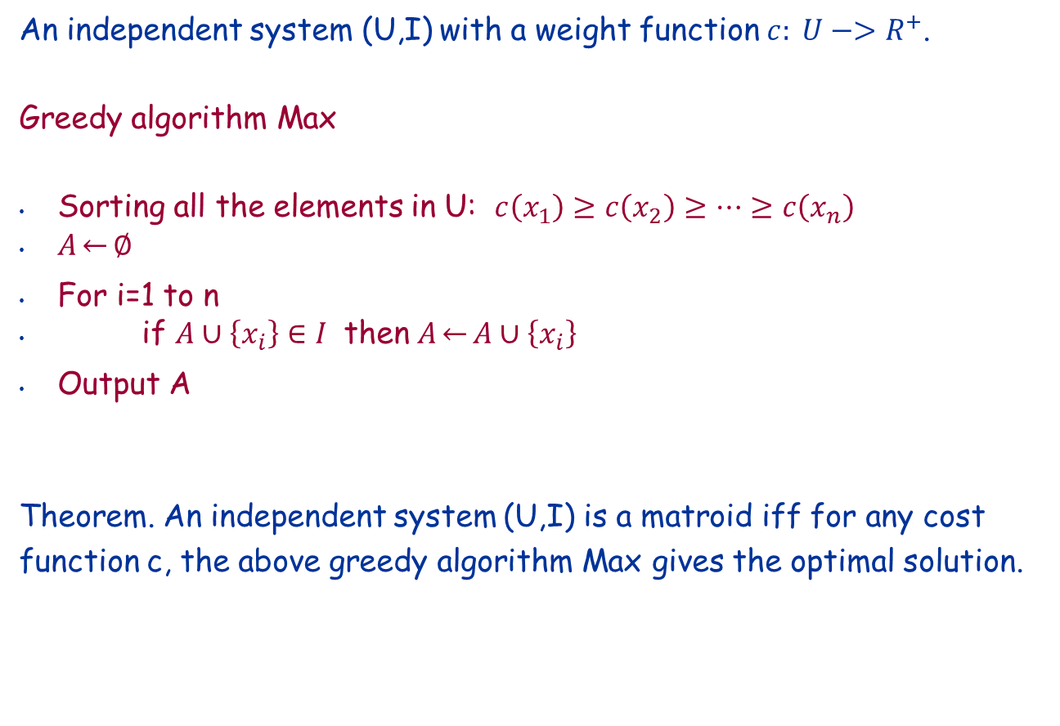
Weighted Independent System
An independent system (U,I) with a weight function $c: U−>R^{+}$.
Greedy algorithm Max
Sorting all the elements in U: $c\left(x_{1}\right)≥c\left(x_{2}\right)≥…≥c\left(x_{n}\right)$
$A\overset{←}{}∅$
For i=1 to n
if $A∪\left\{x_{i}\right\}∈I$ then $A\overset{←}{}A∪\left\{x_{i}\right\}$
Output A
Theorem. An independent system (U,I) is a matroid iff for any cost function c, the above greedy algorithm Max gives the optimal solution.

Slide 74
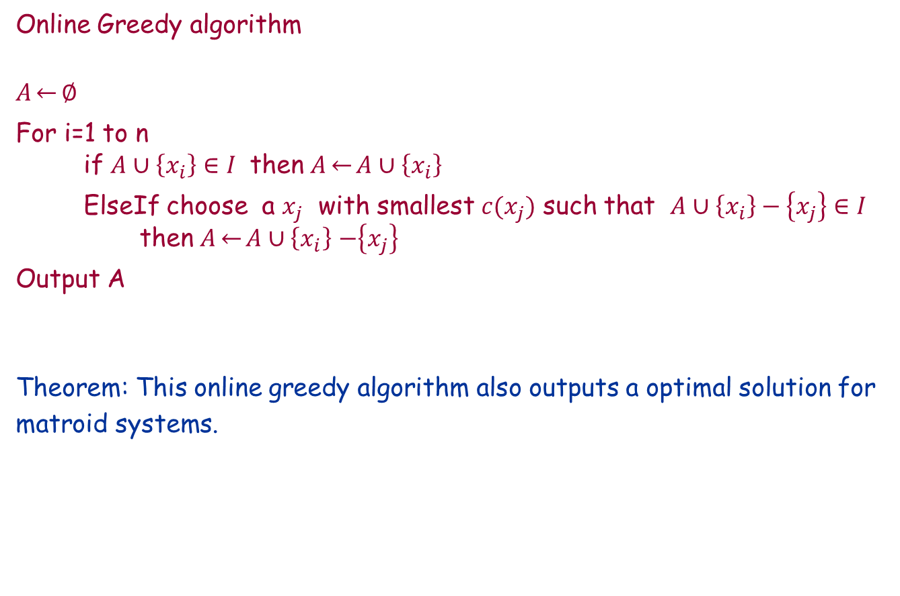
Online Greedy Algorithm
Online Greedy algorithm
$A\overset{←}{}∅$
For i=1 to n
if $A∪\left\{x_{i}\right\}∈I$ then $A\overset{←}{}A∪\left\{x_{i}\right\}$
ElseIf choose a $x_{j}$ with smallest $c(x_{j})$ such that $A∪\left\{x_{i}\right\}−\left\{x_{j}\right\}∈I$ then $A\overset{←}{}A∪\left\{x_{i}\right\}$ $−\left\{x_{j}\right\}$
Output A
Theorem: This online greedy algorithm also outputs a optimal solution for matroid systems.

