Slide 1
Analysis Tools
Beautiful_And_Simple_Drawing_Atificer
(BASDA)
Yan Wang
09-04-2018

Slide 2
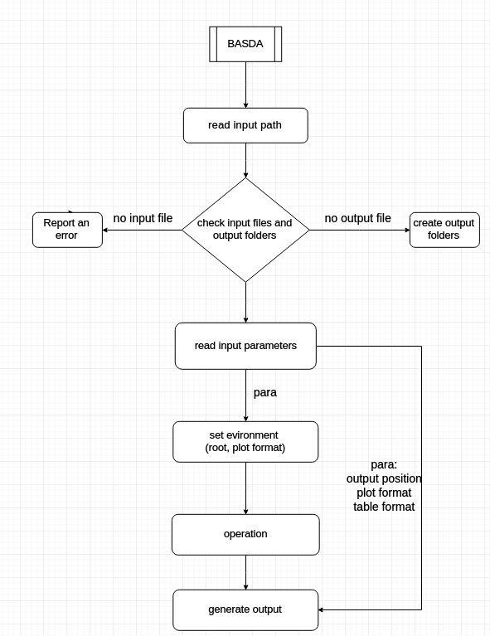
Code structure

Slide 3
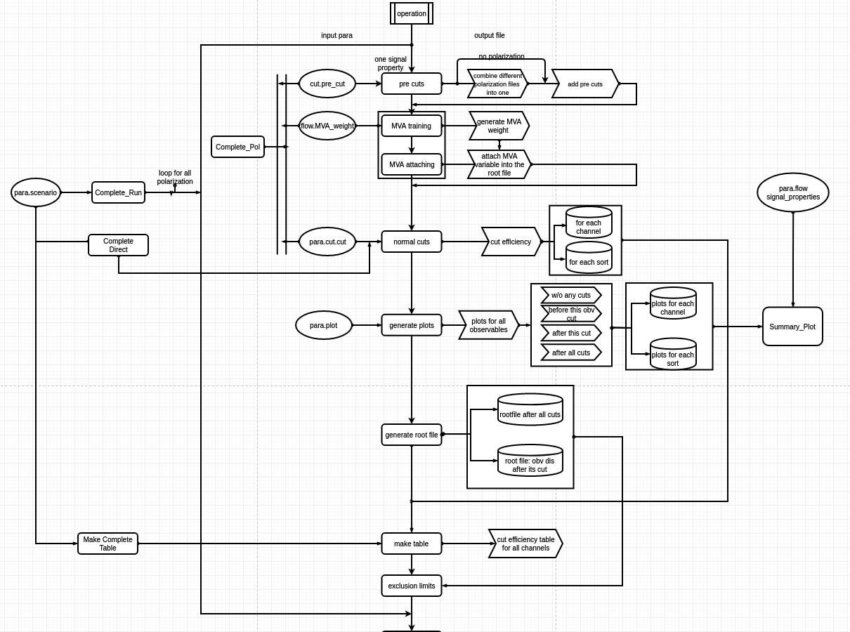

Slide 4
only tested
by me
assistant
funcitons
Tested by
Shin-ichi

Slide 5
Improvement since last meeting
code structure
support "integer", "float" and "double"
force them into float
fix some bugs

Slide 6
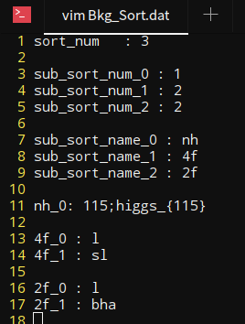
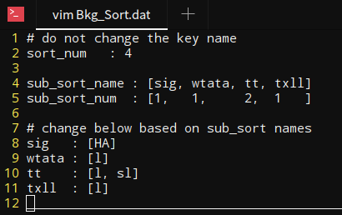
Improvement since last meeting
improve offriendly interface
basic/advanced configs
input for a sequence
generalize more settings into config files (MVA, plot ...)
improve safety (report errors, tell where/how it happens)
add more for introductions/README/Usage
past
current

Slide 7
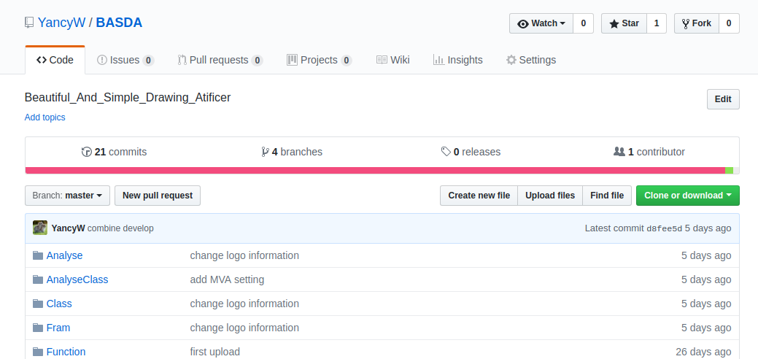
Installation
https://github.com/YancyW/BASDA
four branches: master, release, develop, feature.

Slide 8
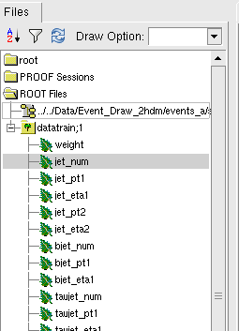
installation
c++14 ⊕ root6 ⊕ boost_filesystem
yaml-cpp
https://github.com/jbeder/yaml-cpp
input root file structure
weight
observables

Slide 9
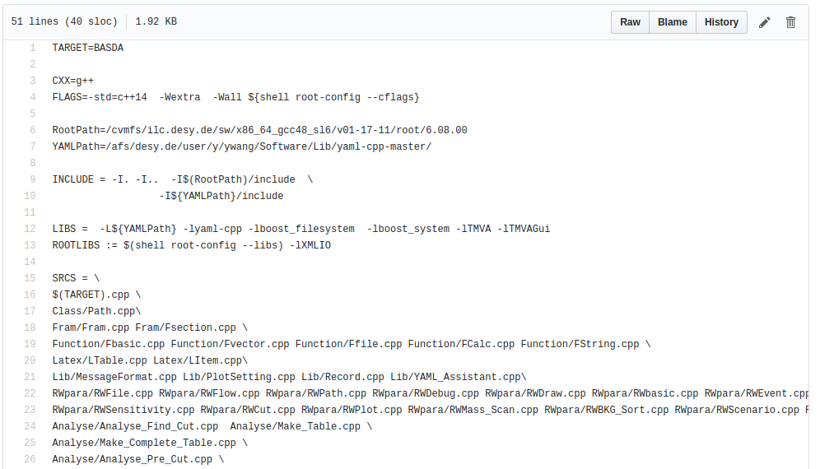
Installation (on NAF)
initialize ilcsoft for gcc≧4.8, root 6
install YAML, change path for makefile_server
in BASDA, cover makefile with makefile_server
mv makefile_server makefile
change YAML path

Slide 10
YAML format
YAML---YAML Ain't Markup Language
download/manuals https://github.com/jbeder/yaml-cpp
a human-readable data serialization language
in BASDA, only use simplest command
key : value
or,
key :
key : value
key :
key : value
or list,
key: [value1,value2, value3...]

Slide 11
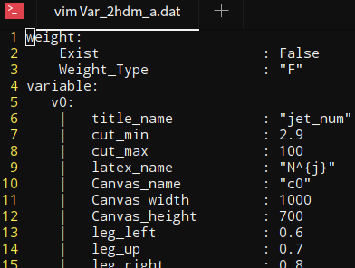
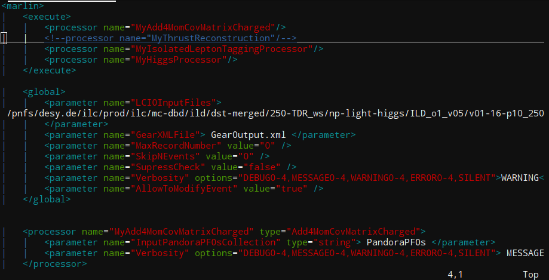
YAML format
space, NOT tab
note: DO NOT use tab in YAML.
DO NOT try to modify everything.
comments with #

Slide 12
Motivation

Slide 13
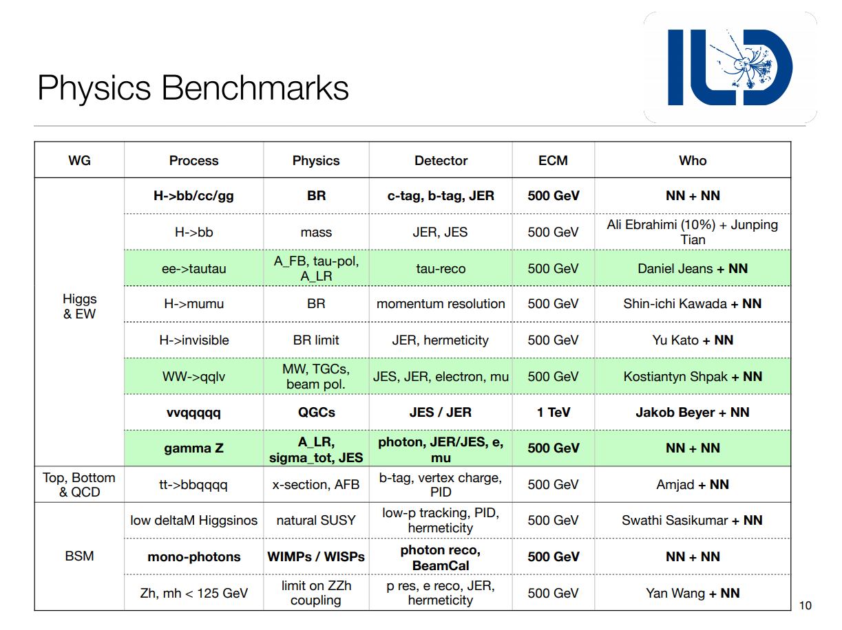
Motivation: a standard analysis code will be helpful!

Slide 14
General Strategy for analysis
Analysis
track
vertex
jet
leptons
jets
photons
missing Energy
...
particle
reconstruction
and calibration
final state
identification
adjust cuts
normal
observables
pt
E
angle
...
input paras
normal cuts
and
MVA
scenario
Special
observables
invairant mass
correlated angle
jet shape
jet substructure
...
drawing figures
final cuts
& final figures
significance
and
cut effi table
expected
limits

Slide 15
General Strategy for analysis
Analysis
track
vertex
jet
leptons
jets
photons
missing Energy
...
particle
reconstruction
and calibration
final state
identification
process dependent
adjust cuts
normal
observables
pt
E
angle
...
input paras
normal cuts
and
MVA
scenario
Special
observables
independent
invairant mass
correlated angle
jet shape
jet substructure
...
drawing figures
final cuts
& final figures
significance
and
cut effi table
expected
limits

Slide 16
The key role
display distribution
check cut effects
Observables
Add Cuts
MVA
cut orders & values
combination
data structure
number
vector of number

Slide 17
General Strategy for analysis
Analysis
track
vertex
jet
leptons
jets
photons
missing Energy
...
particle
reconstruction
and calibration
final state
identification
pt
E
angle
...
an
independent
package
Observables
invairant mass
correlated angle
jet shape
jet substructure
...

Slide 18
Beautiful_And_Simple_Drawing_Atificer (BASDA)

Slide 19
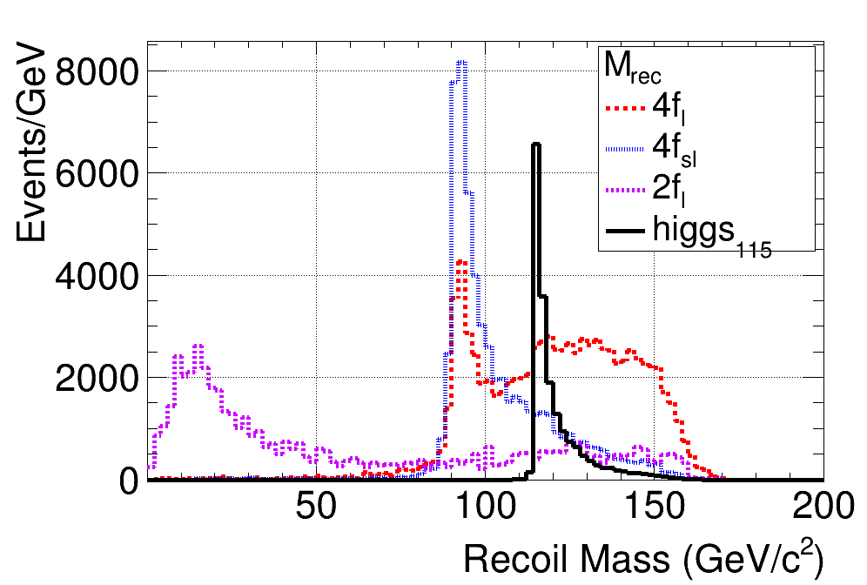
(BASDA)
The beautiful figure
plot templates
easy to adjust
once fixed, used forever
The simple operation
all with control files
Release time from programing.
Focus on Physics!
Easy to repeat
only need to
preserve control file.
Cross check

Slide 20
installation
c++14 ⊕ root6 ⊕ boost_filesystem
ilcsoft environment
for gcc≧4.8, root 6
yaml-cpp
https://github.com/jbeder/yaml-cpp
input root file structure
weight
observables

Slide 21
Code structure
YAML
format
input
path
input files
output files
settings
analysis
file name
file events
observable
process
classification
log file
data
figures
observable
files
figure
table
scenario
cut order
different
signal character
sensitivity
working flow
pre cuts
MVA
trainning
Add MVA
obs
cuts
cut
efficiency
output
calc
sensitivity
draw
distribution

Slide 22
input data
which file for
analysis
sort A: file 1,2
sortB: file 3,
sortC: file 4,5,6
name,
figure setting
for this obs,
cut,
which event
for running,
all,
the first 100,
101-303...
file
classify
observable
event

Slide 23
input example

Slide 24
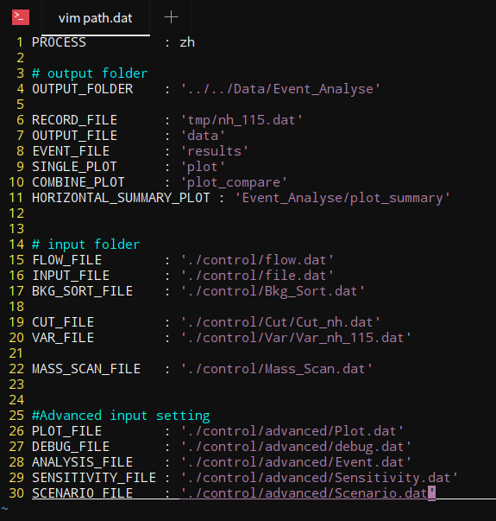
Path
process name
main output folder,
sub folders are under this
if doesn't exist, code will create one
sub output folder
input folder
if doesn't exist, report error
advanced input folder

Slide 25
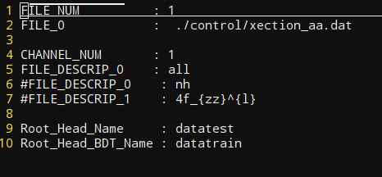
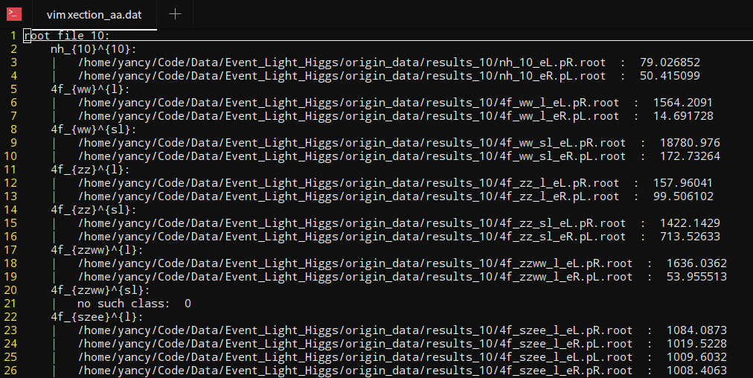
input file
input root file structure
channel used in this time
weight
root tree name
observables (float)
xection file
observables in one channel

Slide 26
xection file
signal property:
seperate different analysis processes
every mh can different input files
channel name: a_{b}^{c}
observables in one channel
input file name with different polarizations:
1 file : no polarization
2 files: lr/rl
4 files: lr/rl/ll/rr
cross section:
works when choosing no "weight"
when really don't have "weight" in input files
when hoping to reweight events

Slide 27
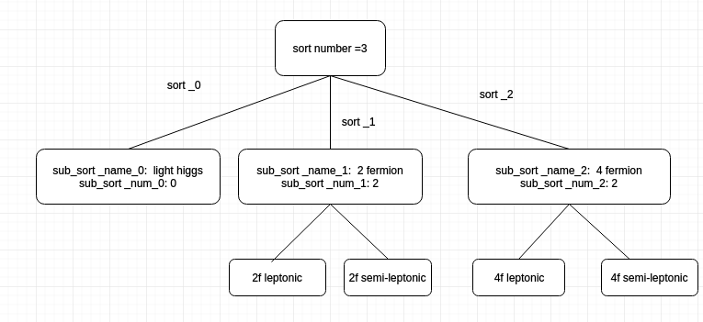
classify
channel name: a_{b}^{c}
a : sort
c : sub_sort
b : some special label

Slide 28
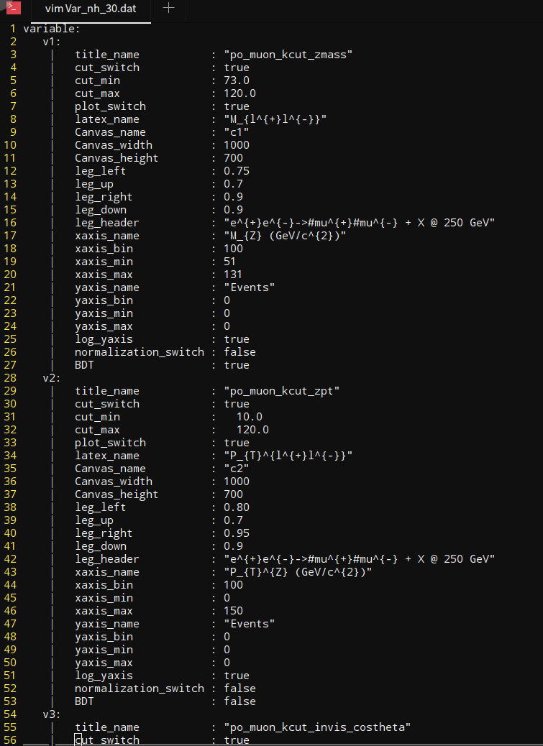
observables
obs name in code
obs name in input file
cut for this obs
plot para
whether use this
obs as MVA input

Slide 29
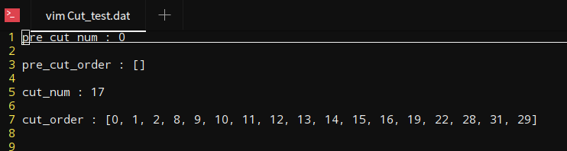
Cut
pre-cut order
no pre cuts for this case,
after Pre-CUT, event should be applied with MVA
for normal cut: 17 cuts
cut order

Slide 30
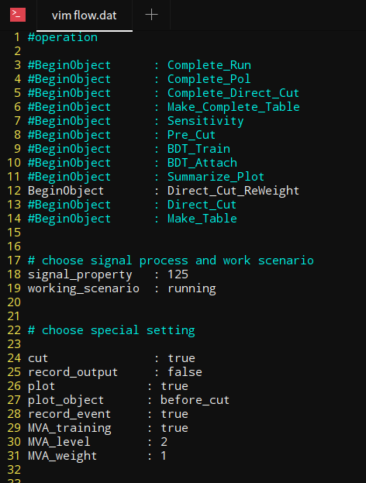
Operation Flow
will do which operation with this code
use cut
record everything in log file
draw plots
only works for Summarize_Plot
generate events after all cuts
MVA setting

Slide 31
output

Slide 32
output data
input
parameters
&
running
information
cut efficiency
for
different
process,
polarization,
&
signal
characters
plot for
single process
&
combined all
processes
root file
after cuts
on different
levels
(pre cuts,
all cuts,
w/o MVA vars
...)
log
data
figures
observables

Slide 33
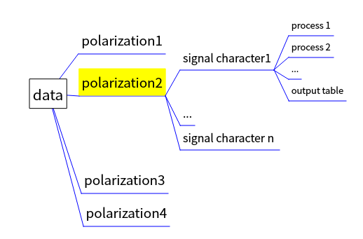
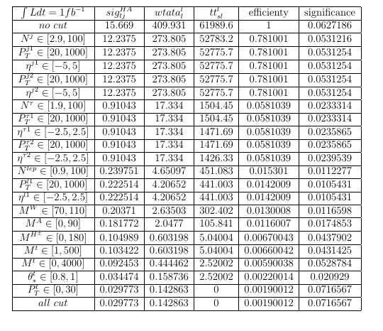
output data structure
data
the output table contains cut efficiency table for all processes with "Tex format",
can be directly used in latex file

Slide 34
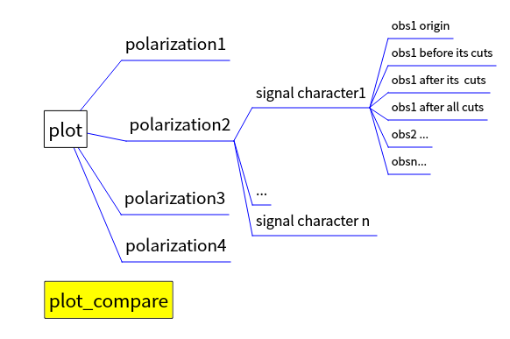
Diagram (png format)
for each process
compare all processes in one figure

Slide 35
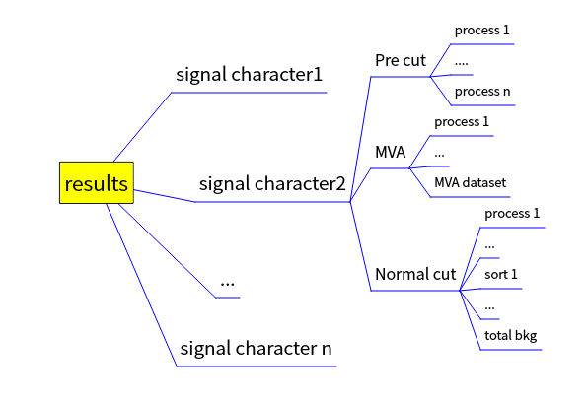
Root results
root format
after cuts in different level
can be used independently
events after all cuts
all distributions
adjust diagrams directly

Slide 36
output example

Slide 37
Pre cuts
sp is "signel property" set in the flow.dat
xxx is channel names set in the xection.dat
input: cut.pre_cut
output:
data/sp/xxx_sp_Unpol.dat
cut efficiency for pre cuts
results/sp_Unpol/xxx_sp.dat
root file after applying pre cuts
results/sp_MVA/xxx_sp.dat
file for attaching MVA values
file for applying normal cuts

Slide 38
MVA trainning
input: flow.MVA
output:
data/sp/dataset
MVA weight dataset

Slide 39
MVA value attaching
input: MVA weight file
output:
results/sp_MVA/xxx_sp.dat
add MVA value for each channel

Slide 40
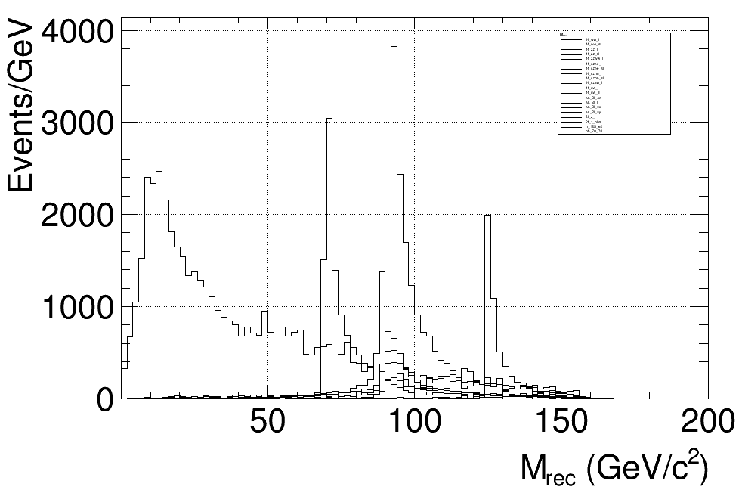
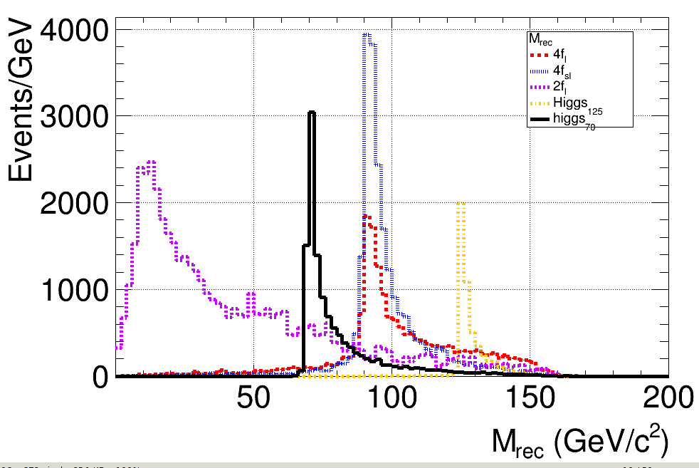
normal cuts
input: cut.pre_cut
output:
data/sp/xxx_sp.dat
cut efficiency for pre cuts
results/sp_CUT/xxx_sp.dat
file for applying normal cuts
plot/sp/obv.png
for each channel
plot_compare/sp/obv.png
for each sort
all channel
combined into sorts

Slide 41
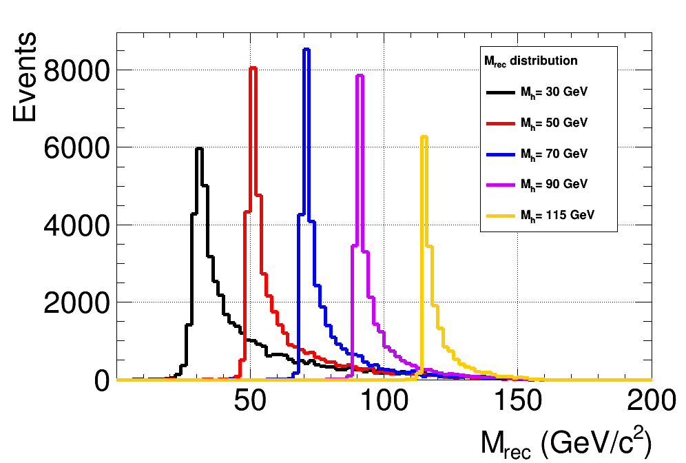
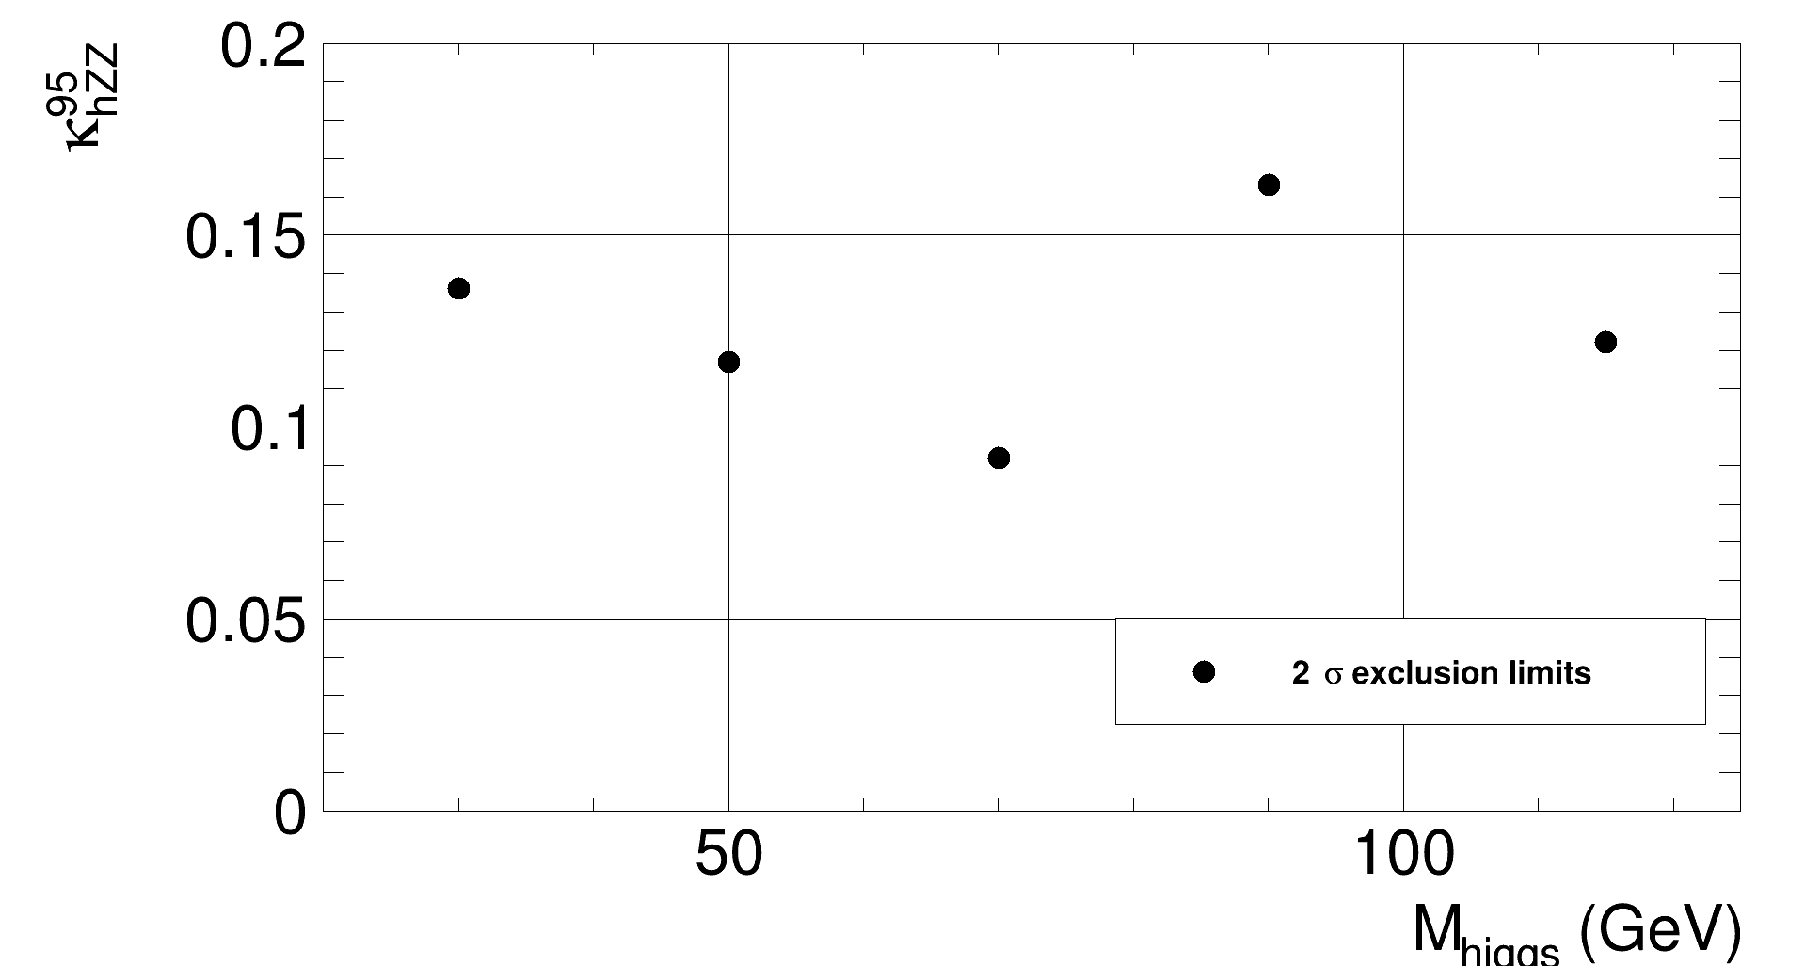
compare between different signal
characters
after generate results for different signal characters
compare them by control/scan.dat
signal distribution
cut efficiency table
sensitivity

Slide 42
advanced input example

Slide 43
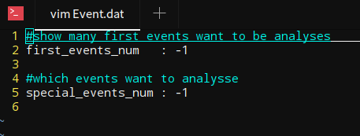
Event
when first =-1, special=-1 => use all events
when first = n, special=-1 => use first n events
when first =-1, special= n => use the n-th event
when first =n1, special=n2 => use events from n1 to n2
where if n > total events, n = total events, and n1 < n2

Slide 44
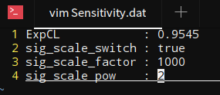
Sensitivity
control/Sensitivity.dat
get data from root results
calculate sensitivities according to the control file.
rescale signal cross section
rescale signal cross section

Slide 45
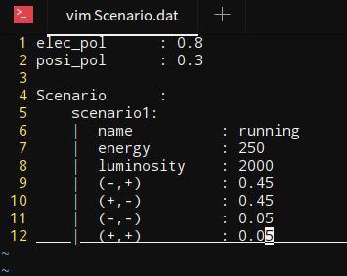
new scenario
control/scenario.dat
re-use results in Cuts_1 when changing the polarization. (MVA variable need to be recalculated.)
re-use results in Cuts_2 when changing the luminosity.
polarization value
luminosity
running polarization

Slide 46
Conclusion
programing
free
beautiful
figures
BASDA
light
weight
easily
use
repeatable

Slide 47
Summary & Future
https://github.com/YancyW/BASDA
four branches: master, release, develop, feature.
provide more functions,
2-D plots
statistic (like wsmaker,nplot ... in ATLAS group).
GUI for basic users

Slide 48
Backup

Slide 49
Thank you!

