Slide 1
Beautiful_And_Simple_Drawing_Atificer
(BASDA)
usage --- example
Yan Wang
11-04-2018

Slide 2
Installation

Slide 3
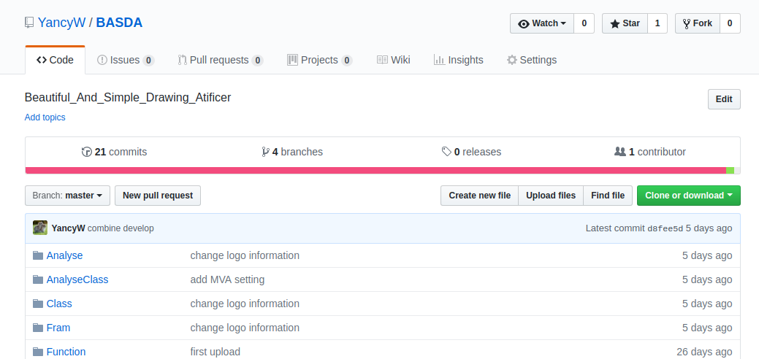
Installation
https://github.com/YancyW/BASDA
four branches: master, release, develop, feature.
stable
version

Slide 4
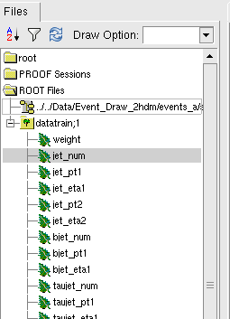
installation
c++14 ⊕ root6 ⊕ boost_filesystem
yaml-cpp
https://github.com/jbeder/yaml-cpp
input root file structure
weight (not necessary)
observables

Slide 5
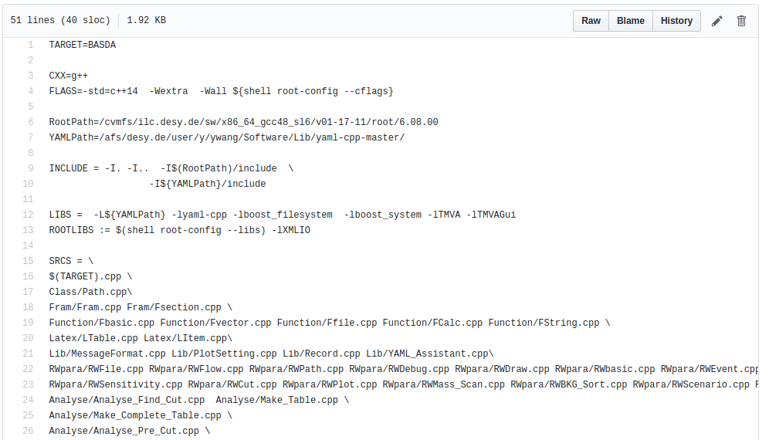
Installation (on NAF)
initialize ilcsoft for gcc≧4.8, root 6
install YAML, change path for makefile_server
in BASDA, cover makefile with makefile_server
mv makefile_server makefile
change YAML path

Slide 6
YAML

Slide 7
YAML format
YAML---YAML Ain't Markup Language
download/manuals https://github.com/jbeder/yaml-cpp
a human-readable data serialization language
in BASDA, only use simplest command
key : value
or,
key :
key : value
key :
key : value
or list,
key: [value1,value2, value3...]

Slide 8
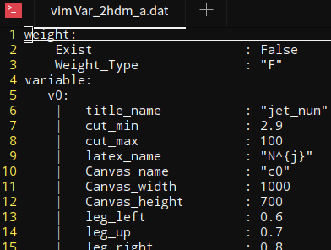
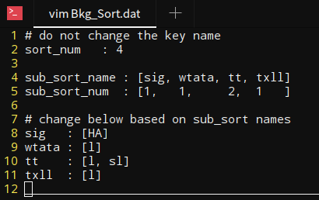
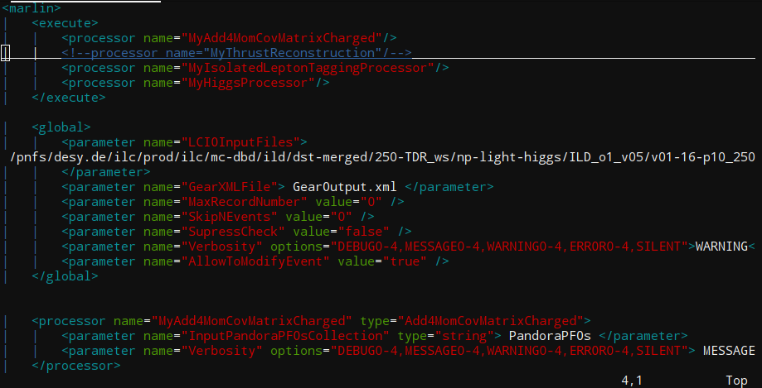
YAML format
it's space, NOT tab
note: DO NOT use tab in YAML.
DO NOT try to modify everything.
comments with #

Slide 9
a quick example

Slide 10
searching charge Higgs at LHC
sig: pp->tj->H⁺bj->AWbj->ττWbj
bkg: Wττ, tt(l,sl),tllj(tjττ,ttll)
identification cuts
lep=1, τ jet=2, jet>=1, pt, eta cuts
invariant mass cut
m_{A} , m_{H+-}

Slide 11
input example

Slide 12
input data
which file for
analysis
sort A: file 1,2
sortB: file 3,
sortC: file 4,5,6
name,
figure setting
for this obs,
cut,
which event
for running,
all,
the first 100,
101-303...
file
classify
observable
event

Slide 13
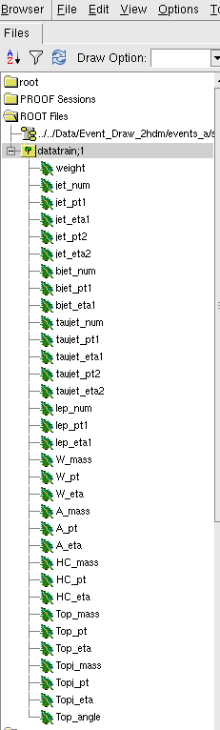
input setting
generate root files with
observables for each channels.
Here, weight = 0 for this example

Slide 14
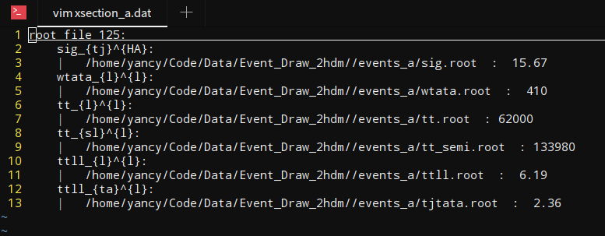
input setting
generate root file
edit input file: xection.dat
signal
bkgs
channel name: format is a_{b}^{c}
tt_{l}^{l}
tt_{sl}^{l}
weight=0 in root file, so tell the xsection here.
class name
user name
sub class name

Slide 15
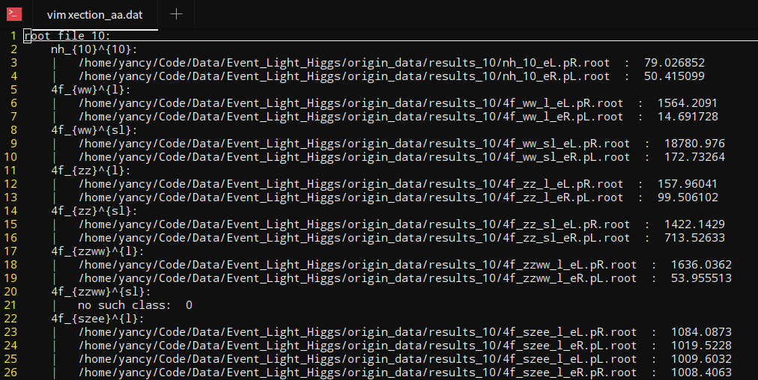
xection file
signal property:
seperate different analysis processes
every mh can different input files
channel name: a_{b}^{c}
observables in one channel
input file name with different polarizations:
1 file : no polarization
2 files: lr/rl
4 files: lr/rl/ll/rr
cross section:
works when choosing no "weight"
when really don't have "weight" in input files
when hoping to reweight events

Slide 16
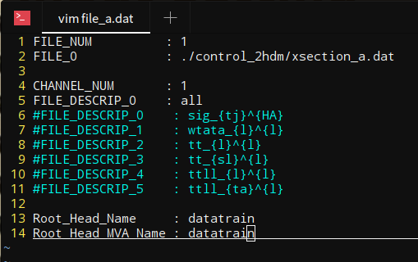
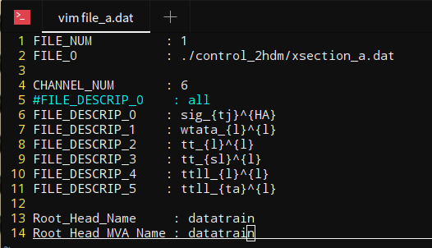
input setting
generate root file
edit xsection.dat
edit file.dat
this is also correct
root tree name
root tree name

Slide 17
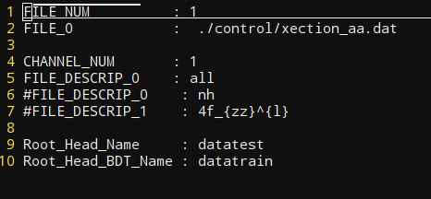
input file
input root file structure
channel used in this time
weight
root tree name
observables (float)
xection file
support "integer", "float" and "double"
currently force them into float
use "I", "F", "D" in Var.dat file to tell the code datatype.
observables in one channel

Slide 18
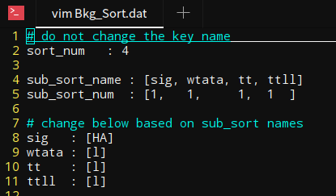
input setting
generate root file
edit input file
edit file.dat
edit Bkg_Sort.dat

Slide 19
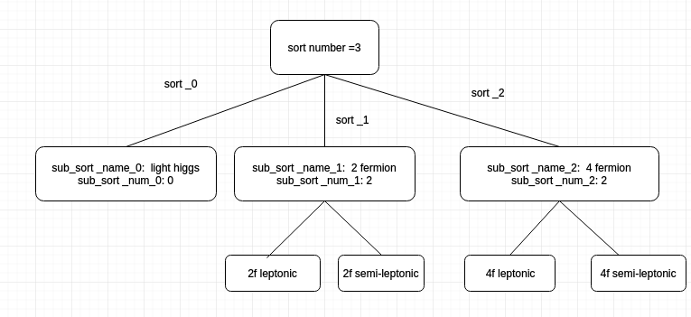
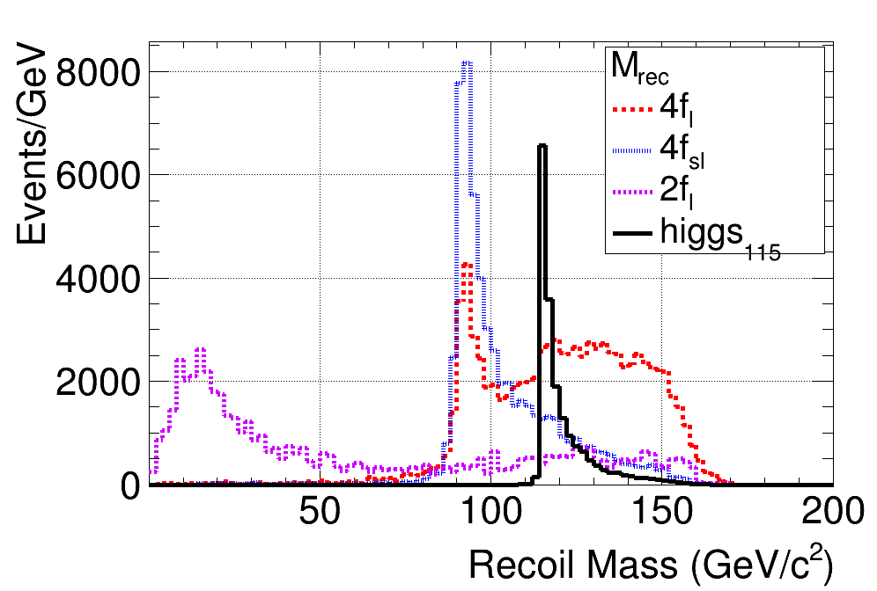
classify
channel name: a_{b}^{c}
a : sort
c : sub_sort
b : some special label

Slide 20
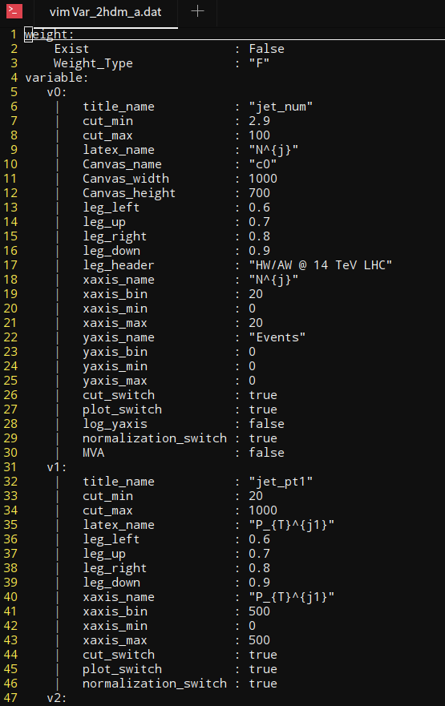
input setting
generate root file
edit input file
edit file.dat
edit Bkg_Sort.dat
edit Var.dat

Slide 21
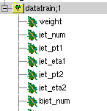
weight=0 in root file, so choose False.
Variable type
obs name in code
obs name in input file
cut for this obs
plot para
whether use this
obs as MVA input
if some settings are missing, it will use the previous ones

Slide 22
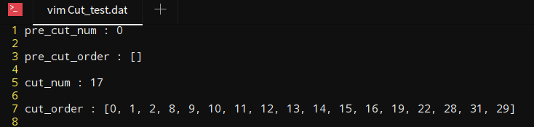
input setting
generate root file
edit input file
edit file.dat
edit Bkg_Sort.dat
edit Var.dat
edit Cut.dat
variable number in Var.dat

Slide 23
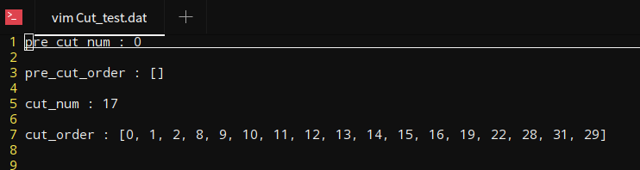
Cut
pre-cut order
no pre cuts for this case,
after Pre-CUT, event should be applied with MVA
for normal cut: 17 cuts
cut order

Slide 24
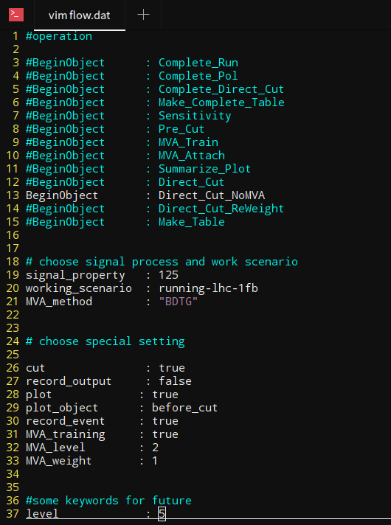
input setting
Here, we only use cut directly
generate root file
edit input file
edit file.dat
edit Bkg_Sort.dat
edit Var.dat
edit Cut.dat
edit flow.dat
luminosity
MVA method,
no used here
record everything in file, using when submit jobs
generate plot

Slide 25
Operation Flow
use cut
record everything in log file
draw plots
only works for Summarize_Plot
generate events after all cuts
MVA setting

Slide 26
input setting
generate root file
edit input file
edit file.dat
edit Bkg_Sort.dat
edit Var.dat
edit Cut.dat
edit flow.dat
edit path.dat,
include all above directories

Slide 27
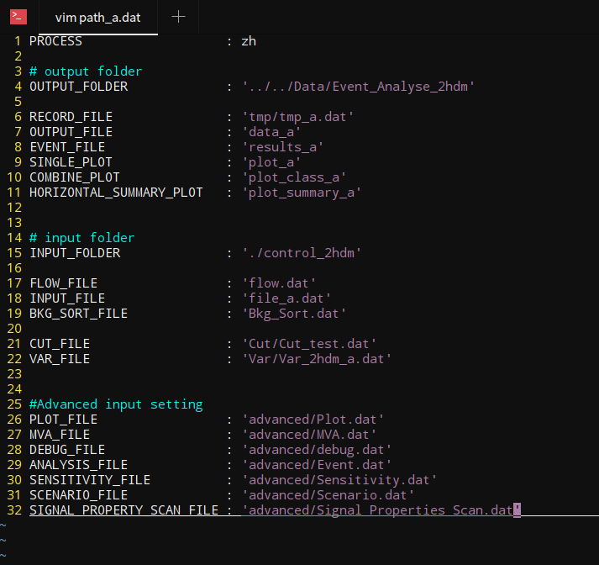
output
basic input
advanced input

Slide 28
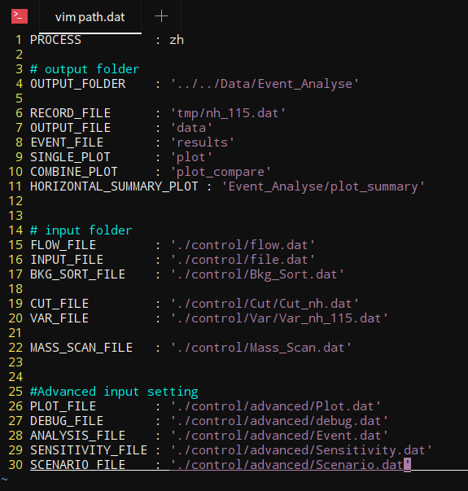
Path
process name
main output folder,
sub folders are under this
if doesn't exist, code will create one
sub output folder
input folder
if doesn't exist, report error
advanced input folder

Slide 29
run the code

Slide 30
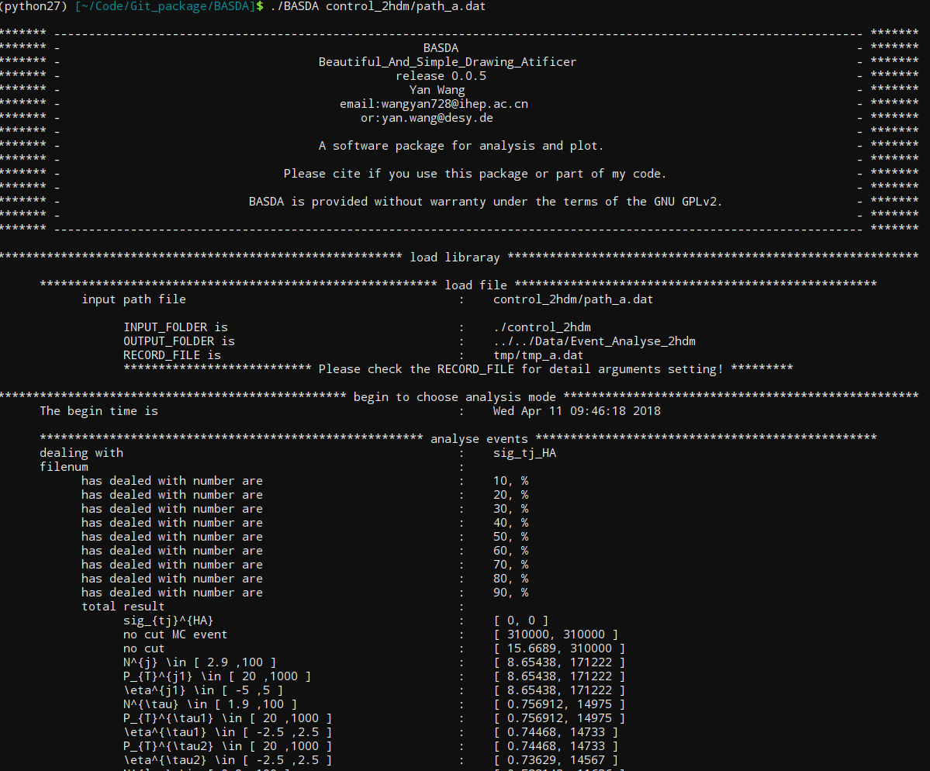
output on screen

Slide 31
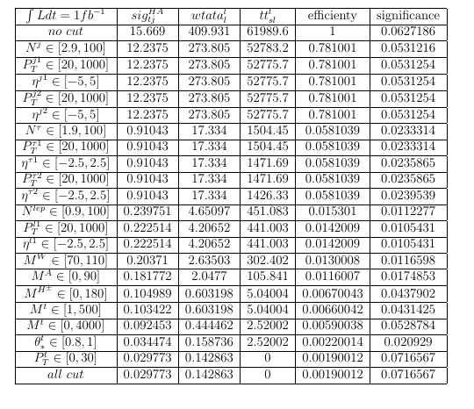
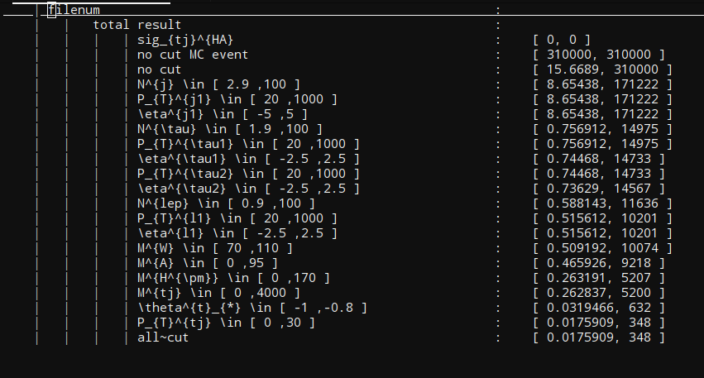
data

Slide 32
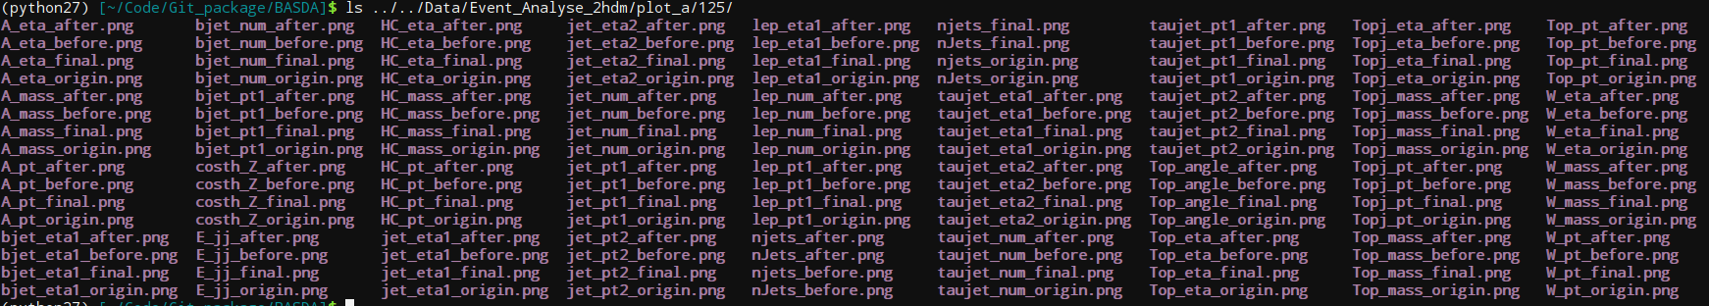
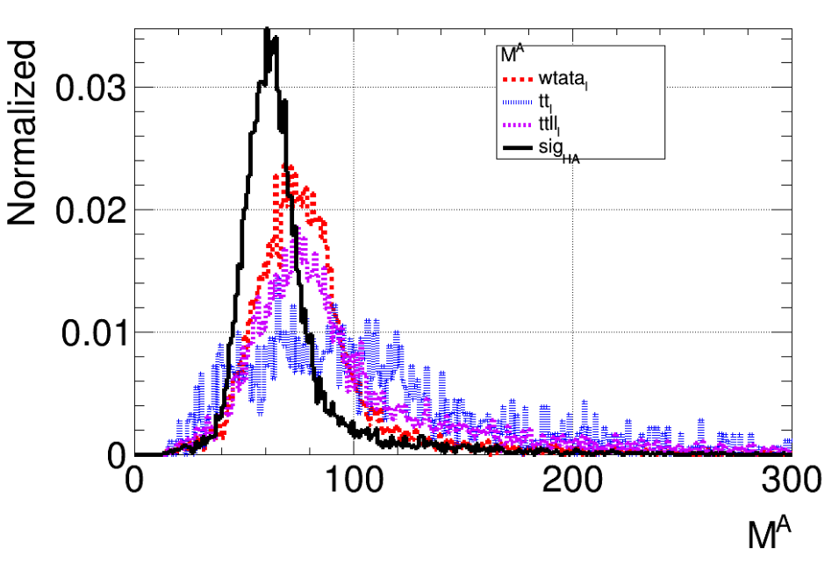
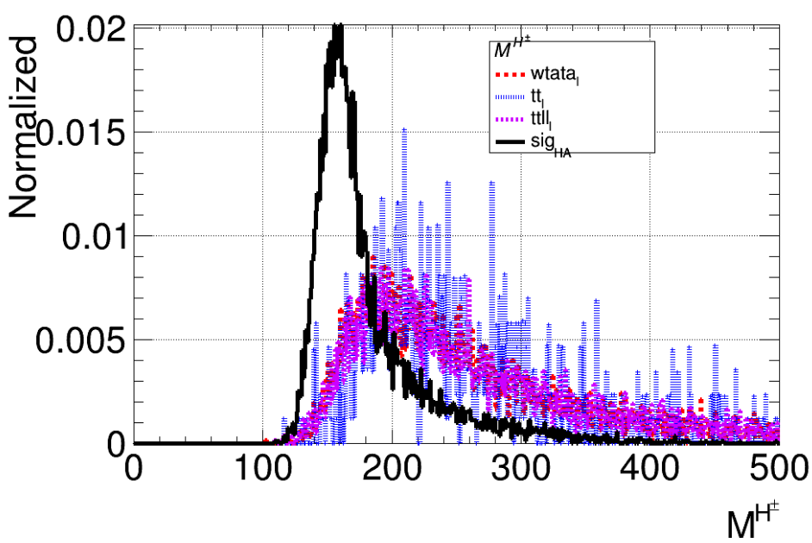
origin/before cuts/
after cuts/final
plots for
each observable
figures
before A mass cuts
before H+- mass cuts

Slide 33
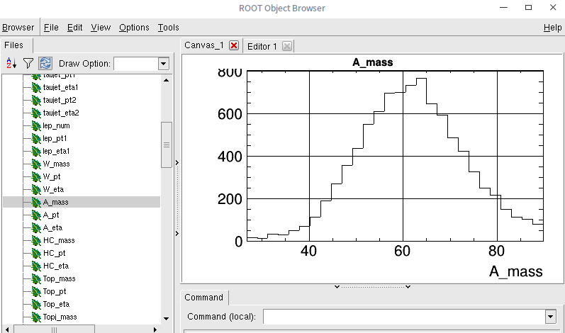
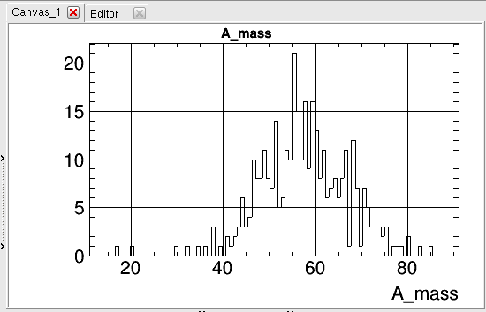
observable after its own cut,
and after all cuts are preserved
for further use
root file
after mA cut,
after all cuts,

Slide 34
other outputs

Slide 35
Pre cuts
sp is "signel property" set in the flow.dat
xxx is channel names set in the xection.dat
related input: cut.pre_cut
output:
data/sp/xxx_sp_Unpol.dat
cut efficiency for pre cuts
results/sp_Unpol/xxx_sp.dat
root file after applying pre cuts
results/sp_MVA/xxx_sp.dat
file for attaching MVA values
file for applying normal cuts

Slide 36
MVA trainning
related input: flow.MVA
output:
data/sp/dataset
MVA weight dataset

Slide 37
MVA value attaching
related input: MVA weight file
output:
results/sp_MVA/xxx_sp.dat
add MVA value for each channel

Slide 38
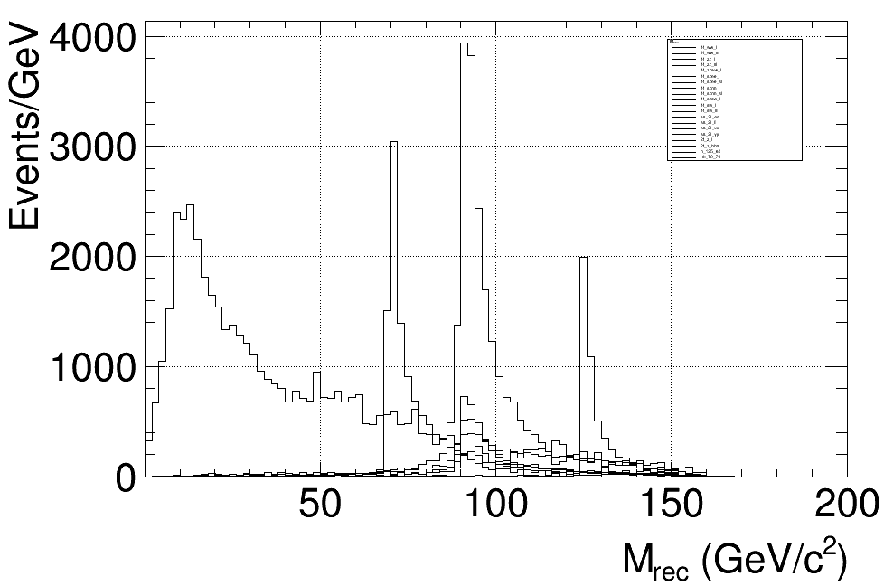
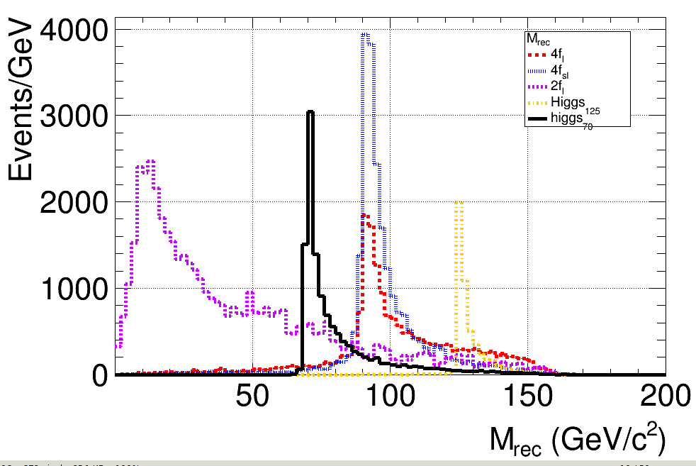
normal cuts
related input: cut.pre_cut
output:
data/sp/xxx_sp.dat
cut efficiency for pre cuts
results/sp_CUT/xxx_sp.dat
file for applying normal cuts
plot/sp/obv.png
for each channel
plot_compare/sp/obv.png
for each sort
all channel
combined into sorts

Slide 39
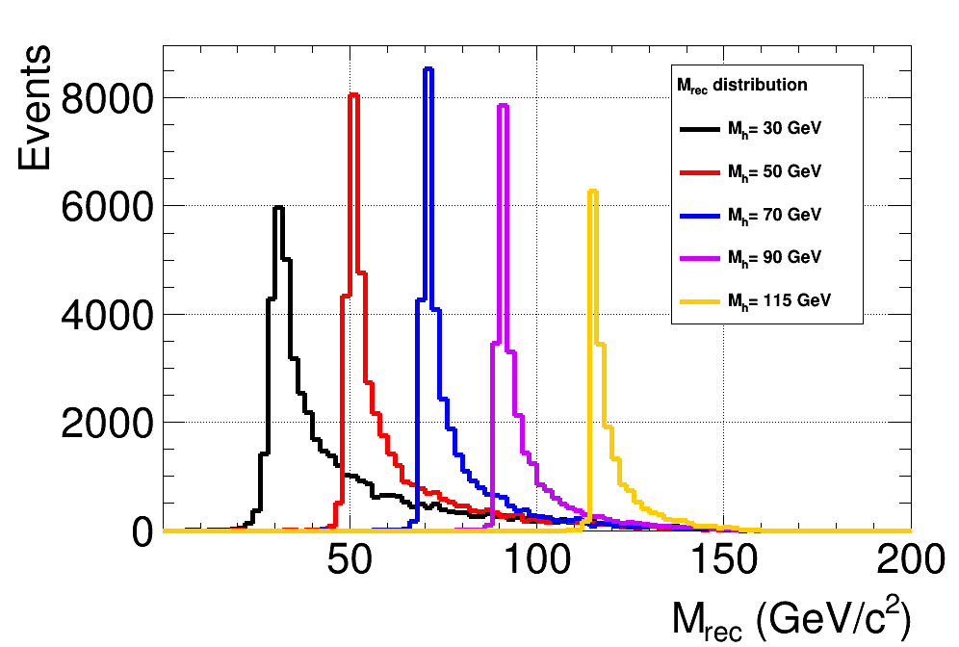
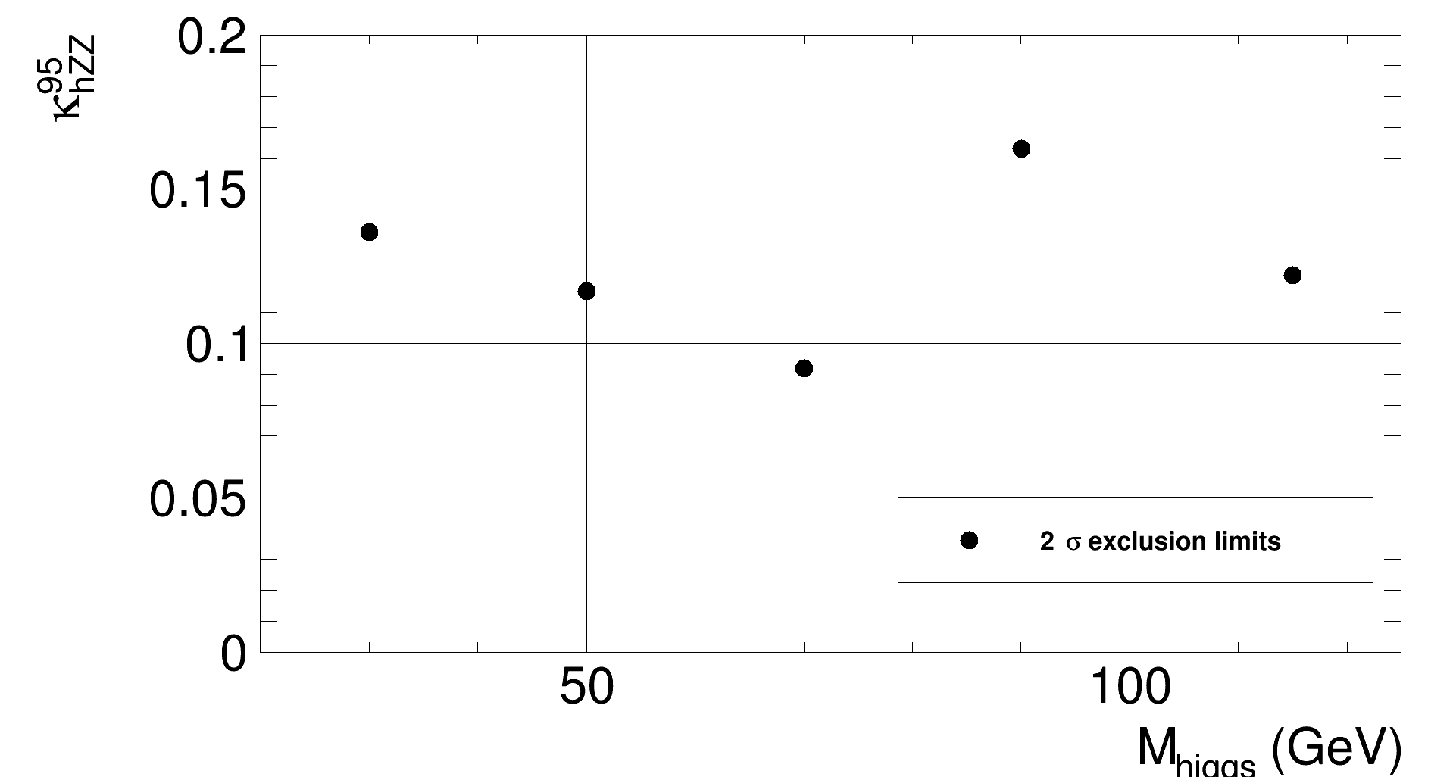
compare between different signal
characters
after generate results for different signal characters
compare them by control/scan.dat
signal distribution
cut efficiency table
sensitivity

Slide 40
advanced input example

Slide 41
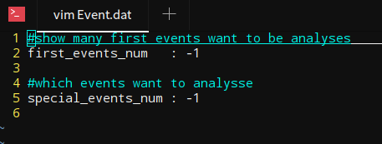
Event
when first =-1, special=-1 => use all events
when first = n, special=-1 => use first n events
when first =-1, special= n => use the n-th event
when first =n1, special=n2 => use events from n1 to n2
where if n > total events, n = total events, and n1 < n2

Slide 42
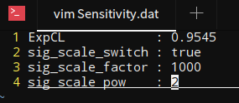
Sensitivity
control/Sensitivity.dat
get data from root results
calculate sensitivities according to the control file.
rescale signal cross section
rescale signal cross section

Slide 43
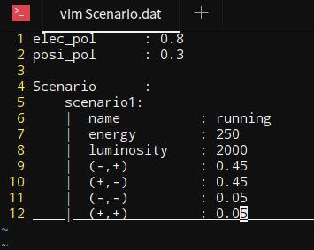
new scenario
control/scenario.dat
can automatically combine different polarizations
re-use results in Pre_Cuts when changing the polarization. (MVA variable need to be recalculated.)
re-use results in Cuts when changing the luminosity.
polarization value
luminosity
running polarization

Slide 44
Thank you!

