Slide 1
Analysis Tools
Beautiful_And_Simple_Drawing_Atificer
(BASDA)
Yan Wang
11-04-2018

Slide 2
Motivation

Slide 3
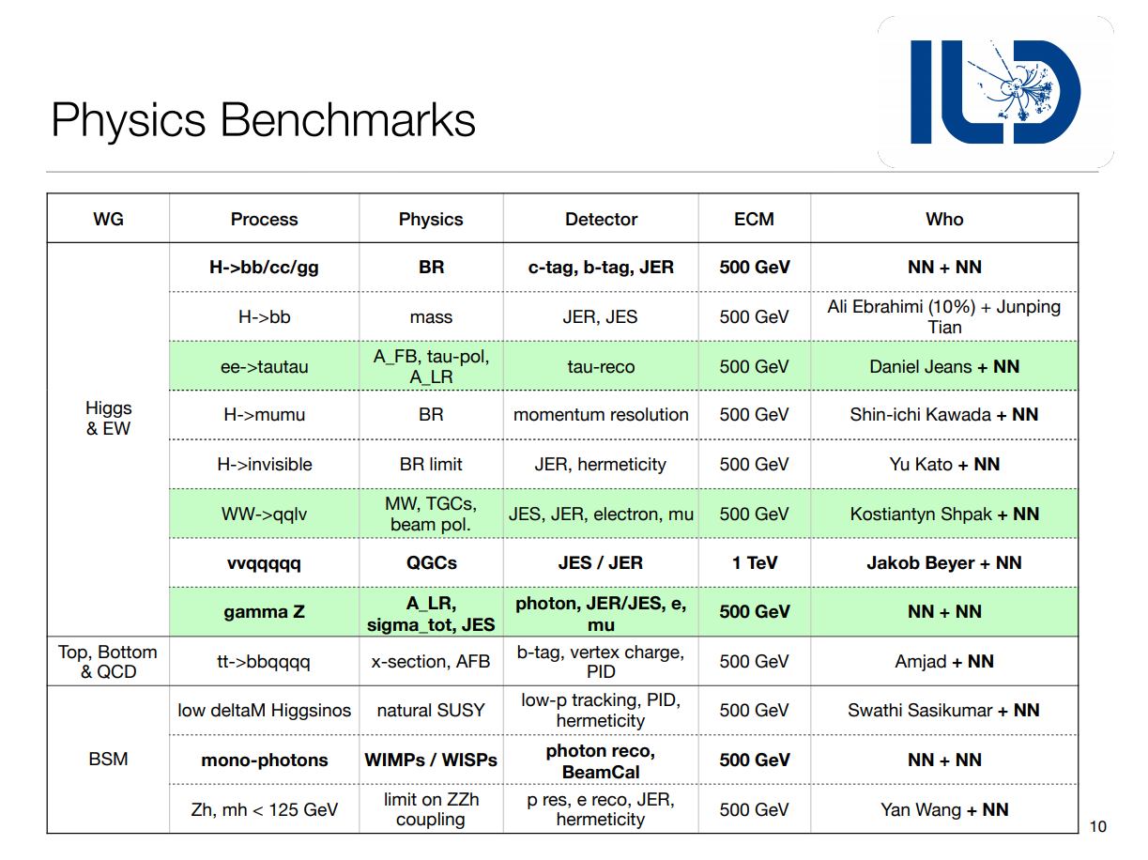
Motivation: a standard analysis code will be helpful!

Slide 4
General Strategy for analysis
Analysis
track
vertex
jet
leptons
jets
photons
missing Energy
...
particle
reconstruction
and calibration
final state
identification
Marlin processors
adjust cuts
normal
observables
pt
E
angle
...
input paras
normal cuts
and
MVA
scenario
Special
observables
invairant mass
correlated angle
jet shape
jet substructure
...
drawing figures
user code
final cuts
& final figures
significance
and
cut effi table
expected
limits

Slide 5
General Strategy for analysis
Analysis
track
vertex
jet
leptons
jets
photons
missing Energy
...
particle
reconstruction
and calibration
final state
identification
process dependent
adjust cuts
normal
observables
pt
E
angle
...
input paras
normal cuts
and
MVA
scenario
Special
observables
invairant mass
correlated angle
jet shape
jet substructure
...
independent
drawing figures
final cuts
& final figures
significance
and
cut effi table
expected
limits

Slide 6

The key role
Bad programmers worry about the code.
Good programmers worry about data structures and their relationships.
--- Linus Torvalds
distribution
cut effects
Observables
cut orders
MVA
cut values
combination
data structure
number
vector of number

Slide 7
General Strategy for analysis
Analysis
track
vertex
jet
leptons
jets
photons
missing Energy
...
particle
reconstruction
and calibration
final state
identification
Marlin processors
pt
E
angle
...
an
independent
package
Observables
invairant mass
correlated angle
jet shape
jet substructure
...
user code

Slide 8
Beautiful_And_Simple_Drawing_Atificer (BASDA)

Slide 9
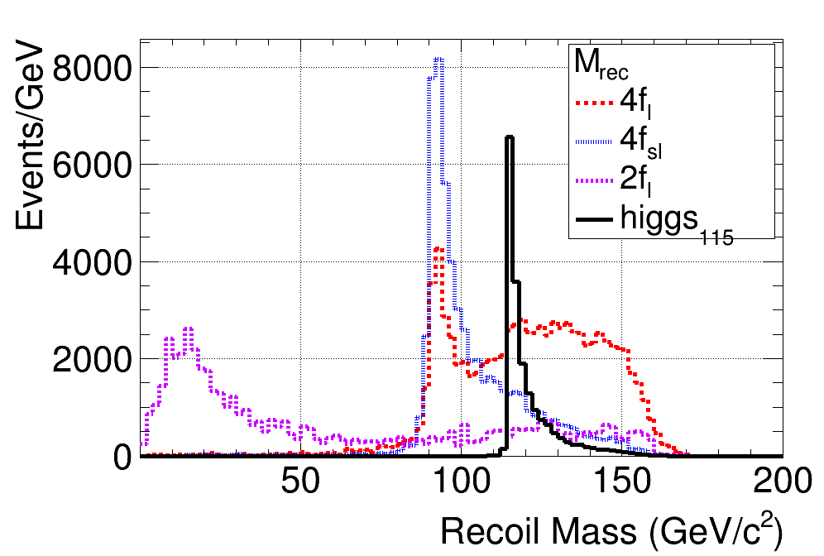
BASDA
The beautiful figure
plot templates --- easy to set
a cohesive, unified style for
the whole group
The simple operation
Release time from programing.
Focus on Physics!
all with control files
Easy to repeat
only need to
preserve control files.
Easy for comparing and finding the differences
Complete tool sets
one-click for all analysis and the final results
provide many analysis tools,
fulfill most of requirements

Slide 10
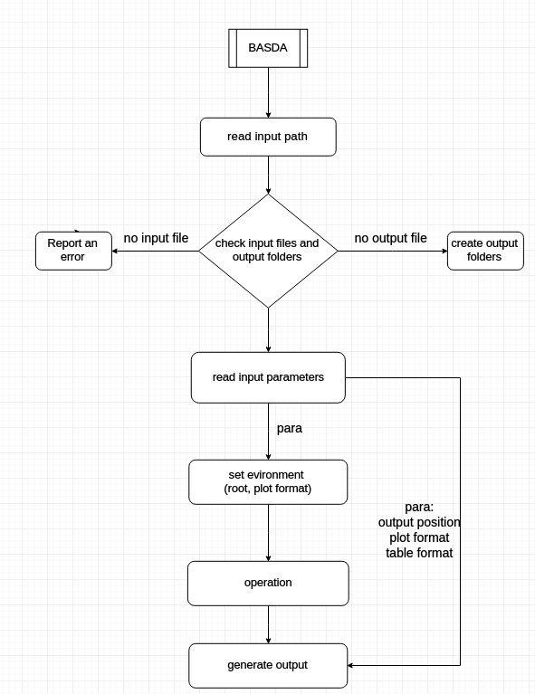
Code structure
I/O system

Slide 11
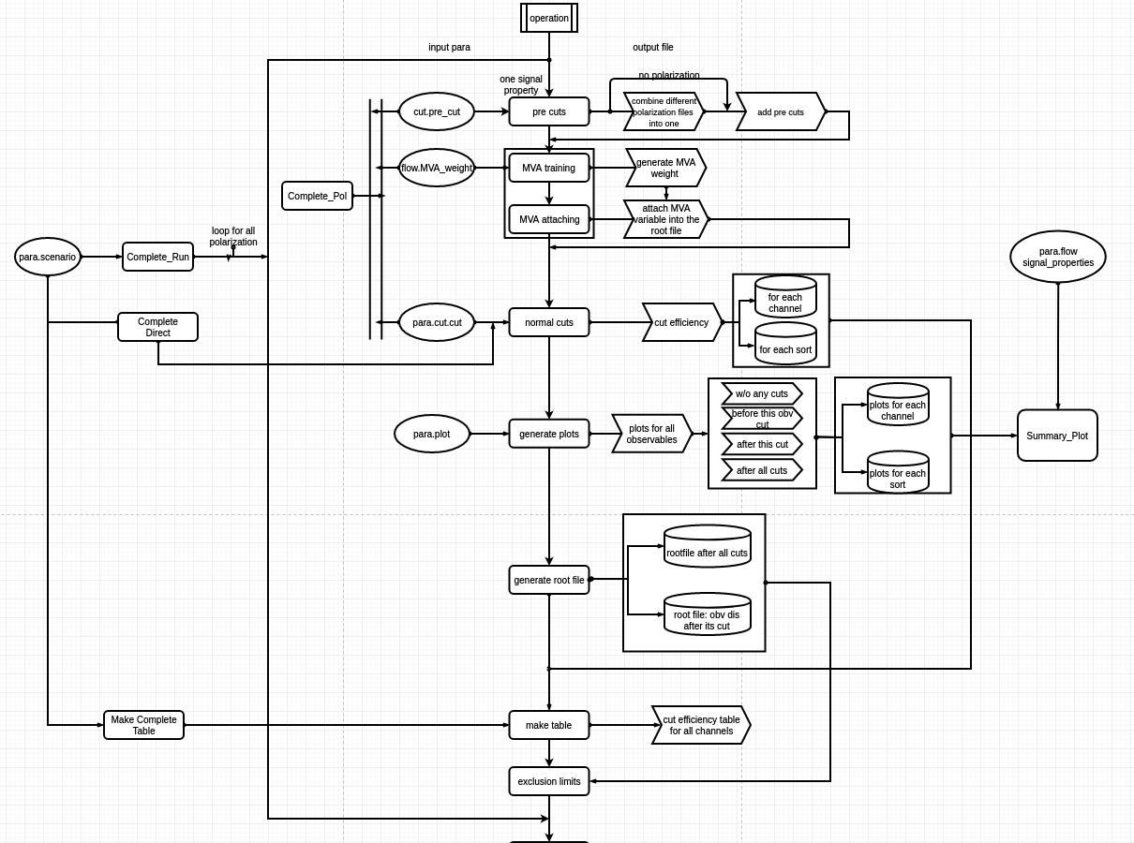
only tested
by me
assistant
funcitons
Tested by
Shin-ichi

Slide 12
Code structure
YAML
format
input
path
input root files
output setting
analysis flow
advanced
setting
file name
file events
observable
process
classification
log file
data
figures
observable
files
cut order
sensitivity
working flow
figure
table
scenario
different
signal property
pre cuts
MVA
trainning
Add MVA
obs
cuts
cut
efficiency
operation
calc
sensitivity
draw
distribution

Slide 13
input data
input root
files for
analysis
classify input
files into
different
subjects
by name
observable's
name,
cut,
figure setting,
...
which cut,
cut order
file
classify
observable
cut

Slide 14
output

Slide 15
output data
all
input
parameters
&
running
information
cut efficiency
table,
&
sensitivity
results
origin/
before cuts/
after cuts/
final
plots for
each observable
&
different sorts
root file
after cuts
on different
levels
(pre cuts,
all cuts,
w/o MVA vars
...)
log
data
figures
root file
all temporary data are preserved for reuse.
for my light-higgs analysis:
23 higgs mass banchmark points, with four polarized results (--,-+,+-,++),
total output takes 8.3G hard-disk space

Slide 16
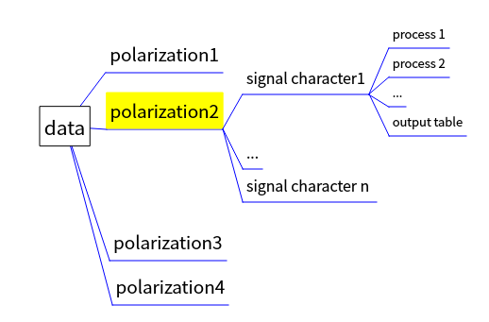
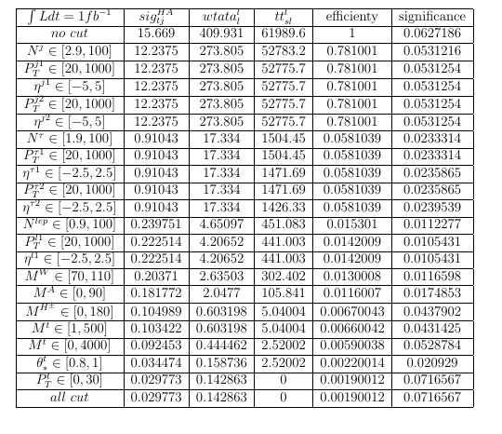
data
cut efficiency table with "Tex format",
directly used in latex file

Slide 17
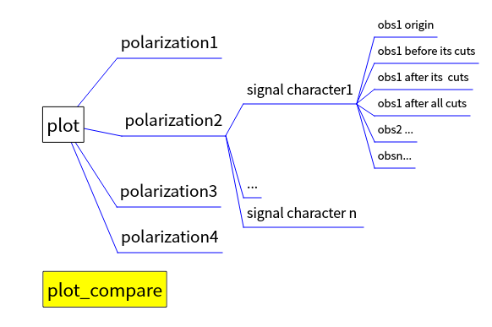
figures
all channel
all sorts in one figure (png format)

Slide 18
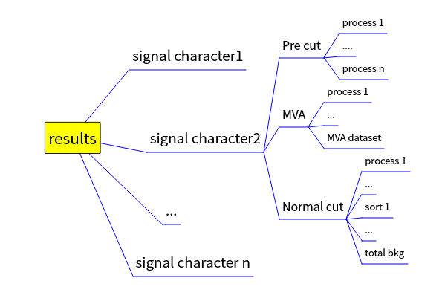
root file
root format
after cuts in different level
can be used independently
events after all cuts
all distributions
adjust diagrams directly

Slide 19
Short Conclusion
programing
free
beautiful
figures
BASDA
light
weight
easily
use
repeatable

Slide 20
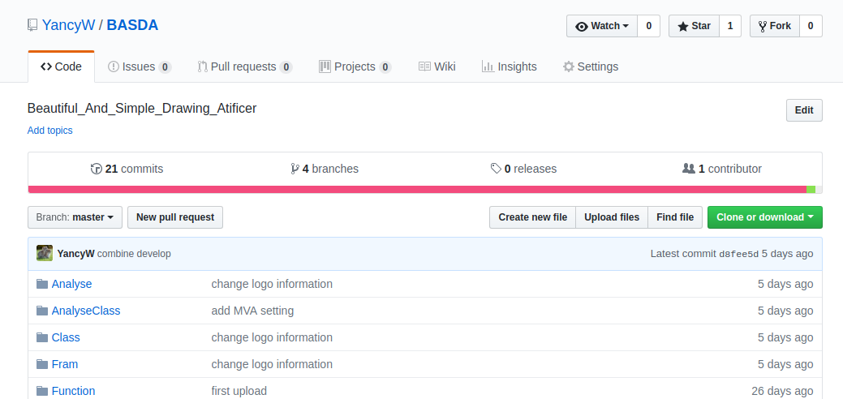
Installation
https://github.com/YancyW/BASDA
four branches: master, release, develop, feature.

Slide 21
a quick example

Slide 22
searching charge Higgs at LHC
sig: pp->tj->H⁺bj->AWbj->ττWbj
bkg: Wττ, tt(l,sl),tllj(tjττ,ttll)
identification cuts
lep=1, τ jet=2, jet>=1,
their pt, eta cuts
invariant mass cut
m_{A} , m_{H+-} cuts
top angle between boosted tj and c.m. framework

Slide 23
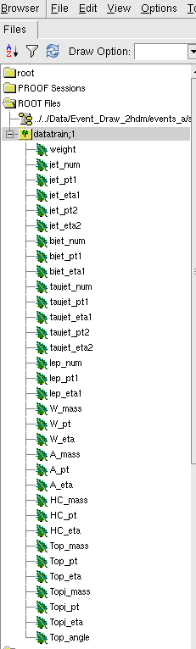
input setting
generate root files with
observables for each channels.
Here, weight = 0 for this example

Slide 24
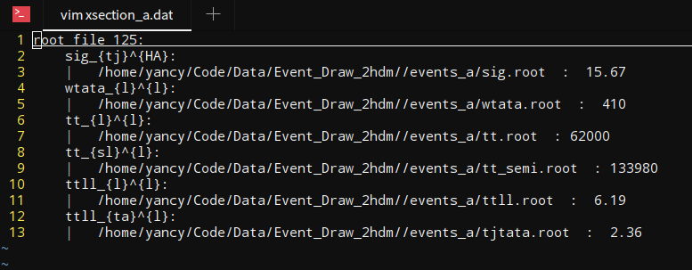
input setting
generate root file
edit input file: xection.dat
signal
bkgs
channel name: format is a_{b}^{c}
tt_{l}^{l}
tt_{sl}^{l}
weight=0 in root file, so tell the xsection here.
class name
user name
sub class name

Slide 25
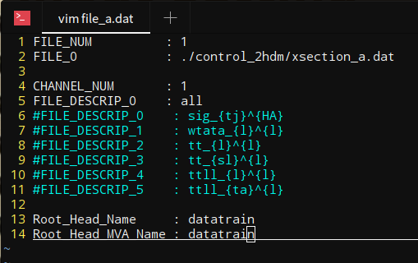
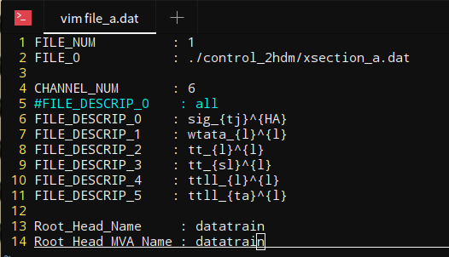
input setting
generate root file
edit xsection.dat
edit file.dat
this is also correct
root tree name
root tree name

Slide 26
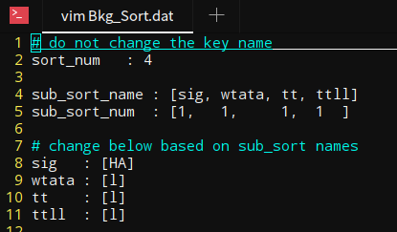
input setting
generate root file
edit input file
edit file.dat
edit Bkg_Sort.dat

Slide 27
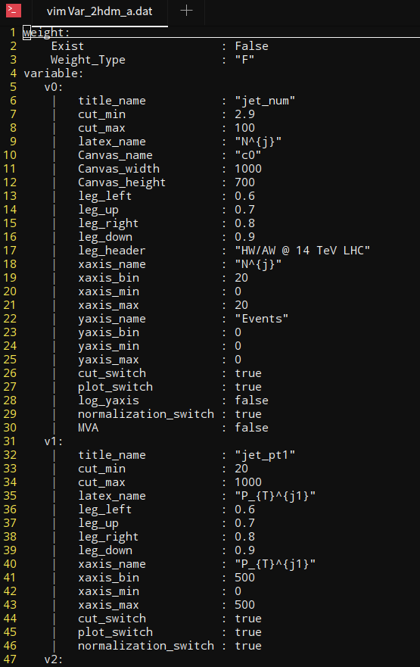
input setting
generate root file
edit input file
edit file.dat
edit Bkg_Sort.dat
edit Var.dat

Slide 28
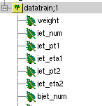
weight=0 in root file, so choose False.
Variable type
obs name in code
obs name in input file
cut for this obs
plot para
whether use this
obs as MVA input
if some settings are missing, it will use the previous ones

Slide 29
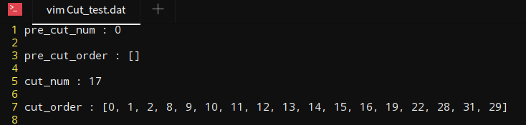
input setting
generate root file
edit input file
edit file.dat
edit Bkg_Sort.dat
edit Var.dat
edit Cut.dat
variable number in Var.dat

Slide 30
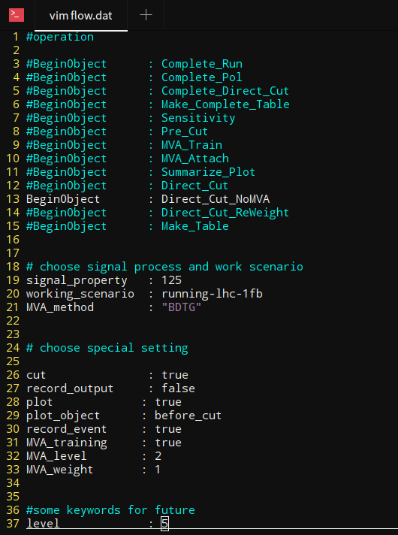
input setting
Here, we only use cut directly
generate root file
edit input file
edit file.dat
edit Bkg_Sort.dat
edit Var.dat
edit Cut.dat
edit flow.dat
luminosity
MVA method,
no used here
record everything in file, using when submit jobs
generate plot

Slide 31
input setting
generate root file
edit input file
edit file.dat
edit Bkg_Sort.dat
edit Var.dat
edit Cut.dat
edit flow.dat
edit path.dat
include all above directories

Slide 32
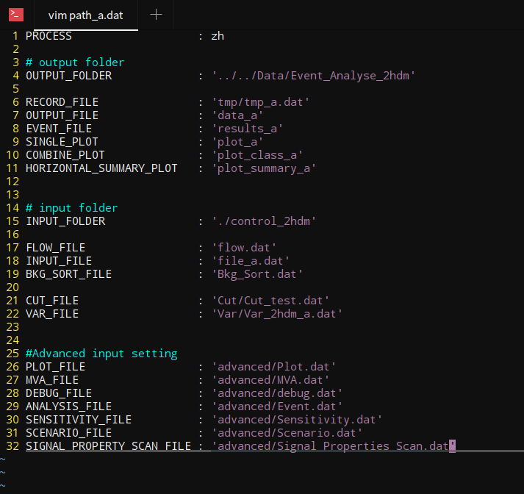
output
basic input
advanced input

Slide 33
run the code ./BASDA

Slide 34
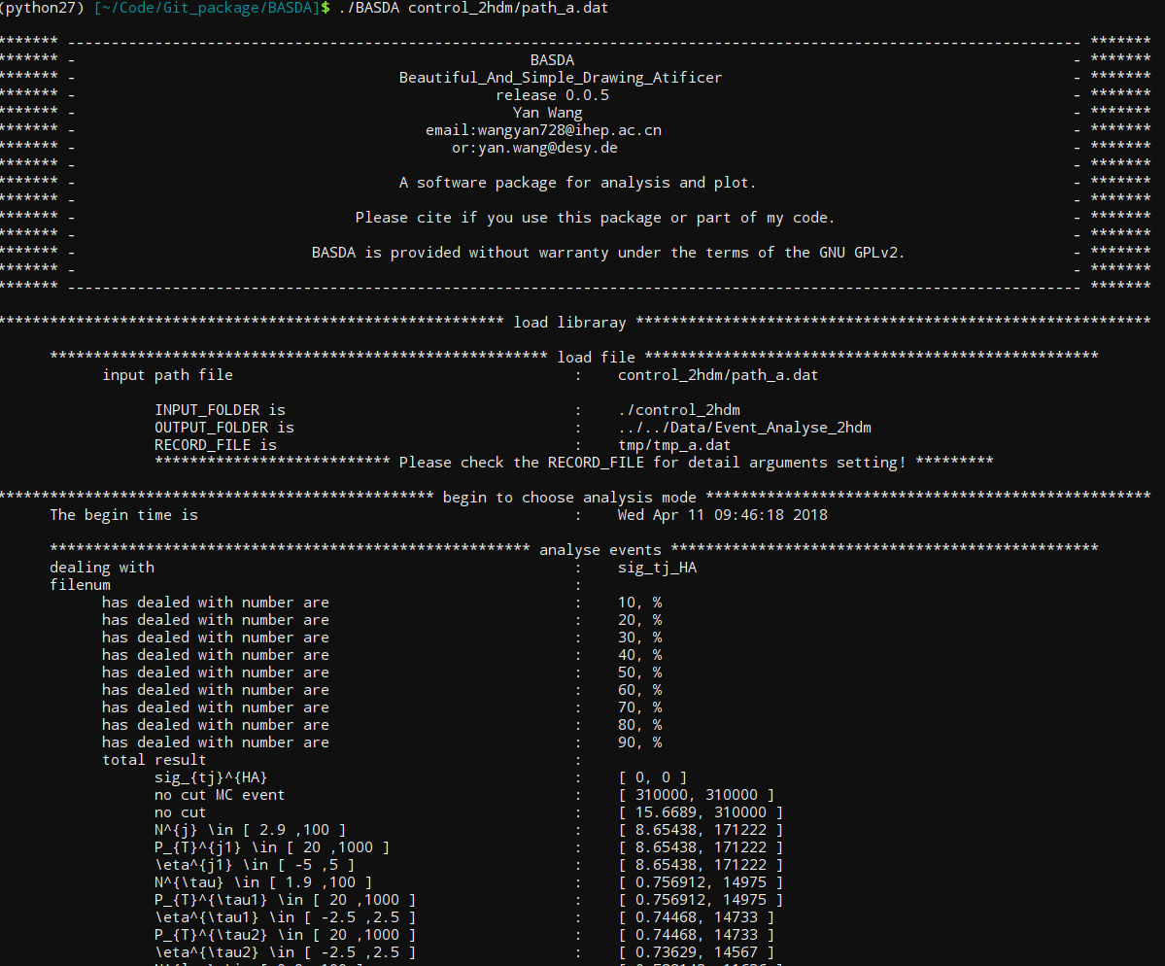
output on screen

Slide 35
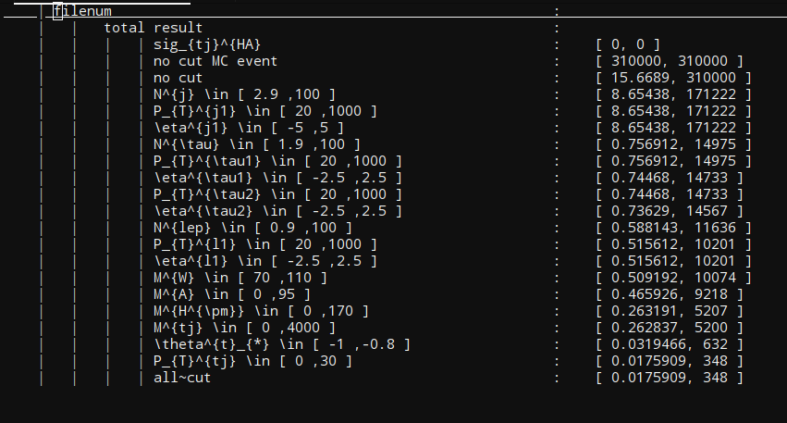
data

Slide 36
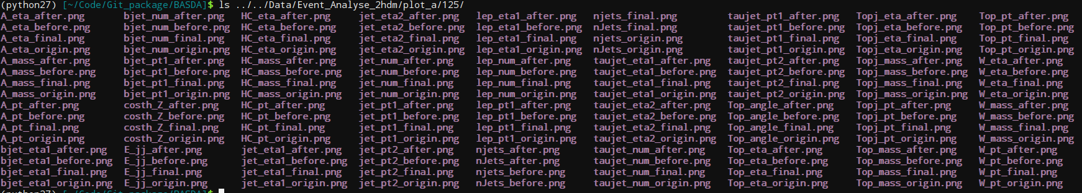
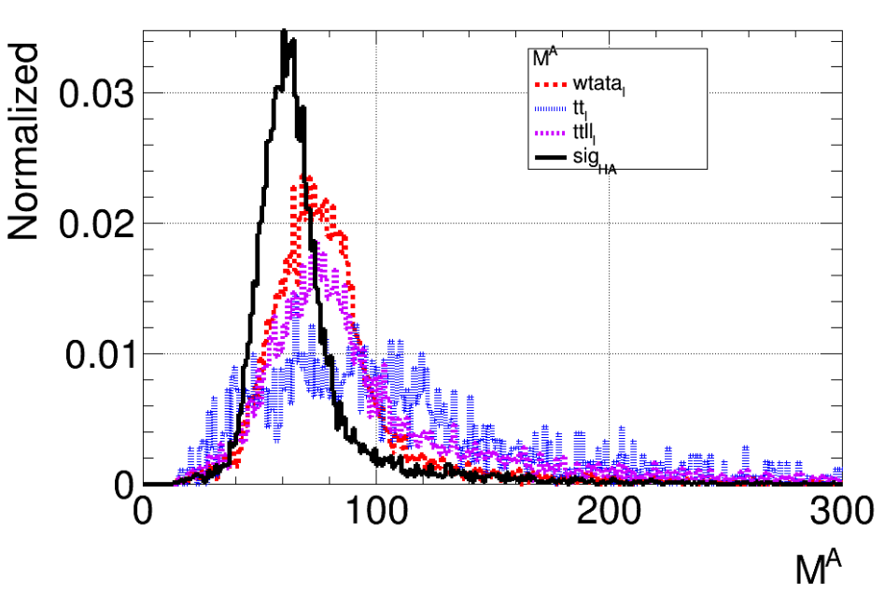
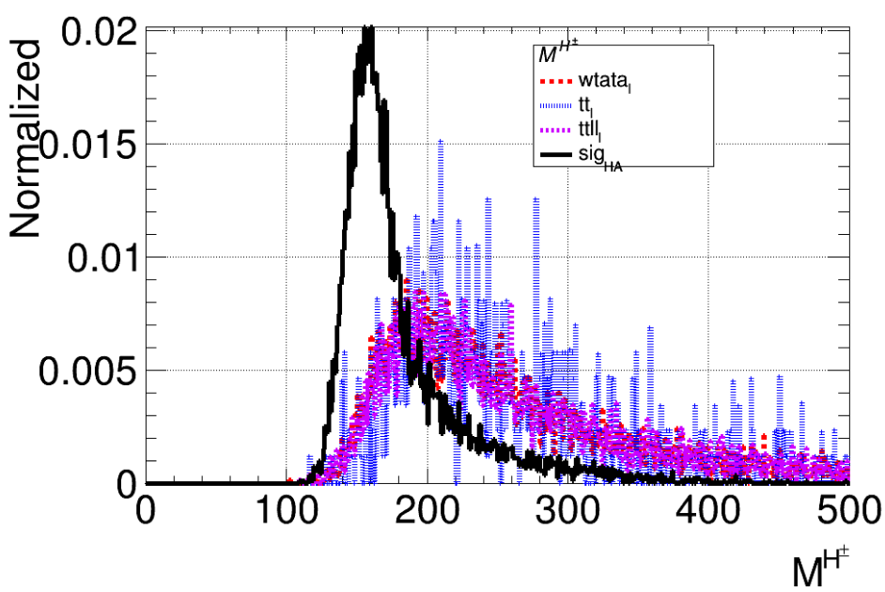
origin / before cuts /
after cuts / final
plots for
each observable
figures
before A mass cuts
before H+- mass cuts

Slide 37
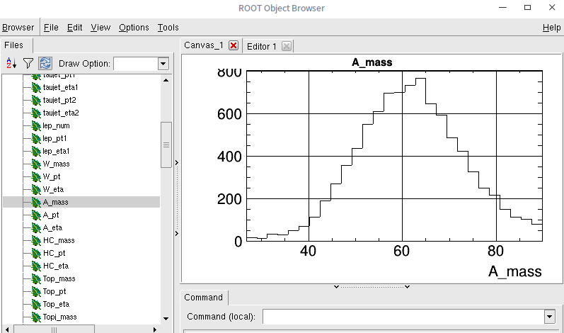
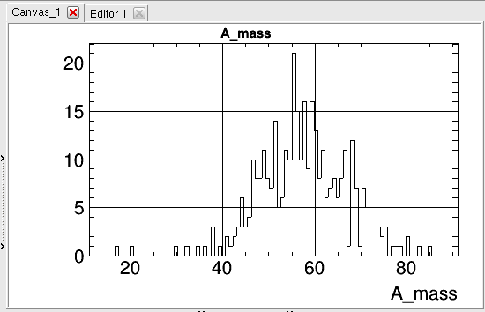
observable after its own cut,
and after all cuts are preserved
for further use
root file
after mA cut,
after all cuts,

Slide 38
General Strategy for analysis
Analysis
track
vertex
jet
leptons
jets
photons
missing Energy
...
particle
reconstruction
and calibration
final state
identification
Marlin processors
pt
E
angle
...
BASDA
Observables
invairant mass
correlated angle
jet shape
jet substructure
...
what you need to do in future
Hope to Save 50% time

Slide 39
Summary & Future
https://github.com/YancyW/BASDA
Manuals/Examples:
mygithub/doc/BASDA_Usage_Example.pdf
mygithub/doc/Usage.md
More tests:
MVA
Code consistency
More functions:
2-D plots
statistic (like wsmaker,nplot ... in ATLAS group).
GUI for basic users

Slide 40
Thank you!

