Slide 1
Analysis Tools
Beautiful_And_Simple_Drawing_Atificer
(BASDA)
Yan Wang
05-03-2018

Slide 2
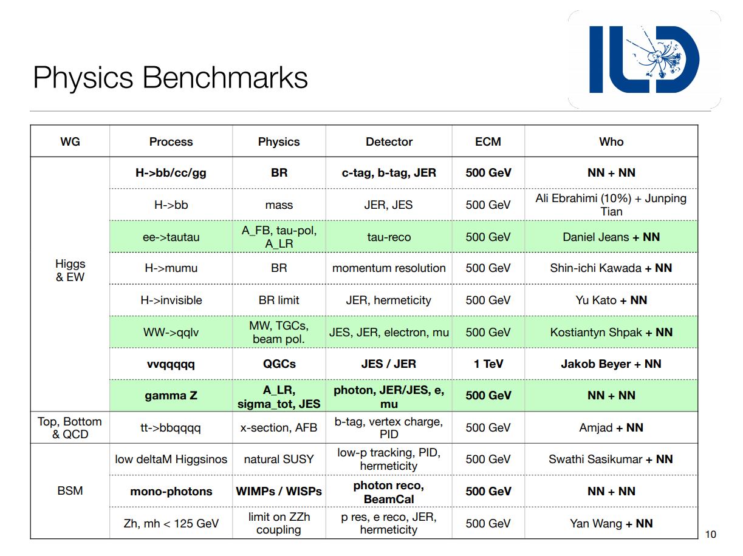
a standard analysis code will be helpful!

Slide 3
General Strategy for analysis
Analysis
track
vertex
jet
leptons
jets
photons
missing Energy
...
particle
reconstruction
and calibration
final state
identification
adjust cuts
normal
observables
pt
E
angle
...
input paras
normal cuts
and
MVA
scenario
Special
observables
invairant mass
correlated angle
jet shape
jet substructure
...
drawing figures
final cuts
& final figures
significance
and
cut effi table
expected
limits

Slide 4
General Strategy for analysis
Analysis
track
vertex
jet
leptons
jets
photons
missing Energy
...
particle
reconstruction
and calibration
final state
identification
process dependent
adjust cuts
normal
observables
pt
E
angle
...
input paras
normal cuts
and
MVA
scenario
Special
observables
independent
invairant mass
correlated angle
jet shape
jet substructure
...
drawing figures
final cuts
& final figures
significance
and
cut effi table
expected
limits

Slide 5
The key role
display distribution
check cut effects
Observables
Add Cuts
MVA
cut orders & values
combination
data structure
number
vector

Slide 6
General Strategy for analysis
Analysis
track
vertex
jet
leptons
jets
photons
missing Energy
...
particle
reconstruction
and calibration
final state
identification
pt
E
angle
...
an
independent
package
Observables
invairant mass
correlated angle
jet shape
jet substructure
...

Slide 7
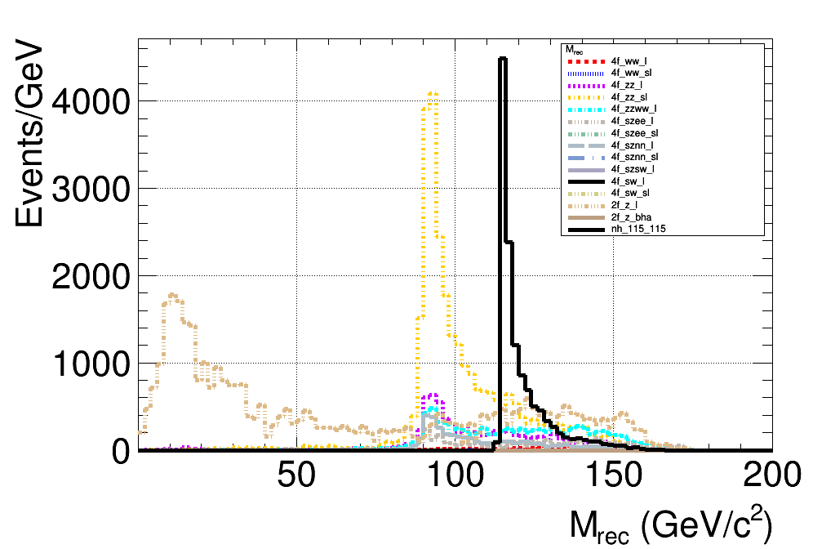
Beautiful_And_Simple_Drawing_Atificer (BASDA)
The beautiful figure
plot templates
easy to adjust
once fixed, used forever
The simple operation
all with control files
Release time from programing.
Focus on Physics!
Easy to repeat
only need to
preserve control file.
Cross check

Slide 8
Code structure
YAML
format
path
input files
output files
settings
analysis
file name
file events
observable
process
classification
log file
data
figures
observable
files
figure
table
scenario
cut order
different
signal character
sensitivity
working flow
pre cuts
MVA
trainning
Add MVA
obs
normal
cuts
cut
efficiency
calc
sensitivity
draw
distribution

Slide 9
YAML format
YAML---YAML Ain't Markup Language
a human-readable data serialization language
in BASDA, only use simplest command
key : value
or,
key :
key : value
key :
key : value
or list,
key: [value1,value2, value3...]
note: tabs is forbiden in YAML. comments with #

Slide 10
input data
which file for
analysis
sort A: file 1,2
sortB: file 3,
sortC: file 4,5,6
name,
figure setting
for this obs,
cut,
which event
for running,
all,
the first 100,
101-303...
file
classify
observable
event

Slide 11
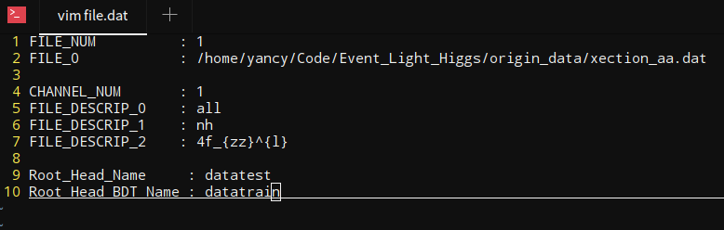
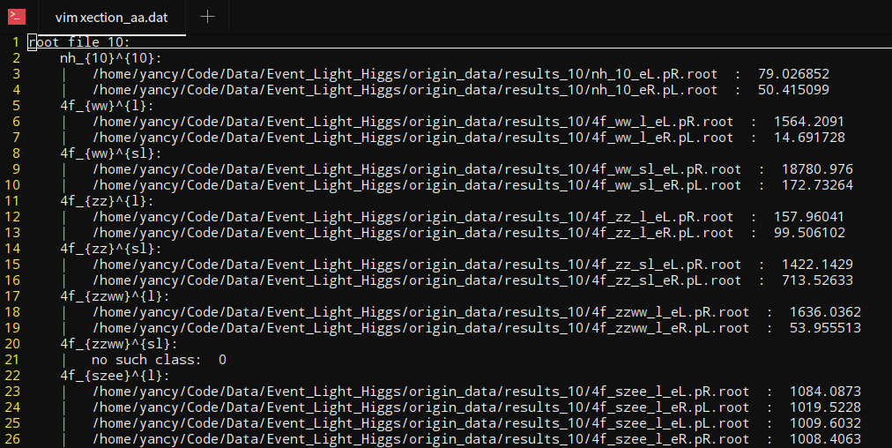
file
channel used in this time
root tree name
xection file
channel name
signal
property
observables in one channel
observables in one channel
cross section

Slide 12
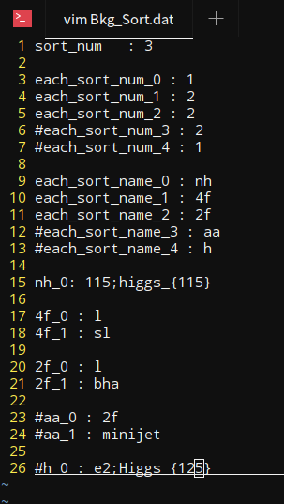
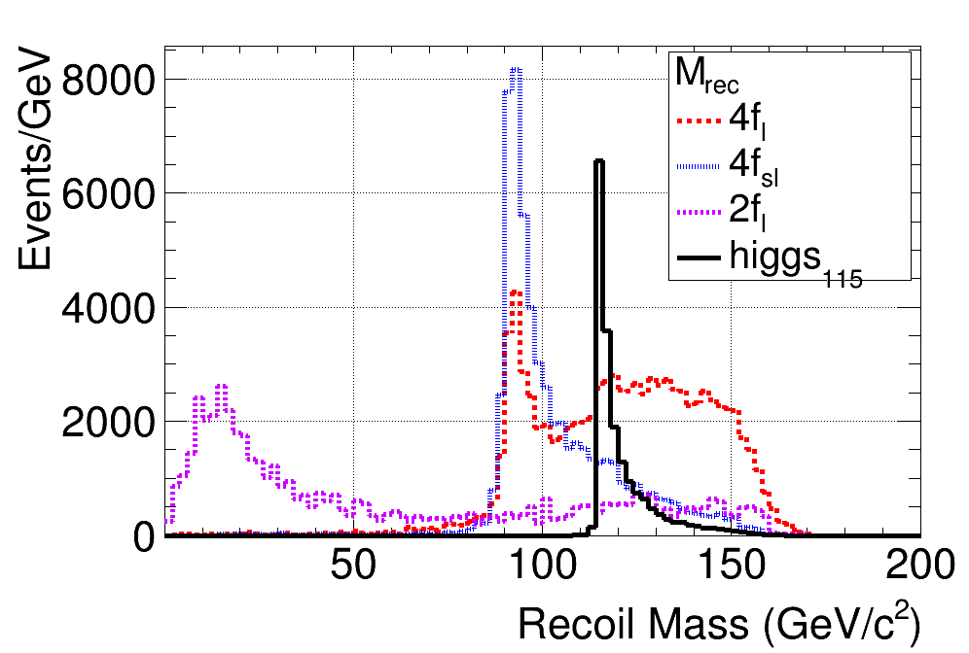
classify
alias
comment

Slide 13
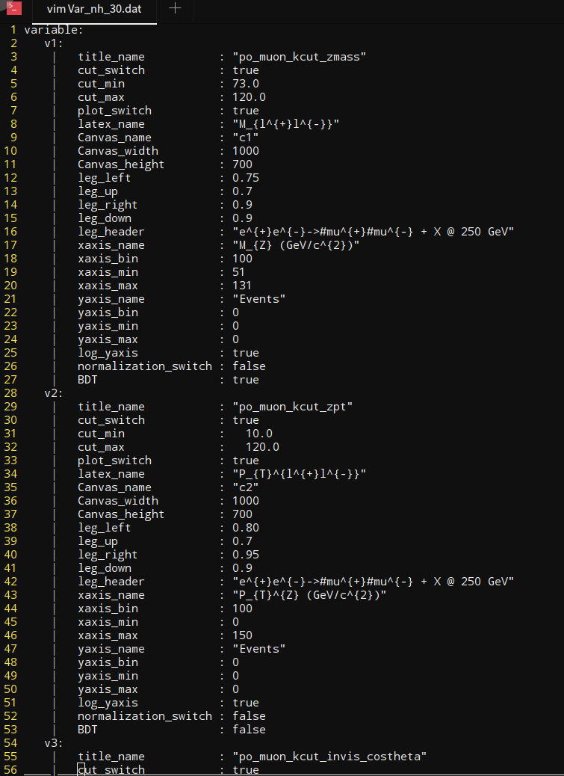
observables
obs name in code
obs name in input file
cut for this obs
plot para
whether use this
obs as MVA input

Slide 14
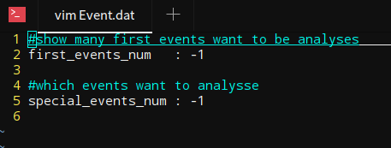
Event
when first =-1, special=-1 => use all events
when first = n, special=-1 => use first n events
when first =-1, special= n => use the n-th event
when first =n1, special=n2 => use events from n1 to n2
where if n > total events, n = total events, and n1 < n2

Slide 15
output data
input
parameters
&
running
information
cut efficiency
for
different
process,
polarization,
&
signal
characters
plot for
single process
&
combined all
processes
root file
after cuts
on different
levels
(pre cuts,
all cuts,
w/o MVA vars
...)
log
data
figures
observables

Slide 16
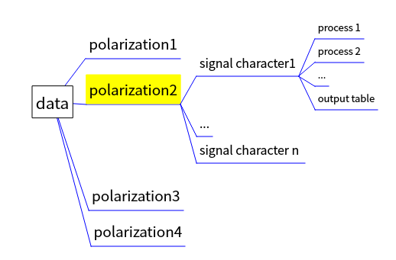
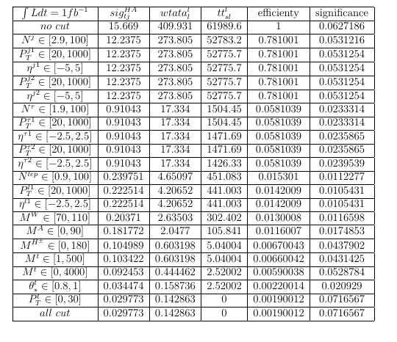
output data structure
data
the output table contains cut efficiency table for all processes with "Tex format",
can be directly used in latex file

Slide 17
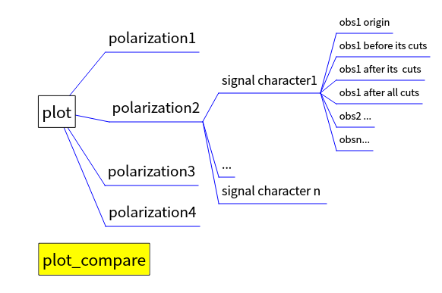
Diagram
for each process
compare all processes in one figure

Slide 18
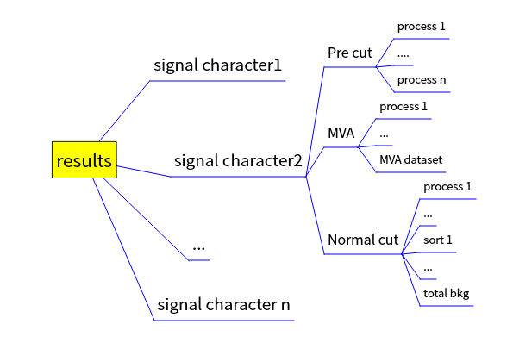
Root results
root format
after cuts in different level
can be used independently
events after all cuts
all distributions
adjust diagrams directly

Slide 19
Sensitivity
control/Sensitivity.dat
get data from root results
calculate sensitivities according to the control file.

Slide 20
new scenario
control/scenario.dat
re-use results in PreCut when changing the polarization. (MVA variable need to be recalculated.)
re-use results in NormalCut when changing the luminosity.

Slide 21
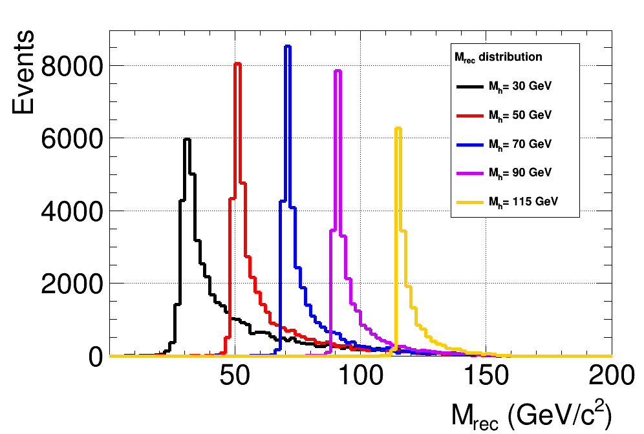
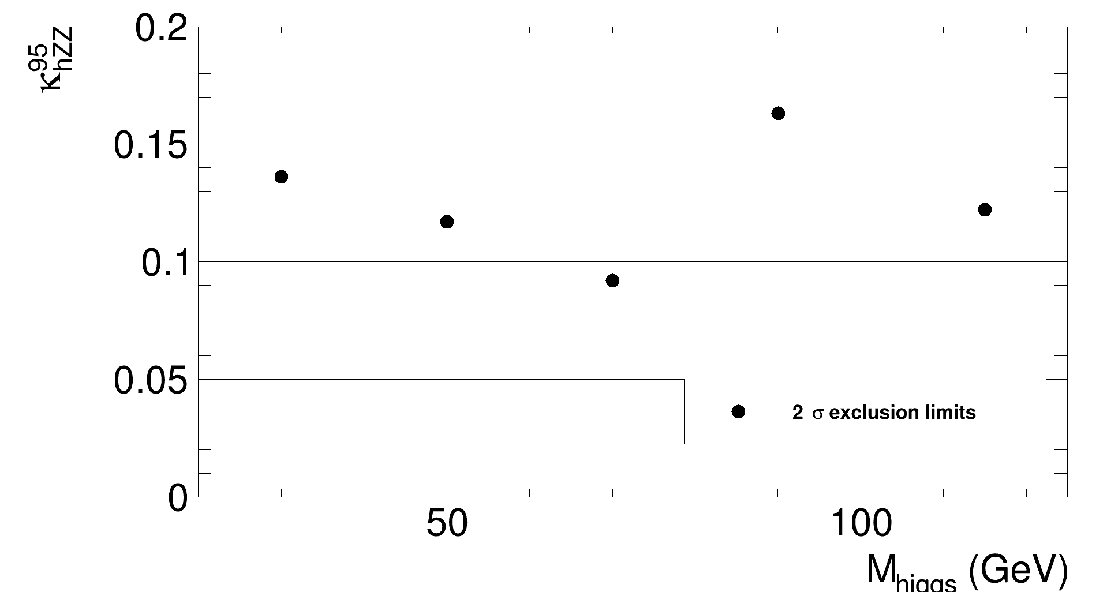
compare between different signal
characters
after generate results for different signal characters
compare them by control/scan.dat
signal distribution
cut efficiency table
sensitivity

Slide 22
Future
update with smart pointor to increase steadiblity
provide more functions

Slide 23
Conclusion
programing
free
beautiful
figures
BASDA
light
weight
easily
use
repeatable

Slide 24
Thank you!

