Slide 1
Beautiful_And_Simple_Drawing_Atificer
(BASDA)
usage --- example
Yan Wang
10-04-2018

Slide 2
Installation

Slide 3
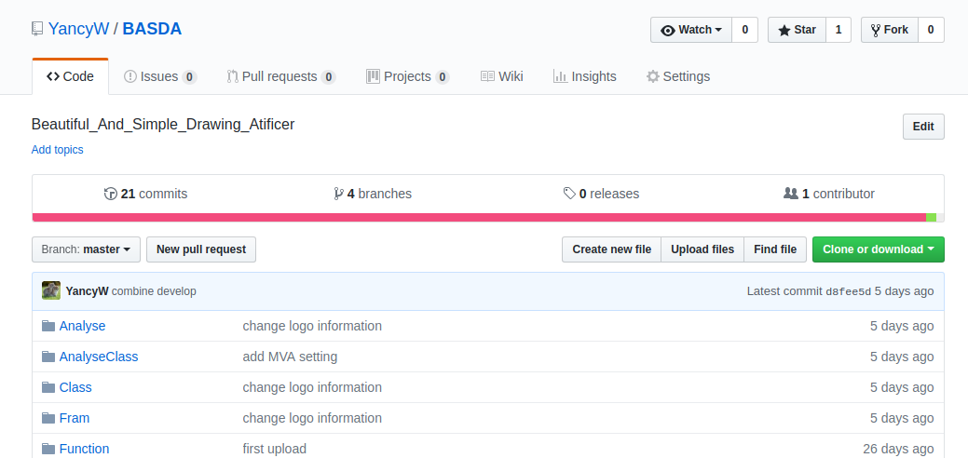
Installation
https://github.com/YancyW/BASDA
four branches: master, release, develop, feature.
stable
version

Slide 4
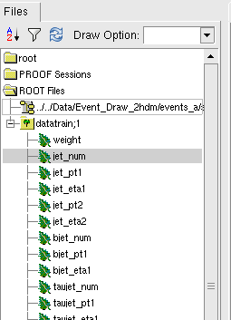
installation
c++14 ⊕ root6 ⊕ boost_filesystem
yaml-cpp
https://github.com/jbeder/yaml-cpp
input root file structure
weight (not necessary)
observables

Slide 5
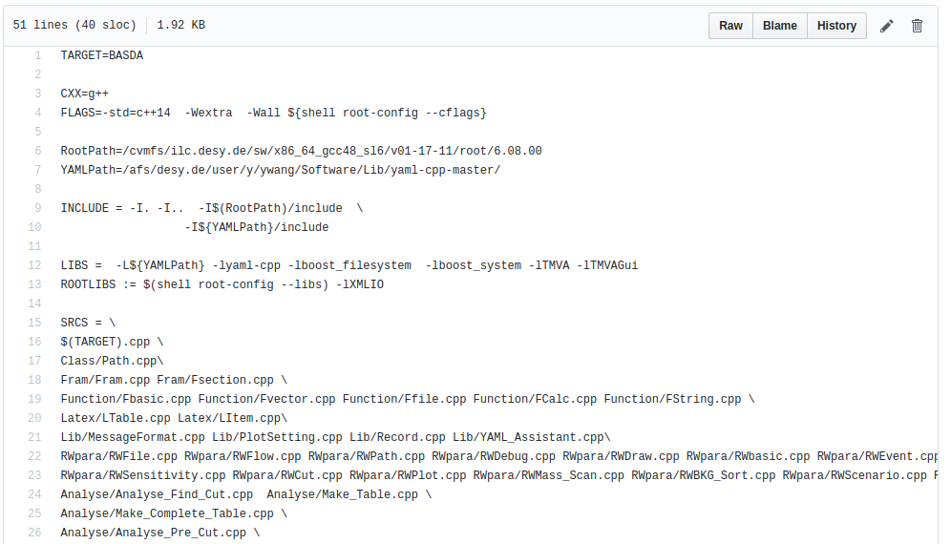
Installation (on NAF)
initialize ilcsoft for gcc≧4.8, root 6
install YAML, change path for makefile_server
in BASDA, cover makefile with makefile_server
mv makefile_server makefile
change YAML path

Slide 6
YAML

Slide 7
YAML format
YAML---YAML Ain't Markup Language
download/manuals https://github.com/jbeder/yaml-cpp
a human-readable data serialization language
in BASDA, only use simplest command
key : value
or,
key :
key : value
key :
key : value
or list,
key: [value1,value2, value3...]

Slide 8
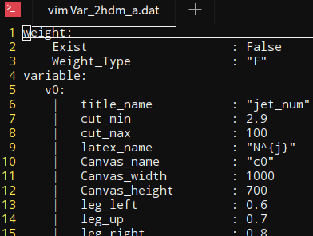
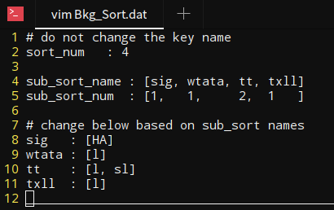
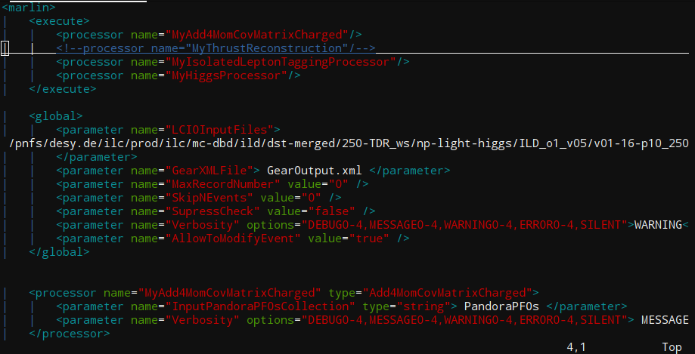
YAML format
it's space, NOT tab
note: DO NOT use tab in YAML.
DO NOT try to modify everything.
comments with #

Slide 9
input example

Slide 10
input data
which file for
analysis
sort A: file 1,2
sortB: file 3,
sortC: file 4,5,6
name,
figure setting
for this obs,
cut,
which event
for running,
all,
the first 100,
101-303...
file
classify
observable
event

Slide 11
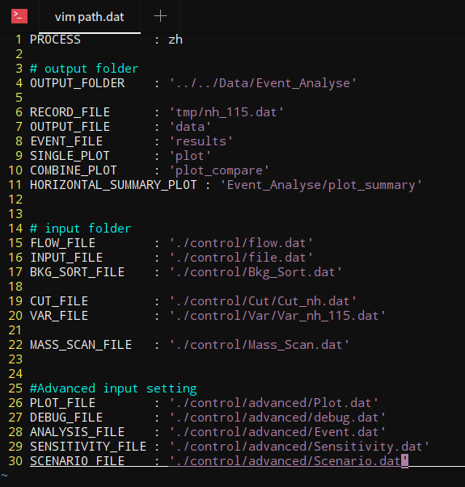
Path
process name
main output folder,
sub folders are under this
if doesn't exist, code will create one
sub output folder
input folder
if doesn't exist, report error
advanced input folder

Slide 12
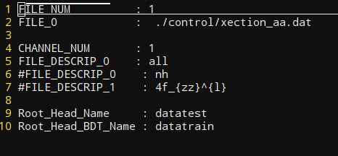
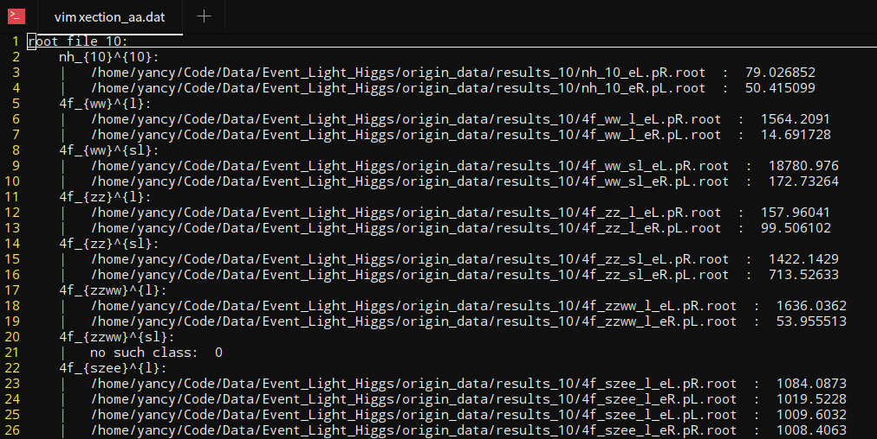
input file
input root file structure
channel used in this time
weight
support "integer", "float" and "double"
force them into float
root tree name
observables (float)
xection file
support "integer", "float" and "double"
currently force them into float
use "I", "F", "D" in Var.dat file to tell the code datatype.
observables in one channel

Slide 13
xection file
signal property:
seperate different analysis processes
every mh can different input files
channel name: a_{b}^{c}
observables in one channel
input file name with different polarizations:
1 file : no polarization
2 files: lr/rl
4 files: lr/rl/ll/rr
cross section:
works when choosing no "weight"
when really don't have "weight" in input files
when hoping to reweight events

Slide 14
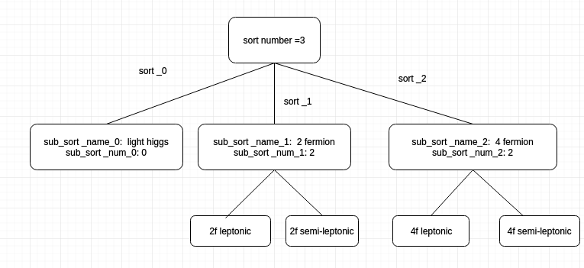
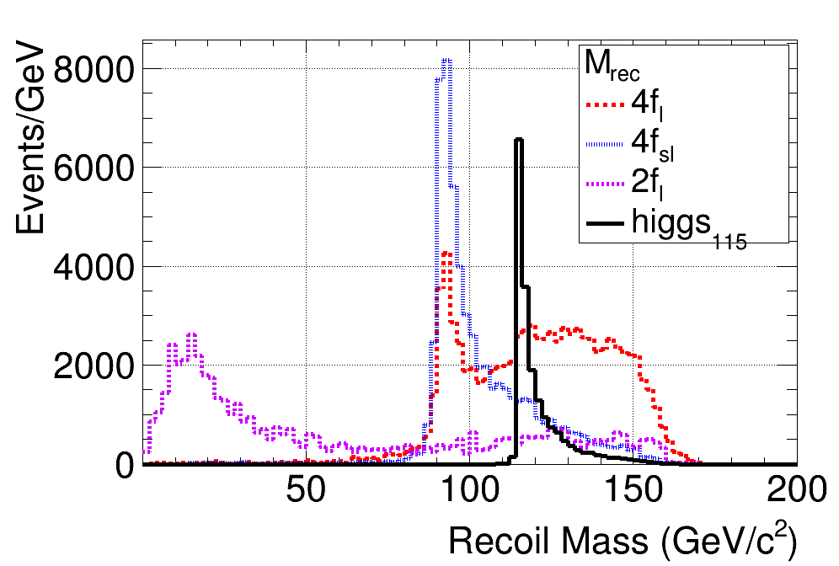
classify
channel name: a_{b}^{c}
a : sort
c : sub_sort
b : some special label

Slide 15
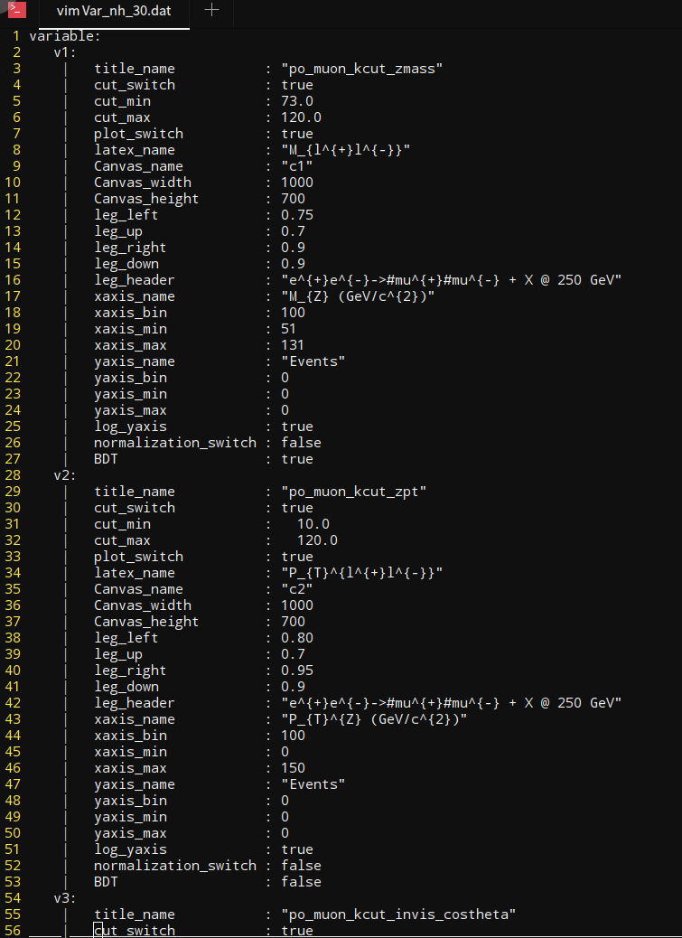
observables
obs name in code
obs name in input file
cut for this obs
plot para
whether use this
obs as MVA input

Slide 16
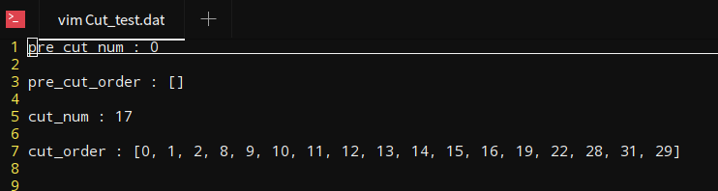
Cut
pre-cut order
no pre cuts for this case,
after Pre-CUT, event should be applied with MVA
for normal cut: 17 cuts
cut order

Slide 17
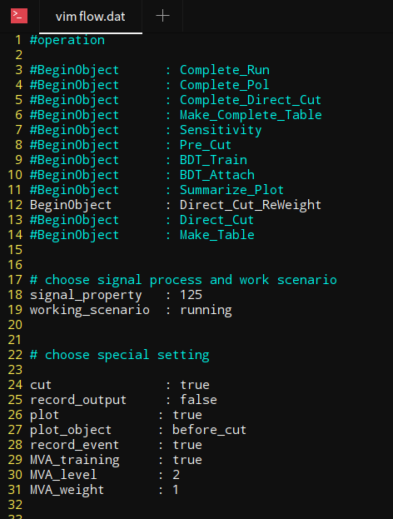
Operation Flow
will do which operation with this code
use cut
record everything in log file
draw plots
only works for Summarize_Plot
generate events after all cuts
MVA setting

Slide 18
output example

Slide 19
Pre cuts
sp is "signel property" set in the flow.dat
xxx is channel names set in the xection.dat
related input: cut.pre_cut
output:
data/sp/xxx_sp_Unpol.dat
cut efficiency for pre cuts
results/sp_Unpol/xxx_sp.dat
root file after applying pre cuts
results/sp_MVA/xxx_sp.dat
file for attaching MVA values
file for applying normal cuts

Slide 20
MVA trainning
related input: flow.MVA
output:
data/sp/dataset
MVA weight dataset

Slide 21
MVA value attaching
related input: MVA weight file
output:
results/sp_MVA/xxx_sp.dat
add MVA value for each channel

Slide 22
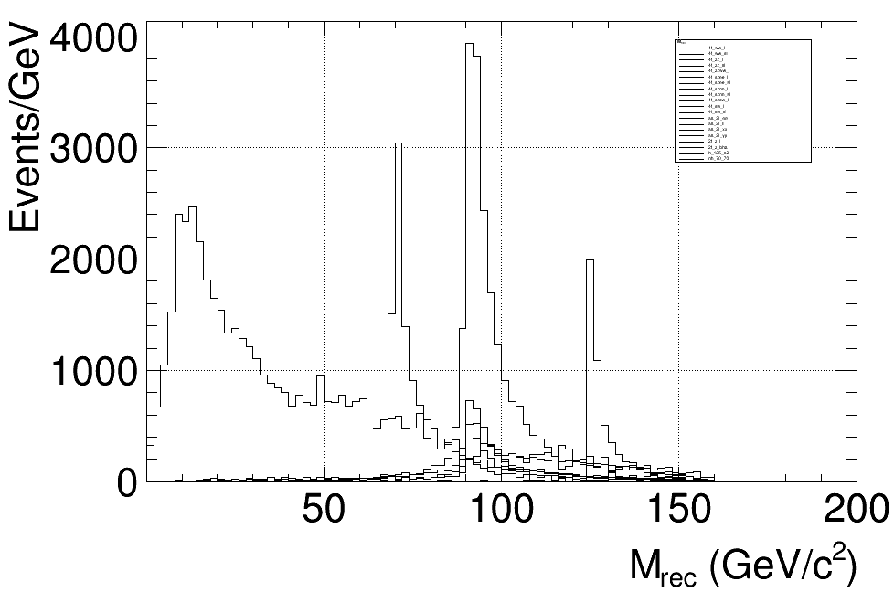
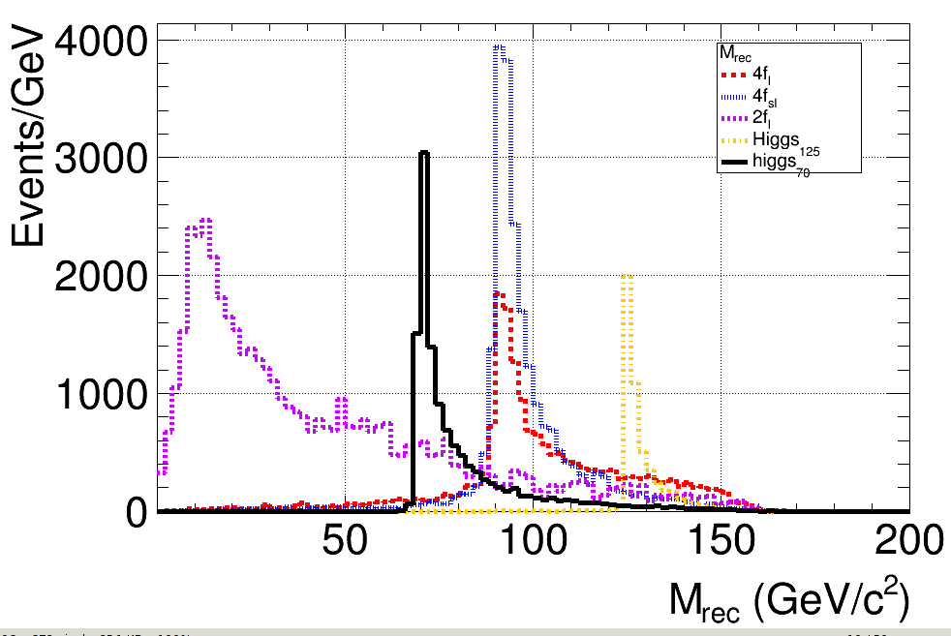
normal cuts
related input: cut.pre_cut
output:
data/sp/xxx_sp.dat
cut efficiency for pre cuts
results/sp_CUT/xxx_sp.dat
file for applying normal cuts
plot/sp/obv.png
for each channel
plot_compare/sp/obv.png
for each sort
all channel
combined into sorts

Slide 23
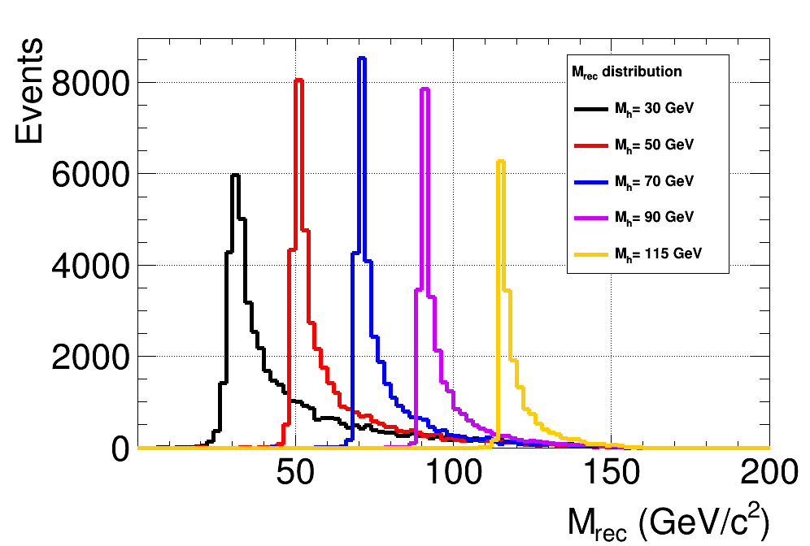
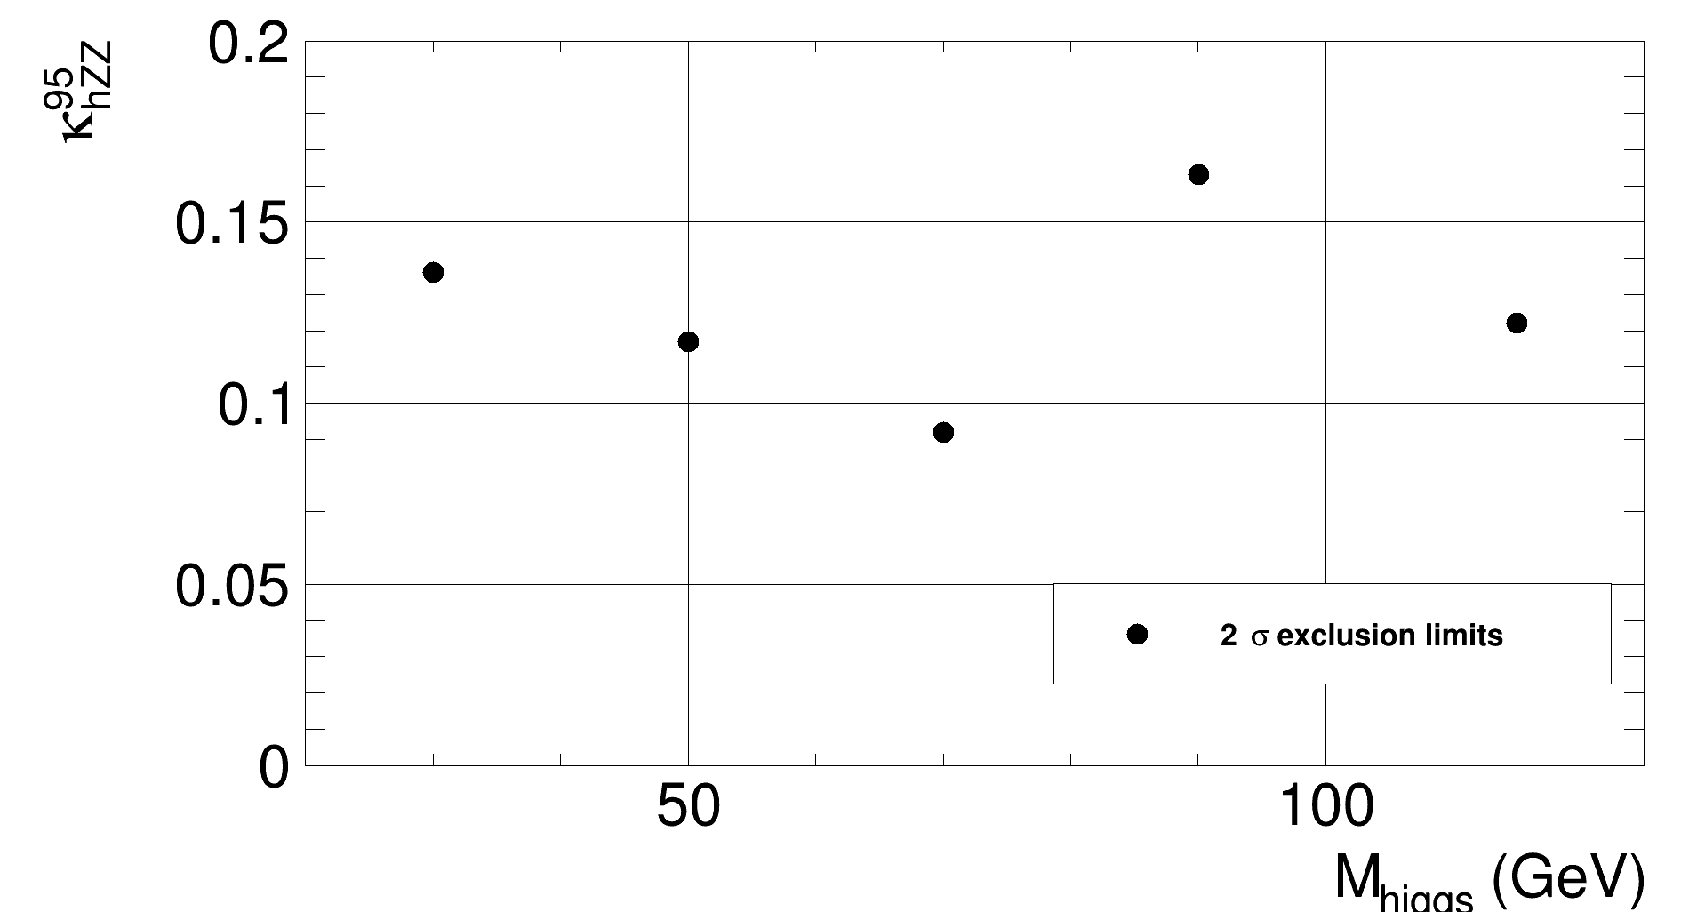
compare between different signal
characters
after generate results for different signal characters
compare them by control/scan.dat
signal distribution
cut efficiency table
sensitivity

Slide 24
advanced input example

Slide 25
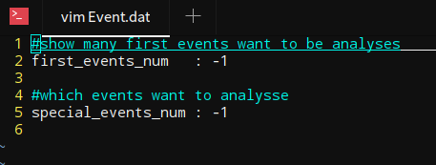
Event
when first =-1, special=-1 => use all events
when first = n, special=-1 => use first n events
when first =-1, special= n => use the n-th event
when first =n1, special=n2 => use events from n1 to n2
where if n > total events, n = total events, and n1 < n2

Slide 26
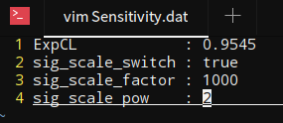
Sensitivity
control/Sensitivity.dat
get data from root results
calculate sensitivities according to the control file.
rescale signal cross section
rescale signal cross section

Slide 27
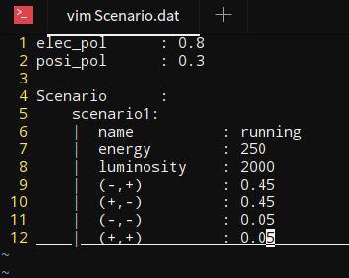
new scenario
control/scenario.dat
re-use results in Cuts_1 when changing the polarization. (MVA variable need to be recalculated.)
re-use results in Cuts_2 when changing the luminosity.
polarization value
luminosity
running polarization

Slide 28
Thank you!

