Slide 1
Standardized Test Analysis
Project 1
Goh Yan Da
Notes:
Hi guys, today I will be running through our project 1, which is about standardized test analysis.

Slide 2
Table of contents
01
02
03
04
Background
Problem Statement
Methodology
Discussion &
recommendations
Notes:
Here is a quick overview of what i will be covering today, starting with background of what is a SAT, the problem statement we are addressing, the methodology used and then we will discuss our results and recommendations that can be made

Slide 3
Background
Originally established in the US in 1926, developed by the college board for high school students.
College Admissions
Indicator of Success
Consists of 3 sections:
  Reading
  Writing
  Math
However, as of fall 2022 SAT is no longer
required in most Universities in the US.
Notes:
Basically at a glance, the SAT is a form of admission application for universities in the US. Originally established in the 1926, the College Board stated that the SAT is intended to measure educational capabilities of high school students. To take the SAT test, students are required to pay $60. Similarly to data, most people argued that the SAT is a predictive analysis of a student’s success in college.
So the SAT can be further broken down into reading (evidence based) and writing, and math.
The minimum total score is 400 and the maximum score is 1600. Recently, most US uni’s have dropped the need for the SAT for college admissions. This actually started way back in 2018, where top ivy uni’s such as Harvard, Yale and Dartmouth dropped the need for SAT for admissions.

Slide 4
Problem Statement
In 2018, top ivy universities such as Harvard dropped the SAT requirement for university application, how did it affect the total SAT scores and participation rates?
Notes:
So today, we are identifying if the influence of top ivy uni’s dropping the need for SAT has influenced the total SAT scores and the participation rates.

Slide 5
Methodology
Using historical data of past SAT scores from 2017 to 2019
Total scores
Participation rates
Data is filtered and sorted and unwanted columns removed.
Using python libraries such as matplotlib, numpy, and pandas.
Notes:
So a quick overview of methodology, we have extracted historical data of past SAT from 2017 to 2019. Such data used was total scores and participation rates. The Data was filtered and unwanted columns were removed. Using open source python libraries, such as matplotlib, numpy and pandas, I was able to analyse the data.

Slide 6
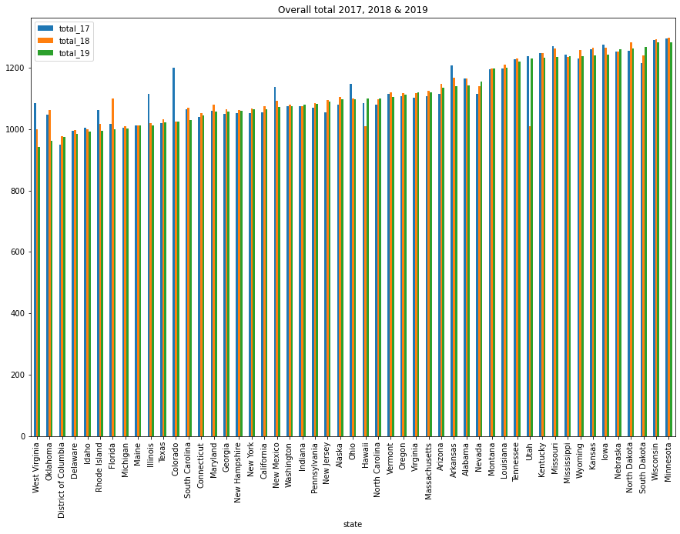
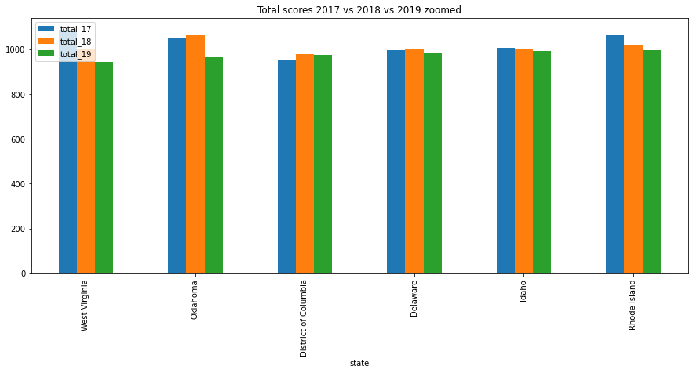
Total SAT Scores
US total SAT scores was observed to have a decrease from 2017 to 2019.
Notes:
I have concise the data to states, and then i zoomed in to a small subset of the states. As we can observe, there is a decrease in total scores from 2017 to 2018. The mean of the total scores in 2017 was 1126, 2018 was 1120 , 2019 was 1113.

Slide 7
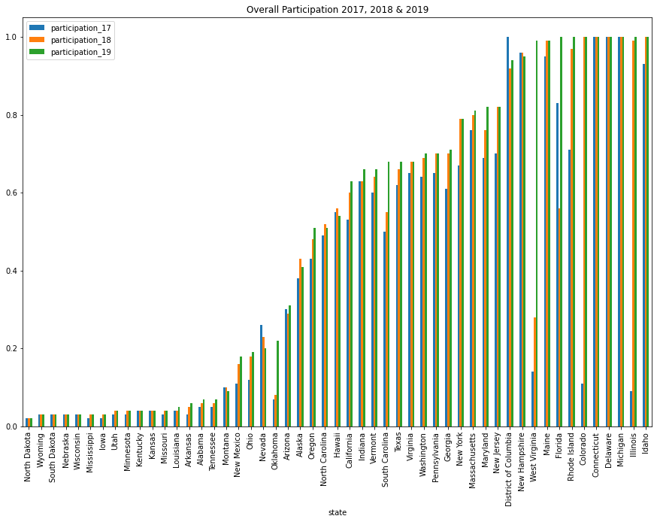
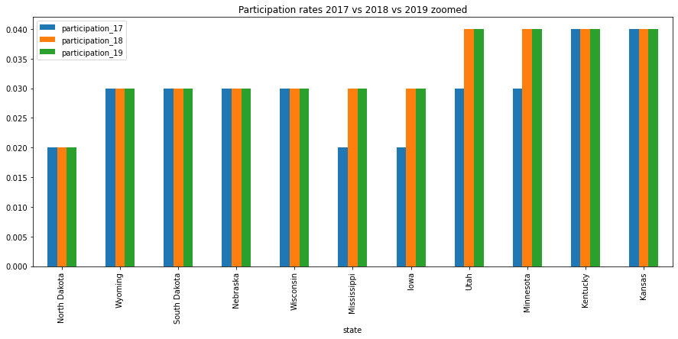
Participation rates
US total participation rates was observed to have an increase from 2017 to 2019.
Notes:
Interestingly, participation rates actually went up from 2017 to 2019. As you can see, I zoomed in to another small subset of participation. It is observed that some states had an increase in participation rate.

Slide 8
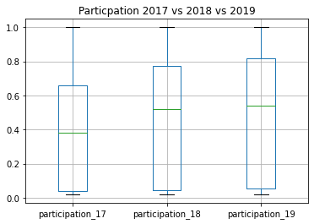
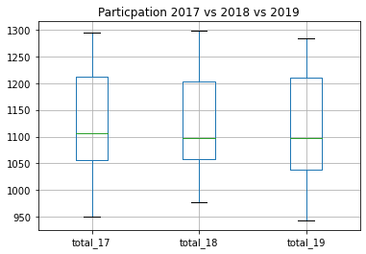
Box plot Representation
Notes:
Here is a boxplot of the same data. With this you can see a much clearer overview of the medians of the total scores and participations.

Slide 9
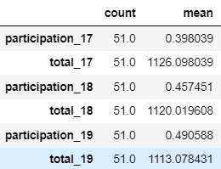
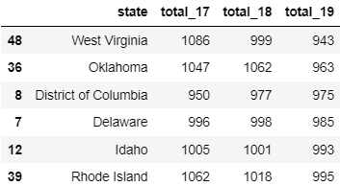
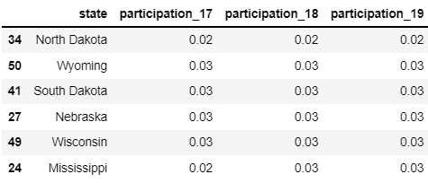
Conclusions
Did the Top Ivy Universities had an influence?
Total score - decreased slightly
Participation rates- no significant change
Notes:
There was a drop in total mean and median of total scores. So yes, there was a slight influence on the total scores and participation rates. However, this is up to further research as to whether there is a correlated or independent.

Slide 10
Recommendations
Putting emphasis and educating high school students on the importance of SAT
Reducing SAT cost and easing the fee waiver eligibilities
Restructuring the learning structure of high schools to boost the total states SAT scores
Notes:
Some recommendations that can be made to improve SAT scores and increase participation scores is to put emphasis and educate high school students the importance of the SAT. The SAT also allows students to be eligible for scholarships and identify areas to improve to prepare students for college.
A way of increasing the participation rates of students in states is to reduce the 60 USD fee of taking the SAT and by easing the fee waiver eligibility.
However, the biggest influence of the SAT scores is by the high schools, and a possible way is to restructure learning structures to nurture the students more.

Slide 11
Discussion
Other external factors
Pandemic, changes in learning structure, political background)
Checking the averages of college students to identify if SAT is a good indicator of success
Notes:
Even though ivy league universities had a small influence on total score and participation scores, it is worth checking if they are correlated or coincidental. Other external factors such as the pandemic occurring in the tail end of 2019, changes in the learning structure and political background. There is an ease of requirements to fee waivers allowing more students to take the SAT.
Also, it is worth researching whether the SAT is a good indicator of a students growth in college, as the SAT was established in 1926 and the world has changed alot since then.

Slide 12
Questions

